Slide 1
“CRM Gap analysis and customer feedback module development”
Internal Guide:
Prof. Ronak R Patel
External Guide:
Mr. Paresh Darji
Prepared by:
Pranita Zaveri (18CE136)
Project id: PRJ2022CE009

Slide 2
Presentation Contents:
Project Introduction
Objective/Purpose
Analysis
Features and Functionalities
Tools and Technology used
Flow of the system
Use case diagram
Demo

Slide 3

Project t Definition Project Introduction
CRM gap analysis and customer feedback module is a ‘Analysis and Solution approach’. The project carries out a gap analysis for the current CRM system and provides with a customer feedback module developed in PHP

Slide 4

Objective
The aim of the project is to perform a gap analysis on the existing ERP system focusing specifically on the CRM module.
A successful gap analysis helps make improvements which can contribute to better company performance, team productivity, and overall customer experience.
And as an extension to it , indulge into developing features approved by the company.

Slide 5
Post Analysis and System Requirements
Customer side login portal
Separate Login for customer and OEMs.
Complain management ( register and tracking)
Order placing and order tracking
Feedback form submission
Chat bot
Admin side:
Graphical representation and report generation of customer feedbacks for analysis purposes.

Slide 6
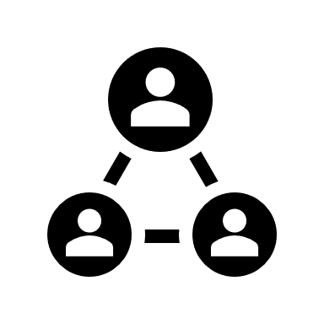
Approved and Implemented Functionalities
Admin Login
The admin (member/staff of elmex) can login to the system with username and password.
Add new user (customer).
View previously registered users
Handle complains
View and analyse feedbacks

Slide 7

User Login
The customer can login to the system by username and password provided by the elmex
They can submit a feedback for the purchased products quarterly or as decided by Elmex
The customer can submit a complaint w.r.t delivery or damage via this portal and check its status.

Slide 8
Tools and Technology
The Project is developed using PHP,HTML, CSS, Bootstrap and JavaScript
( IDE: Visual Studio Code)
The database is MySQL
( Server used: Xampp)

Slide 9
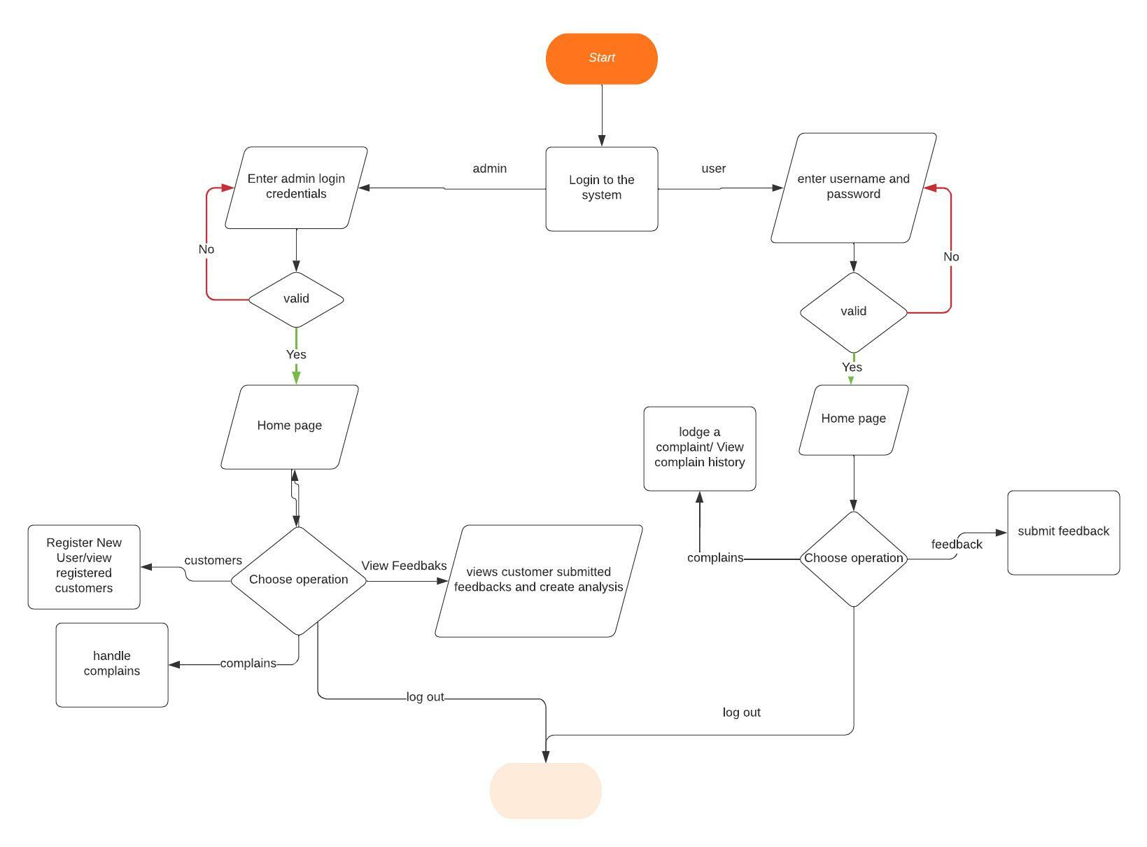
Flowchart

Slide 10
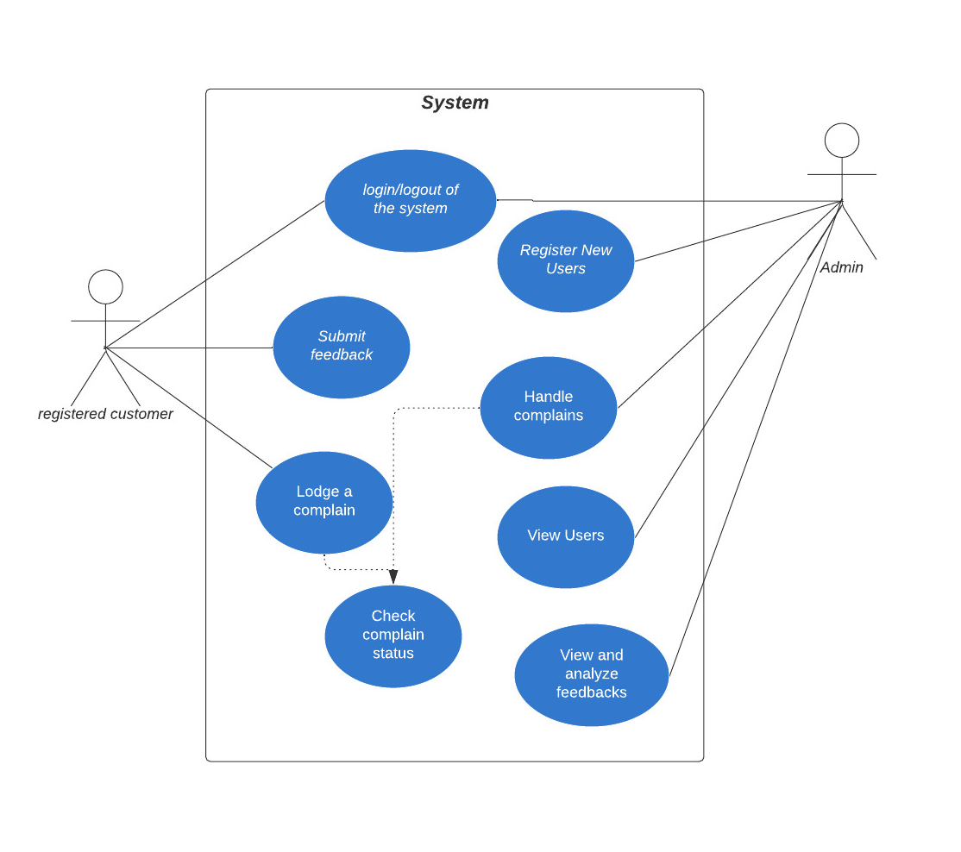
Use case diagram

Slide 11
Conclusion
Change is the only constant. In the field of technology where there is something new emerging every single day, staying up to date becomes a necessity. The project will benefit the company as it will provide a fresh standpoint for their current system. It will help bridge the gap between customer expectations and delivered product.
Apart from the approved development module, the analysis hold a great deal of future enhancements for the existing CRM system.

Slide 12
Thank You!

Slide 13
DEMO

