Slide 1
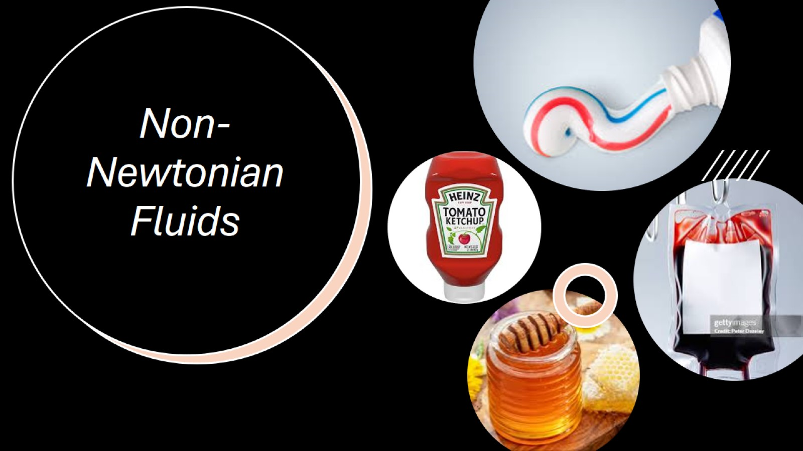
Non-Newtonian Fluids

Slide 2
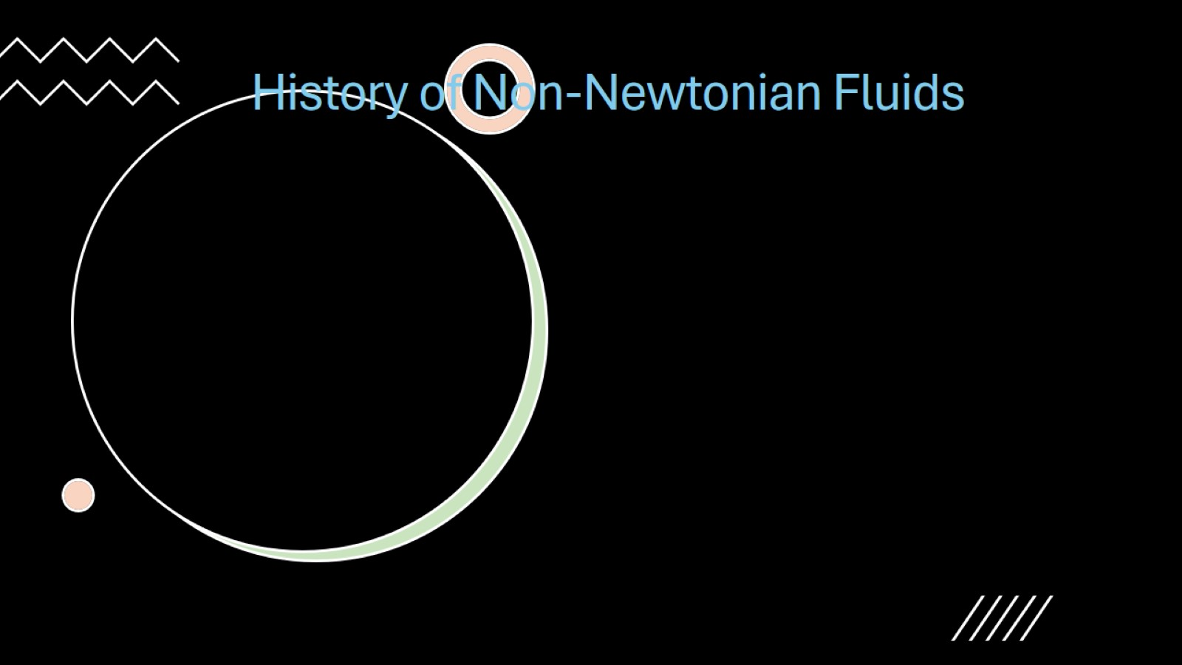
History of Non-Newtonian Fluids

Slide 3
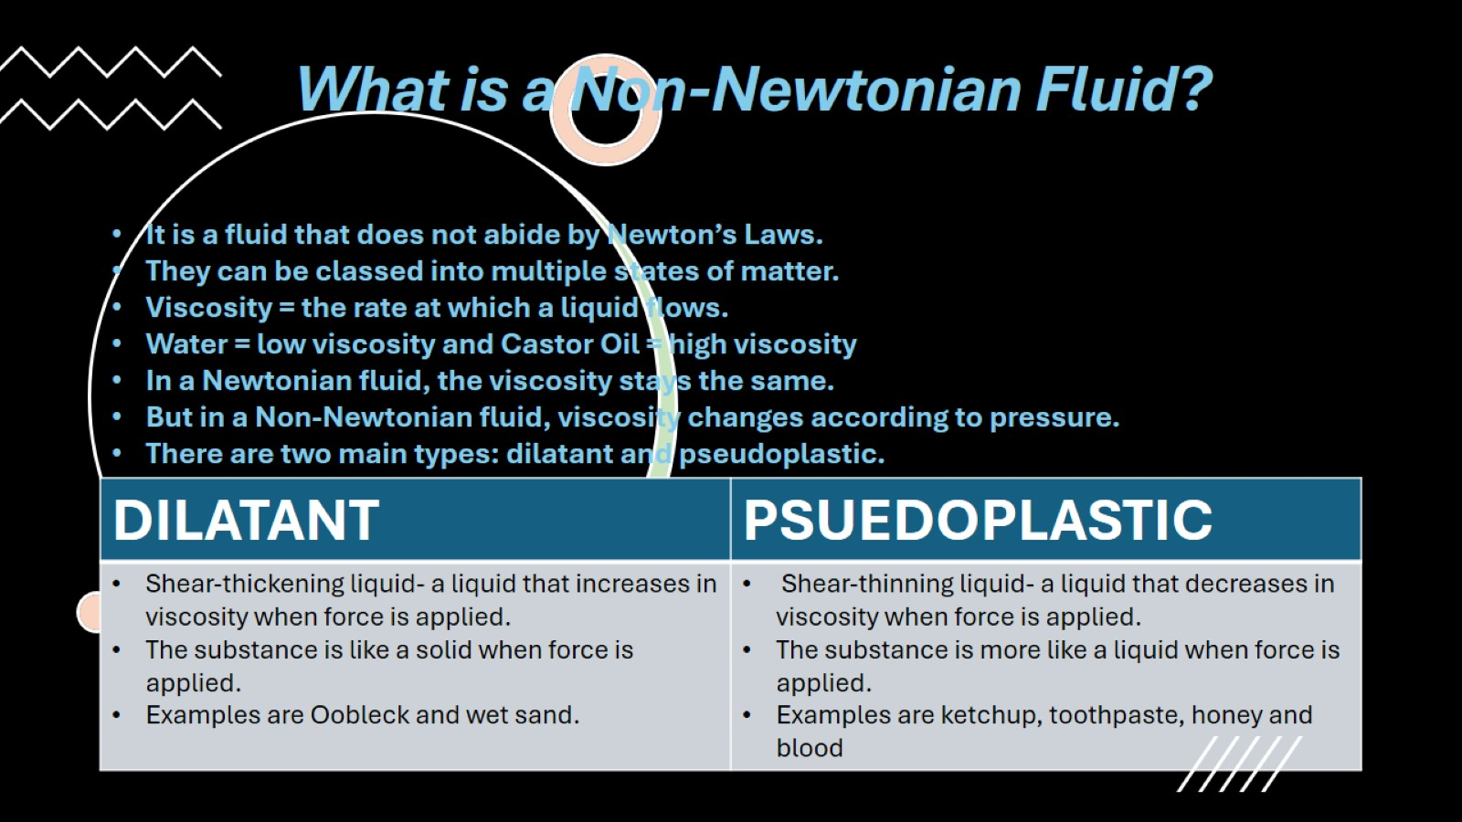
What is a Non-Newtonian Fluid?

Slide 4
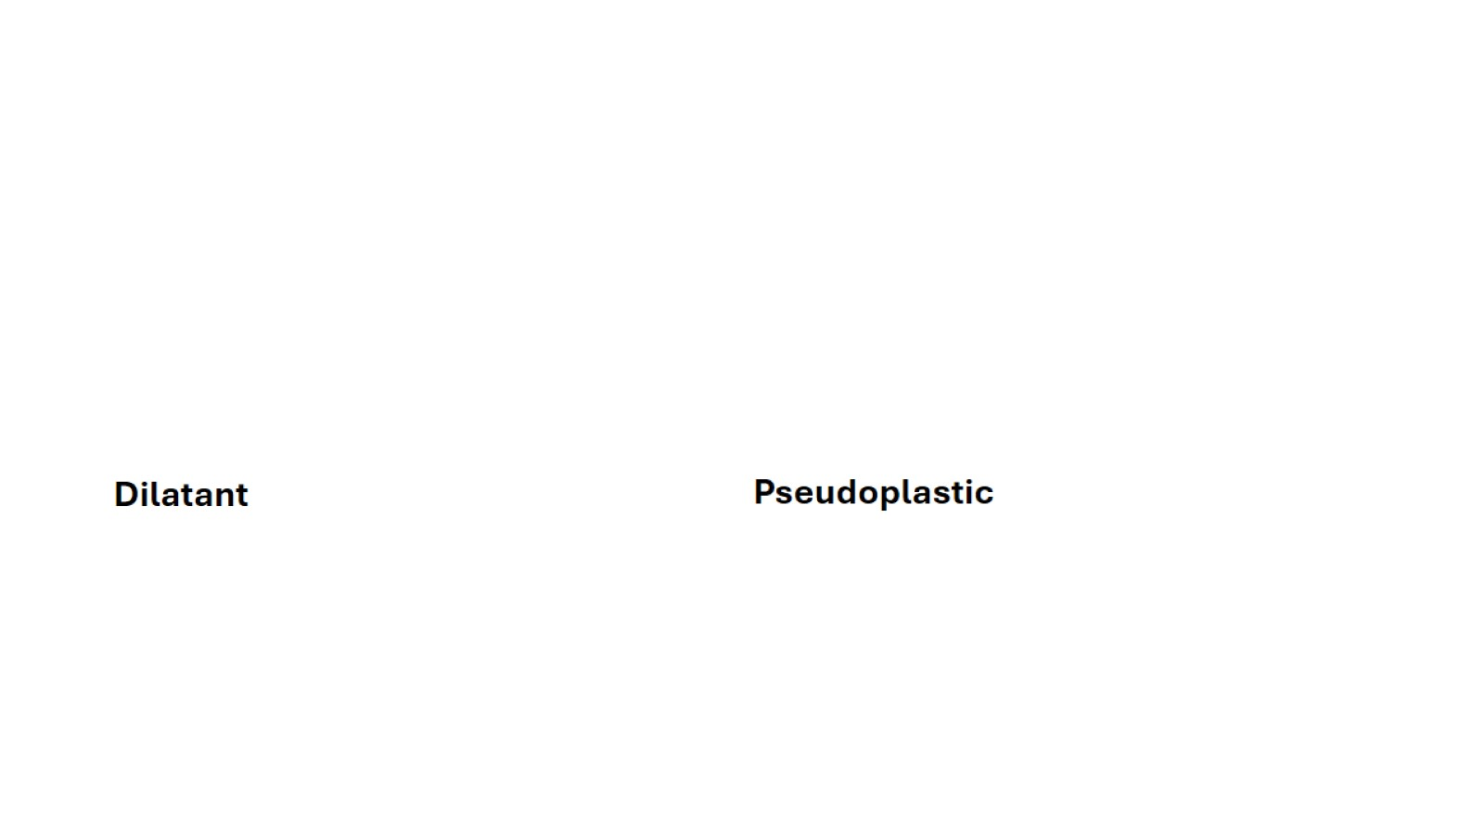

Slide 5


Slide 6
History of Non-Newtonian Fluids

