Slide 1
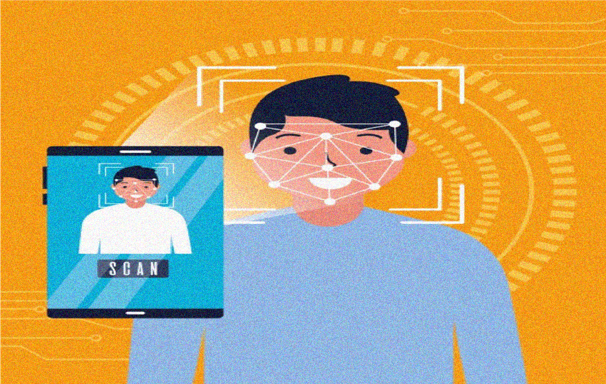
FACE RECOGNITION-BASED AUTOMATED ATTENDANCE SYSTEM USING DEEP LEARNING
Guide
Dr.Hemanth S R
Team Members
Bhuvan M
Spoorthi H R
Aishwarya M Bharadwaj
Likith G B
Dept. of CSE (AI), MIT Mysore

Slide 2
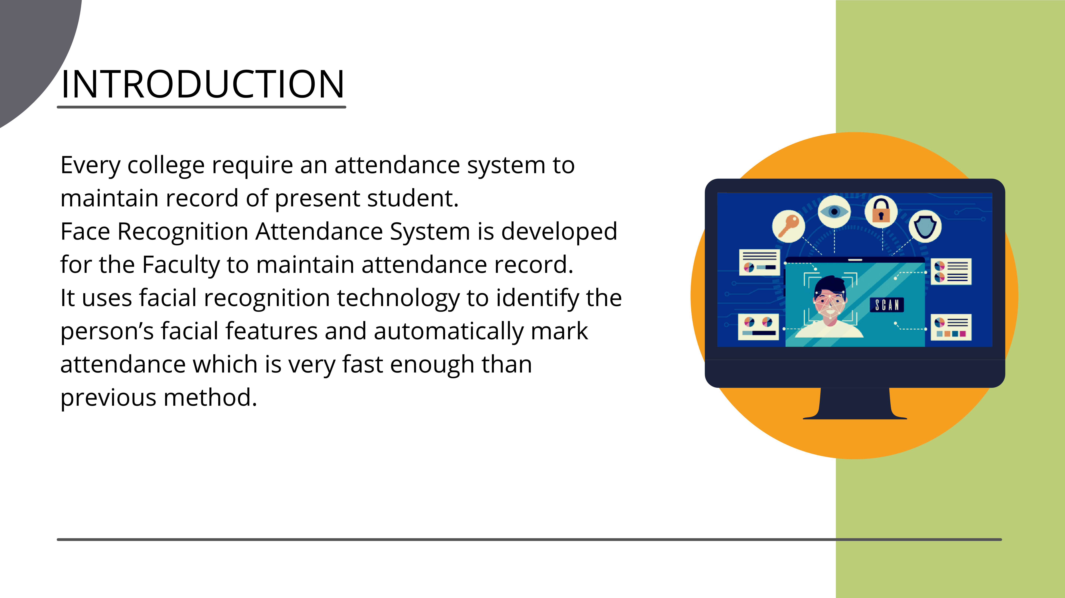
2

Slide 3














STUDENT DETAILS
TRAIN
SAMPLE
PHOTO
DATA
ADMIN
SAMPLE
IMPORT
EXPORT
SAVE
RESET
UPDATE
DELETE

Slide 4







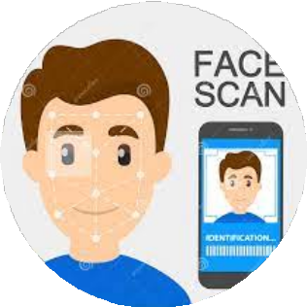
CAMERA
ATTENDANCE
STUDENT
DETECTION

Slide 5
Problem Statement
FACE RECOGNITION-BASED AUTOMATED ATTENDANCE SYSTEM USING DEEP LEARNING
Manual attendance systems are often time-consuming, error-prone, and susceptible to proxy attendance, leading to inefficiencies in managing large groups. To overcome these challenges, there is a strong need for a secure, automated, and real-time face recognition-based attendance system.

Slide 6
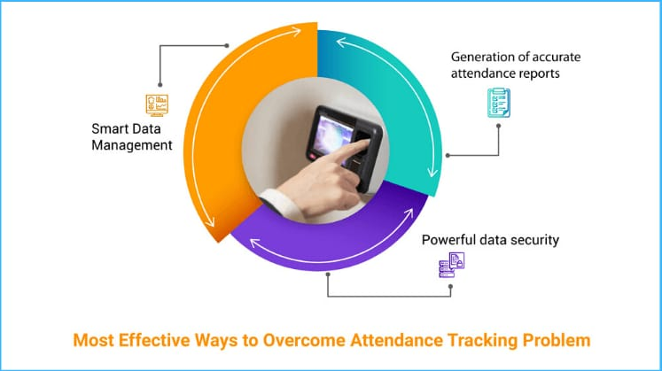
Objectives
FACE RECOGNITION-BASED AUTOMATED ATTENDANCE SYSTEM USING DEEP LEARNING
Develop real-time face recognition for attendance.
Implement liveness detection to prevent spoofing.
Store data securely on the cloud.
Provide AI-driven analytics and visual insights.

Slide 7
Objectives
FACE RECOGNITION-BASED AUTOMATED ATTENDANCE SYSTEM USING DEEP LEARNING
Importance: Need for secure, automated, and contactless attendance solutions.
Limitations: Current systems suffer from spoofing, lack of analytics, and hygiene concerns.

Slide 8
Methodology Overview
FACE RECOGNITION-BASED AUTOMATED ATTENDANCE SYSTEM USING DEEP LEARNING
Flow:
Face Detection using MTCNN
Feature Extraction with FaceNet
Anti-spoofing measures
Cloud storage with Firebase/MySQL
React.js UI and Flask/Django backend
Analytics and Dashboard
Tools: FaceNet, MTCNN, Firebase, React.js, Flask/Django

Slide 9
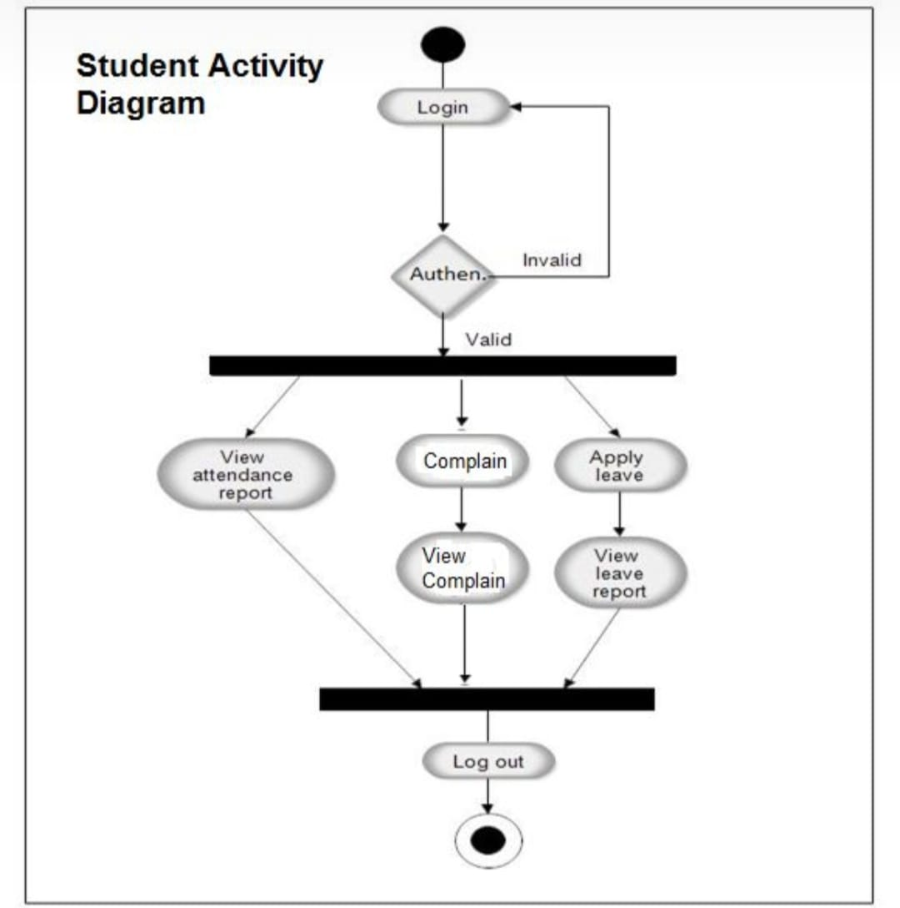
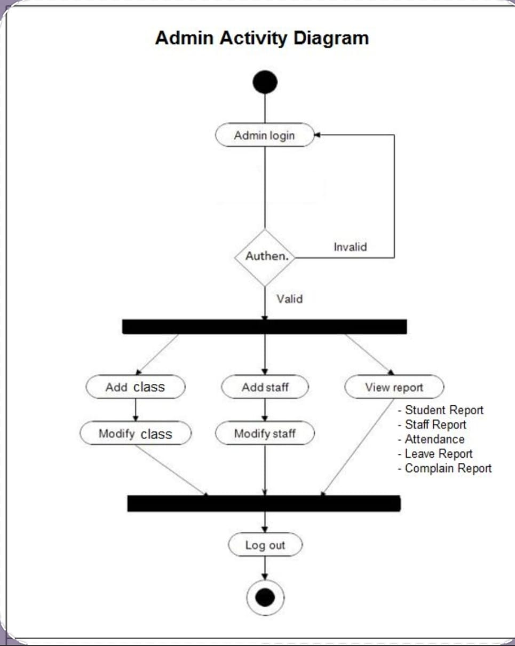
FACE RECOGNITION-BASED AUTOMATED ATTENDANCE SYSTEM USING DEEP LEARNING

Slide 10
Paper (Year) | Key Contributions | Strengths | Limitations
Ali et al. (2024) | MTCNN + VGG Face + SVM | 95% F-score | High computational complexity
Lateef & Kamil (2025) | Real-time deep learning | 100% accuracy, scalable | Costly implementation
Ravipati et al. (2025) | LBPH + CNN for lighting robustness | Adapts to lighting | Lower accuracy
Raikar et al. (2025) | PCA + SVM for hostels | Automated logging | Sensitive to pose/occlusion
Ray (2025) | Geolocation integration | Location-specific logs | Needs internet

Slide 11
FACE RECOGNITION-BASED AUTOMATED ATTENDANCE SYSTEM USING DEEP LEARNING
Literature Survey – Paper 1
Title: Effortless Student Attendance: A Smart Human-Computer Interactive System Using Real-Time Facial Recognition.
Authors: Ahmad S. Lateef, Mohammed Y. Kamil
Year & Source: 2025, An-Najah University Journal for Research – A (Natural Sciences)
Problem Addressed: Manual attendance systems are inefficient, costly, and not scalable.

Slide 12
Key Contributions: Developed real-time attendance system using 7 ML/DL models with bilingual GUI.
Techniques: YOLOv7 and MTCNN+FaceNet achieved 100% accuracy.
Limitations: Small dataset (31 students), limited test distance (33 feet), and no testing with sunglasses.
Observations: Deep learning models significantly outperform traditional ML methods in real-time classroom settings.

Slide 13
Literature Survey – Paper 2
Title: Attendance System Optimization through Deep Learning Face Recognition.
Authors: Mahmoud Ali, Anjali Diwan, Dinesh Kumar
Year & Source: 2024, International Journal of Computing and Digital Systems.
Problem Addressed: Traditional attendance systems are slow, error-prone, and limited to single face recognition.

Slide 14
Key Contributions: Built a real-time system using MTCNN, VGGFace, and SVM with multi-face detection.
Techniques: VGGFace + SVM achieved 95% accuracy and F1-score.
Limitations: Lower performance on alternative classifiers, sensitive to occlusions and lighting.
Observations: SVM outperformed other classifiers; system is modular and scalable for real-time use

Slide 15
Literature Survey – Paper 3
Title: Enhanced Attendance Management of Face Recognition Using Machine Learning
Authors: Sowmya Ravipati, Lasya Modem, Sahith Yellinedi, Tejeswara Rao Namburi, Sajida Sultana Sk
Year & Source: 2025, ITM Web of Conferences, ICCPCI-2024
Problem Addressed: Manual attendance is inefficient and error-prone, requiring automation via face recognition.

Slide 16
Key Contributions: Developed real-time GUI-based system using Haar Cascade for detection and LBPH for recognition.
Techniques: Combined Haar + LBPH for accurate facial detection and classification with low storage needs.
Limitations: Limited detail on large-scale testing, lighting challenges, and lacks benchmarking against deep models.
Observations: GUI (Tkinter), password security, and structured data handling enhanced system usability and privacy.

Slide 17
Literature Survey – Paper 4
Title: Attendance System for College Hostels Using Facial Recognition
Authors: Dr. Poornima Raikar, Mr. Pranesh K, Shreesha A Rao
Year & Source: 2025, IJCRT, Volume 15, Issue 1
Problem Addressed: Manual hostel attendance is prone to proxy and inefficiencies; automation needed.

Slide 18
Key Contributions: Built a facial recognition system using OpenCV with Haar Cascade, Eigenface, Fisherface, and LBPH.
Techniques: LBPH and Haar Cascade used for accurate face detection and real-time recognition.
Limitations: Challenges in angled faces, lighting, and image quality; limited deep learning integration.
Observations: Real-time attendance automation with parent SMS alert and improved accuracy via XML-based storage.

Slide 19
Literature Survey – Paper 5
Title: A Face Recognition Based Attendance System with Geolocation and Real-Time Action Logging
Author: Debmalya Ray
Year: 2025 Source: IIIT Bangalore, ResearchSquare
Problem Addressed: Inaccuracies, inefficiency, fraud risk, and hygiene issues in manual and RFID-based attendance systems

Slide 20
Key Contributions: Real-time face recognition using OpenCV and face_recognition libraryGeolocation tagging via IP APIs and reverse geocodingPyQt5 GUI with live feed, theme toggle, and export options95% accuracy in controlled settingsCSV-based logging and duplicate entry prevention
Limitations: Performance drops in poor lighting and crowded environmentsGaps: Lacks deep learning-based adaptability, mobile/web platform support, and multimodal biometrics
Observations: Strong performance in real-world and ideal conditionsEasily integrable into existing systemsHigh scalability and practical value for educational and corporate contexts

Slide 21
Survey Insights
Facial recognition is widely adopted
Deep learning models show higher accuracy
Real-time systems with GUI are effective
High performance in controlled environments
Systems are modular and scalable

Slide 22
Common Gaps/Challenges:
Small and limited datasets
Sensitive to lighting and occlusion
Lack of deep learning benchmarking
No mobile/web platform support
Minimal focus on privacy and security

Slide 23
Influence on Our Project
Use of advanced DL models (YOLOv7, FaceNet)
Robust real-time performance in varied conditions
User-friendly bilingual GUI
Scalable and modular design
Secure data handling and logging

Slide 24
Justification for Proposed System
Overcomes accuracy and lighting issues
Supports real-time, multi-user detection
Enhances usability and accessibility
Fills gaps in existing systems with scalable, secure design

Slide 25
Objective-wise Methodology
Objective 1: MTCNN + FaceNet for real-time recognition
Objective 2: Texture + motion analysis for liveness detection
Objective 3: Firebase/MySQL with encryption
Objective 4: Python analytics with reports, trends, heatmaps

Slide 26
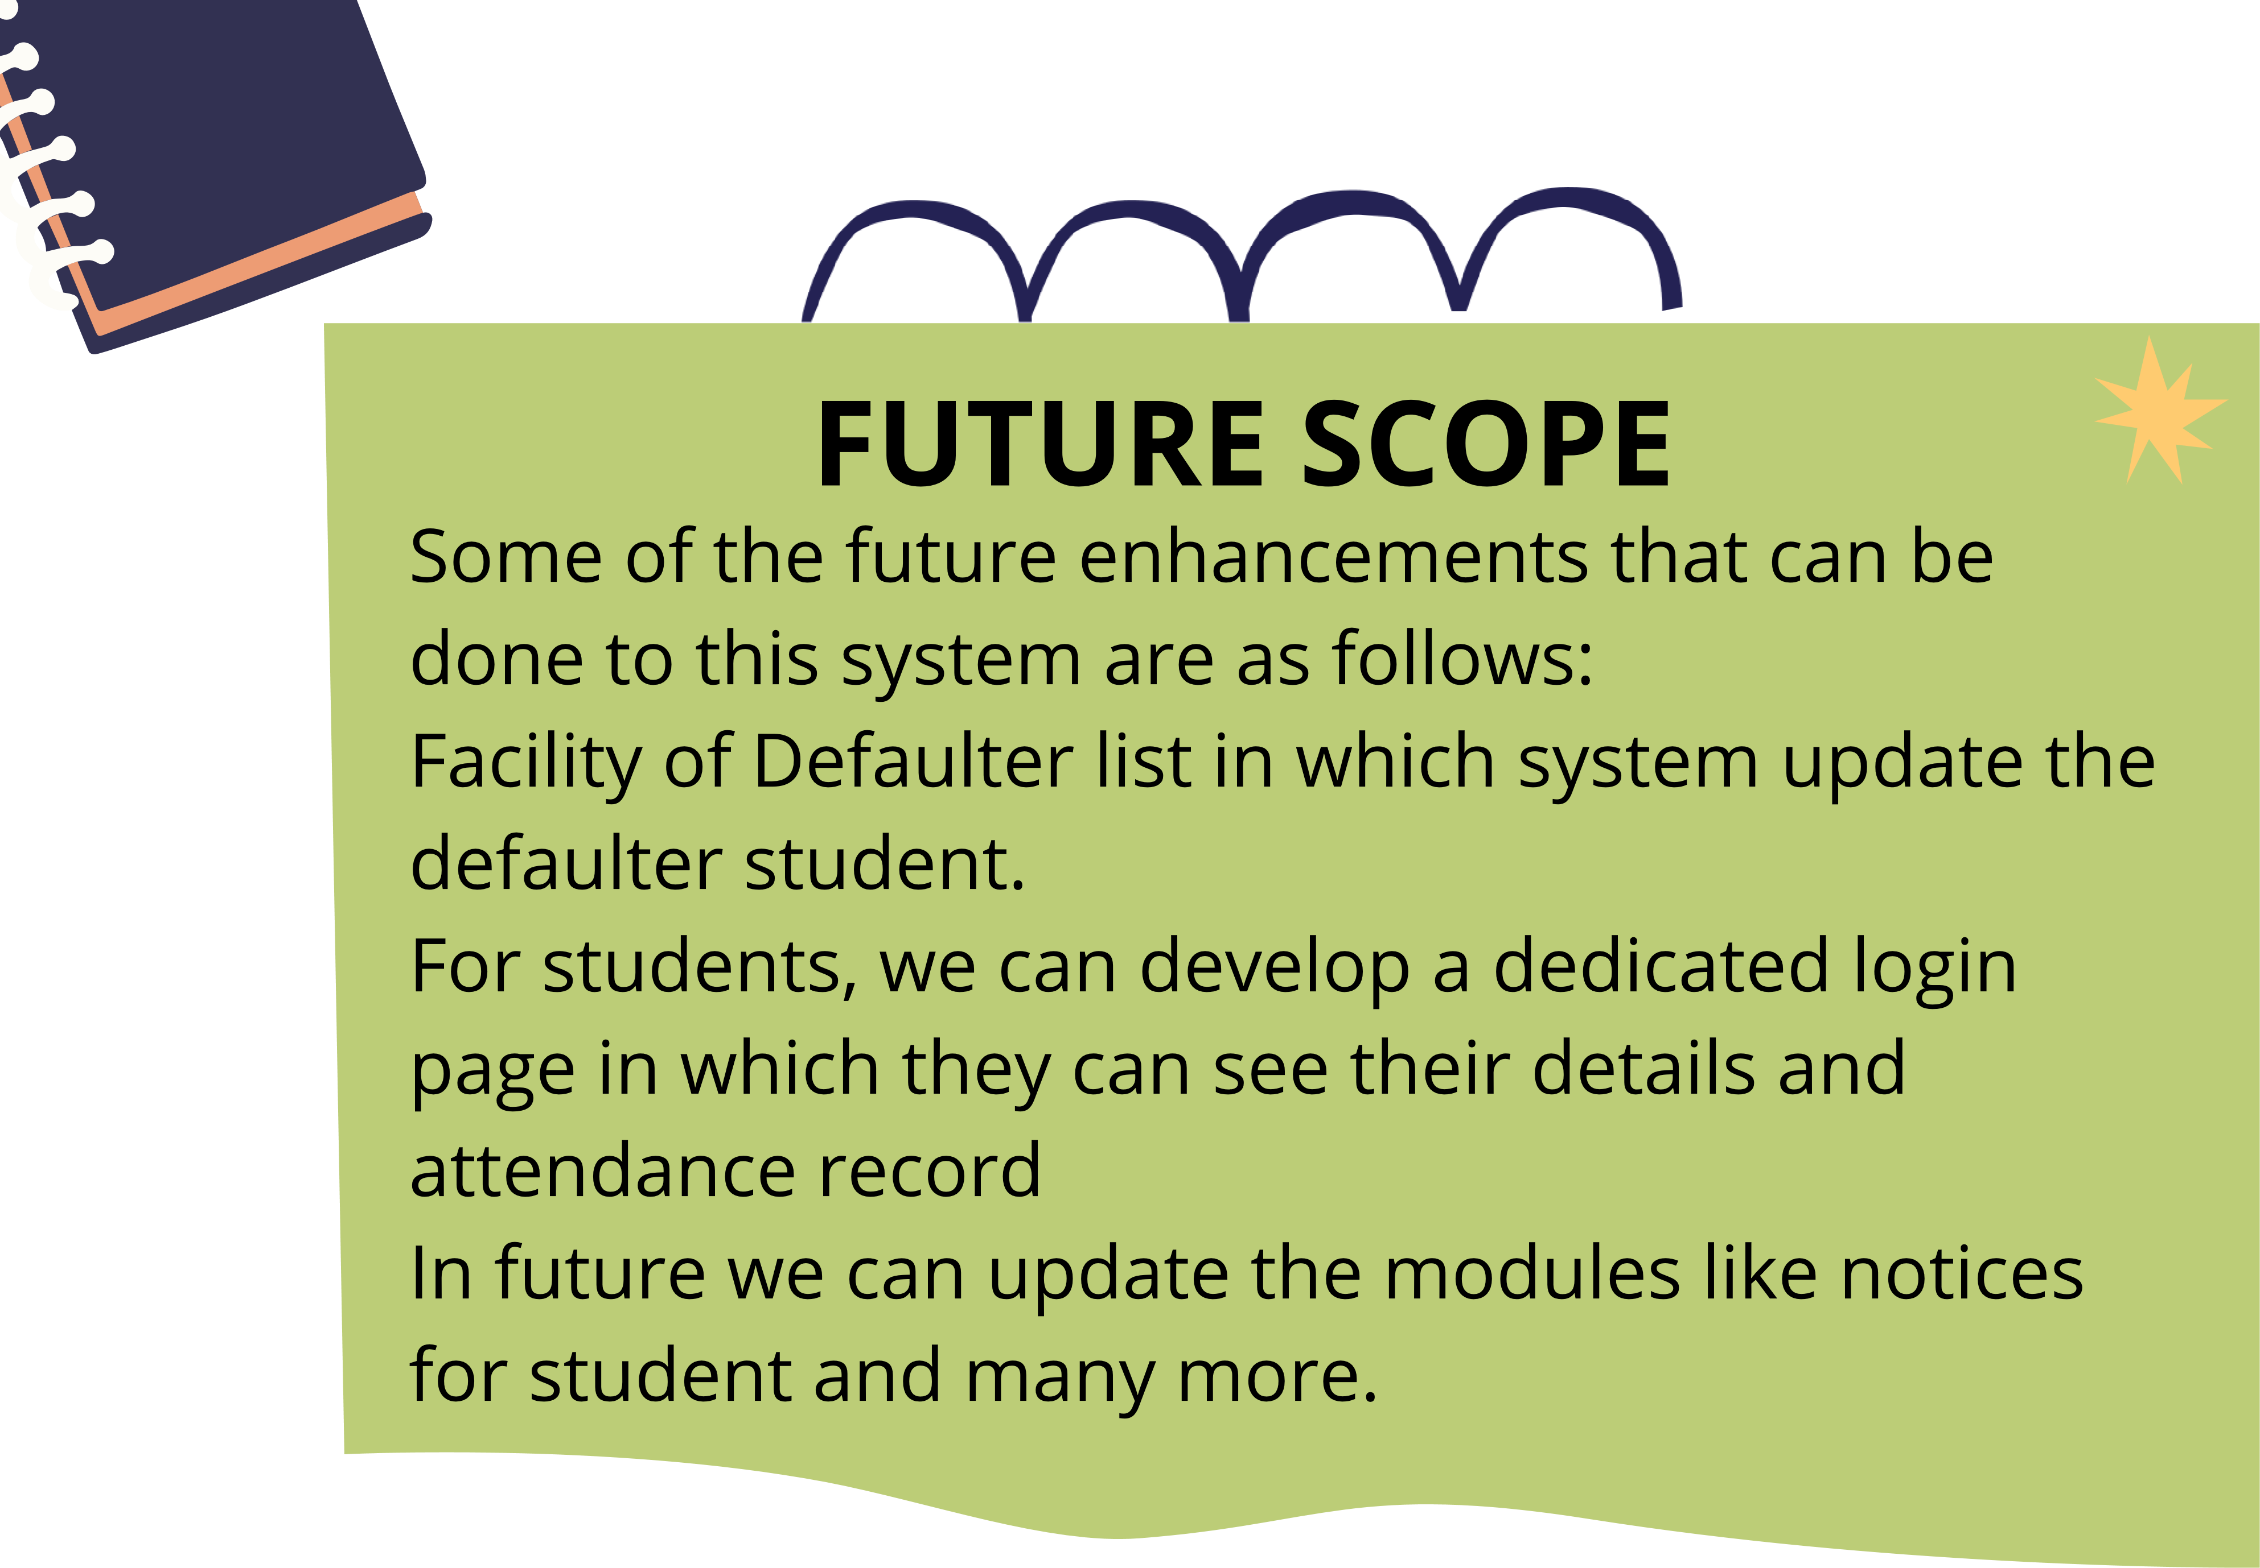

Slide 27
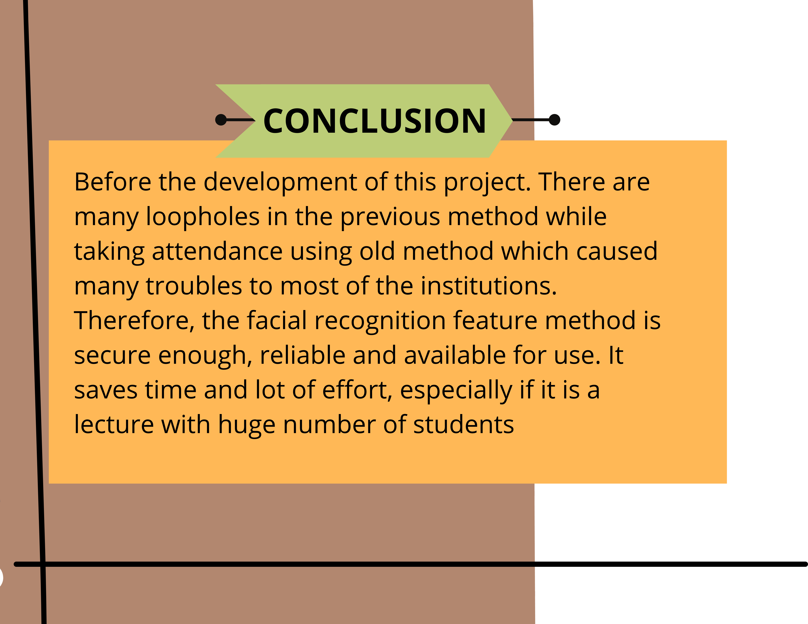

Slide 28
References
[1] M. Ali, A. Diwan, and D. Kumar, “Attendance System Optimization through Deep Learning Face Recognition,” International Journal of Computing and Digital Systems, vol. 15, no. 1, pp. 1527–1540, Apr. 2024. DOI: 10.12785/ijcds/1501108
[2] A. S. Lateef and M. Y. Kamil, “Effortless Student Attendance: A Smart Human-Computer Interactive System Using Real Time Facial Recognition,” An-Najah University Journal for Research - A (Natural Sciences), in press, 2025. DOI: 10.xxxx

Slide 29
References
[3] S. Ravipati, L. Modem, S. Yellinedi, T. R. Namburi, and S. S. Sk, “Enhanced Attendance Management of Face Recognition Using Machine Learning,” ITM Web of Conferences, vol. 74, 2025. DOI: 10.1051/itmconf/20257401012
[4] P. Raikar, P. K. Pranesh, and S. A. Rao, “Attendance System for College Hostels Using Facial Recognition,” International Journal of Current Research and Techniques (IJCRT), vol. 15, no. 1, pp. 50380–50387, Jan. 2025. DOI: 10.61359/2024050047
[5] D. Ray, “A Face Recognition Based Attendance System with Geolocation and Real-Time Action Logging,” IIIT Bangalore, Preprint, Jan. 2025. DOI: 10.21203/rs.3.rs-5931462/v1

Slide 30
Thank You

