Slide 1
Paris Olympics 2024 – Power BI Dashboard
Capstone Project 1
By Bhuvan P

Slide 2
Problem Statement
Olympic data related to athletes, medals, countries, and events is highly fragmented and complex, as it exists across multiple datasets, making integration and comprehensive performance analysis difficult. Traditional static reports and tables further limit analytical visibility by not supporting interactive exploration of data based on parameters such as country, sport, gender, or age category. As a result, identifying key performance indicators, medal distribution patterns, and athlete participation trends becomes time-consuming and inefficient. To address these challenges, stakeholders such as sports authorities, media teams, and sponsors require decision-oriented and insightful visualizations that can transform raw Olympic data into meaningful and actionable insights.
Goal of the Project
The goal of this project is to develop an interactive Power BI dashboard that integrates and analyzes Paris Olympics 2024 data to provide clear, dynamic, and decision-oriented insights into athlete participation, medal distribution, and country-wise performance.

Slide 3
Aim of the Project
Develop an Integrated Olympic Analytics Dashboard
To design and implement an interactive Power BI dashboard that consolidates athlete, medal, country, and event data into a single analytical platform.
Enable Interactive and Dynamic Data Exploration
To allow users to explore Olympic data dynamically using filters and slicers based on country, sport, gender, and age category.
Analyze Performance and Participation Trends
To identify medal distribution patterns, top-performing countries, and athlete participation trends through KPI-driven visualizations.
Support Data-Driven Decision Making
To provide meaningful visual insights that assist sports authorities, analysts, and sponsors in making informed strategic decisions.

Slide 4
DAX Functions Used
Country_playing – Calculates the total number of countries participating in the Paris Olympics 2024.
Playing_Teams – Counts the total number of teams participating across all Olympic sports.
Total_Athletes – Computes the total number of athletes participating in the Olympics.
Total_Male_Athletes – Calculates the total number of male athletes in the tournament.
Total_Female_Athletes – Calculates the total number of female athletes participating in the Olympics.
Total_Gold_Medals – Computes the total number of gold medals won across all countries.
Total_Silver_Medals – Calculates the total number of silver medals awarded in the Olympics.
Total_Bronze_Medals – Computes the total number of bronze medals won across all events.
Total_Medals – Calculates the combined total of gold, silver, and bronze medals.
Total_Male_Athletes_with_Gold_Medals – Calculates the number of male athletes who have won gold medals.
Total_Female_Gold_Medals_Won – Calculates the total number of gold medals won by female athletes.
Top_Performance_Country – Identifies the country with the highest overall medal count.
Highlights – Displays key insights and summary information derived from Olympic performance data.

Slide 5
Client Use Cases
Sports Authority of India (SAI):
Analyze athlete participation, medal performance, and gender distribution to improve training and talent development programs.
Indian Olympic Association (IOA):
Track India’s medal performance across sports and compare it with other countries for strategic planning.
Sports Federations (Athletics, Shooting, Wrestling):
Identify strong and weak sports categories to allocate funding and coaching resources effectively.
Government & Policy Makers:
Use participation and performance data to design long-term sports development policies.

Slide 6
Client Use Cases
Media & Sports Broadcasters:
Generate quick insights, rankings, and performance summaries for Olympic coverage and storytelling.
Sponsors & Brand Partners:
Identify high-visibility sports, countries, and athletes to optimize sponsorship investments.
Event Organizers:
Analyze participation trends to improve event planning and scheduling.
Data Analysts & Researchers:
Use the dashboard for performance analysis, reporting, and research studies.

Slide 7
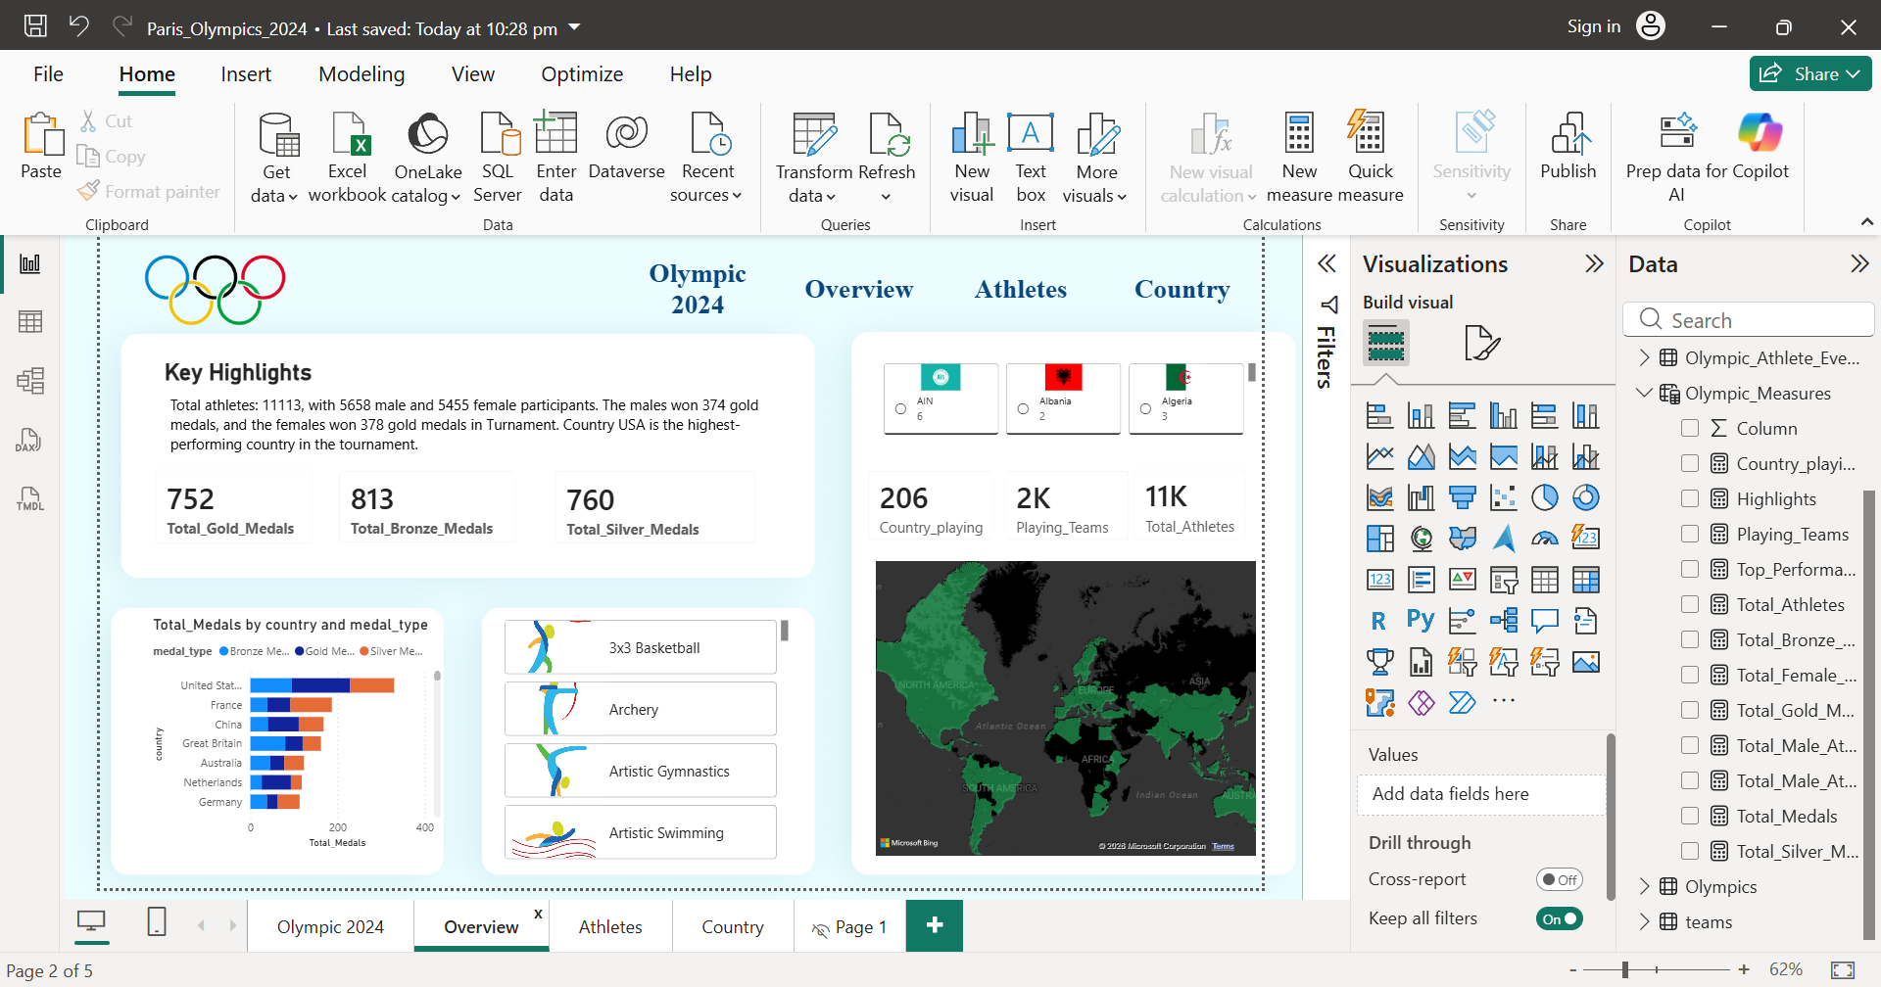
Dashboard Overview

Slide 8
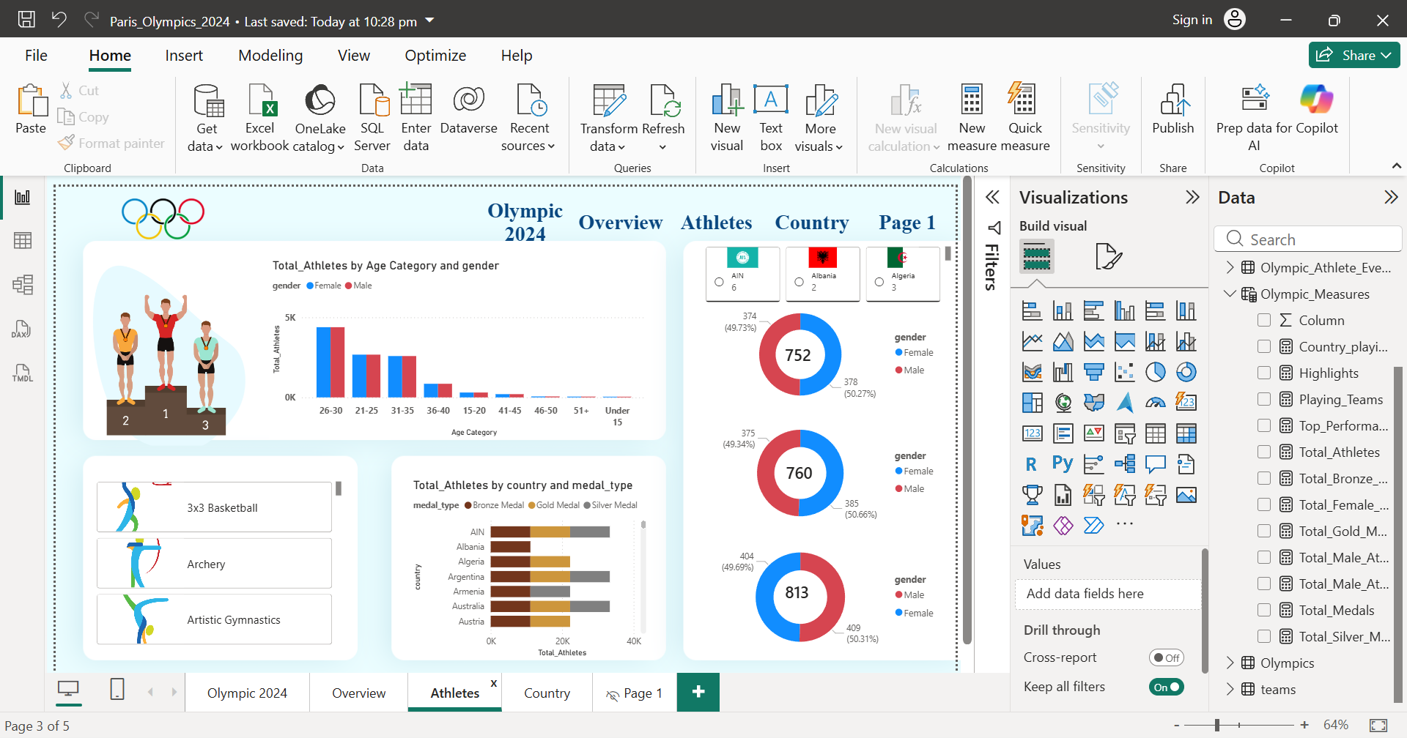
Athletes Analysis

Slide 9
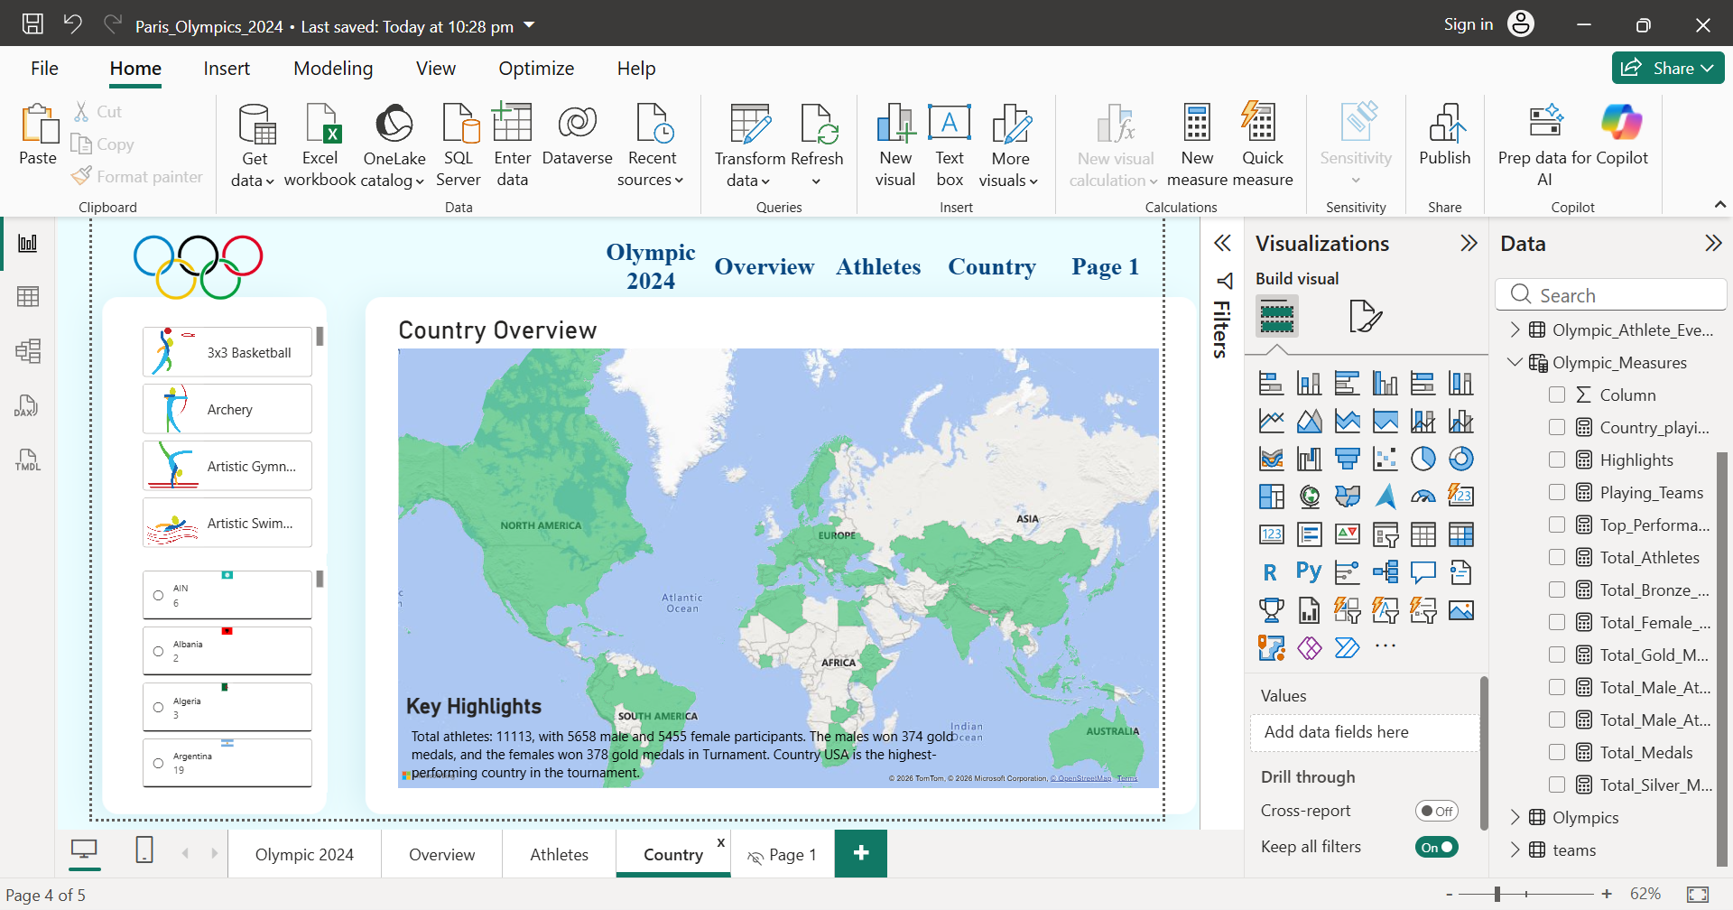
Country Analysis

