Slide 1
Stock Sentiment Analysis
Presented by: Bhuvan P
Capstone Project 2

Slide 2
Problem Statement
Stock market movements are highly influenced by financial news and sentiments.
Large volumes of news data make manual analysis difficult and time-consuming.
Investors may miss important insights due to information overload.
Lack of automated tools to quickly interpret market sentiment from news.
Need for a system that can automatically classify news as positive or negative to support better decision-making.

Slide 3
Dataset
Dataset consists of historical stock market news headlines.
Contains top news articles (Top1–Top25) for each day.
Includes a Date column representing daily records.
Label column indicates sentiment:
0 → Stock Up (Positive)
1 → Stock Down (Negative)
Used for training and testing the sentiment prediction models.

Slide 4
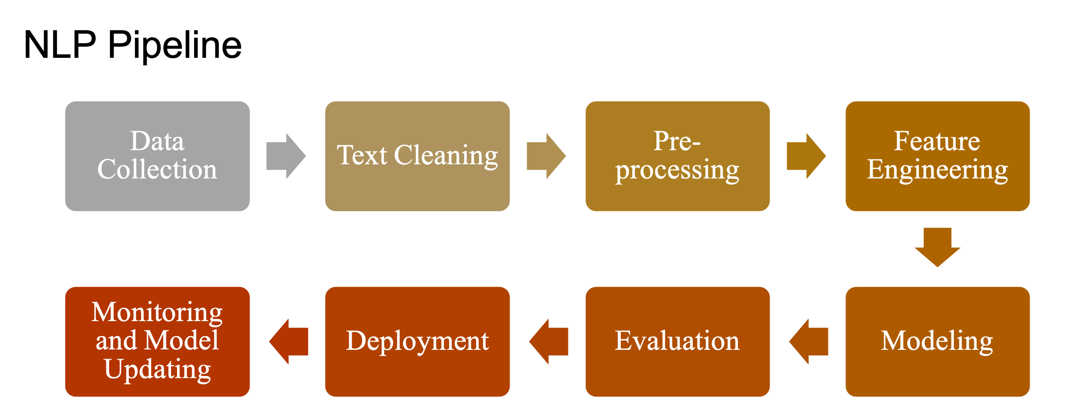
Workflow

Slide 5
Preprocessing
Converted all text to lowercase to maintain consistency
Removed special characters and numbers from the text
Tokenized sentences into individual words
Removed stopwords such as common words that do not add meaning
Applied stemming to reduce words to their root form

Slide 6
Feature Engineering
Used TF-IDF Vectorizer to convert text data into numerical format
Applied same feature engineering technique across all models for consistency
Captured importance of words based on their frequency and relevance
Included both unigrams and bigrams to improve context understanding
Ensured transformed features are suitable for machine learning algorithms

Slide 7
Models Used
Logistic Regression
A linear classification algorithm used for binary classification tasks
Works well with high-dimensional sparse data like text
Learns relationship between features and output using probability
Efficient and fast for large datasets
Performed best among all models in this project

Slide 8
Models Used
Naive Bayes
Probabilistic classifier based on Bayes’ Theorem
Assumes independence between features (words)
Particularly effective for text classification tasks
Works well with TF-IDF features
Provides fast and reliable predictions

Slide 9
Models Used
Random Forest
Ensemble learning method based on multiple decision trees
Combines predictions from several trees to improve accuracy
Handles non-linear relationships in data
Less effective for sparse text data compared to other models
Used for comparison with other algorithms

Slide 10
Ensemble Learning
Ensemble learning combines multiple machine learning models to improve prediction performance
In this project, three models were used: Logistic Regression, Random Forest, and Naive Bayes
Each model independently predicts the sentiment of the input news
Final prediction is determined using majority voting (most common output among models)
This approach improves accuracy, reduces individual model errors, and provides more stable results

Slide 11
Evaluation
Model Evaluation
Evaluated model performance using accuracy score to measure overall correctness
Used confusion matrix to analyze correct and incorrect predictions (true positives, false positives, etc.)
Applied ROC curve and AUC score to assess model performance across different thresholds
Compared performance of Logistic Regression, Random Forest, and Naive Bayes
Logistic Regression showed the best performance, while ensemble voting improved overall reliability

Slide 12
Results
Logistic Regression achieved the highest performance among all models
Naive Bayes performed well for text classification due to its probabilistic nature
Random Forest showed comparatively lower performance on text data
Ensemble (majority voting) improved overall prediction stability and reliability
The model successfully classified news headlines into positive and negative sentiment with good accuracy

Slide 13
Frontend
Developed an interactive web application using Streamlit
Allows users to input custom news headlines for prediction
Provides a random news feature to test the model on unseen data
Displays final sentiment prediction using majority voting
Ensures real-time prediction with a simple and user-friendly interface

Slide 14
Business Insights
Stock market movements are strongly influenced by news sentiment, enabling predictive analysis
The system helps investors make faster and more informed trading decisions
Early detection of negative sentiment supports effective risk management
Automates large-scale financial news analysis, reducing manual effort
Ensemble approach improves prediction reliability, making it suitable for real-world applications

Slide 15
Conclusion
Developed an end-to-end NLP-based stock sentiment analysis system
Successfully converted unstructured news text into meaningful predictions
Implemented multiple machine learning models and compared their performance
Improved prediction reliability using ensemble (majority voting) approach
Built an interactive frontend application for real-time sentiment prediction

