Slide 1
Blogging for you
Stay in race!
Bhuvaneswaran A
Senthil Kumaran S
Dec 2009

Slide 2


Why Blog?

Slide 3









Where to start?
Free Services
Hosted Services

Slide 4
Best practices
Unique name for your blog
It's ok to say what you think
Engage from the beginning
Incentives and rewards
It's a conversation, keep the discussion open
Link to other blogs whenever possible
Use Trackbacks
Comment = Community
It doesn't have to be perfect
Use syndicating technologies
Content doesn't matter, promotion is
No broken links, please ...

Slide 5
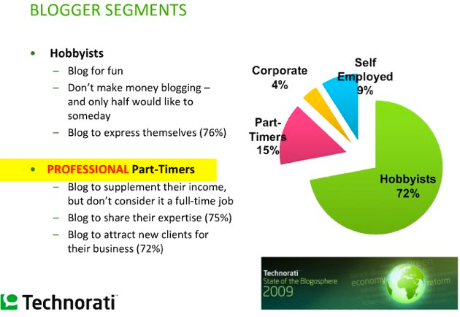
Who's blogging?

Slide 6
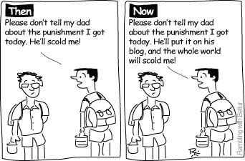
Then and now ...

Slide 7
Important Blogger Statistics
Over 12 million American adults currently maintain a blog
More than 147 million Americans use the Internet
Over 57 million Americans read blogs
1.7 million American adults list making money as one of the reasons they blog
89% of companies surveyed say they think blogs will be more important in the next five years
9% of internet users say they have created blogs
6% of the entire US adult population has created a blog
Technorati is currently tracking over 70 million blogs
over 120 thousand blogs are created every day
There are over 1.4 million new blog posts every day
22 of the 100 most popular websites in the world are blogs
37% of blog readers began reading blogs in 2005 or 2006
51% of blog readers shop online
Blog readers average 23 hours online each week

Slide 8
Generating web traffic
Create valuable content
Create Original content
Genuinely helping people
Use clean urls
Sensible keywords in blog
Context sensitive tags
Advertisement
  Community pages
  Email signature
Submit to Aggregation sites like digg, technorati

Slide 9
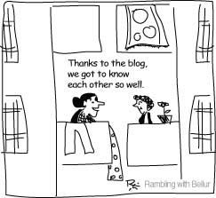
Bond with blog ...

Slide 10
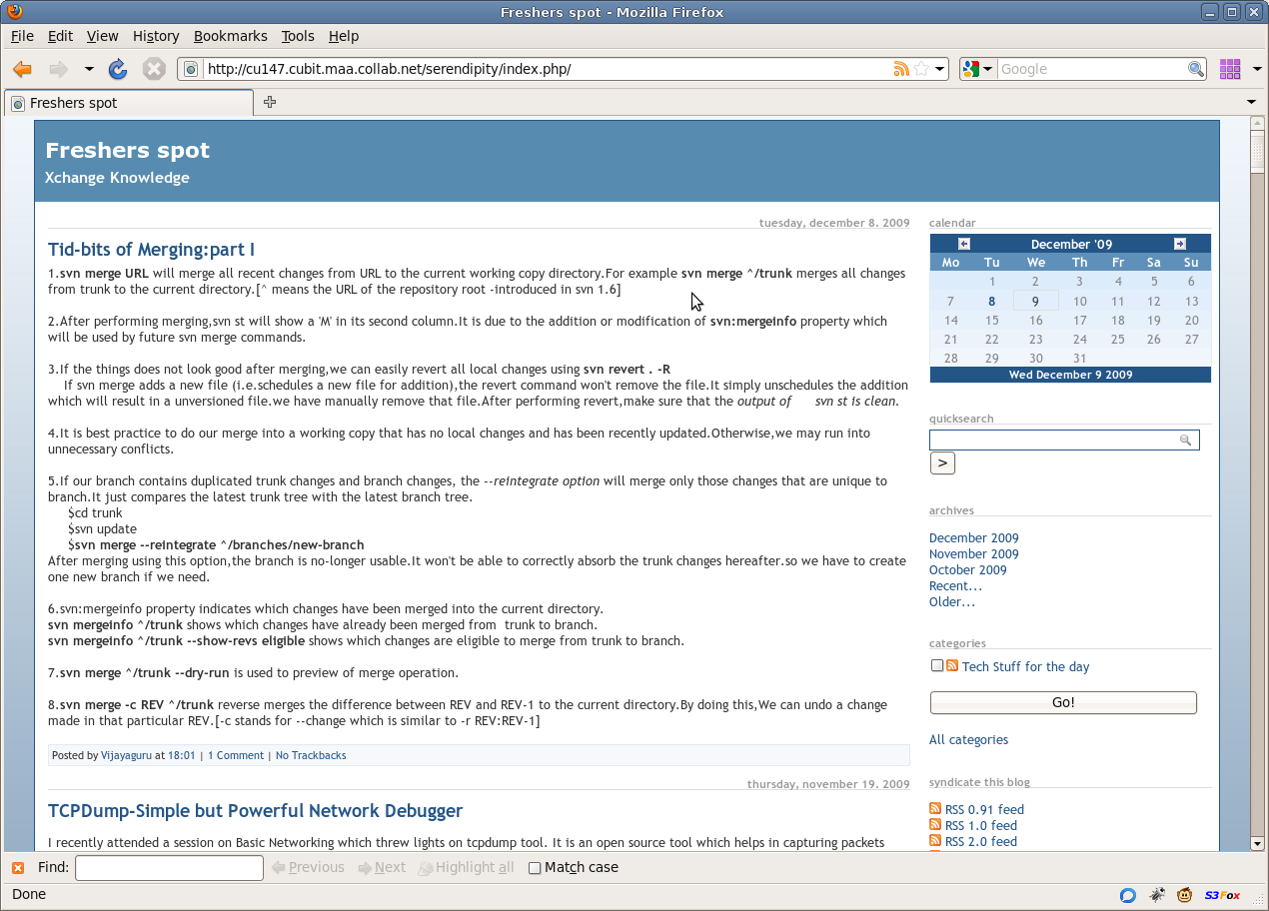
Blogging at CSPL ...

Slide 11
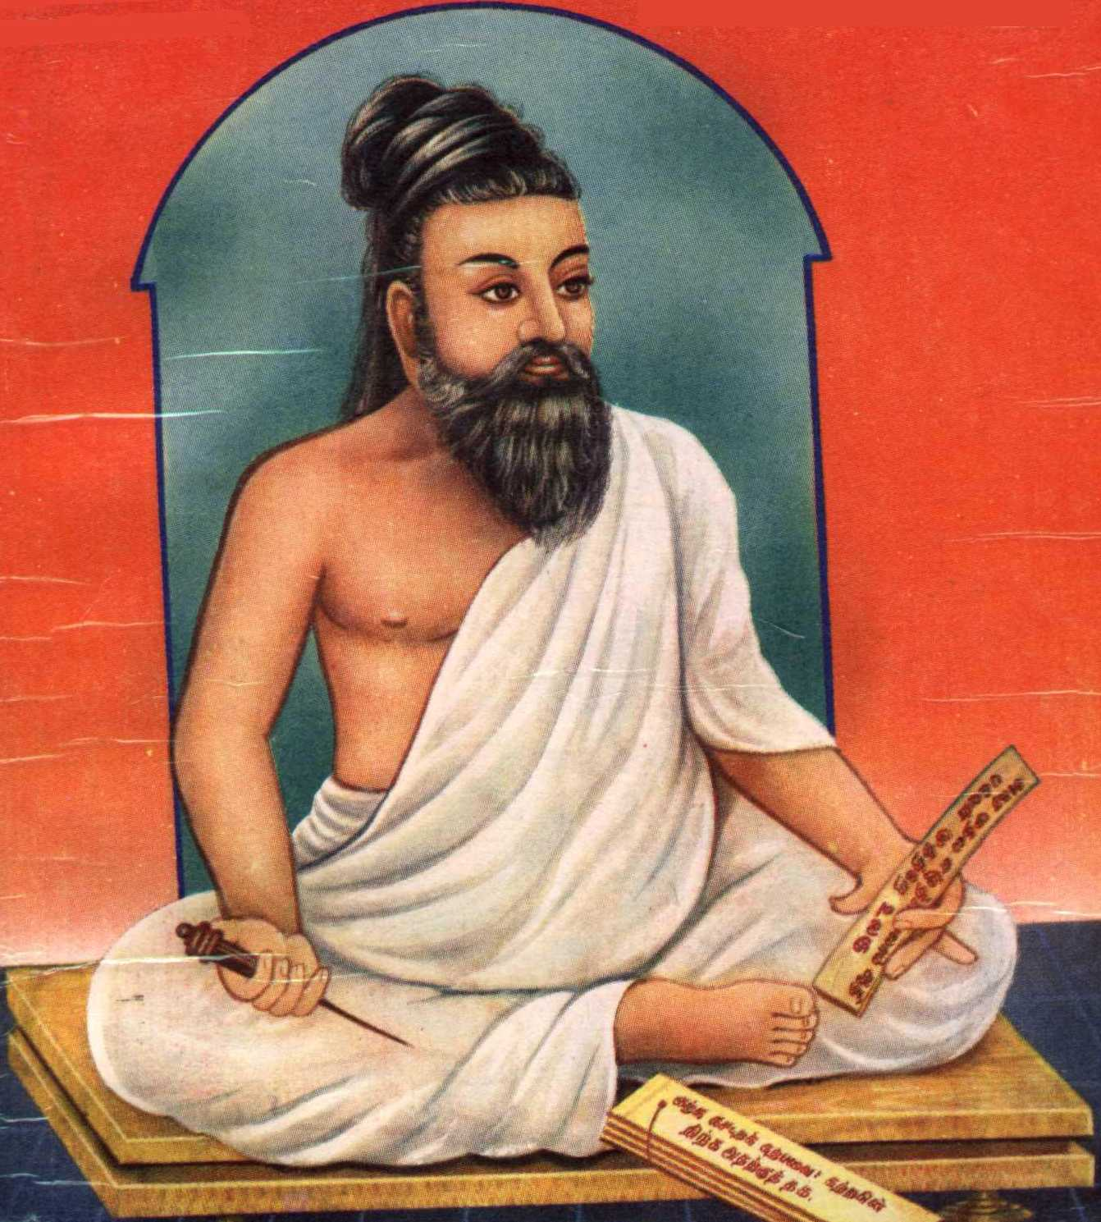
The next junction … Micro blogging!
Access to news quickly, faster than Google and Yahoo!
140 characters
Followers
  Whom you follow
  Who is following you
Retweets
Searchable
Quick and frequent messages are not good

Slide 12
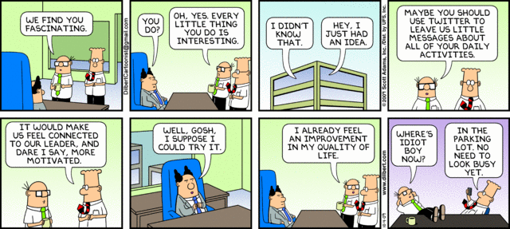
Where's the idiot boy now ...

Slide 13
Micro blogging platform
Twitter, the winner of Technology Pioneers Award 2010
Facebook (yet another feature in FB)
Orkut (new feature)
Identi.ca (open source)
Twingr (for intranet)
Tumblr
Yonkly (open source)
Blippr (for ratings and reviews)
Seesmic (video microblogging)
Yammer (for corporates)
Laconi.ca, open source platform for corporates

Slide 14
Microblogging tools
Integration with other application
  Facebook
  Gtalk
  Websites
  Blogs
Tweet using mobile
Plugins
  Firefox plugin: Echofon
  Pidgin IM
Twitscoop
  Search
  Stats
  No reloads
Twitterstats
URL Shorteners
  bit.ly
  tr.im
  myurl.in
  lnk.in

Slide 15
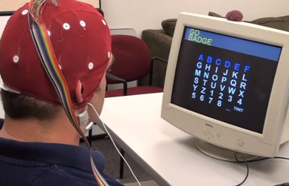
Future Tools ...

Slide 16
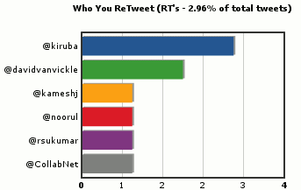
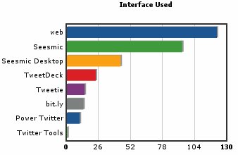
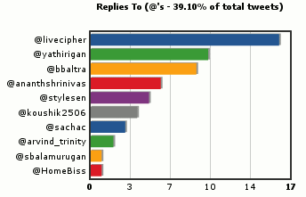
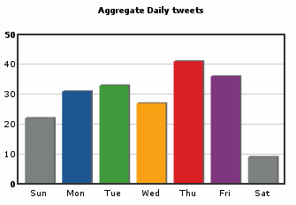
A sample statistics ...

Slide 17
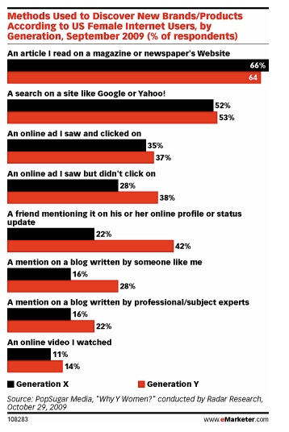
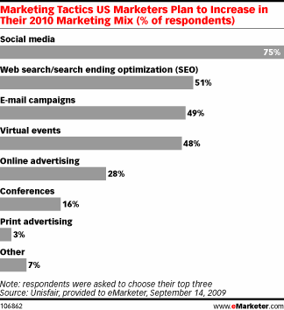
Importance of Social Media

Slide 18
Questions?

Slide 19
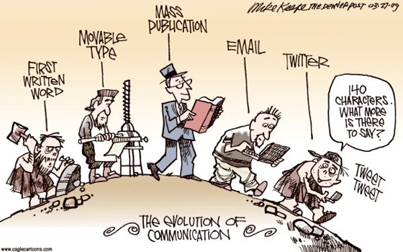
Thank you!
CollabNet Blogs:
CollabNet: http://blogs.open.collab.net/
CSPL: http://cu147.cubit.maa.collab.net/serendipity/index.php/
Bhuvan: http://livecipher.com/
Kamesh: http://kameshj.blogspot.com/
Prakash: http://prakashspot.blogspot.com/
Senthil: http://stylesen.org/

