Slide 1

Version Control with Subversion
for
by
Bhuvaneswaran A
bhuvan@ubuntu.com

Slide 2

OUTLINE
Introduction
Version control
Parallel development
Introducing Subversion
Typical usage
Global revisioning
Create working copy
Standard work cycle
  update your working copy
  make your changes
  examine your changes
  bring in others’ changes
  commit your changes
Terminology
Examine history
Other useful commands
Sub commands overview
Where to get help

Slide 3
INTRODUCTION –
VERSION CONTROL
To record and track changes to a collection of files & directories
  History - who / did what / to what / when / why
To enable parallel development
  Multiple people
  Multiple independent efforts, e.g. maintenance on prior release while building the next
Note, version control is part of software configuration management
  Many definitions of SCM typically also include build management, release management, defect tracking, CM process automation

Slide 4
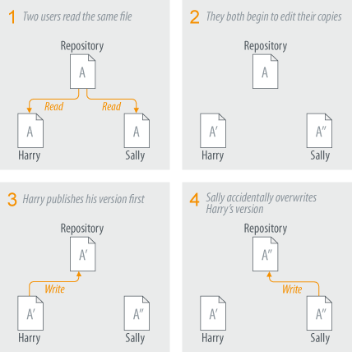

PARALLEL DEVELOPMENT
Fundamental challenge version control systems have to solve: how to work in parallel and prevent one from overwriting the work of another
Two solution flavours:
copy-modify-merge (default)
lock-modify-unlock (not for beginners)
Subversion supports both

Slide 5
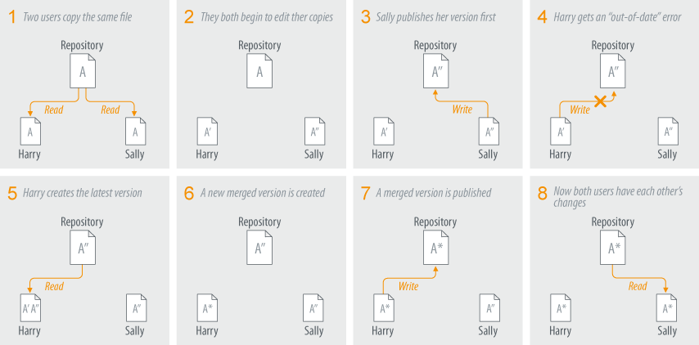
COPY – MODIFY – MERGE
Not possible for formats without merge algorithm available
Better suited for collaborative, distributed projects

Slide 6
WHAT IS SUBVERSION
State-of-the-art version control system
Built from scratch
Designed for WAN
Open Source
  Anyone can download, modify, and redistribute Subversion as they please without the need for permission from anybody else
Large, diverse developer community

Slide 7
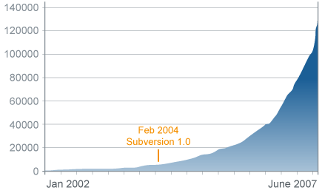
MOMENTUM
Explosive adoption rate
  E.g. public Subversion servers using Apache for repository access
Thriving open source project
  very active community (e.g. > 30 posts/day on dev list)
  many related projects that develop clients and integrations
June 2007: 133,665
Public Subversion servers using Apache for repository access
Data from www.securityspace.com

Slide 8
SOME KEY FEATURES
Versioned directories & renames
Versioned meta data
Atomic commits & change sets
Global revisions
Designed for wide area networks
Efficient handling of binary files
Branching and tagging are cheap
Easy to integrate with other systems, e.g. defect tracking systems

Slide 9
TERMINOLOGY
Term
Description
repository
master copy with full history, lives on the server
path
location of a file or directory within the repository
revision
numbered snapshot of the full repository tree after a change
working copy
tree checked out from the repository onto your local (client) machine; changes are ‘committed’ from here to the repository
tag
a human friendly name for a particular repository tree
branch
a line of development that starts out as a copy of a repository tree and then develops independently (but can be merged)
trunk
the main development line
HEAD
the latest revision

Slide 10
CLIENTS & PLATFORMS
Graphical Clients
  TortoiseSVN (MS Windows)
  SCPlugin, SvnX (Mac OS X)
  RapidSVN (multi-platform)
IDE Integration
  Eclipse: Subclipse, Subversive
  Microsoft Visual Studio .NET: AnkhSVN, PushOk, VisualSVN
  Netbeans
  Jdeveloper, JBuilder
  Windows-based IDE integrations using SCC
  Java (IDEA integrations)
Command-line Client
  portable
  output both human readable and automatically parseable
Web Interfaces
  read-only, browser-based
  good for ad-hoc examination of repository
  ViewVC
Generic WebDAV access
  extends Subversion to business users
  limited client functionality

Slide 11
TYPICAL USAGE - GLOBAL REVISIONING
Every commit increments the global repository revision number
  no matter how much or how little changed
  whatever did not change remains the same in the new revision
Referring to versioned objects:
  “/path/to/blue” refers to all revisions of blue
  “/path/to/blue in r7” identifies an exact revision of “blue”
  “/path/to/blue@7” is another way to say it

Slide 12
WORKING COPY
A working copy comprises
A copy of a revision of the data set
Another copy of the same revision of the data set, the so-called “pristine copy”, to enable sending only deltas across the wire (and offline operations)
Administrative data

Slide 13
CREATE A WORKING COPY
Use svn checkout to create your working copy
Use svn info to list the repository and revision a working copy points to
You can have multiple working copies on your system to alternate working on different tasks

Slide 14
STANDARD WORK CYCLE
Update your working copy
Make your changes
  optionally, get locks on relevant files
Examine your changes
Bring in others’ changes
  resolve conflicts, if any
Commit your changes

Slide 15
UPDATE YOUR WORKING COPY
Use svn update to update from the top of your working copy
Update reports status for each changed path
  updated (U)
  added (A)
  deleted (D)
  replaced (R)
  merged (G)
  conflicting (C)

Slide 16
MAKE YOUR CHANGES
If working in lock-modify-unlock approach, use svn lock to lock a file or directory before changing it
Make your changes
  change files: use your editor
  change structure: use Subversion to add, copy, delete, and move files and directories
  common pitfall when using command-line or TortoiseSVN: do not use local file system commands to change structure
Note that a rename is reflected as a copy with history plus a delete of the original path
  recursive: when renaming a directory, the copy with history and delete touch the whole sub tree

Slide 17
EXAMINE YOUR CHANGES
Use svn status to list an overview of changes in your working copy
  columns indicate content status, prop status, copied or renamed, switched, locked
  defaults to showing local modifications; use -u flag to also show remote modifications and anticipate conflicts
Use svn diff to examine exactly what has changed
  default against unchanged version (offline operation)
  can also work between any two revisions in repository
  external, format-specific diff tools can be plugged in

Slide 18
EXAMINE YOUR CHANGES (CONT’D)
Example output of svn status –u:
L some_dir # svn left a lock in the .svn area of some_dir
M bar.c # the content in bar.c has local modifications
M baz.c # baz.c has property but no content modifications
X 3rd_party # dir is part of an externals definition
? foo.o # svn doesn't manage foo.o
! some_dir # svn manages this, but it's missing or incomplete
~ qux # versioned as file/dir/link, but type has changed
I .screenrc # svn doesn't manage this, and is set to ignore it
A + moved_dir # added with history of where it came from
M + moved_dir/README # added with history and has local modifications
D stuff/fish.c # file is scheduled for deletion
A stuff/loot/bloo.h # file is scheduled for addition
C stuff/loot/lump.c # file has textual conflicts from an update
C stuff/loot/glub.c # file has property conflicts from an update
R xyz.c # file is scheduled for replacement
S stuff/squawk # file or dir has been switched to a branch
K dog.jpg # file is locked locally; lock-token present
O cat.jpg # file is locked in the repository by other user
B bird.jpg # file is locked locally, but lock has been broken
T fish.jpg # file is locked locally, but lock has been stolen

Slide 19
COMMIT YOUR CHANGES
Use svn commit to commit your changes to the repository
  Commit automatically releases locks unless explicitly specified not to
Best practices
  Execute a build and unit test to ensure your commit will not break anything
  Commit exactly one logical unit of work at a time
  Write a sensible commit message, e.g.:
Add new speed and radius options for twirling batons.
* lib/twirl.c
(parse_options): Accept new “speed” and “radius”
options, convert them, and pass them along to
twirl_baton.
(twirl_baton): Take new 'speed' and 'radius‘
parameters.
* www/manual.html
(Twirling For Beginners): Document the new options.

Slide 20
EXAMINE HISTORY
Command
Description
svn log
list log messages with date and author information attached to revisions and which paths changed in each revision
svn diff
show specific details of how a file changed over time
svn cat
retrieve any file as it existed in a particular revision number and display it on your screen
svn list
show the files in a directory for any given revision
svn blame
show file with revision and author information in-line

Slide 21
SVN LOG
svn log
svn log –v (shows paths changed)
------------------------------------------------------------------------
r200 | jrandom | 2007-07-15 10:51:34 -0700 (Sun, 15 Jul 2007) | 10 lines
Add new speed and radius options for twirling batons.
...
------------------------------------------------------------------------
r199 | kathym | 2007-07-15 10:51:34 -0700 (Sun, 15 Jul 2007) | 3 lines
...
------------------------------------------------------------------------
r200 | jrandom | 2007-07-15 10:51:34 -0700 (Sun, 15 Jul 2007) | 10 lines
Changed paths:
M /trunk/twirl.c
D /trunk/degrees.c
A /trunk/conversion-tables.c (from /trunk/degrees.c:130)
Add new speed and radius options for twirling batons.
...

Slide 22
SVN DIFF
svn diff (shows local, uncommitted changes)
Index: lib/twirl.c
==============================================
--- lib/twirl.c (revision 199)
+++ lib/twirl.c (working copy)
@@ -43,7 +43,8 @@
(screen_context,
convert_degrees(&new_x,
&new_y,
degrees,
+ speed,
+ radius,
baton,
rotation_func)
Index: www/manual.html
==============================================
--- www/manual.html (revision 199)
+++ www/manual.html (working copy)
@@ -3057,5 +3057,27
<div id=”features” title=”features”>
+ <p>You can control the speed and radius of the baton by...

Slide 23
SVN BLAME
svn blame gives a line-by-line annotation of a file, showing when each line was last changed
svn blame twirl.c
18946 patsmith /* Load ADM_ACCESS's entries file. */
18471 jrandom entries_read(&entries, access));
18471 jrandom svn_wc_entries_read(&nohidden, access);
1532 freda
1532 freda /* Ensure that NAME is valid. */
29 kathym if (name == NULL)
2024 jrandom name = ENTRY_THIS_DIR;
1532 freda
29 kathym if (entry_modify_schedule)
29 kathym {
1532 freda entry_t *entry_before, *entry_after;
21728 dionisos int orig_modify_flags = modify_flags;
9882 navarya schedule_t schedule = entry->schedule;

Slide 24
IMPORT & EXPORT A (SUB) TREE
Use svn import to copy an unversioned tree into your repository
  note, this does not automatically convert the imported source tree into a working copy – you still need to do a checkout
Use svn export to export a clean tree from your repository
  exporting a tree delivers only a revision of the data set – it excludes the pristine copy and administrative data
  afterwards, Subversion will not know that this tree comes from the repository

Slide 25
SVN SUB COMMANDS OVERVIEW
  Before we wind up, let us visit list of all sub-commands.
add
blame (praise, annotate, ann)
cat
checkout (co)
cleanup
commit (ci)
copy (cp)
delete (del, remove, rm)
diff (di)
export
import
info
list (ls)
lock
log
merge
mkdir
move (mv, rename, ren)
propdel (pdel, pd)
propedit (pedit, pe)
propget (pget, pg)
proplist (plist, pl)
propset (pset, ps)
resolved
revert
status (stat, st)
switch (sw)
unlock
update (up)

Slide 26
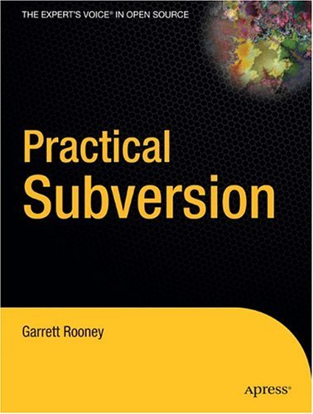
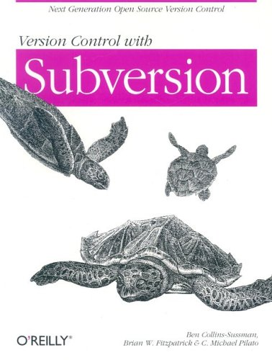
LINKS & RESOURCES
Communities & documentation
  openCollabNet: http://subversion.open.collab.net
  blog: http://blogs.open.collab.net/svn
  development project: http://subversion.tigris.org
  users’ list: users@subversion.tigris.org
Books
  Ben Collins-Sussman, Brian W.
  Fitzpatrick, and C. Michael Pilato,
  Version Control with Subversion,
  O’Reilly, June 2004.
  http://svnbook.red-bean.com
  Garrett Rooney, Daniel Berlin,
  Practical Subversion, Apress,
  November 2006.

Slide 27
WHERE TO GET HELP
Integrated help, e.g.
  command line: svn help <subcommand>
  help menu in all mature clients
Subversion book
  http://svnbook.red-bean.com/
  chapter 9 provides complete reference
Mailing list
  users’ mailing list: users@subversion.tigris.org
Discussion forums
  http://www.open.collab.net/forums.html

Slide 28
Questions?

Slide 29
Thank you!

