Slide 1

The Science Behind Dreams

Slide 2
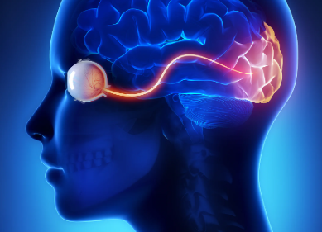
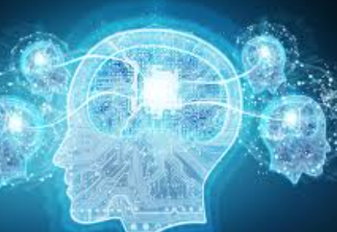
How dreams are generated ?
Dreams occur during the Rapid Eye Movement (REM) stage of sleep.
The brainstem sends signals to the cerebral cortex, triggering random thoughts, emotions and memories.
The amygdala (emotion processing) and hippocampus (memory storage) play a key role.
The hippocampus pulls stored memories, emotions and creates dream scenes.
The visual cortex is responsible for processing images even though the eyes are closed.

Slide 3

Scientific Efforts to Decode Dreams
Fmri & EEG - used to study brain activity during sleep
AI & ML – Researchers are trying to reconstruct dream imagery based on neural activity
Neural Decoding – Some studies show brain scans can predict images a person is seeing or thinking about
In Japan, Partially reconstructed images from dreams were traced using AI models trained on brain signals.

Slide 4
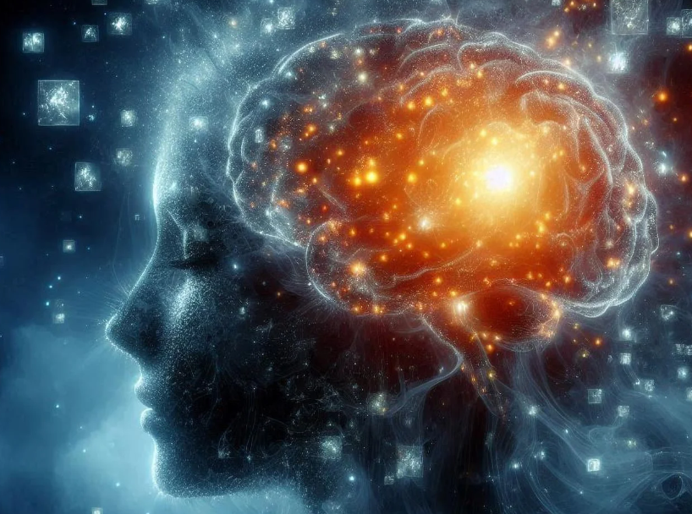
Future of Dream-Capturing Technology
Brain-Computer Interfaces (BCI) : Devices like Neuralink aim are used to record and interpret thoughts.
Advancements in AI: AI models might reconstruct dream visuals with accuracy.
Ethical Concerns: Privacy, Subconscious data misuse & psychological impact must be considered.
Potential Applications : Aids in medical treatment, creative inspiration, and memory enhancement.

Slide 5
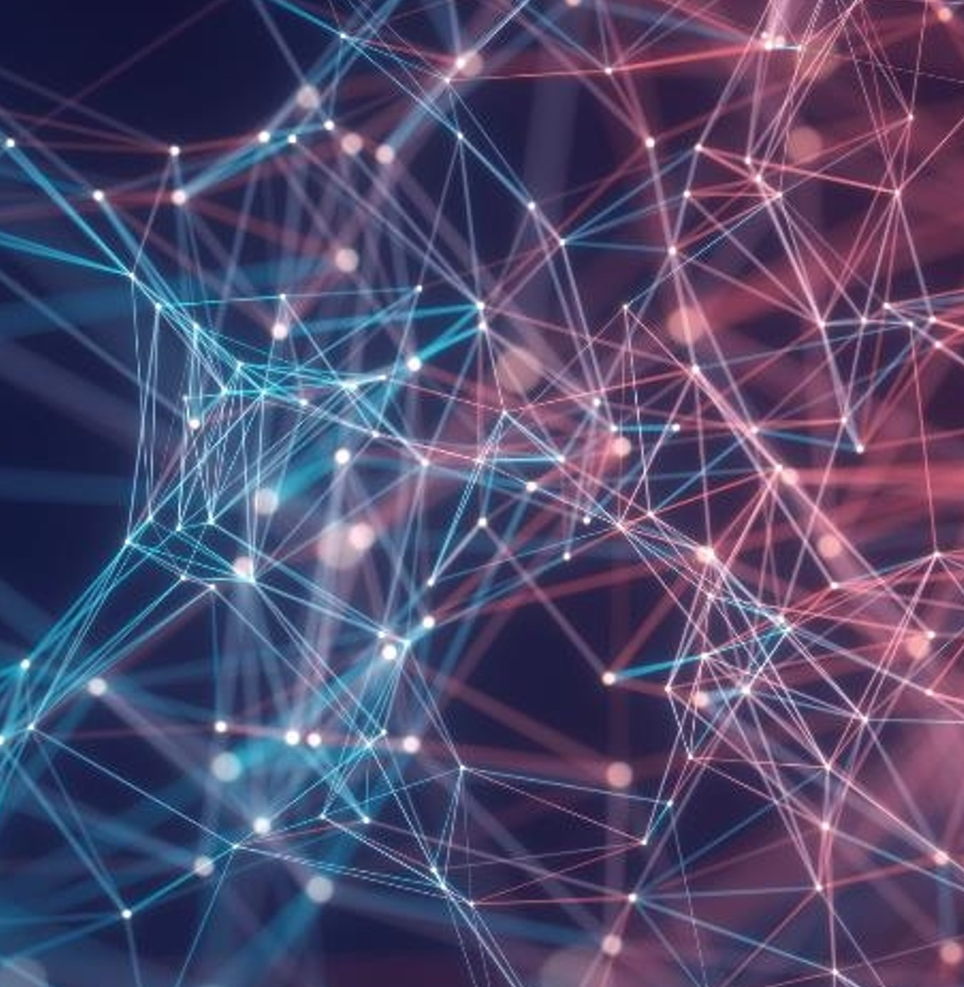
Thank You
A. Bhuvana Naga Sai
2389408

