Slide 1
FLASHCARDS
APPLICATION

Slide 2
CONTENTS
01
02
03
04
ABSTRACT
LITERATURE SURVEY
SUMMARY OF OUR RESEARCH PROJECT
COMPREHENSIVE SUMMARY OF PREVIOUS RESEARCH
WEBSITE FEATURES
ADD ONS
FEATURES ALREADY PRESENT
ADDITIONAL FEATURES ADDED

Slide 3
WHAT ARE FLASHCARDS?
A FLASHCARD IS A SMALL PIECE OF CARD YOU HOLD IN YOUR HAND AND GLANCE AT IT QUICKLY TO TAKE THE INFORMATION IN.

Slide 4
ABSTRACT
A Flashcard is one of the media to develop student information literacy in which its application includes activities of analyzing, writing and telling stories.Flashcard use is a standard study technique where traditional flashcards are typically pieces of paper or note cards that have a term written on one side and a definition on the other side. When one studies using flashcards, users often look at one side and try to recall information on the other side. Advantages of flashcards include their portability and their ease of use in various locations.

Slide 5
Keywords
Flashcards
Learning styles
Smartphone apps
Active recall
Visual Learning

Slide 6
Literature survey
Previous survey research has documented students' use of self-regulated study strategies, with a particular interest in self-testing. These surveys indicate that students frequently use flashcards to self-test and that self-testing is primarily used as a way to monitor learning. Accordingly, the primary purpose of the current survey was to explore how and when students engage in self-testing. We surveyed 374 undergraduates about the amount of practice and the timing of practice, two factors that strongly affect the efficacy of self-testing. Results indicate that students understand the benefits of practising to higher criterion levels (amount of practice) but do not typically implement or understand the benefits of practising with longer lags (timing of practice).

Slide 7
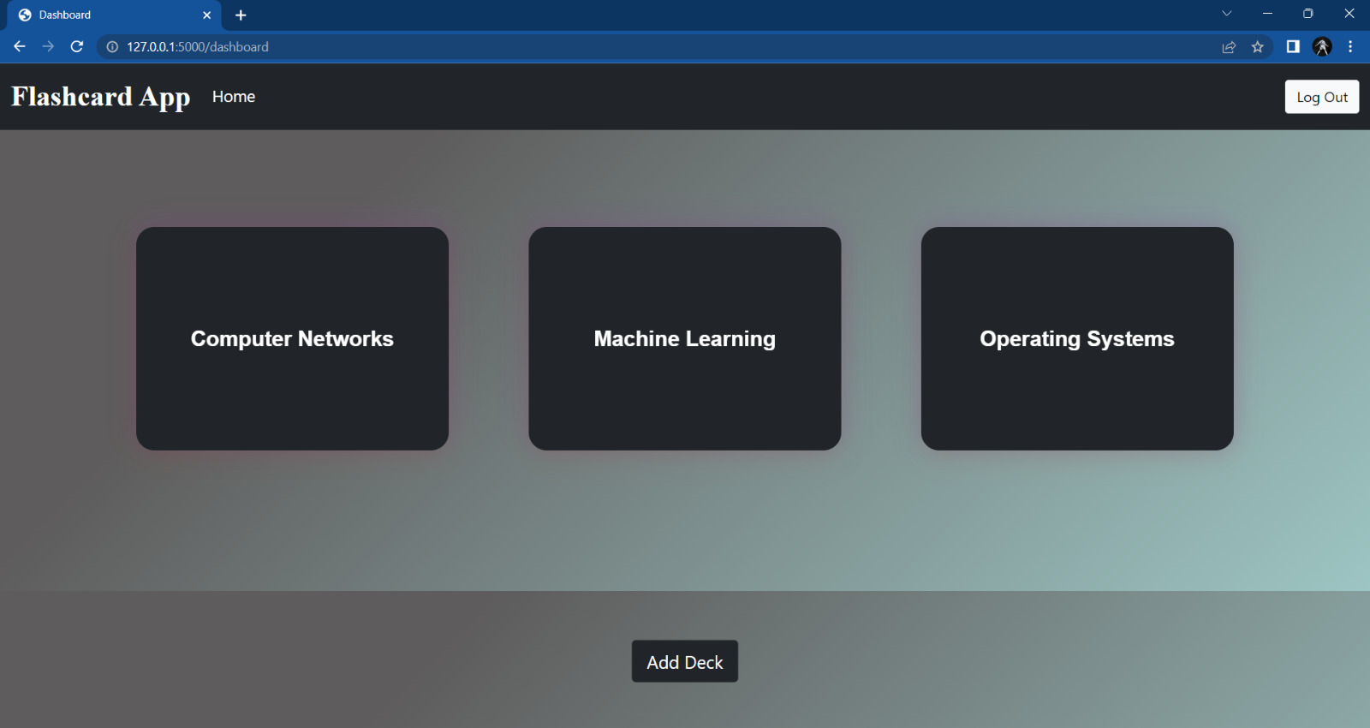
Sneak Peek
DECKS IN THE FLASHCARD APP IS DISPLAYED

Slide 8
Features
Login Verification
Updating / Deleting Decks
Revised time
Feature 1
Feature 3
Feature 5
Feature 2
Feature 4
Adding Decks
Score card

Slide 9
Add on
Feature

Slide 10
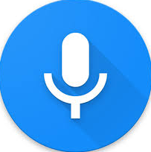

Voice play on
This feature is included because students who are visually impaired can also easily access these flashcards in their academics.And through audio its more easier to read

Slide 11
Front end
01
03
02
HTML
Bootstrap
Hypertext Markup Language
HTML + CSS + JS
CSS
Cascading Style Sheets

Slide 12
Back end
Flask
Web application framework written in Python
Controller - Python
Python is a high-level, general-purpose programming language

Slide 13


Team Members
ATHITHYAA R
BHUVANA I

Slide 14
Thank you!

