Slide 1
MAJOR PROJECT PRESENTATION · II
AI-Powered Personalised
Career Guidance and
Skill Gap Analysis
SKILLS
ROLES
PROFILE
An explainable career-matching and growth-planning platform
GOALS
GAPS
TEAM
B23CS024 · B23CS023 · B23CS032 · B23CS054
College name was not present in supplied project files.
Supervisor Dr. Ms. N. Jayashree | Department CSE
College / institution: [add name]
PATHFINDER
Notes:
Presenter 1 — Introduce the project and team. Replace the editable college placeholder with the institution name before presenting. Team names were not in project files; the roll numbers were found in the Phase-I deck.

Slide 2
01 · CONTEXT
Why career guidance needs more than a job title
A useful recommendation should connect three things:
THE PLATFORM’S EVIDENCE BASE
1
What a student can do
1,016
Self-rated skills and experience
O*NET occupations in generated metadata
2
What a role needs
Occupation skill importance and level
68
selected O*NET skill dimensions used in matching
3
What to do next
Prioritized gaps and learning actions
Ratings are self-reported; results are guidance, not hiring predictions.
AI-Powered Personalised Career Guidance and Skill Gap Analysis
02
Notes:
Presenter 1 — Explain the motivation. The exact counts come from the generated metadata and the selected skill-map dimensions. Clarify that the platform compares a student profile with occupational data; it does not predict hiring success. Sources: data/processed/career_metadata.csv, data/processed/career_skill_map.csv, data_processing/build_career_skill_map.py.

Slide 3
02 · NEED
Problem statement
Students often face separate questions with no clear path between them.
01
Which roles fit me?
Compare my strengths and interests with real role requirements.
02
What am I missing?
Show skill gaps and which gaps matter most for a selected role.
03
What should I do next?
Turn gaps into learning steps, practice projects, and career actions.
Project focus: connect profile → role fit → skill development in one workflow.
AI-Powered Personalised Career Guidance and Skill Gap Analysis
03
Notes:
Presenter 1 — State the user problem as the project’s motivation, not a quantified claim about every student. Explain the three questions and the integrated workflow the project aims to support.

Slide 4
03 · SCOPE
Design gap and project contribution
Separate capabilities
Gap targeted here
Our contribution
Career databases list roles
Profile and role requirements are disconnected
One profile-to-role workflow
Assessments capture interests
Skill gaps can lack priority
Explainable weighted skill match
Course catalogs list learning
Advice may not lead to a learning plan
Prioritized gaps and resources
Chat tools give broad guidance
Progress can be hard to track
Optional persistence and career tools
This is the project’s design rationale, not a systematic review of all commercial systems.
AI-Powered Personalised Career Guidance and Skill Gap Analysis
04
Notes:
Presenter 1 — Describe this as the design gap addressed by this project. It is not a formal systematic literature review or an experimentally proven claim that all existing systems are separate. The Phase-I presentation contains the same comparative-study rationale.

Slide 5
04 · SYSTEM
Proposed system and implemented modules
01
02
03
Profile & assessment
Career matching
Growth planning
Collect profile basics, interests, strengths, and skill ratings.
Rank O*NET roles and explain strengths and gaps.
Skill-gap progress, roadmap resources, and portfolio projects.
04
05
06
Resume intelligence
Career tools
Accounts & admin
PDF text extraction and heuristic, role-aware report.
Mentor, mock interview, job-description fit, applications.
Optional accounts, saved progress, user review, and audit.
AI provider is optional: career scoring remains deterministic; mentor/interview have local fallbacks.
AI-Powered Personalised Career Guidance and Skill Gap Analysis
05
Notes:
Presenter 2 — Walk through the modules. These modules exist in the source. Some depend on account mode; external AI is optional and not required for career matching. Automatic fake-profile detection is not part of admin. Source: frontend/src/pages/WorkspacePage.jsx, backend/src/main/java/edu/careerguidance/.

Slide 6
05 · ENGINEERING
Technology stack and why it fits
React 19 + Vite 7
Interactive routed workspace and fast local development
Spring Boot 3.5.5 · Java 24
REST API, validation, security, and backend services
Python · pandas · NumPy
Dataset processing and the existing weighted matcher
MySQL 8.4 · Flyway · JDBC
Optional user persistence with versioned SQL migrations
O*NET + ESCO
Occupational and skill source data; only O*NET drives current scoring
OpenAI-compatible API
Optional server-side mentor/interview generation with fallback
Docker Compose · nginx
Local multi-service packaging and static frontend hosting
Development assistant: OpenAI Codex (project-work context); it is not part of the deployed application.
AI-Powered Personalised Career Guidance and Skill Gap Analysis
06
Notes:
Presenter 2 — Explain the technology choices and the boundary between application stack and development tools. Alternatives: one Python API could replace the Java-to-Python bridge, but the project keeps Java for REST/security and Python for existing data/matching logic; a different relational database could replace MySQL, but MySQL is configured in Compose. Codex assisted development; it is not a runtime AI component. Sources: frontend/package.json, backend/pom.xml, docker-compose.yml, docs/adr/0001-python-matcher-bridge.md.

Slide 7
06 · DATA
Datasets and preprocessing pipeline
46
19
50,261
68
O*NET Excel source files present
ESCO CSV source files present
rows in generated career-skill map
O*NET skill dimensions selected for matching
1
Inspect
2
Clean
3
Normalize
4
Build map
Check source columns and values
→
Standardize fields and write CSV
→
Apply aliases; flag uncertain terms
→
Join importance + level by role and skill
O*NET supplies current scores. ESCO is cleaned as supplementary data; ESCO scoring is not implemented.
Sources: data/raw/, data/processed/, reports/data_analysis_report.md
AI-Powered Personalised Career Guidance and Skill Gap Analysis
07
Notes:
Presenter 1 — These values were checked against the current files: 46 O*NET files, 19 ESCO files, 50,261 generated map rows, and 68 selected dimensions. Pipeline: inspection → cleaning → alias normalization/review flags → map generation. O*NET uses essential skills, transferable skills, and knowledge; abilities are excluded from the current scorer. ESCO is supplementary and not scored. Sources: data_processing/clean_data.py, data_processing/normalize_skills.py, data_processing/build_career_skill_map.py, generated CSV row count, reports/data_analysis_report.md.

Slide 8
07 · DATA
Database design and persistence boundary
Account mode
users
→
student_profiles
→
match_sessions
Identity, role, account status
One JSON profile per user
Inputs and saved results
Per-user career data
career_assessments
resume_analyses
skill_gap_progress
roadmap_items
saved_careers
career_tool_records
job_applications
Guest profiles use browser storage. MySQL + Flyway migrations V1–V7 persist account data.
Runtime schema = Flyway migrations; backend/schema.sql is an older separate design.
AI-Powered Personalised Career Guidance and Skill Gap Analysis
08
Notes:
Presenter 2 — Explain account ownership and the optional persistence boundary. The Flyway migrations are what the Spring application uses when AUTH_ENABLED is true. `backend/schema.sql` describes a separate older database design and should not be applied as the current application schema. Data is mostly stored through JDBC repositories, with JSON/text payloads for flexible records. Sources: backend/src/main/resources/db/migration/V1–V7, backend/src/main/java/edu/careerguidance/auth/, backend/src/main/resources/application.yml.

Slide 9
08 · ARCHITECTURE
System architecture
Student
React + Vite
Spring Boot API
MatcherBridge
Python matcher
→
→
→
→
Skills, interests, profile
Routes and UI
Validation, services, access control
Subprocess boundary
Weighted scoring + gaps
account mode
local files
MySQL + Flyway
Generated O*NET CSVs
Optional account storage
career_skill_map + metadata
Optional server-side LLM is called only by mentor/interview guidance; it is outside the scoring path.
AI-Powered Personalised Career Guidance and Skill Gap Analysis
09
Notes:
Presenter 2 — Trace the implemented architecture. React sends API requests to Spring. For matching/what-if, Spring invokes the Python matcher through MatcherBridge, which reads generated local files. Signed-in account records go to MySQL via JDBC/Flyway. The optional server-side OpenAI-compatible provider is used for mentor and interview text generation/feedback, not the matching score. Sources: docs/ARCHITECTURE.md, docs/adr/0001-python-matcher-bridge.md, backend/src/main/java/edu/careerguidance/service/MatcherBridge.java.

Slide 10
09 · METHOD
End-to-end user workflow
01
→
02
→
03
→
04
→
05
→
06
Profile
Rate & choose
Normalize
Compare
Prioritize
Act
Education, goals, experience
Skill levels + RIASEC interests
Rating 1–5 → O*NET 0–7
Weighted coverage per occupation
Rank roles; sort gaps by importance
Explore, learn, save progress
Returned result
Ranked role · match similarity · strong skills · prioritized gaps · resource-backed next steps
Signed-in progress persists per account; guest data remains in browser storage.
AI-Powered Personalised Career Guidance and Skill Gap Analysis
10
Notes:
Presenter 3 — Talk through one user journey. Skill ratings are translated to the O*NET level scale, role skill coverage is importance-weighted, interest overlap adds a small capped bonus, then the roles and gaps are ranked. The platform returns recommendations and actionable gaps. Sources: docs/MATCHING.md, data_processing/matching_engine.py, backend/src/main/java/edu/careerguidance/api/MatchController.java.

Slide 11
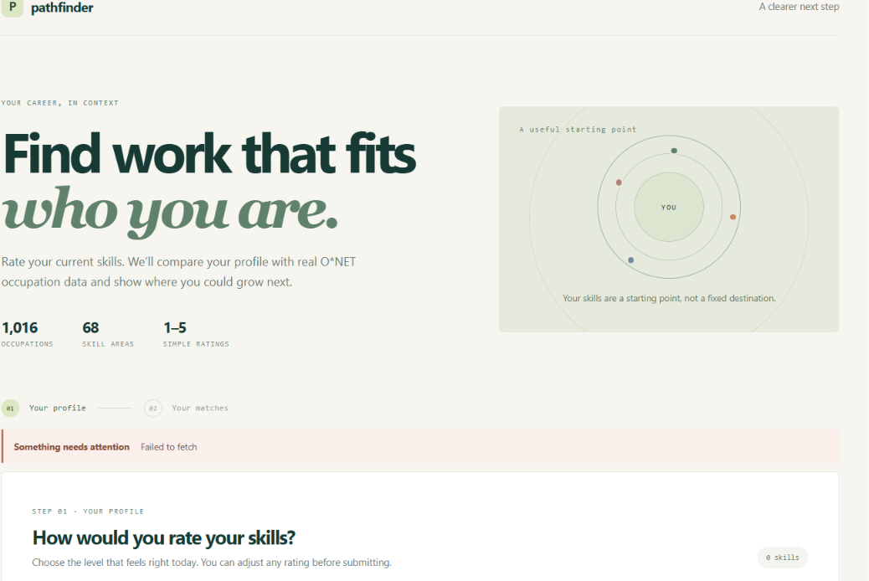
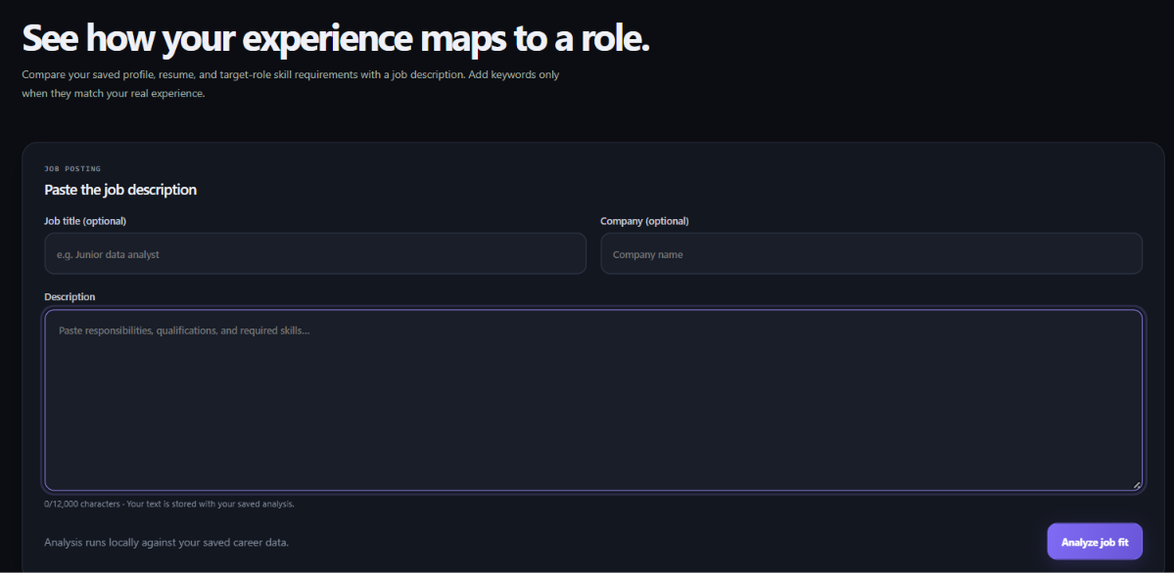
10 · IMPLEMENTATION EVIDENCE
Application screens captured in earlier sessions
Profile / skill-rating view
Job-description matcher form
The screenshot shows “Failed to fetch” at capture.
Input screen only; no successful analysis output is captured.
These are genuine user-provided screenshots, not proof of a successful live run. Current app screenshots/results were unavailable.
AI-Powered Personalised Career Guidance and Skill Gap Analysis
11
Notes:
Presenter 3 — Be transparent: these genuine screenshots were supplied in earlier project sessions and show the profile screen with a fetch error and a job-matcher input form with no result. They are not successful output evidence. The Docker daemon and localhost were unavailable during preparation, so no current running-app screenshots or recommendation result could be captured. Use a fresh live screenshot only after verifying the app.

Slide 12
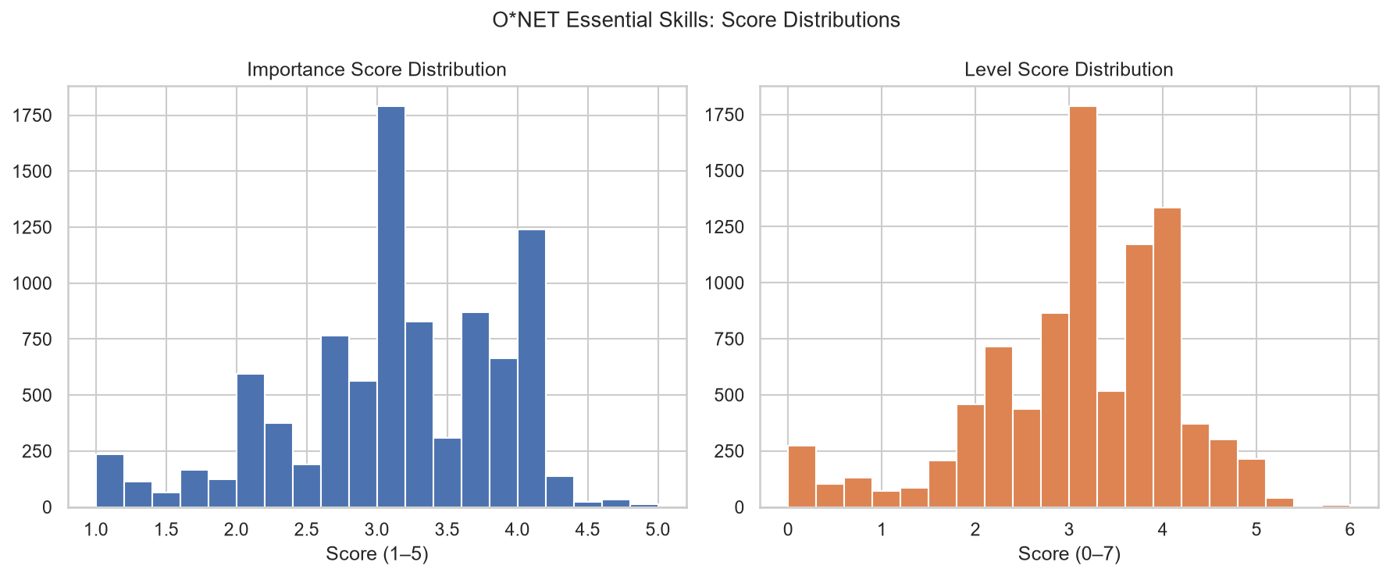
11 · EVIDENCE
Results and verification evidence
Dataset facts
9,100
O*NET essential-skill importance ratings
1,016
occupation records in metadata
Recorded test checkpoints
Python 87 passed · Java 23 passed · Frontend 32 passed
Phase reports dated 2026-10-27; not rerun for this deck.
Docker startup and browser E2E were explicitly unverified in those reports.
AI-Powered Personalised Career Guidance and Skill Gap Analysis
12
Notes:
Presenter 3 — The chart is generated from the real O*NET essential-skills data, not app output. The dataset inspection report records 9,100 importance entries and the generated metadata has 1,016 occupations. The Phase 9/10 reports record 87 Python tests, 23 backend tests, and 32 frontend tests passed at their documented checkpoints. These results were not rerun for this deck. Docker startup and Playwright end-to-end acceptance were marked unverified in the reports. Sources: reports/data_analysis_report.md, reports/PHASE9_2026-10-27.md, reports/PHASE10_2026-10-27.md.

Slide 13
12 · HONEST STATUS
Limitations and next steps
Current limitations
Prioritized follow-up
•
Self-rated skill levels are not independently validated.
Before demo
Restart/verify Docker; test health, login, and one full match.
•
Match scores are similarities, not hiring probabilities.
Validation
Run Java/Python/frontend suites and authenticated E2E.
•
Resume score is a heuristic; OCR for scanned PDFs is absent.
•
AI is optional; blank key or failure uses local fallback.
Research
Evaluate recommendations with a documented, reviewed test set.
•
No automatic fake-profile detector or email reset flow.
Future scope
Add OCR or account-abuse review only with clear safeguards.
•
Generated datasets must be present locally for matching.
No accuracy, effectiveness, or live-deployment result is claimed.
AI-Powered Personalised Career Guidance and Skill Gap Analysis
13
Notes:
Presenter 4 — Separate implemented source code from verified live operation. Mention self-report bias, deterministic similarity scores, heuristic resume analysis, the optional AI key, local data requirement, and missing OCR/automatic abuse detection. The first practical next step is to verify the Docker stack and authenticated user journey. Do not invent accuracy measurements.

Slide 14
13 · TAKEAWAY
Conclusion and live demonstration
One explainable path from a student profile to a practical next step.
1
Create / open profile
Rate skills + interests
Review matches + gaps
Open roadmap / resource
→
2
→
3
→
4
Compose prerequisites
mvn -B -f backend/pom.xml -DskipTests package
docker compose up --build -d
docker compose ps
Generated data/processed/ + private .env + Docker Desktop
Build backend JAR, then start the stack:
Demo only after backend, frontend, and MySQL report healthy. Otherwise show the verified pipeline and explain the blocker.
Guest alternative: start_backend.ps1 + npm run dev (generated data still required).
AI-Powered Personalised Career Guidance and Skill Gap Analysis
14
Notes:
Presenter 4 — Summarize the contribution and demonstrate only if the stack is verified healthy. Compose requires locally generated processed data and private .env values; the backend image requires a packaged JAR. For guest-mode local dev, start the API with .\start_backend.ps1 and frontend from frontend/ with npm run dev. Do not run `docker compose down -v`, which deletes the MySQL volume. A Docker restart and live demo were not verified during deck preparation.

Slide 15
14 · REFERENCES
References and source material
01
O*NET 31.0 Database
U.S. Department of Labor / Employment and Training Administration
https://www.onetcenter.org/database.html
02
ESCO v1.2.1 Classification
European Commission
https://esco.ec.europa.eu/en/use-esco/download
03
Project architecture + matching
docs/ARCHITECTURE.md · docs/MATCHING.md · docs/LIMITATIONS.md
Local project documentation
04
Implementation evidence
reports/PHASE9_2026-10-27.md · reports/PHASE10_2026-10-27.md
Recorded checks and limitations; dates shown in notes
05
Technical implementation
backend/pom.xml · frontend/package.json · docker-compose.yml · Flyway V1–V7
Current source/configuration files
Thank you · Questions
AI-Powered Personalised Career Guidance and Skill Gap Analysis
15
Notes:
Presenter 4 — Close and invite questions. Dataset sources and project evidence are listed on the slide. Named external reference PPTs (SecureFS_Project_Presentation.pptx and STAGE2ppt.pptx) were not found in the project, Downloads, Documents, or Codex attachment folders checked; the existing Phase-I project deck was the only presentation deck available locally.

