Slide 1
Chapter 10 - JavaScript: Functions
Outline
10.1 Introduction
10.2 Program Modules in JavaScript
10.3 Programmer-Defined Functions
10.4 Function Definitions
10.5 Random-Number Generation
10.6 Example: Game of Chance
10.7 Duration of Identifiers
10.8 Scope Rules
10.9 JavaScript Global Functions
10.10 Recursion
10.11 Example Using Recursion: Fibonacci Series
10.12 Recursion vs. Iteration
10.13 JavaScript Internet and World Wide Web Resources

Slide 2
10.2 Program Modules in JavaScript
main
worker1
worker2
worker3
worker4
worker5
Fig. 10.1 Hierarchical boss-function/worker-function relationship.

Slide 3
SquareInt.html
<!-- Fig. 10.2: SquareInt.html -->
<!-- Square function -->
<html xmlns = "http://www.w3.org/1999/xhtml">
<head>
<title>A Programmer-Defined square Function</title>
<script type = "text/javascript">
<!—
document.writeln( "<h1>Square the numbers from 1 to 10</h1>" );
for ( var x = 1; x <= 10; ++x )
document.writeln( "The square of " + x + " is " +
square( x ) + "<br />" );
function square( y )
{
return y * y;
}
// -->
</script>
</head><body></body>
</html>

Slide 4
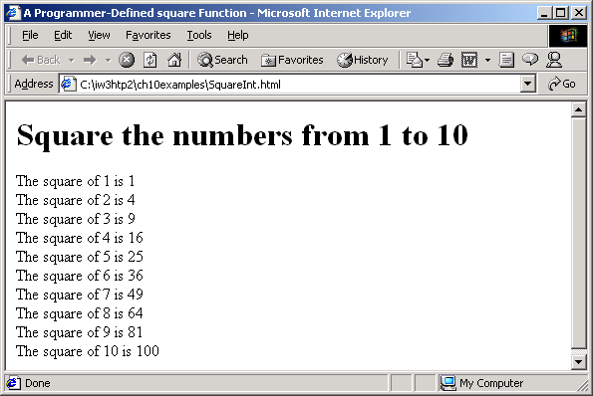
Program Output

Slide 5
5 <!-- Fig. 10.3: maximum.html -->
6 <!-- Maximum function -->
7 <html xmlns = "http://www.w3.org/1999/xhtml">
9 <head>
10 <title>Finding the Maximum of Three Values</title>
11 <script type = "text/javascript">
13 <!--
14 var input1 =
15 window.prompt( "Enter first number", "0" );
16 var input2 =
17 window.prompt( "Enter second number", "0" );
18 var input3 =
19 window.prompt( "Enter third number", "0" );
20 var value1 = parseFloat( input1 );
22 var value2 = parseFloat( input2 );
23 var value3 = parseFloat( input3 );
25 var maxValue = maximum( value1, value2, value3 );
27 document.writeln( "First number: " + value1 +
28 "<br />Second number: " + value2 +
29 "<br />Third number: " + value3 +"<br />Maximum is: " + maxValue );
32 // maximum method definition (called from line 25)
33 function maximum( x, y, z )
34 {
35 return Math.max( x, Math.max( y, z ) );

Slide 6
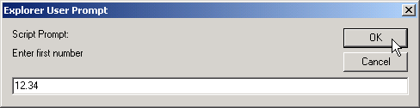
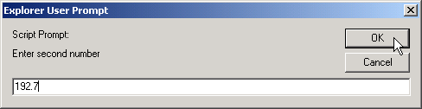

Maximum.html
Program Output
36 }
37 // -->
38 </script>
39
40 </head>
41 <body>
42 <p>Click Refresh (or Reload) to run the script again</p>
43 </body>
44 </html>

Slide 7
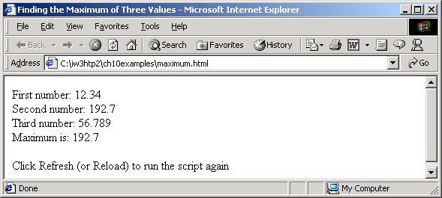
Program Output

Slide 8
5 <!-- Fig. 10.4: RandomInt.html -->
6 <!-- Demonstrating the Random method -->
7 <html xmlns = "http://www.w3.org/1999/xhtml">
9 <head>
10 <title>Shifted and Scaled Random Integers</title>
12 <script type = "text/javascript">
13 <!--
14 var value;
16 document.writeln(
17 "<table border = \"1\" width = \"50%\">" );
18 document.writeln("<caption>Random Numbers</caption><tr>" );
for ( var i = 1; i <= 20; i++ ) {
22 value = Math.floor( 1 + Math.random() * 6 );
23 document.writeln( "<td>" + value + "</td>" );
25 // write end and start <tr> tags when is a multiple of 5 and not 20
27 if ( i % 5 == 0 && i != 20 )
28 document.writeln( "</tr><tr>" );
29 }
31 document.writeln( "</tr></table>" );
32 // -->
33 </script>
35 </head>

Slide 9
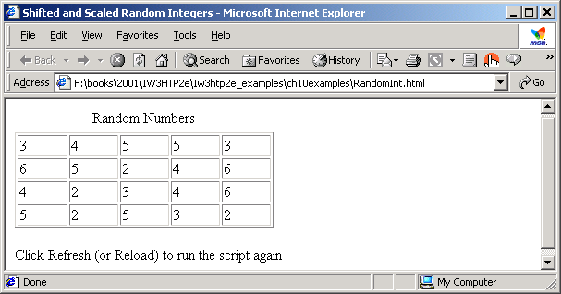
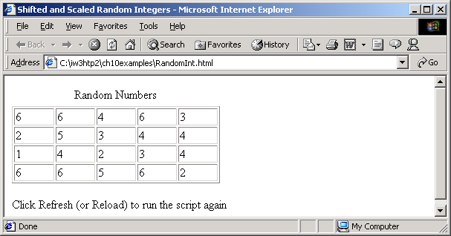
RandomInt.html
Program Output
36 <body>
37 <p>Click Refresh (or Reload) to run the script again</p>
38 </body>
39 </html>

Slide 10
RollDie.html
<!-- Rolling a Six-Sided Die -->
<html xmlns = "http://www.w3.org/1999/xhtml">
9 <head>
10 <title>Roll a Six-Sided Die 6000 Times</title>
12 <script type = "text/javascript">
13 <!--
14 var frequency1 = 0, frequency2 = 0,
15 frequency3 = 0, frequency4 = 0,
16 frequency5 = 0, frequency6 = 0, face;
18 // summarize results
19 for ( var roll = 1; roll <= 6000; ++roll ) {
20 face = Math.floor( 1 + Math.random() * 6 );
22 switch ( face ) {
23 case 1:
24 ++frequency1;
25 break;
26 case 2:
27 ++frequency2;
28 break;
29 case 3:
30 ++frequency3;
31 break;
32 case 4:
33 ++frequency4;
34 break;
35 case 5:

Slide 11
RollDie.html
36 ++frequency5;
37 break;
38 case 6:
39 ++frequency6;
40 break;
41 }
42 }
44 document.writeln( "<table border = \"1\"" +"width = \"50%\">" );
46 document.writeln( "<thead><th>Face</th>" +
47 "<th>Frequency<th></thead>" );
48 document.writeln( "<tbody><tr><td>1</td><td>" +frequency1 + "</td></tr>" );
50 document.writeln( "<tr><td>2</td><td>" + frequency2 +"</td></tr>" );
52 document.writeln( "<tr><td>3</td><td>" + frequency3 +"</td></tr>" );
54 document.writeln( "<tr><td>4</td><td>" + frequency4 +"</td></tr>" );
56 document.writeln( "<tr><td>5</td><td>" + frequency5 +"</td></tr>" );
58 document.writeln( "<tr><td>6</td><td>" + frequency6 +
59 "</td></tr></tbody></table>" );
60 // -->
61 </script>
63 </head>
64 <body>
65 <p>Click Refresh (or Reload) to run the script again</p>
66 </body>
67 </html>

Slide 12
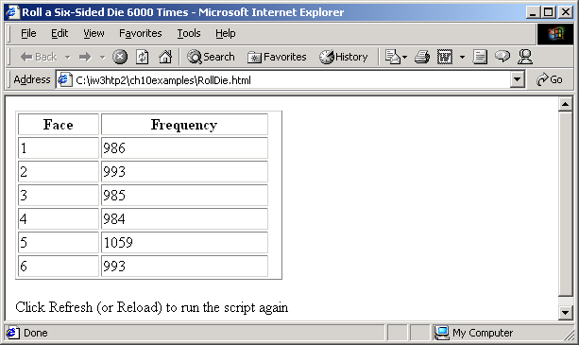

Program Output

Slide 13
Craps.html
1<!-- Craps Program -->
8 <html xmlns = "http://www.w3.org/1999/xhtml">
9 <head>
10 <title>Program that Simulates the Game of Craps</title>
12 <script type = "text/javascript">
14 // variables used to test the state of the game
15 var WON = 0, LOST = 1, CONTINUE_ROLLING = 2;
17 // other variables used in program
18 var firstRoll = true, // true if first roll
19 sumOfDice = 0, // sum of the dice
20 myPoint = 0, // point if no win/loss on first roll
21 gameStatus = CONTINUE_ROLLING; // game not over yet
23 // process one roll of the dice
24 function play()
25 {
26 if ( firstRoll ) { // first roll of the dice
27 sumOfDice = rollDice();
29 switch ( sumOfDice ) {
30 case 7: case 11: // win on first roll
31 gameStatus = WON;
32 // clear point field
33 document.craps.point.value = "";
34 break;
35 case 2: case 3: case 12: // lose on first roll

Slide 14
Craps.html
36 gameStatus = LOST;
37 // clear point field
38 document.craps.point.value = "";
39 break;
40 default: // remember point
41 gameStatus = CONTINUE_ROLLING;
42 myPoint = sumOfDice;
43 document.craps.point.value = myPoint;
44 firstRoll = false;
45 }}
47 else {
48 sumOfDice = rollDice();
50 if ( sumOfDice == myPoint ) // win by making point
51 gameStatus = WON;
52 else
53 if ( sumOfDice == 7 ) // lose by rolling 7
54 gameStatus = LOST; }
57 if ( gameStatus == CONTINUE_ROLLING )
58 window.status = "Roll again";
59 else {
60 if ( gameStatus == WON )
61 window.status = "Player wins. "+"Click Roll Dice to play again.";
63 else
64 window.status = "Player loses. " +"Click Roll Dice to play again.";
67 firstRoll = true;
68 }}

Slide 15
Craps.html
71 // roll the dice
72 function rollDice()
73 {
74 var die1, die2, workSum;
76 die1 = Math.floor( 1 + Math.random() * 6 );
77 die2 = Math.floor( 1 + Math.random() * 6 );
78 workSum = die1 + die2;
80 document.craps.firstDie.value = die1;
81 document.craps.secondDie.value = die2;
82 document.craps.sum.value = workSum;
84 return workSum;
85 }
86 // -->
87 </script>
89 </head>
90 <body>
91 <form name = "craps" action = "">
92 <table border = "1">
93 <caption>Craps</caption>
94 <tr><td>Die 1</td>
95 <td><input name = "firstDie" type = "text" />
96 </td></tr>
97 <tr><td>Die 2</td>
98 <td><input name = "secondDie" type = "text" />
99 </td></tr>
100 <tr><td>Sum</td>
101 <td><input name = "sum" type = "text" />
102 </td></tr>
103 <tr><td>Point</td>
104 <td><input name = "point" type = "text" />
105 </td></tr>

Slide 16
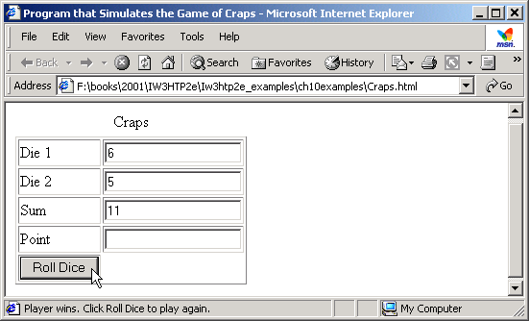
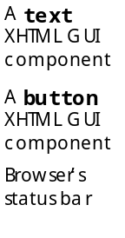

Craps.html
Program Output
106 <tr><td><input type = "button" value = "Roll Dice"
107 onclick = "play()" /></td></tr>
108 </table>
109 </form>
110 </body>
111 </html>

Slide 17
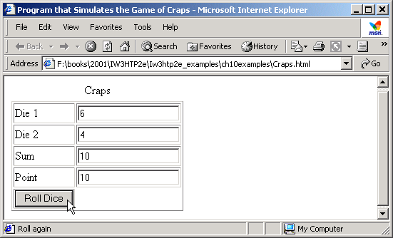


Program Output

Slide 18

Program Output

Slide 19
Scoping.html
<!-- Local and Global Variables -->
8 <html xmlns = "http://www.w3.org/1999/xhtml">
9 <head>
10 <title>A Scoping Example</title>
12 <script type = "text/javascript">
13 <!--
14 var x = 1; // global variable
16 function start()
17 {
18 var x = 5; // variable local to function start
20 document.writeln( "local x in start is " + x );
22 functionA(); // functionA has local x
23 functionB(); // functionB uses global variable x
24 functionA(); // functionA reinitializes local x
25 functionB(); // global variable x retains its value
27 document.writeln(
28 "<p>local x in start is " + x + "</p>" );
29 }
31 function functionA()
32 {
33 var x = 25; // initialized each time
34 // functionA is called

Slide 20
Scoping.html
35
36 document.writeln( "<p>local x in functionA is " +
37 x + " after entering functionA" );
38 ++x;
39 document.writeln( "<br />local x in functionA is " +
40 x + " before exiting functionA" + "</p>" );
41 }
43 function functionB()
44 {
45 document.writeln( "<p>global variable x is " + x +
46 " on entering functionB" );
47 x *= 10;
48 document.writeln( "<br />global variable x is " +
49 x + " on exiting functionB" + "</p>" );
50 }
51 // -->
52 </script>
53
54 </head>
55 <body onload = "start()"></body>
56 </html>

Slide 21
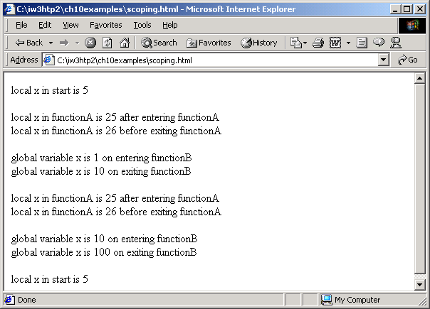
Program Output

Slide 22
10.10 Recursion
Final value = 120
5!
5!
5! = 5 * 24 = 120 is returned
5 * 4!
5 * 4!
4! = 4 * 6 = 24 is returned
4 * 3!
4 * 3!
3! = 3 * 2 = 6 is returned
3 * 2!
3 * 2!
2! = 2 * 1 = 2 is returned
2 * 1!
2 * 1!
1 returned
1
1
(a) Procession of recursive calls.
(b) Values returned from each recursive call.
Fig. 10.9 Recursive evaluation of 5!.

Slide 23
FactorialTest.html
5 <!-- Recursive factorial example -->
7 <html xmlns = "http://www.w3.org/1999/xhtml">
8 <head>
9 <title>Recursive Factorial Function</title>
11 <script language = "javascript">
12 document.writeln( "<h1>Factorials of 1 to 10</h1>" );
13 document.writeln("<table border = '1' width = '100%'>" );
for ( var i = 0; i <= 10; i++ )
17 document.writeln( "<tr><td>" + i + "!</td><td>" +
18 factorial( i ) + "</td></tr>" );
20 document.writeln( "</table>" );
22 // Recursive definition of function factorial
23 function factorial( number )
24 {
25 if ( number <= 1 ) // base case
26 return 1;
27 else
28 return number * factorial( number - 1 );
29 }
30 </script>
31 </head><body></body>
32 </html>

Slide 24
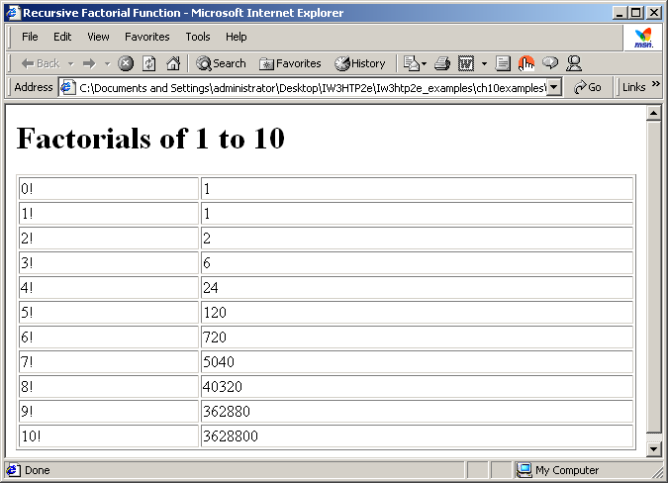
Program Output

Slide 25
FibonacciTest.html
5 <!-- Recursive Fibonacci example -->
7 <html xmlns = "http://www.w3.org/1999/xhtml">
8 <head>
9 <title>Recursive Fibonacci Function</title>
11 <script language = "javascript">
13 // Event handler for button XHTML component in myForm
14 function getFibonacciValue()
15 {
16 var value = parseInt(document.myForm.number.value );
18 window.status ="Calculating Fibonacci number for " + value;
20 document.myForm.result.value = fibonacci( value );
21 window.status = "Done calculating Fibonacci number";
22 }
24 // Recursive definition of function fibonacci
25 function fibonacci( n )
26 {
27 if ( n == 0 || n == 1 ) // base case
28 return n;
29 else
30 return fibonacci( n - 1 ) + fibonacci( n - 2 );
31 }
32 </script>
33 </head>
34

Slide 26
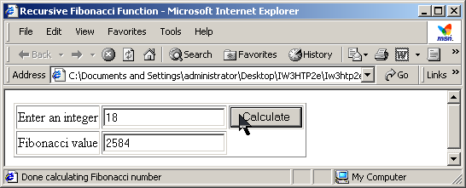
FibonacciTest.html
Program Output
35 <body>
36 <form name = "myForm">
37 <table border = "1">
38 <tr><td>Enter an integer</td>
39 <td><input name = "number" type = "text"></td>
40 <td><input type = "button" value = "Calculate"
41 onclick = "getFibonacciValue()"</tr>
42 <tr><td>Fibonacci value</td>
43 <td><input name = "result" type = "text"></td></tr>
44 </table>
45 </form></body>
46 </html>

Slide 27
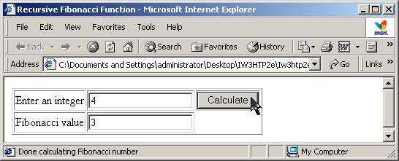
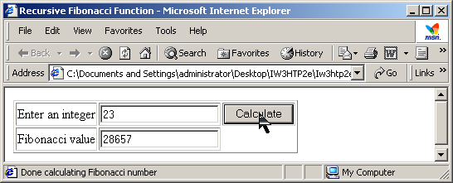
Program Output

Slide 28
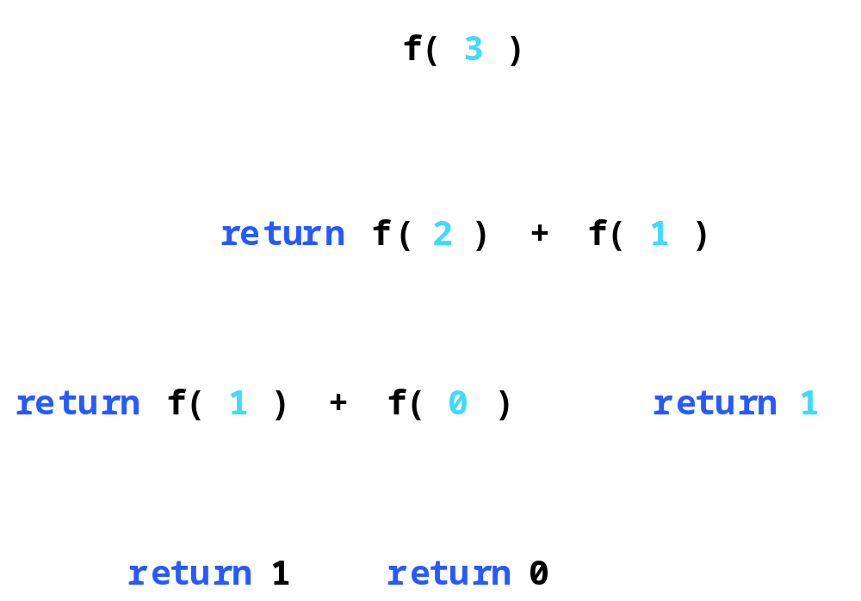
10.11 Example Using Recursion: Fibonacci Series
Fig. 10.12 Set of recursive calls to function fibonacci.

Slide 29
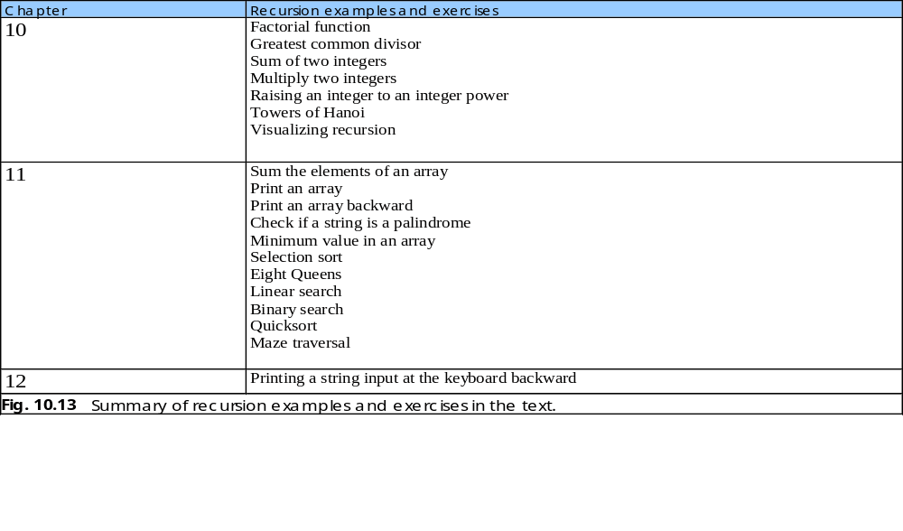
10.12 Recursion vs. Iteration

