Slide 1
Chapter 12 - JavaScript: Objects
Outline
12.1 Introduction
12.2 Thinking About Objects
12.3 Math Object
12.4 String Object
12.4.1 Fundamentals of Characters and Strings
12.4.2 Methods of the String Object
12.4.3 Character Processing Methods
12.4.4 Searching Methods
12.4.5 Splitting Strings and Obtaining Substrings
12.4.6 XHTML Markup Methods
12.5 Date Object
12.6 Boolean and Number Objects
12.7 JavaScript Internet and World Wide Web Resources

Slide 2
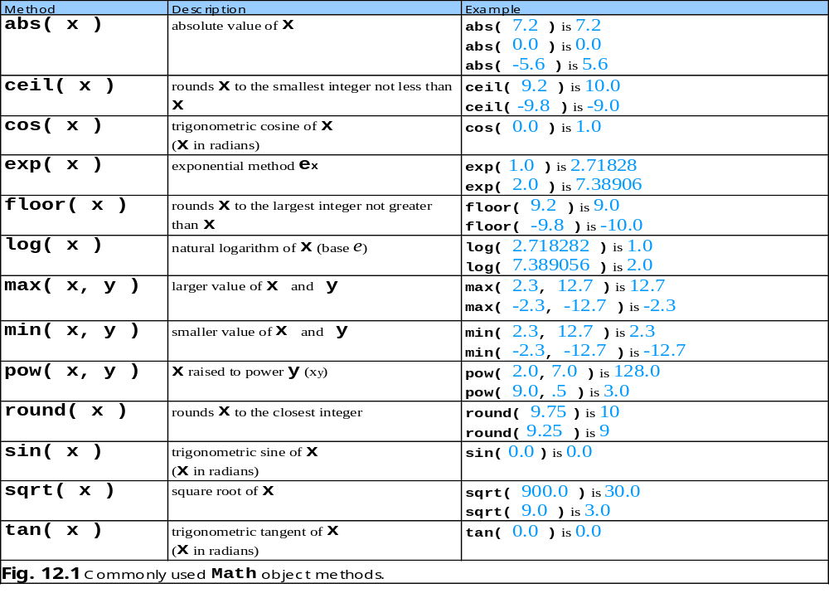
12.3 Math Object

Slide 3
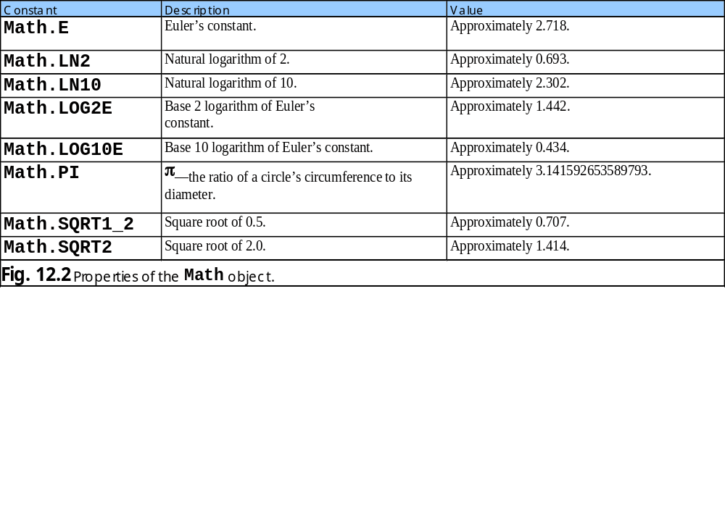
12.3 Math Object

Slide 4
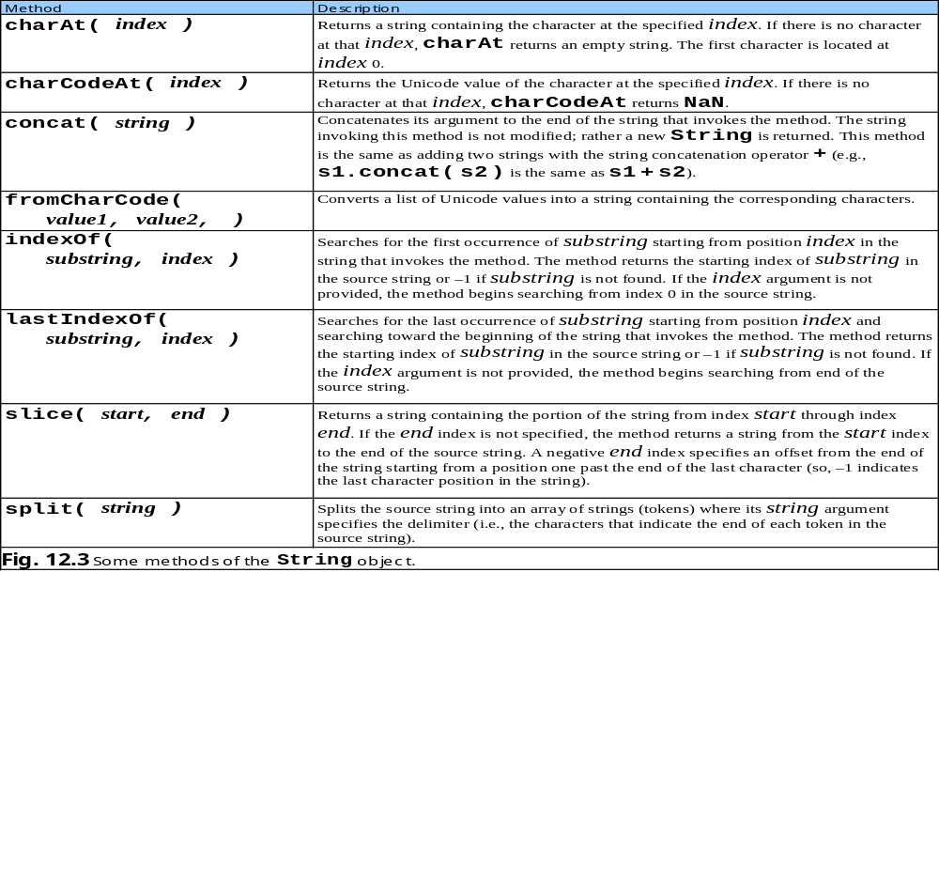
12.4.2 Methods of the String Object

Slide 5
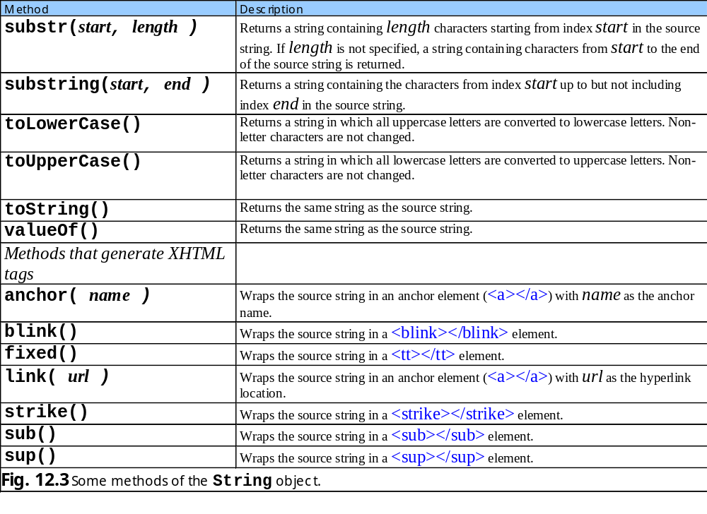
12.4.2 Methods of the String Object

Slide 6
CharacterProcessing.html
<!-- Character Processing Methods -->
8 <html xmlns = "http://www.w3.org/1999/xhtml">
9 <head>
10 <title>Character Processing Methods</title>
12 <script type = "text/javascript">
14 var s = "ZEBRA";
15 var s2 = "AbCdEfG";
17 document.writeln( "<p>Character at index 0 in '" +
18 s + "' is " + s.charAt( 0 ) );
19 document.writeln( "<br />Character code at index 0 in '"
20 + s + "' is " + s.charCodeAt( 0 ) + "</p>" );
22 document.writeln( "<p>'" +
23 String.fromCharCode( 87, 79, 82, 68 ) +
24 "' contains character codes 87, 79, 82 and 68</p>" )
26 document.writeln( "<p>'" + s2 + "' in lowercase is '" +
27 s2.toLowerCase() + "'" );
28 document.writeln( "<br />'" + s2 + "' in uppercase is '"
29 + s2.toUpperCase() + "'</p>" );
30 // -->
31 </script>
33 </head><body></body>
34 </html>

Slide 7
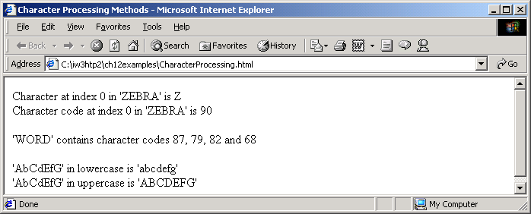
Program Output

Slide 8
SearchingStrings.html
<!-- Searching Strings -->
8 <html xmlns = "http://www.w3.org/1999/xhtml">
9 <head>
10 <title>
11 Searching Strings with indexOf and lastIndexOf
12 </title>
14 <script type = "text/javascript">
16 var letters = "abcdefghijklmnopqrstuvwxyzabcdefghijklm";
18 function buttonPressed()
19 {
20 searchForm.first.value =
21 letters.indexOf( searchForm.inputVal.value );
22 searchForm.last.value =
23 letters.lastIndexOf( searchForm.inputVal.value );
24 searchForm.first12.value =
25 letters.indexOf( searchForm.inputVal.value, 12 );
26 searchForm.last12.value =
27 letters.lastIndexOf(
28 searchForm.inputVal.value, 12 );
29 }
31 </script>
33 </head>

Slide 9
SearchingStrings.html
34 <body>
35 <form name = "searchForm" action = "">
36 <h1>The string to search is:<br />
37 abcdefghijklmnopqrstuvwxyzabcdefghijklm</h1>
38 <p>Enter substring to search for
39 <input name = "inputVal" type = "text" />
40 <input name = "search" type = "button" value = "Search"
41 onclick = "buttonPressed()" /><br /></p>
42
43 <p>First occurrence located at index
44 <input name = "first" type = "text" size = "5" />
45 <br />Last occurrence located at index
46 <input name = "last" type = "text" size = "5" />
47 <br />First occurrence from index 12 located at index
48 <input name = "first12" type = "text" size = "5" />
49 <br />Last occurrence from index 12 located at index
50 <input name = "last12" type = "text" size = "5" /></p>
51 </form>
52 </body>
53 </html>

Slide 10
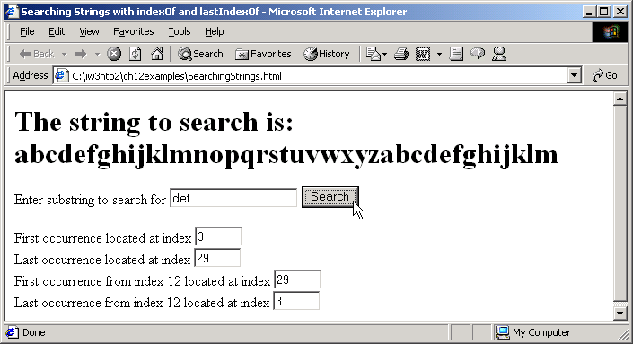

Program Output

Slide 11
SplitAndSubString.html
6 <!-- String Method split and substring -->
8 <html xmlns = "http://www.w3.org/1999/xhtml">
9 <head>
10 <title>String Method split and substring</title>
12 <script type = "text/javascript">
14 function splitButtonPressed()
15 {
16 var strings = myForm.inputVal.value.split( " " );
17 myForm.output.value = strings.join( "\n" );
19 myForm.outputSubstring.value =
20 myForm.inputVal.value.substring( 0, 10 );
21 }
23 </script>
24 </head>
26 <body>
27 <form name = "myForm" action = "">
28 <p>Enter a sentence to split into words<br />
29 <input name = "inputVal" type = "text" size = "40" />
30 <input name = "splitButton" type = "button" value =
31 "Split" onclick = "splitButtonPressed()" /></p>
33 <p>The sentence split into words is<br />
34 <textarea name = "output" rows = "8" cols = "34">
35 </textarea></p>

Slide 12
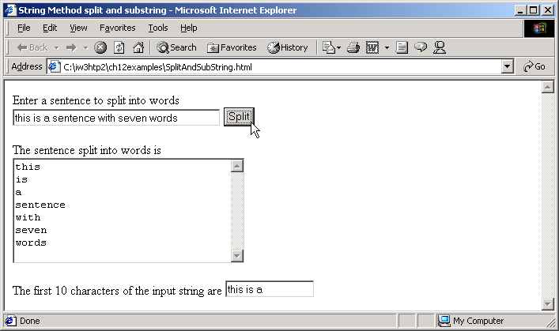
SplitAndSubString.html
Program Output
37 <p>The first 10 characters of the input string are
38 <input name = "outputSubstring" type = "text"
39 size = "15" /></p>
40 </form>
41 </body>
42 </html>

Slide 13
MarkupMethods.html
<!-- XHTML markup methods of the String object -->
8 <html xmlns = "http://www.w3.org/1999/xhtml">
9 <head>
10 <title>XHTML Markup Methods of the String Object</title>
12 <script type = "text/javascript">
14 var anchorText = "This is an anchor",
15 blinkText = "This is blinking text",
16 fixedText = "This is monospaced text",
17 linkText = "Click here to go to anchorText",
18 strikeText = "This is strike out text",
19 subText = "subscript",
20 supText = "superscript";
22 document.writeln( anchorText.anchor( "top" ) );
23 document.writeln( "<br />" + blinkText.blink() );
24 document.writeln( "<br />" + fixedText.fixed() );
25 document.writeln( "<br />" + strikeText.strike() );
26 document.writeln(
27 "<br />This is text with a " + subText.sub() );
28 document.writeln(
29 "<br />This is text with a " + supText.sup() );
30 document.writeln(
31 "<br />" + linkText.link( "#top" ) );

Slide 14
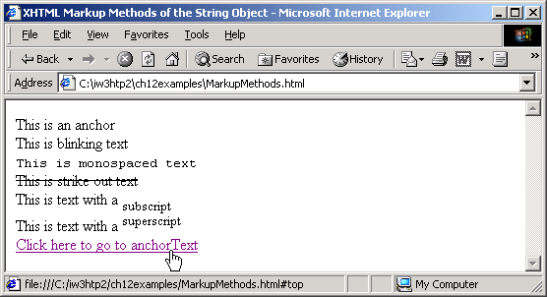
MarkupMethods.html
Program Output
33 </script>
34
35 </head><body></body>
36 </html>

Slide 15
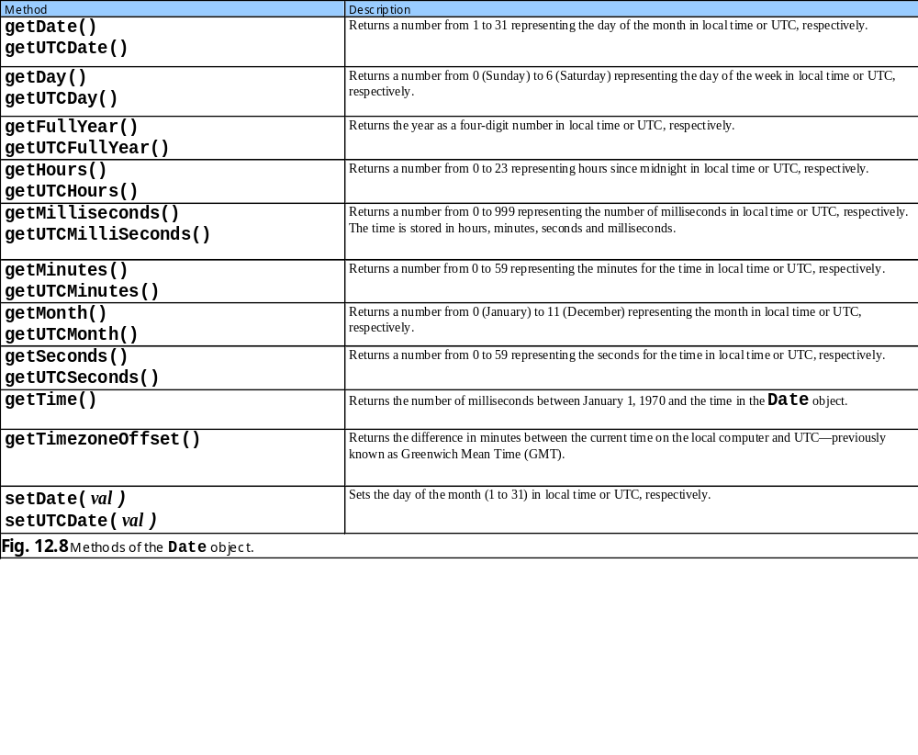
12.5 Date Object

Slide 16
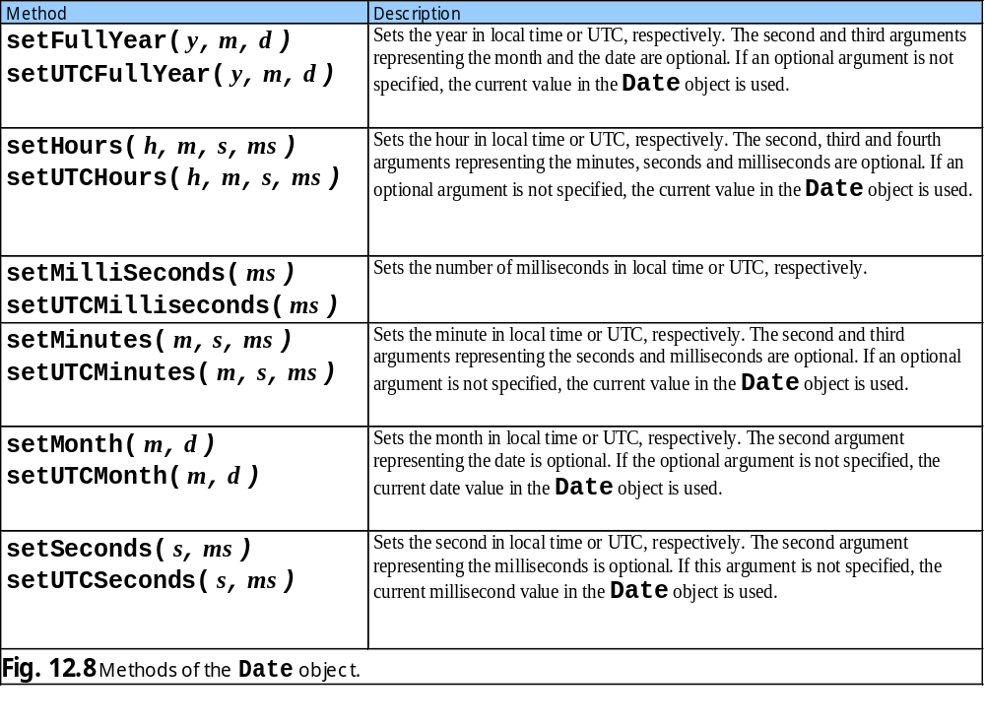
12.5 Date Object

Slide 17
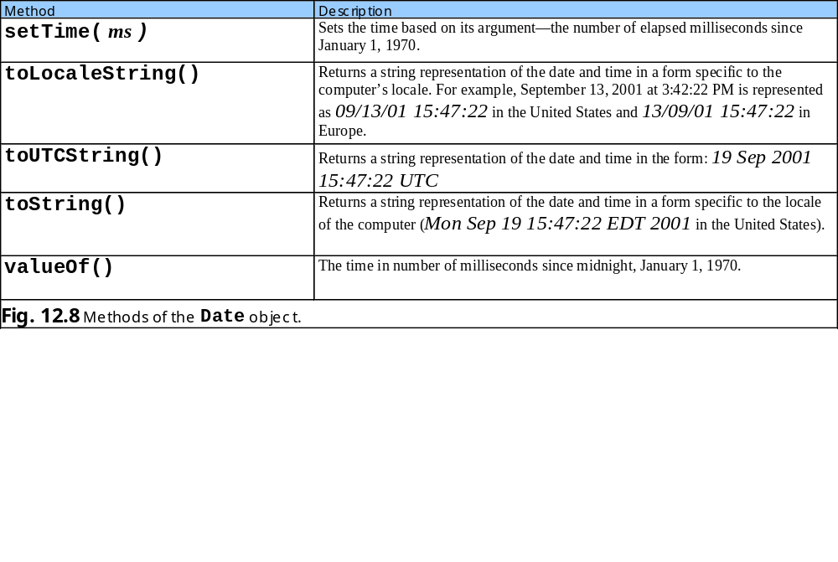
12.5 Date Object

Slide 18
DateTime.html
<!-- Date and Time Methods -->
8 <html xmlns = "http://www.w3.org/1999/xhtml">
9 <head>
10 <title>Date and Time Methods</title>
12 <script type = "text/javascript">
14 var current = new Date();
16 document.writeln(
17 "<h1>String representations and valueOf</h1>" );
18 document.writeln( "toString: " + current.toString() +
19 "<br />toLocaleString: " + current.toLocaleString() +
20 "<br />toUTCString: " + current.toUTCString() +
21 "<br />valueOf: " + current.valueOf() );
23 document.writeln(
24 "<h1>Get methods for local time zone</h1>" );
25 document.writeln( "getDate: " + current.getDate() +
26 "<br />getDay: " + current.getDay() +
27 "<br />getMonth: " + current.getMonth() +
28 "<br />getFullYear: " + current.getFullYear() +
29 "<br />getTime: " + current.getTime() +
30 "<br />getHours: " + current.getHours() +
31 "<br />getMinutes: " + current.getMinutes() +
32 "<br />getSeconds: " + current.getSeconds() +
33 "<br />getMilliseconds: " +

Slide 19
DateTime.html
34 current.getMilliseconds() +
35 "<br />getTimezoneOffset: " +
36 current.getTimezoneOffset() );
37
38 document.writeln("<h1>Specifying arguments for a new Date</h1>" );
40 var anotherDate = new Date( 2001, 2, 18, 1, 5, 0, 0 );
41 document.writeln( "Date: " + anotherDate );
42
43 document.writeln(
44 "<h1>Set methods for local time zone</h1>" );
45 anotherDate.setDate( 31 );
46 anotherDate.setMonth( 11 );
47 anotherDate.setFullYear( 2001 );
48 anotherDate.setHours( 23 );
49 anotherDate.setMinutes( 59 );
50 anotherDate.setSeconds( 59 );
51 document.writeln( "Modified date: " + anotherDate );
52 // -->
53 </script>
54
55 </head><body></body>
56 </html>

Slide 20
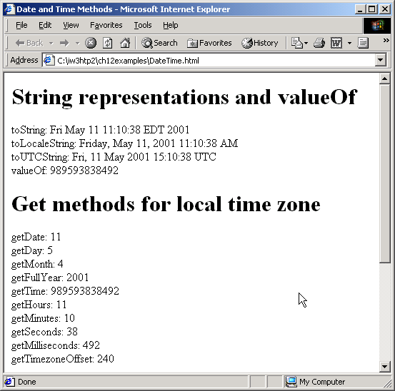
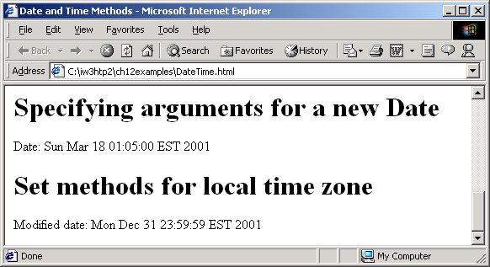
Program Output

Slide 21
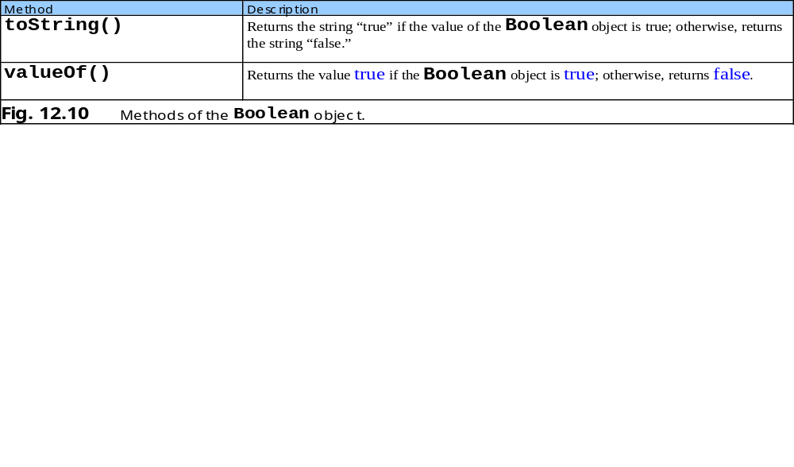
12.6 Boolean and Number Objects

Slide 22
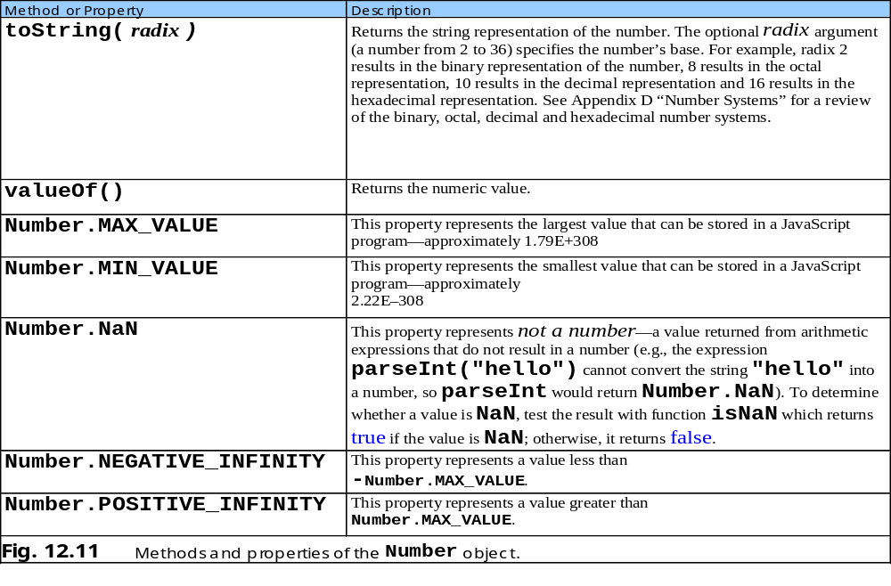
12.6 Boolean and Number Objects

