Slide 1
Learning JavaScript

Slide 2
Setting up
To start programming with JavaScript, you need a text editor and a web browser
JavaScript console is used to display messages from your programs, and it will also help you find mistakes
Chrome :
■ Select View ➤ Developer ➤ JavaScript Console.
Firefox :
■ Select Tools ➤ Web Developer ➤ Web Console.

Slide 3
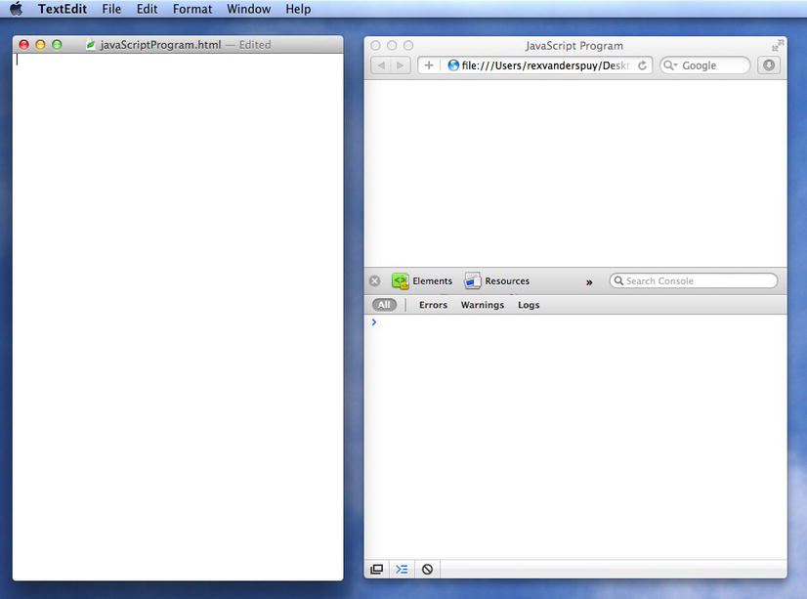
Text editor, the web browser, and the console

Slide 4
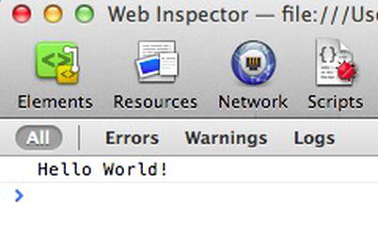
Displaying messages in the console
<!doctype html>
<title>Display console output</title>
<script>
console.log("Hello World!");
</script>
Save this with the file name displayConsoleOutput.html.
Open this file in the web browser.

Slide 5
<script>
... add JavaScript here
</script>
A directive is an action that you want to perform. You can always spot a directive because it ends with a semicolon. The semicolon tells the program, “Do this now!”
console.log("Hello World!");

Slide 6
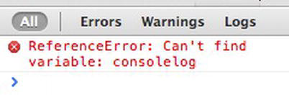
Error message

Slide 7
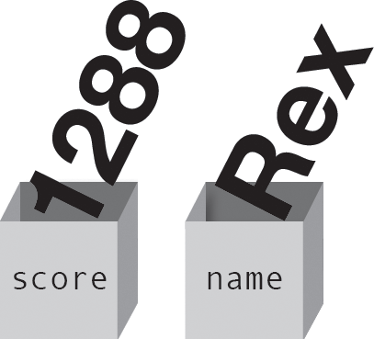
Variables
Figure 2-4 . Variables are boxes that store information

Slide 8
var score;
score = 128;
var score = 1288;
var number = 12;
console.log(number);
var number = 4 + 6;
console.log(number);

Slide 9
var firstNumber = 4;
var secondNumber = 3;
var total = firstNumber + secondNumber;
//Display the total
console.log(total);
var firstNumber = 4;
var secondNumber = 3;
var total = firstNumber + secondNumber;

Slide 10
longer comment
/*
Whatever is between
this set of characters is a comment
and won’t be run as JavaScript code
*/
//Display the total

Slide 11
mathematical operators
var firstNumber = 4;
var secondNumber = 3;
//Mathematical operations
var total = firstNumber + secondNumber;
var product = firstNumber * secondNumber;
var quotient = firstNumber / secondNumber;
var difference = firstNumber - secondNumber;
//Display the total
console.log(total);
//Display the product
console.log(product);
//Display the quotient
console.log(quotient);
//Display the difference
console.log(difference);

Slide 12
program displays in the console:
7
12
1.3333333333333333
1
1

Slide 13
Working with strings
var message = "Hungry hippo";
console.log(message);
var firstWord = "Hungry";
var secondWord = "hippo";
var combinedWords = firstWord + secondWord;
console.log(combinedWords);
This displays:
Hungryhippo

Slide 14
Working with true or false variables
var universeEaten = false;
universeEaten = true;
//Initialize the variable to false when the game starts
var universeEaten = false;
//Change it to true later in the game
universeEaten = true;
//Display its value
console.log(universeEaten);

Slide 15
Decision making
if(fuel > 5)
{
live = true;
}
else
{
live = false;
}

Slide 16
var firstNumber = 10;
var secondNumber = 12;
if(firstNumber === secondNumber)
{
console.log("The numbers are the same");
}
else
{
console.log("The numbers are different");
}

Slide 17
var animal = "cat";
if(animal === "horse")
{
console.log("It's a horse");
}
else if(animal === "mouse")
{
console.log("It's a mouse");
}
else if(animal === "cat")
{
console.log("It's a cat");
}
else
{
console.log("I don't know what it is");
}

Slide 18
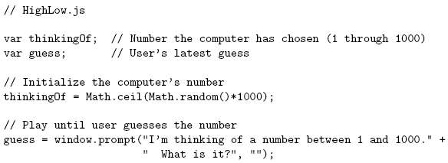
Basic JavaScript Syntax

Slide 19
Basic JavaScript Syntax
Notice that there is no main() function/method

Slide 20
Basic JavaScript Syntax
Comments like Java/C++ (/* */ also allowed)

Slide 21
Basic JavaScript Syntax
Variable declarations:
Not required
Data type not specified

Slide 22
Basic JavaScript Syntax
Semi-colons are usually
not required, but always
allowed at statement end

Slide 23
Basic JavaScript Syntax
Arithmetic operators same as Java/C++

Slide 24
Basic JavaScript Syntax
String concatenation operator
as well as addition

Slide 25
Basic JavaScript Syntax
Arguments can be any expressions
Argument lists are comma-separated

Slide 26
Basic JavaScript Syntax
Object dot notation for method calls as in Java/C++

Slide 27
Basic JavaScript Syntax

Slide 28
Basic JavaScript Syntax
Many control constructs and use of
{ } identical to Java/C++

Slide 29
Basic JavaScript Syntax
Most relational operators syntactically
same as Java/C++

Slide 30
Basic JavaScript Syntax
Automatic type conversion:
guess is String, thinkingOf is Number

Slide 31
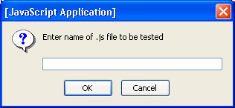
Running Examples
Browse to TestJs.html in examples download package
Enter name of .js file (e.g., HighLow.js) in prompt box:

Slide 32
Variables and Data Types
Type of a variable is dynamic: depends on the type of data it contains
JavaScript has six data types:
Number
String
Boolean (values true and false)
Object
Null (only value of this type is null)
Undefined (data type represented by variable that has been declared but has not yet been assigned a value)
Primitive data types: all but Object

Slide 33
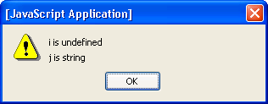
Variables and Data Types
typeof operator returns string related to data type
Syntax: typeof expression
Example:

Slide 34
Variables and Data Types

Slide 35
<script>
document.writeln("<p>john</p>");
document.writeln(typeof 3.14) ;
document.writeln(typeof NaN);
document.writeln( typeof false);
document.writeln( typeof [1,2,3,4]);
document.writeln( typeof {name:'john', age:34}) ;
document.writeln( typeof new Date());
document.writeln( typeof function () {});
document.writeln( typeof myCar);
document.writeln( typeof null);
</script>
o/p john
number number boolean object object object function undefined object

Slide 36
Variables and Data Types
Common automatic type conversions:
Compare String and Number: String value converted to Number
Condition of if or while converted to Boolean
Array accessor (e.g., 3 in records[3]) converted to String
Numeric conversion happens in mathematical functions and expressions automatically.
For example, when division / is applied to non-numbers:
alert( "6" / "2" ); // 3, strings are converted to numbers

Slide 37
Variables and Data Types
"2" > "12" true
When comparing two strings, "2" will be greater than "12", because (alphabetically) 1 is less than 2.
When comparing a string with a number, JavaScript will convert the string to a number when doing the comparison.
An empty string converts to 0. A non-numeric string converts to NaN which is always false.

Slide 38
Variables and Data Types

Slide 39
converting between numbers and Strings:
var count = 10;
var s1 = "" + count; // "10"
var s2 = count + " bananas, ah ah ah!"; // "10 bananas, ah ah ah!"
var n1 = parseInt("42 is the answer");// 42
var n1 = Number("42 is the answer");//NaN
var n1 = Number("42");//42
var n2 = parseFloat("booyah"); // NaN

Slide 40
Variables and Data Types
Special Number values (“Not a Number” and number too large to represent)
x=5
x == 8 false
x == 5 true
x == "5“ true
x === 5 true
x === "5" false

Slide 41
Variables and Data Types
var b=""+a //undefined
var b=a+1 //NaN

Slide 42
Variables and Data Types
Strings used to name variables are called identifiers
Syntax rules for identifiers:
Must begin with letter or underscore ( _ )
Must contain only letters, underscores, and digits (or certain other characters)
Must not be a reserved word
Case sensitive

Slide 43
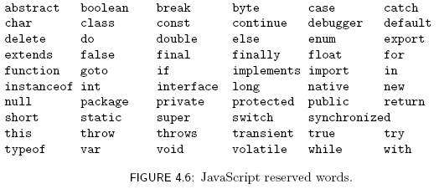
Variables and Data Types

Slide 44

Variables and Data Types
A variable will automatically be created if a value is assigned to an undeclared identifier:
Recommendation: declare all variables
Facilitates maintenance
Avoids certain exceptions
var is not
required

Slide 45
JavaScript Statements
Expression statement: a statement that consists entirely of an expression
Typical expression statements: assignment and increment statements
Block statement: one or more statements enclosed in { } braces
Keyword statement: statement beginning with a keyword, e.g., var or if

Slide 46
JavaScript Statements
var syntax:
Java-like keyword statements:
Comma-separated declaration list with
optional initializers

Slide 47
JavaScript Statements
JavaScript
keyword
statements
are very similar
to Java with
small exceptions

Slide 48
JavaScript Statements

Slide 49
JavaScript Statements

Slide 50
JavaScript Statements

Slide 51
JavaScript Operators
Operators are used to create compound expressions from simpler expressions
Operators can be classified according to the number of operands involved:
Unary: one operand (e.g., typeof i)
Prefix or postfix (e.g., ++i or i++ )
Binary: two operands (e.g., x + y)
Ternary: three operands (conditional operator)

Slide 52
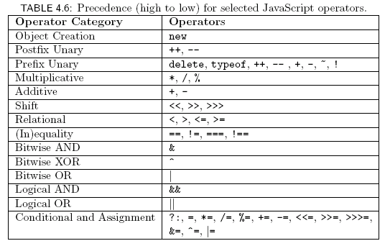
JavaScript Operators

Slide 53
JavaScript Operators
Associativity:
Assignment, conditional, and prefix unary operators are right associative: equal-precedence operators are evaluated right-to-left:
Other operators are left associative: equal-precedence operators are evaluated left-to-right

Slide 54
JavaScript Operators: Automatic Type Conversion
Binary operators +, -, *, /, % convert both operands to Number
Exception: If one of operands of + is String then the other is converted to String
Relational operators <, >, <=, >= convert both operands to Number
Exception: If both operands are String, no conversion is performed and lexicographic string comparison is performed

Slide 55
JavaScript Operators: Automatic Type Conversion
Operators ==, != convert both operands to Number
Exception: If both operands are String, no conversion is performed (lexicographic comparison)
Exception: values of Undefined and Null are considered to be equal
Exception: instance of the Date built-in object is converted to String instead of Number (and host object conversion is implementation dependent)
Exception: two Objects are equal only if they are references to the same object

Slide 56
JavaScript Operators: Automatic Type Conversion
Operators ===, !== are strict:
Two operands are === only if they are of the same type (without conversion) and have exactly the same value
“Same value” for objects means that the operands are references to the same object
Unary +, - convert their operand to Number
Logical &&, ||, ! convert their operands to Boolean (normally)

Slide 57
JavaScript Strings
String literals can be single- or double-quoted
Common escape characters within Strings
\n newline
\” escaped double quote (also \’ for single)
\\ escaped backslash
\uxxxx represents any 16-bit Unicode character value (where xxxx are four hexadecimal digits)

Slide 58
JavaScript Functions
Function declaration syntax

Slide 59
JavaScript Functions
Function declaration syntax
Declaration
always begins
with keyword
function,
no return type

Slide 60
JavaScript Functions
Function declaration syntax
Identifier representing
function’s name

Slide 61
JavaScript Functions
Function declaration syntax
Formal parameter list

Slide 62
JavaScript Functions
Function declaration syntax
One or more statements representing function body

Slide 63
JavaScript Functions
Function call syntax

Slide 64
JavaScript Functions
Function call syntax
Function call is an expression, therefore can
be used on right-hand side of assignments,
as expression statement

Slide 65
JavaScript Functions
Function call syntax
Function name

Slide 66
JavaScript Functions
Function call syntax
Argument list

Slide 67
JavaScript Functions
Function call semantics:

Slide 68
JavaScript Functions
Function call semantics:
Argument value(s)
associated with corresponding
formal parameters

Slide 69
JavaScript Functions
Function call semantics:
Expression(s) in body
evaluated as if formal
parameters are variables
initialized by argument
values

Slide 70
JavaScript Functions
Function call semantics:
If final statement executed
is a return-value statement, then value of its expression becomes value of the function call

Slide 71
JavaScript Functions
Function call semantics:
Value of function call is then used
in larger expression containing
function call.

Slide 72
JavaScript Functions
Function call semantics details:
Arguments:
May be expressions:
Object’s effectively passed by reference (more later)
Formal parameters:
May be assigned values, argument is not affected (see example at the end of page 210)
Return value:
If last statement executed is not a return-value statement, then returned value is of type Undefined

Slide 73
JavaScript Functions
Number mismatch between argument list and formal parameter list:
More arguments: excess ignored
Fewer arguments: remaining parameters are given Undefined value

Slide 74
JavaScript Functions
Local vs. global variables
Global variable: declared outside any function

Slide 75
JavaScript Functions
Local vs. global variables
Local
variable
declared
within
a function

Slide 76
JavaScript Functions
Local vs. global variables
Local
declaration
shadows
corresponding
global
declaration
Output is 6

Slide 77
JavaScript Functions
Local vs. global variables
In browsers,
global
variables
(and functions)
are stored as properties
of the window built-in object.
Output is 7

Slide 78
JavaScript Functions
Recursive functions
Recursion (function calling itself, either directly or indirectly) is supported
C++ static variables are not supported
Order of declaration of mutually recursive functions is unimportant
If one function calls another function, it does not matter which function is declared first in the program

Slide 79
JavaScript Functions
Explicit type conversion supplied by built-in functions
Boolean(), String(), Number()
Each takes a single argument of any data type, and returns a value of the specified type by applying the appropriate rules from Table 4.2, 4.3, or 4.4 (given earlier)

Slide 80
JavaScript Operators
Bit operators
Same set as Java:
Bitwise NOT, AND, OR, XOR (~, &, |, ^)
Shift operators (<<, >>, >>>)
Semantics:
Operands converted to Number, truncated to integer if float, truncated to low-order 32 bits
Operators then applied as if in machine 32-bit registers, result treated as signed two’s complement 32-bit integer
Result of >>> (unsigned right shift) treated as unsigned, while others treated as signed

Slide 81


JavaScript Operators
Example bit operators:
-2
4294967294 (2³² – 2)

Slide 82
JavaScript Numbers
Syntactic representations of Number
Integer (42) and decimal (42.0)
Scientific notation (-12.4e12)
Hexadecimal (0xfa0)
Internal representation
Number values are represented using 64-bit floating point format that provides approximately 16 decimal digits of precision
Approximate range of magnitudes
Smallest: 10⁻³²³
Largest: 10³⁰⁸ (Infinity if literal is larger)

Slide 83
Object Introduction
An object is a set of properties
A property consists of a unique (within an object) name with an associated value
The type of a property depends on the type of its value and can vary dynamically
prop is Boolean
prop is now String
prop is now Number

Slide 84
Object Introduction
There are no classes in JavaScript
Instead, properties can be created and deleted dynamically
Create an object o1
Create property testing
Delete testing property

Slide 85
Property Creation
Assignment to a non-existent (even if inherited) property name creates the property:
Object initializer notation can be used to create an object and one or more properties in a single statement:

Slide 86
Enumerating Properties
Special for-in statement used to iterate through all properties of an object:
Produces three
alert boxes
each with one
of the names kim, sam, or lynn;
However, the order in which they appear
is implementation-dependent.

Slide 87
<script>
var txt = "";
var person = {fname:"John", lname:"Doe", age:25};
var x;
for (x in person) {
txt += person[x] + " ";
}
document.writeln (txt);
o/p John Doe 25

Slide 88
Accessing Property Values
The JavaScript object dot notation is actually shorthand for a more general associative array notation in which Strings are array indices:
Expressions can supply property names:
Converted to String
if necessary

Slide 89
Object Creation
Objects are created using new expression
A constructor is a function
When called via new expression, a new empty Object is created and passed to the constructor along with the argument values
Constructor performs initialization on object
Can add properties and methods to object
Constructor and argument list

Slide 90
Object Creation
The Object() built-in constructor
Does not add any properties or methods directly to the object
Adds object to hierarchy so that it inherits several generic methods including default toString() and valueOf() methods (used when converting the object to String and Number values, respectively)

Slide 91
Object Values
Value of type Object is reference (pointer) to object, not the actual object itself:

Slide 92
Object Values
Value of type Object is reference (pointer) to object, not the actual object itself:
o2 is another
name for o1

Slide 93
Object Values
Value of type Object is reference (pointer) to object, not the actual object itself:
o1 is
changed

Slide 94
Object Values
Value of type Object is reference (pointer) to object, not the actual object itself:
Output is Hello World!

Slide 95
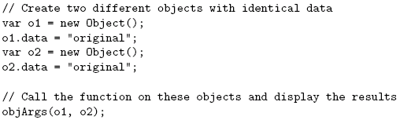
Object Values
Object argument values are references
...}

Slide 96
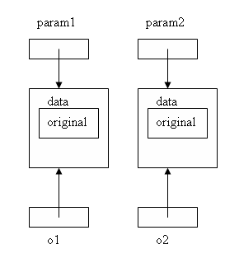
Object Values
Object argument values are references

Slide 97
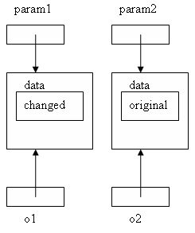
Object Values
Object argument values are references

Slide 98
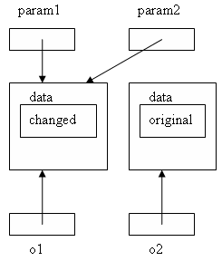
Object Values
Object argument values are references

Slide 99
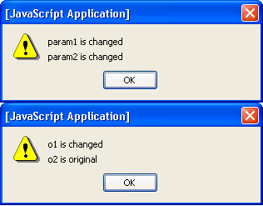
Object Values
Object argument values are references

Slide 100
Object Methods
JavaScript represents every function as an Object value. That is,
When JavaScript processes a function declaration, it creates a specialized object that represents the function.
A variable that has the same name as the function is also created, and a reference to the function object is assigned to this variable.
A method is a function that has been assigned as the value of a property of an object.

Slide 101
Object Methods

Slide 102
Object Methods
Creates global variable named leaf with function value

Slide 103
Object Methods
Creates isLeaf() method that is
defined by leaf() function

Slide 104
Object Methods
Refers to object that “owns” method when
leaf() is called as a method

Slide 105
Object Methods

Slide 106
Object Methods
Creates two objects each with
method isLeaf()

Slide 107
Object Methods
Calls to isLeaf() method

Slide 108
Object Methods
Original version: leaf() can be called as function, but we only want a method

Slide 109
Object Methods
Alternative:
Function expression is syntactically
the same as function declaration but
does not produce a global variable.

Slide 110

Object Methods
Alternative

Slide 111
Object Constructors
User-defined constructor is just a function called using new expression:
Object created using a constructor is known as an instance of the constructor
Constructor

Slide 112
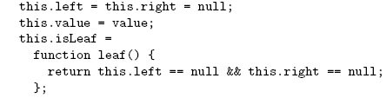
Object Constructors
Original
function
Function
intended
to be used
as constructor

Slide 113
Object Constructors
Object is
constructed
automatically
by new
expression

Slide 114
Object Constructors
Object
referenced
using this
keyword

Slide 115
Object Constructors
No need
to return
initialized
object

Slide 116
Object Constructors
Object created using a constructor is known as an instance of the constructor
instanceof operator can be used to test this relationship:
Instances of BTNode
Evaluates to true

Slide 117
JavaScript Arrays
The Array built-in object can be used to construct objects with special properties and that inherit various methods
ary1
length (0)
Properties
Inherited
methods
toString()
sort()
shift()
…

Slide 118
JavaScript Arrays
The Array built-in object can be used to construct objects with special properties and that inherit various methods
ary2
length (3)
“0” (4)
“1” (true)
“2” (“OK”)
Accessing array elements:
ary2[1] ary2[“1”]
ary2.1
Elements
of array
Must follow identifier
syntax rules
toString()
…

Slide 119

JavaScript Arrays
The Array constructor is indirectly called if an array initializer is used
Array initializiers can be used to create multidimensional arrays
ttt[1][2]

Slide 120
JavaScript Arrays
Changing the number of elements:
Creates a new element dynamically,
increases value of length
ary2
length (4)
“0” (4)
“1” (true)
“2” (“OK”)
“3” (-12.6)
toString()
…

Slide 121
JavaScript Arrays
Changing the number of elements:
Decreasing length can delete elements
ary2
length (2)
“0” (4)
“1” (true)
toString()
…

Slide 122
JavaScript Arrays
Value of length is not necessarily the same as the actual number of elements
var ary4 = new Array(200);
Calling constructor with single argument
sets length, does not create elements
ary4
length (200)
toString()
sort()
shift()
…

Slide 123
JavaScript Arrays

Slide 124
JavaScript Arrays

Slide 125
JavaScript Arrays
Argument to sort is a function that takes two arguments representing array elements and returns a Number value

Slide 126
JavaScript Arrays
Negative return value indicates that the element corresponding to the first argument should come before the element corresponding to the second in the sorted array

Slide 127
JavaScript Arrays
Add element with value 2.5 at
index 2, shift existing elements

Slide 128
JavaScript Arrays
Remove 3 elements starting
at index 5

Slide 129

JavaScript Arrays

Slide 130
JavaScript Arrays
push() adds an element to the end of the
array

Slide 131
JavaScript Arrays
pop() deletes and returns last
element of the array

Slide 132
JavaScript Arrays
Use shift() instead to remove first element (to implement queue)

Slide 133
Built-in Objects
The global object
Named window in browsers
Has properties representing all global variables
Other built-in objects are also properties of the global object
Ex: initial value of window.Array is Array object
Has some other useful properties
Ex: window.Infinity represents Number value

Slide 134
Built-in Objects
The global object and variable resolution:
This is why we can refer to built-in objects (Object, Array, etc.) without prefixing with window.
i = 42;
What does i refer to?
Search for local variable or formal parameter named i
If none found, see if global object (window) has property named i

Slide 135
Built-in Objects
String(), Boolean(), and Number() built-in functions can be called as constructors, created “wrapped” Objects:
Instances inherit valueOf() method that returns wrapped value of specified type:
Output is “number”

Slide 136
Built-in Objects
Other methods inherited by Number instances:
Outputs
5.63
5.63e+0
101.101
Base 2

Slide 137
Built-in Objects
Properties provided by Number built-in object:
Number.MIN_VALUE: smallest (absolute value) possible JavaScript Number value
Number.MAX_VALUE: largest possible JavaScript Number value

Slide 138
Built-in Objects

Slide 139
Built-in Objects
Instances of String have a length property (number of characters)
JavaScript automatically wraps a primitive value of type Number or String if the value is used as an object:
Output is “Str”

Slide 140
Built-in Objects
The Date() built-in constructor can be used to create Date instances that represent the current date and time
Often used to display local date and/or time in Web pages
Other methods: toLocaleDateString() , toLocaleTimeString(), etc.
var now = new Date();
window.alert(“Current date and time: “ + now.toLocaleString());

Slide 141

Built-in Objects
valueOf() method inherited by Date instances returns integer representing number of milliseconds since midnight 1/1/1970
Automatic type conversion allows Date instances to be treated as Numbers:

Slide 142
Built-in Objects
Math object has methods for performing standard mathematical calculations:
Also has properties with approximate values for standard mathematical quantities, e.g., e ( Math.E ) and π (Math.PI)

Slide 143
Built-in Objects

Slide 144
JavaScript Regular Expressions
A regular expression is a particular representation of a set of strings
Ex: JavaScript regular expression representing the set of syntactically-valid US telephone area codes (three-digit numbers):
\d represents the set {“0”, “1”, …, “9”}
Concatenated regular expressions represent the “concatenation” (Cartesian product) of their sets

Slide 145
JavaScript Regular Expressions
Using regular expressions in JavaScript

Slide 146
JavaScript Regular Expressions
Using regular expressions in JavaScript
Variable containing string to be tested

Slide 147
JavaScript Regular Expressions
Using regular expressions in JavaScript
Regular expression as String (must escape \)

Slide 148
JavaScript Regular Expressions
Using regular expressions in JavaScript
Built-in constructor

Slide 149
JavaScript Regular Expressions
Using regular expressions in JavaScript
Method inherited by RegExp instances:
returns true if the argument contains a
substring in the set of strings represented by
the regular expression

Slide 150
JavaScript Regular Expressions
Using regular expressions in JavaScript
Represents beginning of string
Represents end of string
This expression matches only strings with
exactly three digits (no other characters,
even white space)

Slide 151
JavaScript Regular Expressions
Using regular expressions in JavaScript
Alternate syntax:
Represents all strings that begin
with three digits
Regular expression literal.
Do not escape \.

Slide 152
JavaScript Regular Expressions
Simplest regular expression is any character that is not a special character:
Ex: _ is a regular expression representing {“_”}
Backslash-escape d special character is also a regular expression
Ex: \$ represents {“$”}

Slide 153
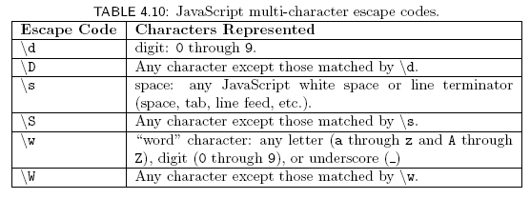
JavaScript Regular Expressions
Special character . (dot) represents any character except a line terminator
Several escape codes are regular expressions representing sets of chars:

Slide 154
JavaScript Regular Expressions
Three types of operations can be used to combine simple regular expressions into more complex expressions:
Concatenation
Union (|)
Kleene star (*)
XML DTD content specification syntax based in part on regular expressions

Slide 155
JavaScript Regular Expressions
Concatenation
Example:
String consisting entirely of four characters:
Digit followed by a . followed by
A single space followed by
Any “word” character
Quantifier shorthand syntax for concatenation:

Slide 156
JavaScript Regular Expressions
Union
Ex:
Union of set of strings represented by regular expressions
Set of single-character strings that are either a digit or a space character
Character class: shorthand for union of one or more ranges of characters
Ex: set of lower case letters
Ex: the \w escape code class

Slide 157
JavaScript Regular Expressions
Unions of concatenations
Note that concatenation has higher precedence than union
Optional regular expression

Slide 158
JavaScript Regular Expressions
Kleene star
Ex: any number of digits (including none)
Ex:
Strings consisting of only “word” characters
String must contain both a digit and a letter (in either order)

