Slide 1
Chapter 3
Style Sheets:
CSS

Slide 2
Motivation
HTML markup can be used to represent
  Semantics: h1 means that an element is a top-level heading
  Presentation: h1 elements look a certain way
It’s advisable to separate semantics from presentation because:
  It’s easier to present documents on multiple platforms (browser, cell phone, spoken, …)
  It’s easier to generate documents with consistent look
  Semantic and presentation changes can be made independently of one another (division of labor)
  User control of presentation is facilitated

Slide 3
Style Sheet Languages
Cascading Style Sheets (CSS)
  Applies to (X)HTML as well as XML documents in general
  Focus of this chapter
Extensible Stylesheet Language (XSL)
  Often used to transform one XML document to another form, but can also add style
  XSL Transformations covered in later chapter

Slide 4
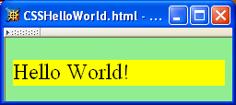
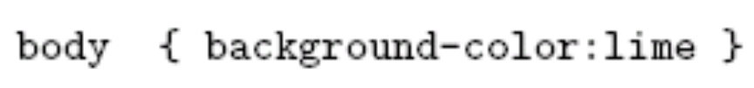
CSS Introduction
A styled HTML document
produced by the style sheet style1.css:

Slide 5
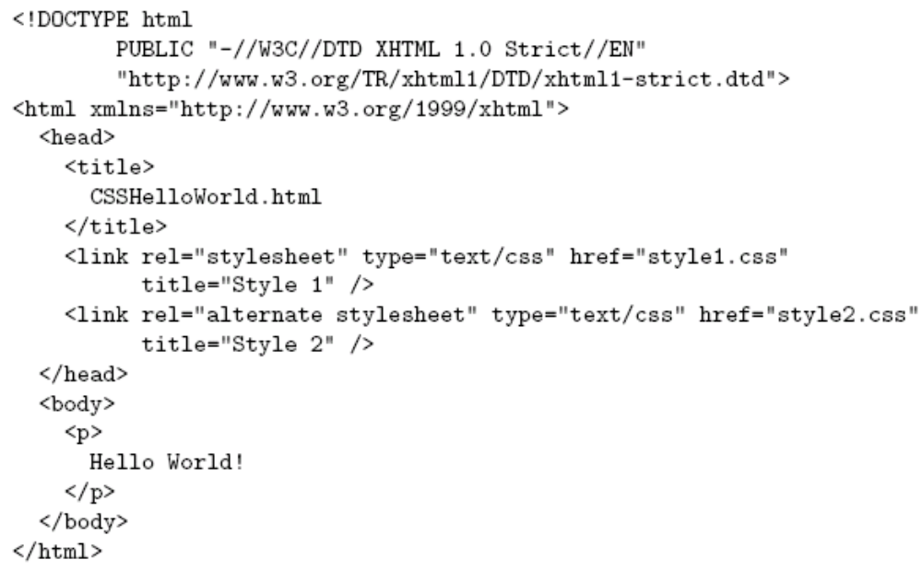
CSS Introduction
link element associates style sheet with doc.

Slide 6
CSS Introduction
type attribute specifies style language used

Slide 7
CSS Introduction
href attribute provides style sheet URL

Slide 8
CSS Introduction
title attribute provides style sheet name

Slide 9
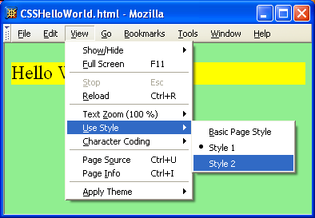
CSS Introduction

Slide 10
CSS Introduction
Alternatively, user selectable style sheets
can be specified

Slide 11
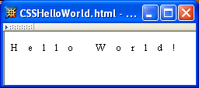
CSS Introduction
A styled HTML document
produced by the style sheet style2.css:

Slide 12
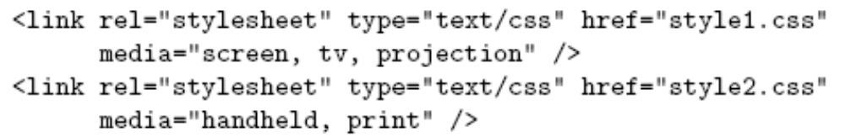
CSS Introduction
Single document can be displayed on multiple media platforms by tailoring style sheets:
This document will be printed differently than it is displayed.

Slide 13
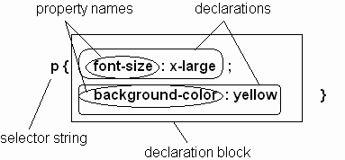
CSS Syntax
Parts of a style rule (or statement)

Slide 14

CSS Syntax:
Selector Strings
Single element type:
Multiple element types:
All element types:
Specific elements by id:

Slide 15
CSS Syntax:
Selector Strings
Single element type:
Multiple element types:
All element types:
Specific elements by id:
type selector

Slide 16
CSS Syntax:
Selector Strings
Single element type:
Multiple element types:
All element types:
Specific elements by id:
universal selector

Slide 17
CSS Syntax:
Selector Strings
Single element type:
Multiple element types:
All element types:
Specific elements by id:
ID selector

Slide 18
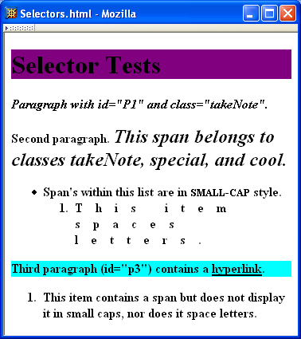
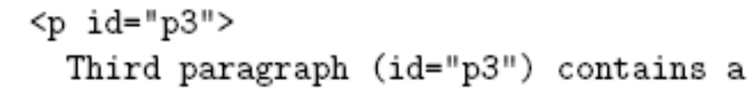
CSS Syntax:
Selector Strings

Slide 19
CSS Syntax:
Selector Strings
Elements belonging to a style class:
  Any element that specifies takeNote (without period) as the value of its class attribute will have the property specified in the above style rule.
  An element can be assigned to multiple classes:
Restricting selector to certain element and class:
  This style rule applies only to span elements that have class value of special
class selector

Slide 20
CSS Syntax:
Selector Strings
Elements belonging to a style class:
  Referencing a style class in HTML:
Elements of a certain type and class:
this span element belongs to three style classes

Slide 21
CSS Syntax:
Selector Strings
Elements belonging to a style class:
  Referencing a style class in HTML:
Elements of a certain type and class:
This rule applies only to span elements that belong to class special

Slide 22
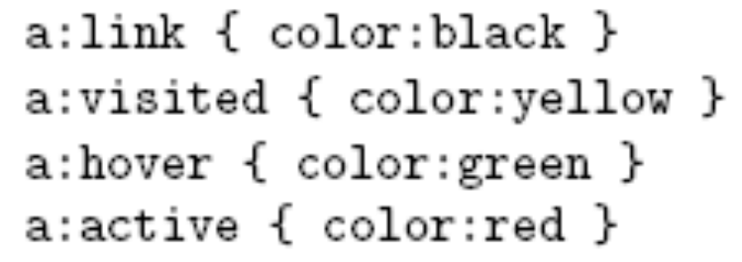
CSS Syntax:
Selector Strings
Source anchor elements:
Descendants selectors:
pseudo-class selectors

Slide 23
CSS Syntax:
Selector Strings
Source anchor elements:
Descendants selectors:
Style rule applies to li element that is

Slide 24
CSS Syntax:
Selector Strings
Source anchor elements:
Descendants selectors:
Style rule applies to li element that is
part of the content of an ol element

Slide 25
CSS Syntax:
Selector Strings
Source anchor elements:
Descendants selectors:
Style rule applies to li element that is
part of the content of an ol element
that is part of the content of a ul element

Slide 26
CSS Syntax
Style rules covered thus far follow ruleset syntax
At-rule is a second type of rule
  Import one style sheet file into another one
  Reads style rules from specified URL
  Must appear at beginning of style sheet
URL relative to URL of the style sheet file containing this import at-rule

Slide 27
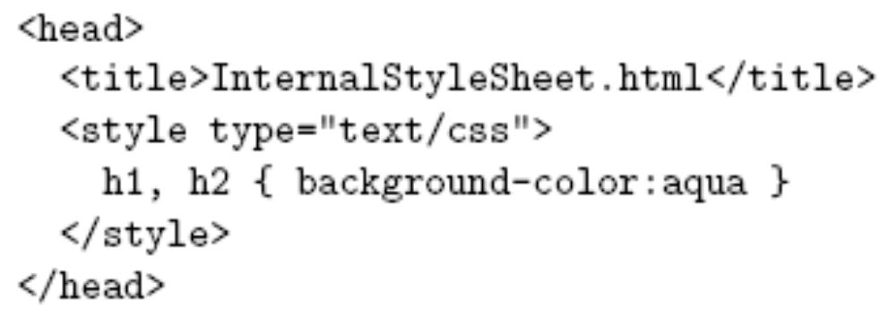
Style Sheets and HTML
Style sheets referenced by link HTML element are called external style sheets
Style sheets can be embedded directly in HTML document using style element
Most HTML elements have style attribute (value is list of style declarations)

Slide 28
Style Sheets and HTML
Rules of thumb:
  Use external style sheets to define site-wide style
  Prefer style sheets (either external or embedded) to style attributes
  XML special characters:
    Must use references in embedded style sheets and style attribute
    Must not use references in external style sheets

Slide 29

CSS Rule Cascade
What if more than one style declaration applies to a property of an element?
The CSS rule cascade determines which style rule’s declaration applies

Slide 30
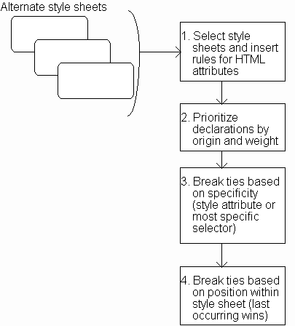
CSS Rule Cascade

Slide 31
CSS Rule Cascade
Select appropriate style sheets based
on user selection and media type.

Slide 32
CSS Rule Cascade
Treat HTML attributes such
as width and height of img as
if defined by style rule instead.

Slide 33
CSS Rule Cascade
Five origin/weight levels:
user/important
author/important
author/normal
user/normal
user agent/normal

Slide 34
CSS Rule Cascade
User can define a style sheet
  Explicitly
  Implicitly (e.g., Edit|Preferences|Appearance)
User/important highest priority in CSS to accommodate users with special needs
  Rules made important by adding “!important”:

Slide 35
CSS Rule Cascade
Specificity:
style attribute
rule with selector:
  ID
  class/pseudo-class
  descendant/element type
  universal
HTML attribute

Slide 36
CSS Rule Cascade
Conceptually, create one
long style sheet. Later
style rules have higher
priority than earlier rules.

Slide 37
CSS Inheritance
What if no style declaration applies to a property of an element?
Generally, the property value is inherited from the nearest ancestor element that has a value for the property
If no ancestor has a value (or the property does not inherit) then CSS defines an initial value that is used

Slide 38
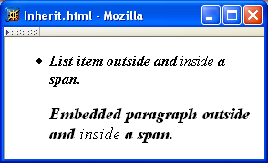
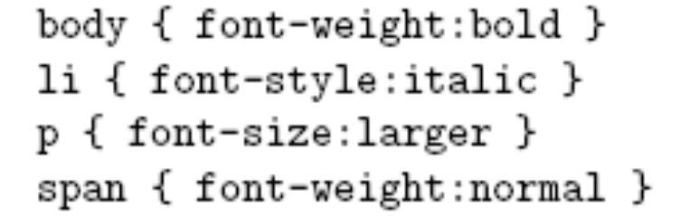
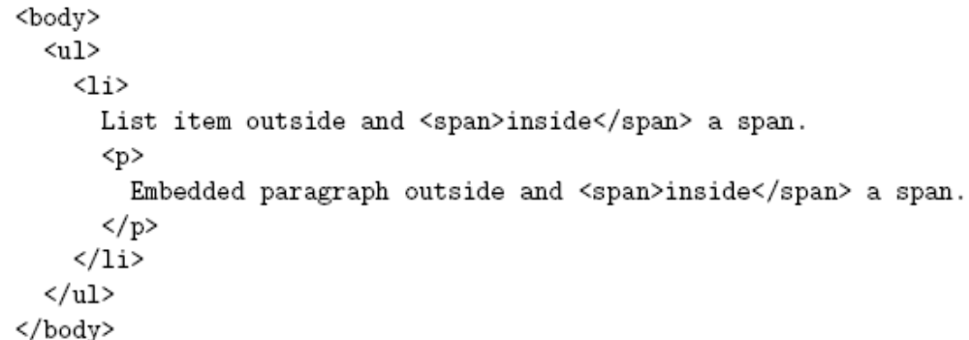
CSS Inheritance

Slide 39
CSS Inheritance
Property values:
  Specified: value contained in declaration
    Absolute: value can be determined without reference to context (e.g., 2cm)
    Relative: value depends on context (e.g., larger)
  Computed: absolute representation of relative value (e.g., larger might be 1.2 x parent font size)
  Actual: value actually used by browser (e.g., computed value might be rounded)

Slide 40
Specified values
User agents must first assign a specified value to a property based on the following mechanisms (in order of precedence):
If the cascade results in a value, use it.
Otherwise, if the value is inherited, use it.
Otherwise use the property's initial value. The initial value of each property is indicated in the property's definition.
Dr. Thomas Tran – CSI3140 Lecture Notes (based on Dr. Jeffrey Jackson’s slides)

Slide 41
Actual value
For example, a user agent may not have a specified font size available, in which case the user agent must approximate the computed value.
Computed values that are transformed to match the current environment are called actual values.
Only actual values are inherited.
Dr. Thomas Tran – CSI3140 Lecture Notes (based on Dr. Jeffrey Jackson’s slides)

Slide 42
body {font-size: 10pt}
h1 {font-size: 120%}
<BODY> <H1>A <EM>large</EM> heading</H1> </BODY>
The computed value of the 'font-size' property for the H1 element is 12pt (120% times 10pt).
If the user agent has the appropriate 12pt font available, 12pt will also be the property's actual value and the EM will inherit that value for the 'font-size' property.
However, if the user agent does not have the 12pt font available, it may assign an actual value of, for example, 11pt to the 'font-size' property of the H1 element. In that case, the EM will inherit a value of 11pt for the same property.
Dr. Thomas Tran – CSI3140 Lecture Notes (based on Dr. Jeffrey Jackson’s slides)

Slide 43
CSS Inheritance
Most properties inherit computed value
  Exception discussed later: line-height
A little thought can usually tell you whether a property inherits or not
  Example: height does not inherit

Slide 44
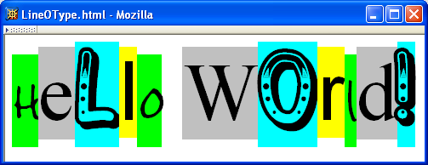
CSS Font Properties
A font is a mapping from code points to glyphs
glyph
character cell
(character’s content area)

Slide 45
CSS Font Properties
A font is a mapping from code points to glyphs
glyphs do not necessary stay inside cells!

Slide 46
CSS Font Properties
A font family is a collection of related fonts (typically differ in size, weight, etc.)
font-family property can accept a list of families, including generic font families
first choice font

Slide 47
CSS Font Properties
A font family is a collection of related fonts (typically differ in size, weight, etc.)
font-family property can accept a list of families, including generic font families
second choice font

Slide 48
CSS Font Properties
A font family is a collection of related fonts (typically differ in size, weight, etc.)
font-family property can accept a list of families, including generic font families
generic, defined by CSS, name is CSS keyword and must not be quoted

Slide 49
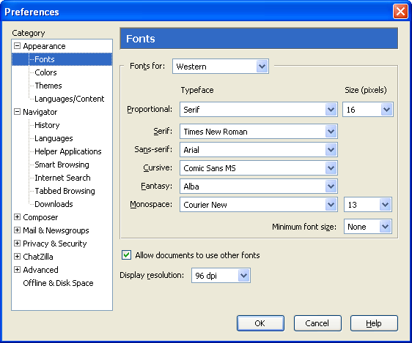
CSS Font Properties
generic
fonts are
system-
specific

Slide 50
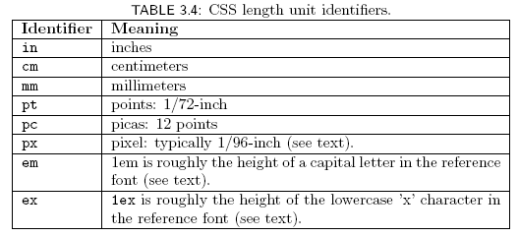
CSS Font Properties
Many properties, such as font-size, have a value that is a CSS length
All CSS length values except 0 need units

Slide 51
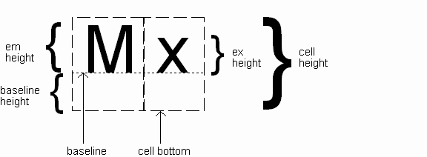
CSS Font Properties
Computed value
of font-size
property

Slide 52
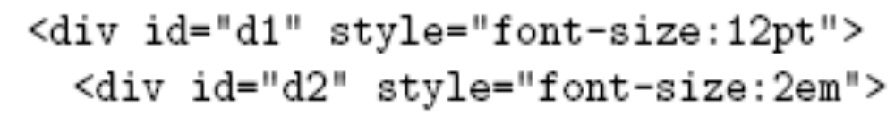
CSS Font Properties
Reference font defines em and ex units
  Normally, reference font is the font of the element being styled
  Exception: Using em/ex to specify value for font-size
parent element’s font is
reference font

Slide 53

CSS Font Properties
Other ways to specify value for
font-size:
  Percentage (of parent font-size)
  Absolute size keyword: xx-small, x-small, small, medium (initial value), large,
  x-large, xx-large
    Browser creates table of actual length corresponding to each of these size key words
    CSS2 recommendation: these keywords should differ by ~ 20%
  Relative size keyword: smaller, larger
    Relative to parent element’s font

Slide 54
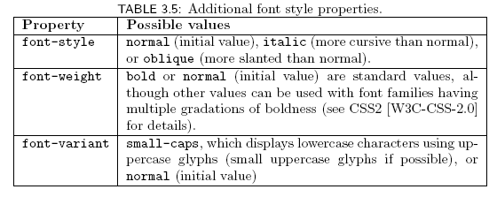
CSS Font Properties
https://developer.mozilla.org/en-US/docs/Web/CSS/font-variant-caps

Slide 55

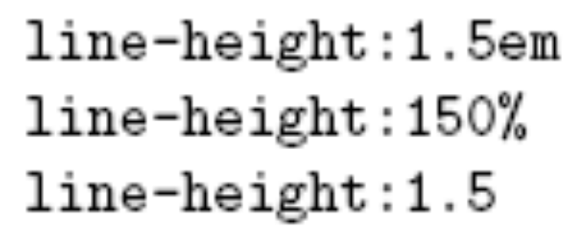
CSS Font Properties
Text is rendered using line boxes
Height of line box given by line-height
  Initial value: normal (i.e., cell height; relationship with em height is font-specific)
  Other values (following are equivalent):
https://developer.mozilla.org/en-US/docs/Web/CSS/line-height

Slide 56
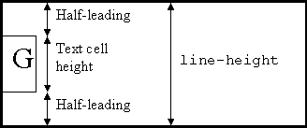
CSS Font Properties
When line-height is greater than cell height:
Inheritance of line-height:
  If normal or a number without units is specified as the value of line-height, then this specified value is inherited rather than the computed value
  For any other specified value, such as 1.5em, the computed value is inherited

Slide 57
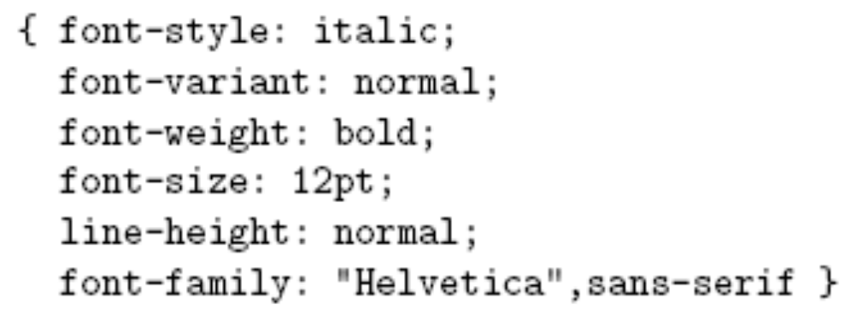
CSS Font Properties
font shortcut property: Allows values to be specified for several properties

Slide 58
CSS Font Properties
font shortcut property:

Slide 59
CSS Font Properties
font shortcut property:

Slide 60
CSS Font Properties
font shortcut property:

Slide 61
CSS Font Properties
font shortcut property:

Slide 62
CSS Font Properties
font shortcut property:
Initial values used if no value specified in font
property list

Slide 63
CSS Font Properties
font shortcut property:
specifying line-height by a slash (/)
style, variant and weight can appear in any order but must appear before font size
size and family are required and order-dependent

Slide 64
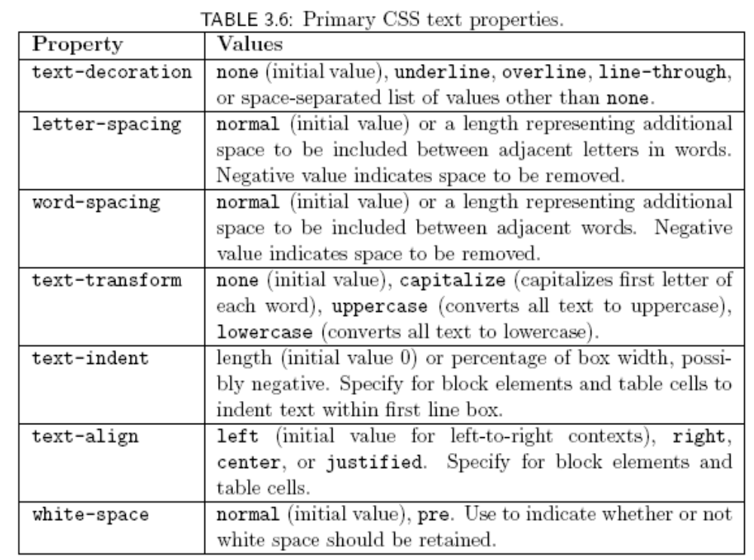
CSS Text Formatting

Slide 65
CSS Text Color
Font color specified by color property
Two primary ways of specifying colors:
  Color name: black, gray, silver, white, red, lime, blue, yellow, aqua, fuchsia, maroon, green, navy, olive, teal, purple, full list at
  http://www.w3.org/TR/SVG11/types.html#ColorKeywords
  red/green/blue (RGB) values

Slide 66
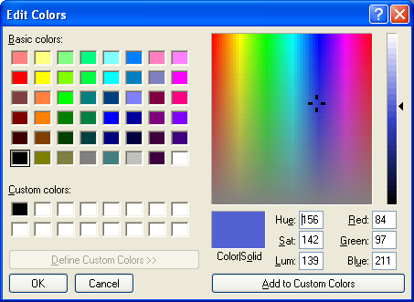
CSS Text Color

Slide 67
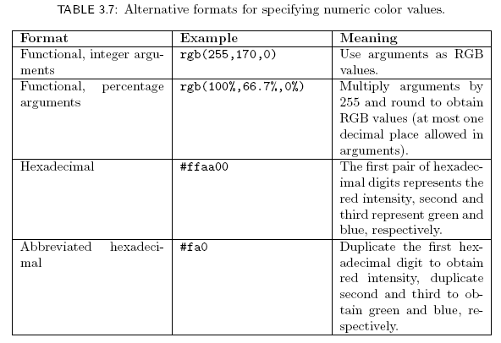
CSS Text Color

Slide 68
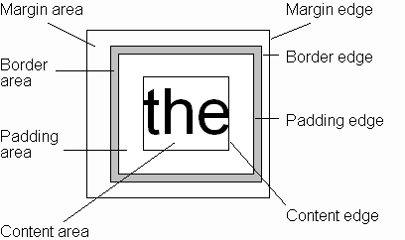
CSS Box Model
Every rendered element occupies a box:
(or outer edge)
(or inner edge)

Slide 69
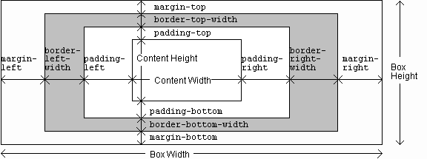
CSS Box Model

Slide 70
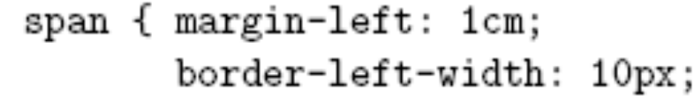
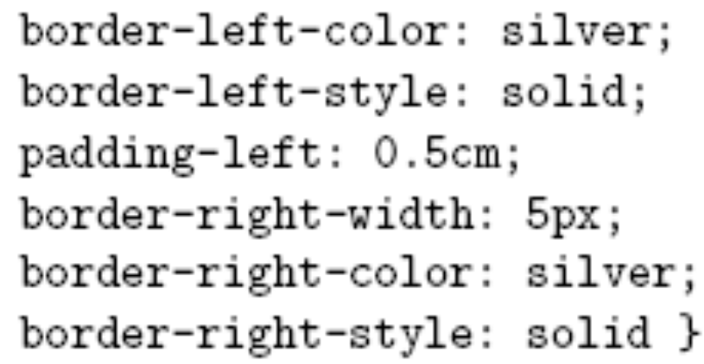
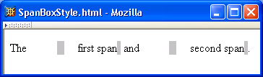
CSS Box Model

Slide 71
<html>
<head>
<style>
div {
border: 1px solid red;
margin-left: 100px;
}
p.ex1 {
margin-left: inherit;
}
</style>
</head>
<body>
<p>Let the left margin be inherited from the parent element:</p>
<div>
<p class="ex1">This paragraph has an inherited left margin (from the div element).</p>
</div>
</body>
</html>
Dr. Thomas Tran – CSI3140 Lecture Notes (based on Dr. Jeffrey Jackson’s slides)

Slide 72
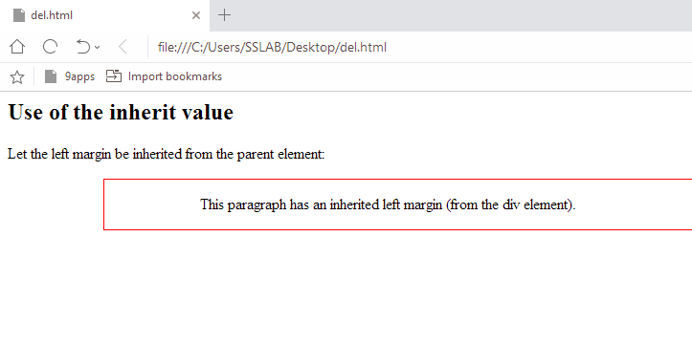
Dr. Thomas Tran – CSI3140 Lecture Notes (based on Dr. Jeffrey Jackson’s slides)

Slide 73
CSS Box Model

Slide 74
CSS Box Model

Slide 75
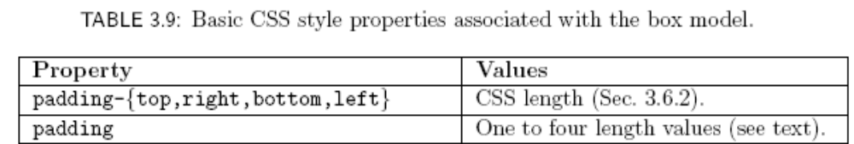
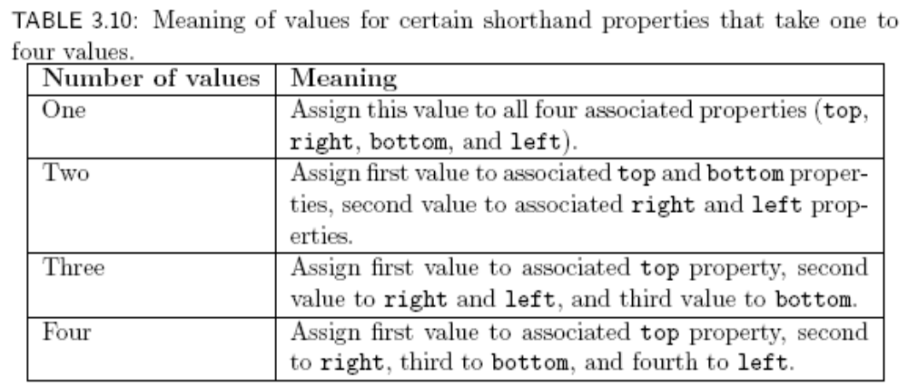
CSS Box Model

Slide 76
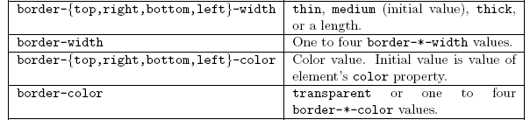
CSS Box Model
This is a shorthand property for setting the width, style, and color of the top, right, bottom, and left border of a box.
h1 { border-bottom: thick solid red }

Slide 77
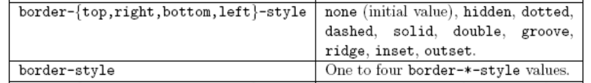
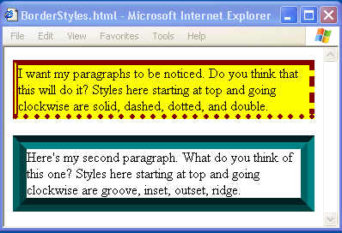
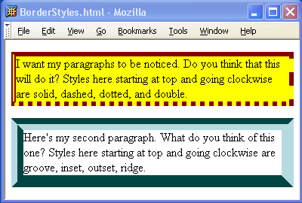
CSS Box Model

Slide 78
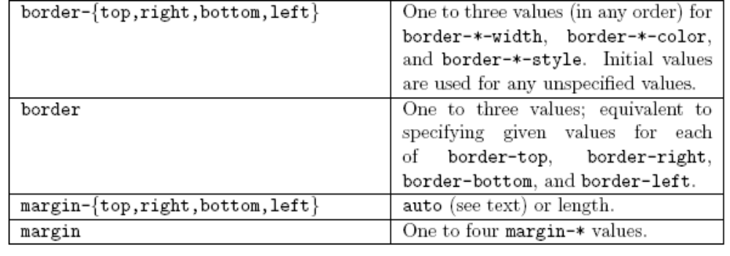
CSS Box Model

Slide 79
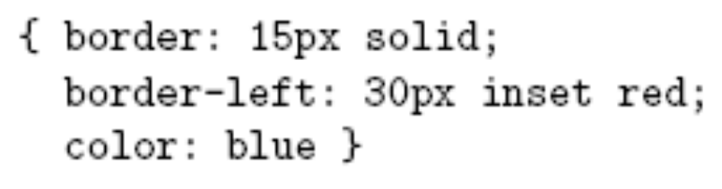
CSS Box Model
If multiple declarations apply to a property, the last declaration overrides earlier specifications
Left border is 30px wide,
inset style, and red

Slide 80
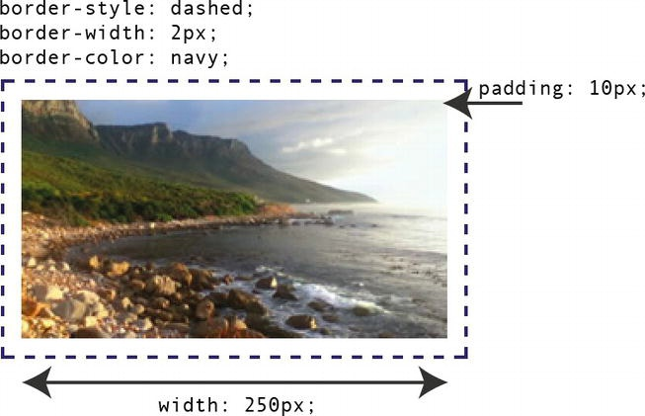
Borders, padding, height, and width

Slide 81
Here’s the CSS code that styles the image in our example.
img
{
width: 250px;
height: auto;
border-style: dashed;
border-width: 2px;
border-color: navy;
padding: 10px;
}

Slide 82
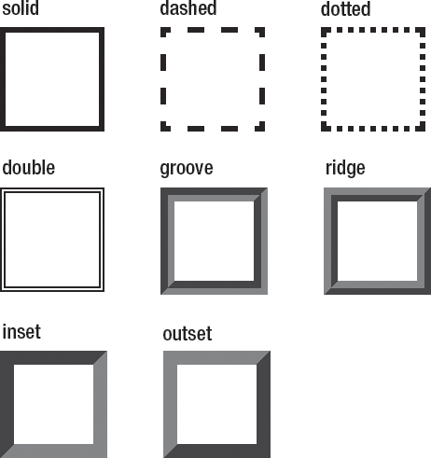
Border styles

Slide 83
padding-top: 10px;
padding-bottom: 20px;
padding-right: 30px;
padding-left: 5px;

Slide 84
Backgrounds
background-color
  Specifies background color for content, padding, and border areas
  Margin area is always transparent
  Not inherited; initial value transparent
background-image
  Specifies (using url() function) image that will be tiled over an element

Slide 85
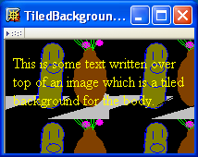
Backgrounds
<body style="background-image:url('CucumberFlowerPot.png')">

Slide 86
CSS images
li { list-style-image: url(“pic.jpg”); }
body { background-image: url(“pic.jpg”); }

Slide 87
Normal Flow Layout
In normal flow processing, each displayed element has a corresponding box
  html element box is called initial containing block and corresponds to entire document
  Boxes of child elements are contained in boxes of parent
  Sibling block elements are laid out one on top of the other
  Sibling inline elements are one after the other

Slide 88
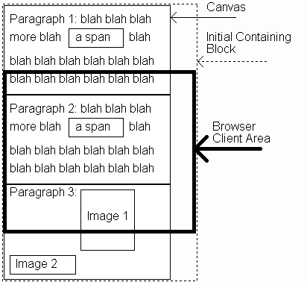
Normal Flow Layout
(body)
(html)

Slide 89
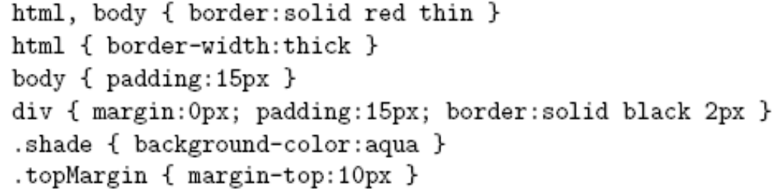
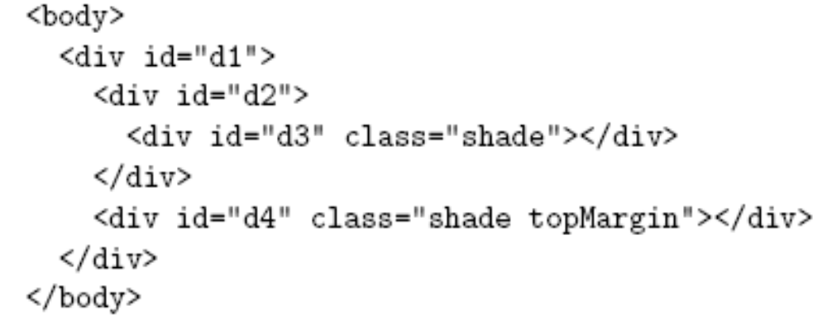
Normal Flow Layout
Block
elements
only

Slide 90
You’ll notice that the body border does not touch the html border.
This is because the Mozilla 1.4 user agent style sheet specifies a nonzero margin value
(apparently about 8 px in Mozilla 1.4 and 10 px in IE6) for the body box,
Dr. Thomas Tran – CSI3140 Lecture Notes (based on Dr. Jeffrey Jackson’s slides)

Slide 91
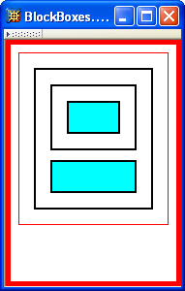
Normal Flow Layout
html
body
div d1
div d2
div d3
div d4
Top edges of
block boxes are
in document order

Slide 92
Normal Flow Layout
What is a “block element”?
  Element with value block specified for its display property
  Standard user agent style sheets define block elements. Typical block elements include html, body, p, pre, div, form, ol, ul, dl, hr, h1 through h6
  Most other elements except li and table-related have value inline specified for the display property

Slide 93
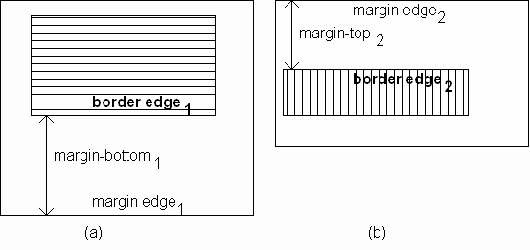
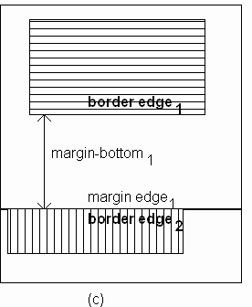
Normal Flow Layout
When blocks stack, adjacent margins are collapsed to the size of the larger margin

Slide 94
Calculating overall dimensions:
When designing our page, we have to calculate how much size a <div> element will consume:
  Total element width = defined width –( left padding + right padding + left border + right border + left margin + right margin)

Slide 95

Normal Flow Layout
Initial value of width property is auto, which for block boxes means to make the content area as wide as possible within margin/padding constraints:
Width of block boxes
increases as browser
client area is widened

Slide 96


Normal Flow Layout
Can also specify CSS length or percentage (of parent’s content width) for width property
By default, width of right margin is adjusted to accommodate a change to width

Slide 97
Normal Flow Layout
Can also specify CSS length or percentage (of parent’s content width) for width property
Centering can be achieved by setting
both margins to auto

Slide 98

Normal Flow Layout
Boxes corresponding to character cells and inline elements are laid out side by side in line boxes that are stacked one on top of the other
Heights based on
content
Character cells aligned by baseline

Slide 99


Normal Flow Layout
Padding/borders/margins affect width but not height of inline boxes

Slide 100

Normal Flow Layout
Specify value for vertical-align to position an inline element within line box:
initial value of vertical-align

Slide 101

Beyond Normal Flow
CSS allows for boxes to be positioned outside the normal flow:
  Relative positioning
span’s shifted backwards relative to normal flow

Slide 102
Beyond Normal Flow
CSS allows for boxes to be positioned outside the normal flow:
  Relative positioning
other span’s are not affected

Slide 103
Beyond Normal Flow
CSS allows for boxes to be positioned outside the normal flow:
  Relative positioning
<span style="background-color:red">&nbsp;&nbsp;&nbsp;&nbsp;
</span><span class="right">Red</span>
<span style="background-color:yellow">&nbsp;&nbsp;&nbsp;&nbsp;
</span><span class="right">Yellow</span>
<span style="background-color:lime">&nbsp;&nbsp;&nbsp;&nbsp;
</span><span class="right">Green</span>
style rules that move span’s
away from normal-flow right edge

Slide 104

Beyond Normal Flow
CSS allows for boxes to be positioned outside the normal flow:
  Float positioning
style rule that “floats” left

Slide 105

Beyond Normal Flow
CSS allows for boxes to be positioned outside the normal flow:
  Float positioning
span taken out of normal
flow and “floated” to the
left of its line box

Slide 106

Beyond Normal Flow
CSS allows for boxes to be positioned outside the normal flow:
  Absolute positioning
style rule that moves span relative to
upper left corner of containing
p element’s box

Slide 107

Beyond Normal Flow
CSS allows for boxes to be positioned outside the normal flow:
  Absolute positioning
span’s removed from
normal flow and
positioned relative
to another box

Slide 108
Beyond Normal Flow
Properties used to specify positioning:
  position: static (initial value), relative, or absolute
    Element is positioned if this property not static
    Properties left, right, top, bottom apply to positioned elements
      Primary values are auto (initial value) or CSS length
  float: none, left, or right
    Applies to elements with static and relative positioning only

Slide 109

Beyond Normal Flow
Float positioning
  Specify value for float property
Floated element becomes a CSS block
element (e.g., can set height and width)

Slide 110
Beyond Normal Flow
Absolute positioning
  Specify location for corner of box relative to positioned containing block
p elements are positioned (but don’t move!)
margin area
padding area
containing
block
This second paragraph has a
note.

Slide 111

Beyond Normal Flow
Absolute positioning
  Specify location for edges of box relative to positioned containing block
  https://learnlayout.com/position.html
  https://css-tricks.com/almanac/properties/p/position/

Slide 112


Beyond Normal Flow
Absolute positioning
10em
padding top
edge
padding left
edge

Slide 113
Beyond Normal Flow
Absolute positioning
8em

Slide 114

Beyond Normal Flow
Absolutely positioned box does not affect positioning of other boxes!
Second absolutely
positioned box
obscures first

Slide 115


CSS Position-Related Properties
z-index: drawing order for overlaid boxes (largest number drawn last)

Slide 116
CSS Position-Related Properties
display: value none means that element and its descendants are not rendered and do not affect normal flow
visibility: value hidden (initial value is visible) means that element and its descendants are not rendered but still do affect normal flow

