Slide 1

React JS

Slide 2
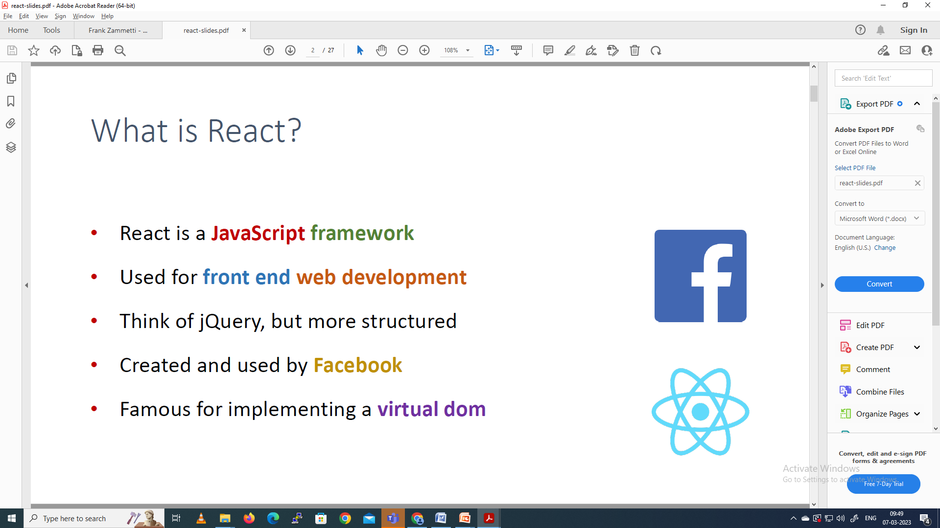

Slide 3
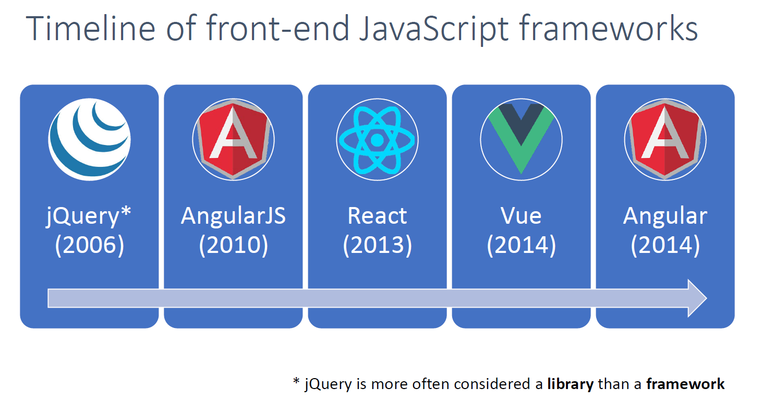

Slide 4
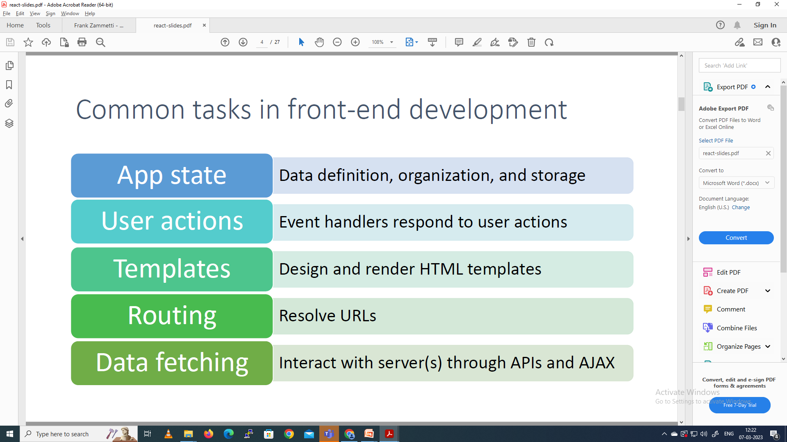

Slide 5
The Real Star of the Show: Components
A basic HTML document to start building our simple React app
<!DOCTYPE html>
<html>
<head>
<meta charset="UTF-8" />
<title>Intro To React</title>
</head>
<body>
</body>
</html>

Slide 6
Add two lines into the <head> of the document to bring React into the fold:
<script crossorigin src="https://unpkg.com/ react@16/umd/react.development.js">
</script>
<script crossorigin src="https://unpkg.com/react-dom@16/umd/react-dom.development.js"> </script>

Slide 7
Simple Eg
ReactDOM.render(<p>Hello</p>, document.getElementById('root'));
<body> <div id="root"></div> </body>

Slide 8
Our first usage of React!
<!DOCTYPE html>
<html>
<head>
<meta charset="UTF-8" />
<title>Intro To React</title>
<script crossorigin src="https://unpkg.com/react@16/umd/react.
development.js"></script>
<script crossorigin src="https://unpkg.com/react-dom@16/umd/react-dom.
development.js"></script>
<script>

Slide 9
function start() {
const rootElement =
React.createElement("div", { },
React.createElement("h1", { }, "Bookmarks"),
React.createElement("ul", { },
React.createElement("li", { },
React.createElement("h2", { }, "Etherient"),
React.createElement("a",
{ href : "https://www.etherient.com" }, "The home page of Etherient“ )
),

Slide 10
React.createElement("li", { },
React.createElement("h2", { }, "Frank's Home“ ),
React.createElement("a", { href: "https://www.zammetti.com" }, "The web home page of Frank Zammetti”)
)
)
);
ReactDOM.render(rootElement,
document.getElementById("mainContainer")
);
}
</script>

Slide 11
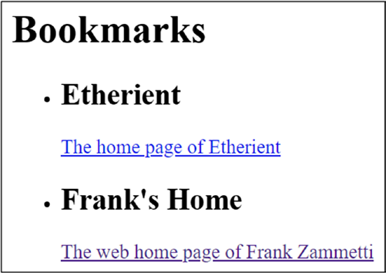
Our first React app

Slide 12
React.createElement() method signature
React.createElement(type, {props}, ...children);

Slide 13
Finally, some of those components
<!DOCTYPE html>
<html>
<head>
<meta charset="UTF-8" />
<title>Intro To React</title>
<script crossorigin src="https://unpkg.com/react@16/umd/react.
development.js"></script>
<script crossorigin src="https://unpkg.com/react-dom@16/umd/react-dom.
development.js"></script>
<script>

Slide 14
function start() {
class Bookmark extends React.Component {
render() {
return (
React.createElement("li", { },
React.createElement("h2", { },
this.props.title),
React.createElement("a",
{ href : this.props.href },
this.props.description
)
)
);
}
}

Slide 15
const rootElement =
React.createElement("div", { },
React.createElement("h1", { }, "Bookmarks"),
React.createElement("ul", { },
React.createElement(Bookmark, {
title : "Etherient",
href : "https://www.etherient.com",
description : "The home page of Etherient"}
),

Slide 16
React.createElement(
Bookmark, {
title : "Frank's Site",
href : "https://www.zammetti.com",
description :
"The web home of Frank W. Zammetti"
}
)
)
);

Slide 17
ReactDOM.render(rootElement,
document.getElementById("mainContainer")
);
}
</script>
</head>
<body onLoad="start();">
<div id="mainContainer"></div>
</body>
</html>

Slide 18
render() method
The render() method, which is the only thing your component is required to contain, is responsible for returning one of several things:
Another React component
A React element
An array of either of those
A fragment
A portal
A string or a number (these are rendered as plain text nodes in the DOM)
A boolean or null (results in nothing being rendered)

Slide 19
Components Need Info: Props

Slide 20
Components (Sometimes) Need Memory: State
Listing 3-4. The Bookmark class (and, by extension, React component)
class Bookmark extends React.Component {
constructor(props) {
super(props);
console.log("Bookmark component created");
this.title = this.props.title;
}
render() {
return (
React.createElement("li", { },
React.createElement("h2", { }, this.title),
React.createElement("a",
{ href : this.props.href }, this.props.description
),

Slide 21
React.createElement("button", {
onClick : () => {
this.title = this.title + "-CHANGED";
this.setState({});
}
}, "Click me")
)
);
}

Slide 23
setState()
The argument passed to setState() is one of two things:
a function or
an object.
function, is called an updater function.
This function receives two arguments: the current state of the object and its props.
This function must then return an object that will be the new state of the component.
It’s important to understand that this function must not mutate the state object passed in! Instead, it must create a new object and return it. If you change the incoming state object, then nothing will appear to happen

Slide 24
setState()
Alternatively, an object is passed setState()
This causes React to perform a shallow merge of the object with the component’s current state.
In the Eg, already altered the state variable, that means that the resulting object has the new value, so what’s returned is a valid new state object.

Slide 25
React will enqueue setState() calls, and the work it results in, and may batch many requests to optimize DOM updates.
So, you aren’t so much telling React to update the component right now; you’re asking it to do so at some point in the future.
The change won’t necessarily be immediate. It is asynchronous.
We can also pass a second argument to setState(), a callback function.
This function will be called after the update has occurred.
It will be needed, when you need to trigger some action but only after the screen has been updated.

Slide 26
Making Them Look Good: Style

Slide 27
Advanced React
A Better Way to Write React Code: JSX

Slide 28
JSX
JSX- stands for JavaScript XML, is an extension to the JavaScript language that adds XML syntax to the language
JSX is interested in allowing us to define tree structures with attributes in a more elegant way than all those JavaScript function calls
React is nothing but trees (of components) with attributes (props)!
Rendering logic and UI logic are intrinsically coupled

Slide 29
What Does It LOOK LIKE?!
const button = <MaterialButton color="red"
onClick="alert('clicked');">
Click Me
</MaterialButton>;

Slide 30
final JavaScript
React.createElement(
MaterialButton,
{ color : "red",
onClick : function() { alert('clicked'); }
},
"Click Me"
)

Slide 31
embed components in JSX
const button = <MaterialButton color="red"
onClick="alert('clicked');">
<ButtonLabel text="Click Me" />
</MaterialButton>;
nested calls
React.createElement(
MaterialButton,
{ color : "red",
onClick : function() { alert('clicked'); }
},
React.createElement(ButtonLabel, { text : "Click Me" })
)

Slide 32
Babel
When a new version of JavaScript comes out, it takes time for browsers, and the JavaScript engines they use, to catch up.
Example, consider this bit of JavaScript:
const newArray = [ 44, 55, 66].map((num) => n * 2);
That code will work in the latest version of Chrome, Firefox, and Opera. But it won’t work in Internet Explorer 11.

Slide 33
Babel allows to write your code using the new language features you want.
When you run that code through Babel, and Babel takes care of generating the appropriate polyfill code.
Babel is considered a transpiler, meaning it transforms and compiles at the same time.
That means your workflow is altered: there is now a step you must do before you can actually run your code.

Slide 34
Babel
Begin a new project.
Choose a directory and npm init the project, using all the default options.
Then install Babel:
npm install --save-dev @babel/core @babel/cli
To run Babel. the command
npx babel
The npx command is that installed by newer versions of NPM
It’s an executable, installed alongside the npm executable, that is a proxy allowing you to run packages and the CLI tools some packages provide

Slide 35
test.js
Code:
const newArray = [ 44, 55, 66].map((num) => n * 2);
Then, execute
npx babel test.js
Babel will echo back the code from the file, but is produced
Add some plugins to it to give the knowledge how to transform the code
List of all the plugins available, check out this site: https://babeljs.io/docs/en/plugins.
install with NPM:
npm install --save-dev @babel/plugin-transform-arrow-functions

Slide 36
Babel to use that plugin
create one more file:
.babelrc configuration file.
Its contents should be
{
"plugins": ["@babel/plugin-transform-arrow-functions"]
}

Slide 37
The output should be
const newArray = [44, 55, 66].map(function (num) {
return n * 2;
});
Notice how the arrow function was replaced with standard function() syntax?
To write that output to a file rather than the console
npx babel test.js --out-file test_new.js

Slide 38
Babel provides the notion of presets.
These effectively are logical groupings of plugins that can be enabled all in one batch.
There are several presets, but the two most used are env and react.

Slide 39
env preset
The env preset allows you to do this in your .babelrc file:
{ "presets": [
[ "@babel/preset-env", {
"targets" : {
"browsers" : [ "last 3 versions", "safari >= 6" ]
}
}]
]
}
produce code that will work in the last three versions of all browsers, and for Safari, support anything from version 6 on up”.
Babel will take care of installing the appropriate plugins

Slide 40
in Node
{ "presets" : [
[ "@babel/preset-env", {
"targets" : { "node" : "7.00" }
}]
]
}
Babel to support Node back to version 7.
To make use of this preset, you need to install a single plugin:
npm install --save-dev @babel/preset-env

Slide 41
Once that’s done, and .babelrc altered as shown in the preceding text (removing the @babel/plugin-transform-arrow-functions plugin),
the output will now be
"use strict";
var newArray = [44, 55, 66].map(function (num) {
return n * 2;
});

Slide 42
Compile JSX
install the preset
npm install @babel/preset-react --save-dev
Then add a new preset in .babelrc to let Babel know how to deal with JSX:
{ "presets" : [
[ "@babel/preset-react" ]
]
}

Slide 43
test.jsx
const button = <MaterialButton color="red"
onClick="alert('clicked');">
Click Me
</MaterialButton>;
The output should be
const button = React.createElement(MaterialButton, {
color: "red",
onClick: "alert('clicked');"
}, "Click Me");

Slide 44
index.html
<!DOCTYPE html>
<html>
<head>
<meta charset="UTF-8" />
<title>Intro To React</title>
<script crossorigin src="https://unpkg.com/react@16/umd/react.
development.js"></script>
<script crossorigin src="https://unpkg.com/react-dom@16/umd/react-dom.
development.js"></script>
<script src="main.js"></script>
</head>
<body onLoad="start();">
<div id="mainContainer"></div>
</body>
</html>

Slide 45
main.jsx
function start() {
class Bookmark extends React.Component {
constructor(props) {
super(props);
console.log("Bookmark component created");
}
title = this.props.title;
titleStyle = { color : "red" }
render() {
return (
<li>
<h2 style={this.titleStyle}>{this.title}</h2>
<a href={this.props.href}>
{this.props.description}
</a>

Slide 46
main.jsx
<button onClick={() => {
this.title = this.title + "-CHANGED";
this.setState({});
}}>
Click me
</button>
</li>
);
}
}

Slide 47
main.jsx
ReactDOM.render(
<div>
<h1>Bookmarks</h1>
<ul>
<Bookmark title={"Etherient"}
href={"https://www.etherient.com"}
description={"The home page of Etherient"}
/>
<Bookmark title={"Frank's Site"}
href={"https://www.zammetti.com"}
description={"The web home of Frank W. Zammetti"}
/>
</ul>
</div>,
document.getElementById("mainContainer")
);
}

Slide 48
Compile JSX:
npx babel main.jsx --out-file main.js
An error message
“Support for the experimental syntax ‘classProperties’ isn’t currently enabled.”
npm install --save-dev @babel/plugin-proposal-class-properties
Add to .babelrc:
{
"presets": [ "@babel/preset-react" ],
"plugins": [ "@babel/plugin-proposal-class-properties" ]
}

Slide 49
Output file main.js
function _defineProperty(obj, key, value)
{ if (key in obj) { Object.defineProperty(obj, key,
{ value: value, enumerable: true, configurable:
true, writable: true }); }
else { obj[key] = value; } return obj; }
function start() {
class Bookmark extends React.Component {
constructor(props) {
super(props);
_defineProperty(this, "title", this.props.title);
_defineProperty(this, "titleStyle", {
color: "red"
});
console.log("Bookmark component created");
}

Slide 50
render() {
return React.createElement("li", null,
React.createElement("h2", {
style: this.titleStyle
}, this.title), React.createElement("a", {
href: this.props.href
}, this.props.description),
React.createElement("button", {
onClick: () => {
this.title = this.title + "-CHANGED";
this.setState({});
}
}, "Click me"));
}
}

Slide 51
ReactDOM.render(React.createElement("div", null, React.
createElement("h1", null, "Bookmarks"), React.createElement("ul", null,
React.createElement(Bookmark, {
title: "Etherient",
href: "https://www.etherient.com",
description: "The home page of Etherient"
}), React.createElement(Bookmark, {
title: "Frank's Site",
href: "https://www.zammetti.com",
description: "The web home of Frank W. Zammetti"
}))), document.getElementById("mainContainer"));
}

Slide 52
Whither prop
Example of passing a prop
const buttonColor = "red";
const button = <MaterialButton color={buttonColor}
onClick="alert('clicked');">
Click Me
</MaterialButton>;
Any valid JavaScript expression can be contained within the braces, so we could do
color={buttonColor + "Alt"}
color="red" is equivalent to color={"red"}.

Slide 53
props in JSX syntax, by default to true if you pass nothing for their value.
<MaterialButton enabled /> is equivalent to <MaterialButton enabled={true} />
Use the spread operator
Eg: <MaterialButton color={"red"} enabled={true} />
Could write this differently using the spread operator:
const props = { color : "red", enabled : true };
<MaterialButton {...props} />
This can be handy if you have several prop values that need to be dynamic, and you need to “calculate”

Slide 54
Default Props
If a component doesn’t pass a particular prop down to the child
class Bookmark extends React.Component {
constructor(props) {
super(props);
console.log("Bookmark component created");
}

Slide 55
title = this.props.title;
titleStyle = { color : "red" }
render() {
return (
<li>
<h2 style={this.titleStyle}>{this.title}</h2>
<a href={this.props.href}>
{this.props.description || "Unknown" }
</a>
<button onClick={() => {
this.title = this.title + "-CHANGED";
this.setState({});
}}>
Click me
</button>
</li>
);
}
}

Slide 56
Define default values for props
class Bookmark extends React.Component {
constructor(props) {
super(props);
console.log("Bookmark component created");
}
static defaultProps = { description : "Unknown" };
title = this.props.title;
titleStyle = { color : "red" }
render() {

Slide 57
return (
<li>
<h2 style={this.titleStyle}>{this.title}</h2>
<a href={this.props.href}>{this.props.description}</a>
<button onClick={() => {
this.title = this.title + "-CHANGED";
this.setState({});
}}>
Click me
</button>
</li>
); }}

Slide 58
Typing Props
First, add propTypes to the component class ‘propTypes’
function start() {
class Bookmark extends React.Component {
constructor(props) {
super(props);
console.log("Bookmark component created");
}
static propTypes = { description : PropTypes.number };
title = this.props.title;
titleStyle = { color : "red" }
render() {
return (
<li>
<h2 style={this.titleStyle}>{this.title}</h2>
<a href={this.props.href}>
{this.props.description}
</a>

Slide 59
add a <script> tag to the index.html file:
<!DOCTYPE html>
<html>
<head>
<meta charset="UTF-8" />
<title>Intro To React</title>
<script crossorigin src="https://unpkg.com/react@16/umd/react.
development.js"></script>
<script crossorigin src="https://unpkg.com/react-dom@16/umd/react-dom.
development.js"></script>
<script crossorigin src="https://unpkg.com/prop-types@15.6/prop-types.
js"></script>
<script src="main.js"></script>
</head>
<body onLoad="start();">
<div id="mainContainer"></div>
</body>
</html>

Slide 60
see the following error in the dev tools console:
react.development.js:1818 Warning: Failed prop type: Invalid prop `description` of type `string` supplied to `Bookmark`, expected `number`. in Bookmark

Slide 61
static propTypes = { description : descriptionValidator };
The descriptionValidator() function will be passed the collection of props, the name of the prop being validated, and the name of the component.
If it then returns null, then React assumes everything is okay;
otherwise, the function would return an Error object

Slide 62
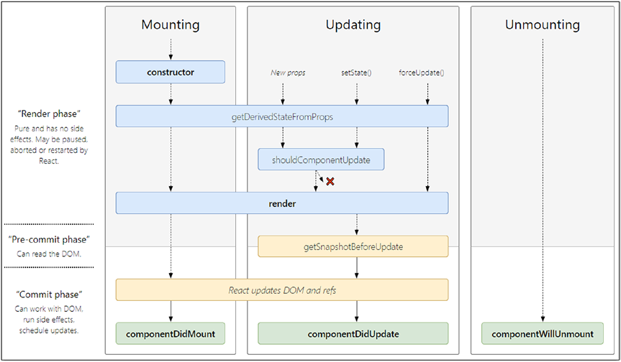
lifecycle events of a React component

Slide 63
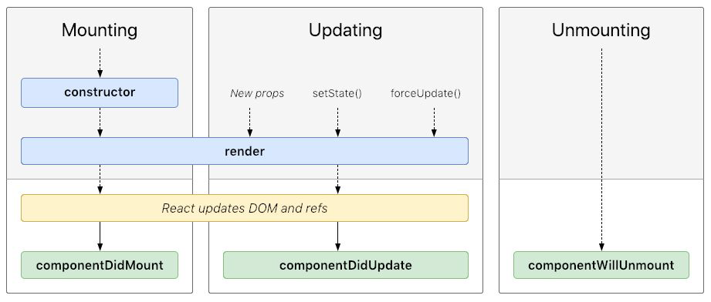
Component Lifecycle

