Slide 1
Typescript

Slide 2


Slide 3
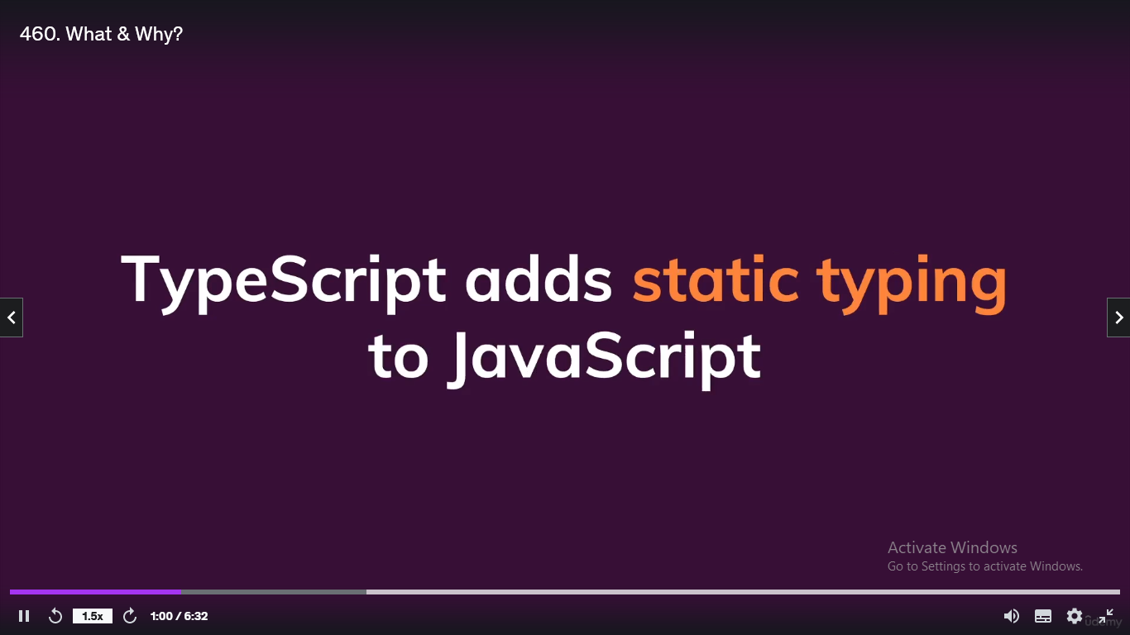

Slide 4
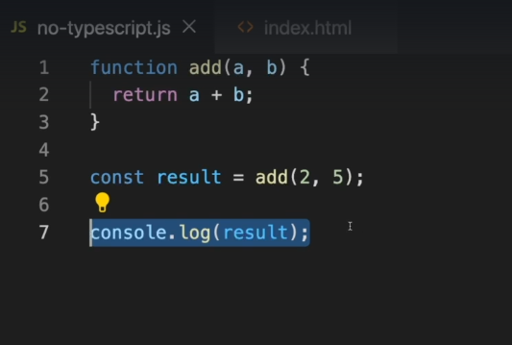
Javascript code

Slide 5
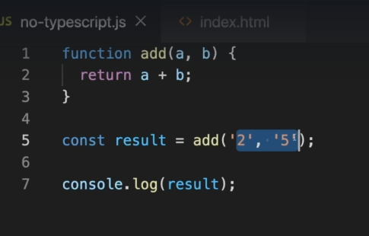
U don’t get error instead o/p will be 25

Slide 6
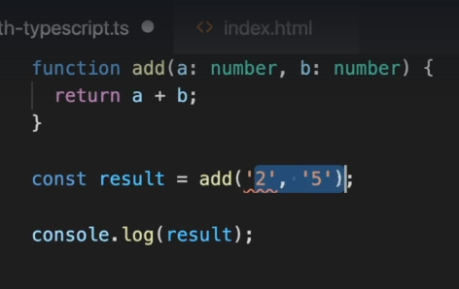
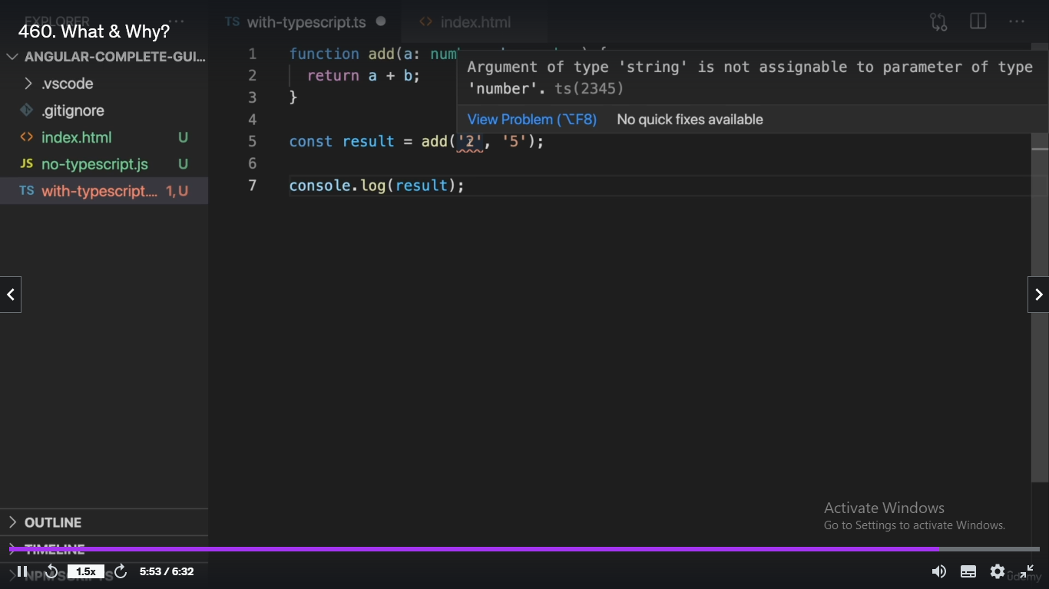

Slide 7
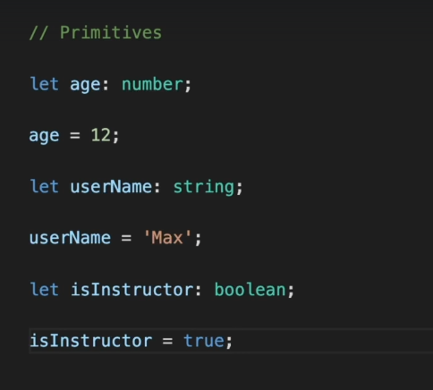
Primitive types

Slide 8
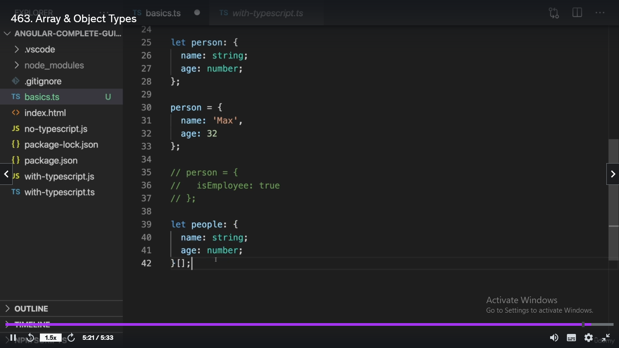
Array and object

Slide 9
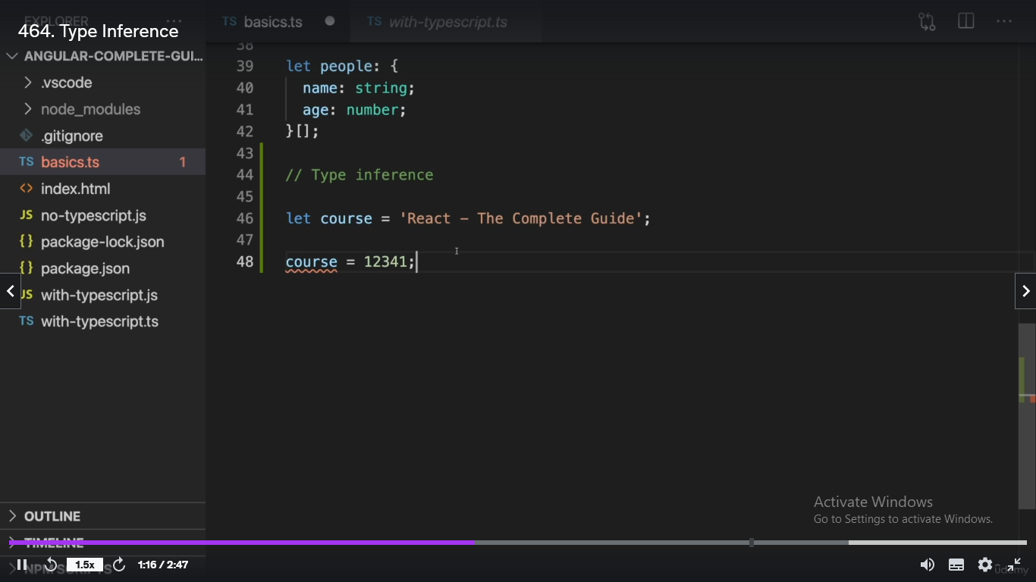
Type Inference (Assigns the type by itself so reassigning with different type gets u an error)

Slide 10
TypeScript Vs JavaScript
you can’t run TypeScript code in a browser or Node
TypeScript must be compiled, or transpiled
TypeScript gets compiled to JavaScript!
TypeScript’s home page at typescriptlang.org called “the playground”

Slide 11
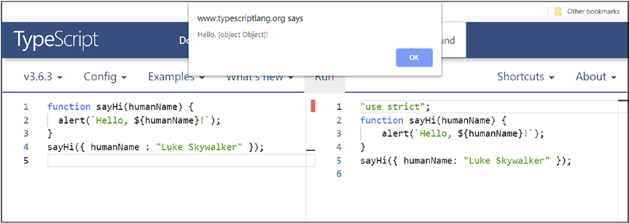
Example code

Slide 12
function sayHi(humanName: string) {
sayHi("Luke Skywalker");

Slide 13
Types
function sayHi(humanName: string) {
You can also declare the type a function returns:
function concatStrings(str1: string, str2: string): string { }

Slide 14
String
const bestShowEver = "Babylon 5";
const bestShowEver: string = "Babylon 5";
Number
const a: number = 42;
const b: number = 3.14;
const a: number = 0xf00d;
const b: number = 0o744; // Zero followed by lower-case o

Slide 15
Boolean
const isThisTheBestBookEver: boolean = true;
const isThisTheBestBookEver: boolean = 1; // Compiler error
Any
let accountBalance;
accountBalance = 15000;
accountBalance = "15000";
let food: any = "pizza";
food = 123; // This is now okay

Slide 16
Arrays
const pets = [ "Belle", "Bubbles" ];
const pets: string[] = [ "Belle", "Bubbles" ];
const pets: any[] = [ "Belle", 42 ];
Tuples
const authors = [ "Frank", 46 ];
const authors: [ string, number ] = [ "Frank", 46 ];

Slide 17
Enums
const Pizza = 0;
const FriedChicken = 1;
const IceCream = 2;
enum Food { Pizza, FriedChicken, IceCream };
let myFavoriteFood: Food.FriedChicken;
alert(myFavoriteFood);

Slide 18
Function
let myMathFunction: (num1: number, num2: number) => string;
function add(n1: number, n2: number): string {
return "" + n1 + n2;
}
myMathFunction = add;
function multiply(a: number, b: number): number {
return a * b;
}
myMathFunction = multiply;

Slide 19
Object
let person = {
firstName : "John", lastName : "Sheridan", age : 52
};
TypeScript infers the type of the object, including its properties, and this is termed an object type.
trying to do person = { a :"John", b : "Sheridan", age : 52 } will be an error
let person: {
firstName: string, lastName: string, age: number
} = {
firstName : "John", lastName : "Sheridan", age : 52
};

Slide 20
Null, Void, and Undefined
let favoriteCar = "Camaro";
favoriteCar = null;
null is considered subtypes of all other types
let myFavoriteNumber: number = null;
let myFavoriteString: string = null;
null is undefined
let favoriteCar;
let favoriteCar = undefined;

Slide 21
TypeScript == ES6 Features
let and const Keywords
Both let and const have block scope rather than var’s global scope, which helps avoid a lot of insidious bugs.
Block Scope
function test() {
if (true) {
var greeting = "hello";
}
alert(greeting);
}
test();

Slide 22
Arrow Functions
const test = (name) => {
alert(`Hello, ${name}`);
}
test("Jack");
const addNums = (a, b) => a + b;
alert(addNums(2, 3));
const addNums = (a: number, b: number): number => a + b;
alert(addNums(2, 3));

Slide 23
Template Literals
The backtick ` character denotes a template literal string,
Within it, insert any valid JavaScript (or TypeScript) expression by wrapping it in ${}.
alert(`Hello, ${name.toUpperCase().substr(2)}`);
They can span multiple lines of source code:
alert(`Hello,
your name is
${name}
`);

Slide 24
Default Parameters
const multNums = (a: number, b: number = 10): number => a * b;
alert(multNums(3));

Slide 25
Spread and Rest
The spread operator, which is three periods together, allows an iterable item, things like arrays or strings, to be expanded in places where zero or more arguments (in the case of function calls) or elements (for array literals) are expected
const addNums = (a: number, b: number): number => a + b;
const nums: number[] = [ 5, 6 ];
alert(addNums(...nums));
This is in contrast to
alert(addNums(nums[0], nums[1]));

Slide 26
Handling error with spread Operator
Handling error on the ...nums spread
Argument passed to addNums() that says “Expected 2 arguments, but got 0 or more”.
const addNums = (a?: number, b?: number): number => a + b;
const nums: number[] = [ 5, 6 ];
alert(addNums(...nums));
question marks after the arguments indicate optional arguments
optional argumentsmust always come last

Slide 27
rest operator
const addNums = (...a: number[]): number =>
a.reduce((acc, val) => acc + val);
const nums: number[] = [ 5, 6 ];
alert(addNums(...nums));
Any argument prefixed with the … operator means that zero or more arguments can be in that place.
Use reduce() method to add up all the numbers passed in.

Slide 28
Destructuring
TypeScript supports two forms of destructuring: object and array.
const person = {
firstName : "Billy", lastName : "Joel", age : 70
};
const firstName = person.firstName;
const lastName = person.lastName;
const age = person.age;
With destructuring
const { firstName, lastName, age } = person;

Slide 29
Arrays can be destructured in the same way:
const vals = [ "Billy", "Joel", 70 ];
const [ firstName, lastName, age ] = vals;
alert(firstName);
alert(lastName);
alert(age);

Slide 30
To swap the value of two variables without using a third, here’s an answer using array
destructuring in TypeScript:
let x = 1;
let y = 2;
[ x, y ] = [ y, x ];
alert(x); // 2
alert(y); // 1

Slide 31
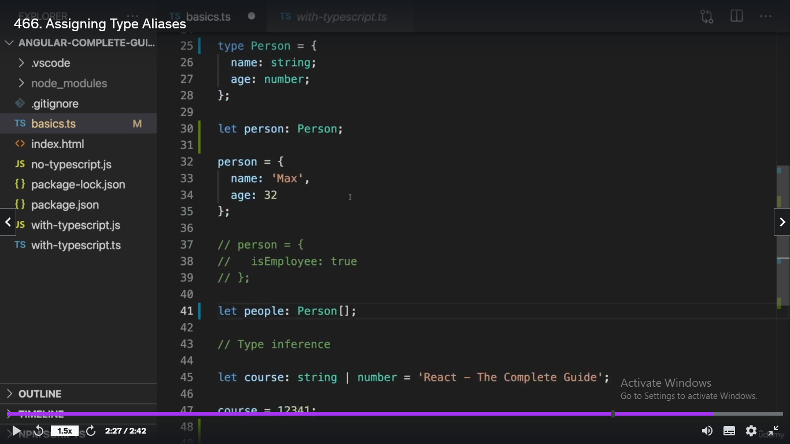
Type Aliases

Slide 32
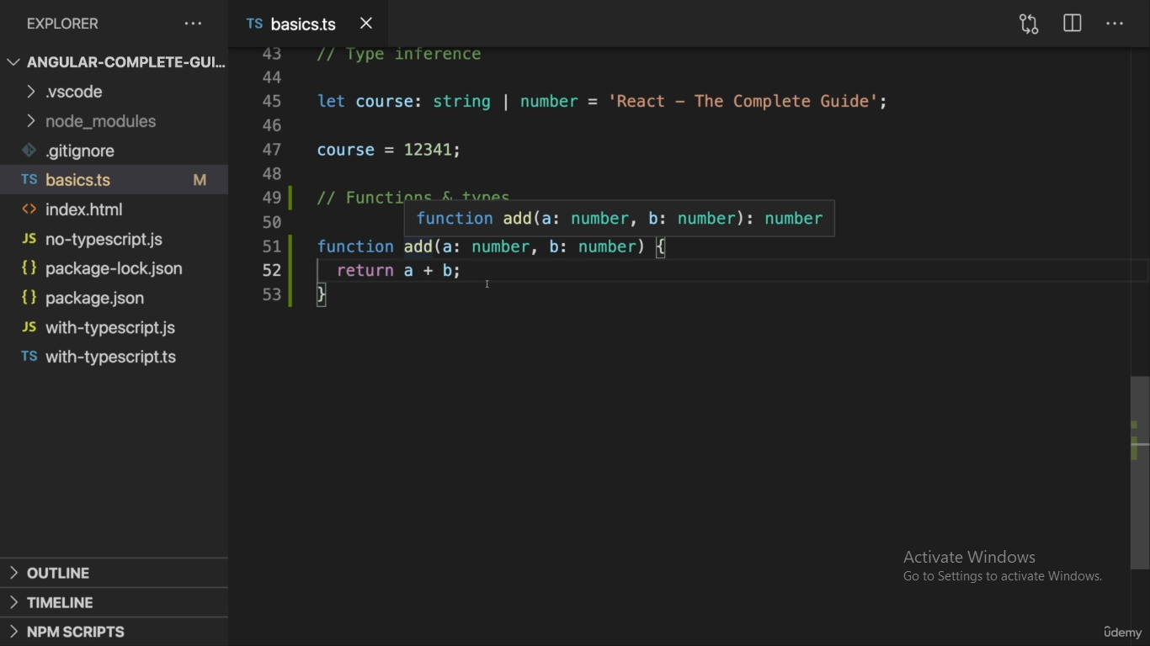
Function and Types

Slide 33
Class
In TypeScript, a class is similar to a class in other object-oriented programming languages like Java and C#.
A class is a blueprint for creating objects that share the same properties and behavior.
It defines the properties and methods of an object, and we can create instances of the class, known as objects, that have their own unique values for the properties.

Slide 34
class Person {
// Properties
private name: string;
private age: number;
// Constructor
constructor(name: string, age: number) {
this.name = name;
this.age = age;
}
// Methods
sayHello() {
console.log(`Hello, my name is ${this.name}`);
}
birthday() {
this.age++;
console.log(`Happy birthday! Now I am ${this.age} years old.`);
}
}

Slide 35
Classes
Properties:
class Planet {
name: string;
mass: number;
}
constructor(inName: string, inMass: number) {
this.name = inName;
this.mass = inMass;
}
}

Slide 36
Member Visibility
TypeScript’s default visibility is public
class Planet {
private name: string = "none";
protected mass: number;
constructor(inName: string, inMass: number) {
this.name = inName;
this.mass = inMass;
}
public printName() {
alert(this.name);
}
}

Slide 37
Inheritance
class Jupiter extends Planet {
private colorBands: boolean = true;
constructor() {
super("Jupiter", 1234);
}
}
let j: Jupiter = new Jupiter();
j.printName();
alert(j.name);// error from TypeScript saying that “Property ‘name’ is private and only accessible within class ‘Planet’.
Subclass constructor, must call the superclass’s constructor via the super() reference.

Slide 38
Override members in the parent class
add protected mass: number = 5555;
to the Jupiter class
In the Planet class:
public calcSuperMass(): number {
return this.mass * 2;
}
public calcSuperMass(): string {
return "" + this.mass * 2;
}
The compiler will complain that you have a duplicate function

Slide 39
Even a different argument list isn’t enough:
public calcSuperMass(): number {
return this.mass * 2;
}
public calcSuperMass(a: number): string {
return "" + this.mass * a;
}

Slide 40
Achieve overloading by using optional parameters or default parameters
public calcSuperMass(massMultiple?: number): number {
if (massMultiple) {
return this.mass * massMultiple;
}
return this.mass * 2;
}
// Or:
public calcSuperMass(massMultiple: number = 2): number {
return this.mass * massMultiple;
}

Slide 41
use a union type
public calcSuperMass(a: number | string): number {
if (typeof a === "number") {
return this.mass * a;
} else {
return this.mass * parseInt(a);
}
}

Slide 42
Getters and Setters
class Planet {
private _name: string = "No name set";
get name() {
return `This planet's name is '${this._name}'.`;
}
set name(inName: string) {
if (inName === "Pluto") {
this._name = "Not a planet";
} else {
this._name = inName;
}
}
}
let p: Planet = new Planet();
alert(p.name); // 'No name set'.
p.name = "Pluto";
alert(p.name); // 'Not a planet' (sorry, little guy!)
p.name = "Venus";
alert(p.name); // 'Venus'

Slide 43
make read-only properties by only supplying a getter.
class Planet {
readonly name: string = "No name set";
}
let p: Planet = new Planet();
alert(p.name); // Okay
p.name = "Neptune"; // Error

Slide 44
Static Members
class Planet {
static theBorgLiveHere: boolean = true;
}
alert(Planet.theBorgLiveHere); // true
we can access the value of theBorgLiveHere without an instance of Planet being created first

Slide 45
Abstract Classes
abstract class BasePlanet {
name: string;
radius: number;
constructor(inName: string, inRadius: number) {
this.name = inName;
this.radius = inRadius;
}
abstract collapseToBlackHole(inMoreMass: number): void;
calcDiameter() {
return this.radius * 2;
}
} class Earth extends BasePlanet {
collapseToBlackHole(inAdditionalMass: number) {
// Perform physics-breaking 2001-like monolith magic here
}
}
An abstract class is simply one that cannot itself be instantiated. It is always meant to be a base class that others extend from.

Slide 46
Advanced TypeScript

Slide 47
Interfaces
Interfaces offer a way to define “contracts” within your code or for code that must interface with your code to follow.
Argument/Object Interfaces
function greet(person: any) {
alert(`Hello, ${person.firstName}`);
}
const person = { firstName : "Frank" };
greet(person);
Expected Output: alert “Hello, Frank”
Alternate possible Output: “Hello, undefined”.// if person didn't have firstName property

Slide 48
creating an interface:
function greet(person: { firstName: string }) {
alert(`Hello, ${person.firstName}`);
}
const person = { name : "Frank" };
greet(person);

Slide 49
Define the interface
interface IPerson {
firstName: string;
};
function greet(person: IPerson) {
alert(`Hello, ${person.firstName}`);
}
function greetLouder(person: IPerson) {
alert(`HELLO, ${person.firstName}!!!!`);
}
const person = { firstName : "Frank", hairColor : "Black" };
greet(person);
greetLouder(person);

Slide 50
function greet(person: IPerson) {
alert(`Hello, ${person.firstName}`);
}
function greetLouder(person: IPerson) {
alert(`HELLO, ${person.firstName}!!!!`);
}
greet({ firstName : "Frank", hairColor : "Black" });
interface IPerson {
firstName: string;
age?: number;
};
function greet(person: IPerson) {
alert(`Hello, ${person.firstName}`);
}
greet({ firstName : "Frank" }); // Okay

Slide 51
Methods in Interfaces
interface IPerson {
firstName: string;
getGreeting(lastName: string): string;
};
const person = {
firstName : "Frank",
getGreeting(lastName: string) {
return `Hello, ${this.firstName} ${lastName}`;
}
};
function greet(person: IPerson) {
alert(person.getGreeting("Zammetti"));
}
greet(person);

Slide 52
Interfaces and Classes
interface IPerson {
firstName: string;
greet(): void;
};
class Person implements IPerson {
firstName: string;
constructor(inFirstName: string) {
this.firstName = inFirstName;
}
greet() {
alert(`Hello, ${this.firstName}`);
}
}
const p = new Person("Frank");
p.greet();

Slide 53
Extending Interfaces
interface IPerson {
firstName: string;
}
interface INinja extends IPerson {
numberOfSwords: number;
}
let ninja = {} as INinja;
ninja.firstName = "Ryuki";
ninja.numberOfSwords = 2;

Slide 54
Namespaces and Modules
Namespaces and modules are two concepts that help you to organize your TypeScript code by partitioning them in some logical fashion
namespace MyFirstNamespace {
export let homeworld = "Jakku";
export function sayName() { alert("Rey"); };
}
alert(MyFirstNamespace.homeworld);
MyFirstNamespace.sayName();
namespace MyFirstNamespace {
export class Jedi { }
export interface RebelScum { }
}

Slide 55
Namespaces
JavaScript code produced from this TypeScript code:
"use strict";
var MyFirstNamespace;
(function (MyFirstNamespace) {
MyFirstNamespace.homeworld = "Jakku";
function sayName() { alert("Rey"); }
MyFirstNamespace.sayName = sayName;
;
})(MyFirstNamespace || (MyFirstNamespace = {}));
alert(MyFirstNamespace.homeworld);
MyFirstNamespace.sayName();

Slide 56
TypeScript uses the IIFE (Immediately Invoked Function Expression) pattern to keep the namespace’s contents separate from everything else on the page when the code finally executes
namespace MyFirstNamespace {
export let homeworld = "Jakku";
}
const homeworld = "Coruscant";
alert(MyFirstNamespace.homeworld); // Jakku
alert(homeworld); // Coruscant

Slide 57
namespaces can break into multiple files:
// app.ts
SomeNS.someFunc1();
SomeNS.someFunc2();
// file1.ts
namespace SomeNS { export someFunc1() { } }
// file2.ts
namespace SomeNS { export someFund2() { } }

Slide 58
To use it import both of the resultant .js files (file1.js and file2.js) in the HTML file
Also need to import app.js
Instead of having to import multiple .js files in the HTML document, you can instead have tsc bundle them for you:
tsc --outFile main.js file1.ts file2.ts app.ts
When bundling like this, you must be aware that order can matter. The files are concatenated in the order you provide

Slide 59
TypeScript-specific syntax for important namespaces, the /// symbol.
To use it, in the app.ts file,
/// <reference path="file1.ts" />
/// <reference path="file2.ts" />
TypeScript, at compile time, will take care of bundling those files together.
Once you have the code bundled
import h = MyFirstNamespace.homeworld;
alert(h) to see “Jakku.”

Slide 60
Nested namespace
namespace SomeNS {
export namespace InnerNS {
export someFunc() { }
}
}
SomeNS.InnerNS.someFunc();
To use it:
import sf = SomeNS.InnerNS.someFunc;
sf();

Slide 61
namespaces are more lightweight and are purely about code organization
classes are about things
interfaces are about contracts

Slide 62
Modules
A module is defined as any TypeScript source file that contains one or more import or export statements
// Variable
export let captain = "Picard";
// Interface
export interface CaptainChecker {
isGreat(inName: string): boolean;
}
// Function
export function addFirst(inLast: string): string {
return "Jean Luc " + inLast;
}
// Class
export class Ship {
const name = "Enterprise";
}
// Type alias
export type cap = captain;

Slide 63
Import { addFirst } from "./MyModule“
execute it like any other function:
addFirst("Riker"); // Wrong last name, but not the point!
Alternatively, you could write your module like so:
function addFirst(inLast: string): string {
return "Jean Luc " + inLast;
}
export addFirst;

Slide 64
export { addFirst as myAddFirstFunc }
If you want to import an entire module, there is a handy shortcut for that:
import * as TheModule from "./MyModule“
export default let captain = "Picard";
What that does for you is that now your import can be this:
import cap from "./MyModule"

Slide 65
Decorators
add the experimentalDecorators:true option to your tsconfig.json file
tsconfig.json:
{
"compilerOptions": {
"target": "ES5",
"experimentalDecorators": true
}
}

Slide 66
Decorators
Decorators are essentially metadata that you can add to the definition of a number of code elements.
Decorators are expressed in the form @<name>, where name must evaluate to a function at runtime.
This function will pass information about the element decorated

Slide 67
function logConstructor(inConstructor: Function) {
console.log(inConstructor);
}
@logConstructor
class Spaceship {
constructor() { console.log("constructor"); }
}
const s = new Spaceship();
we decorate the Spaceship class with function, logConstructor(),

Slide 68
Decorators
A Decorator is a special kind of declaration that can be attached to a classdeclaration, method, accessor, property, or parameter.
Decorators use the form @expression, where expression must evaluate to a function that will be called at runtime with information about the decorated declaration.
For example, given the decorator @sealed we might write the sealed function as follows:
function sealed(target) {
// do something with 'target' ...
}

Slide 69
Decorator Factory
A Decorator Factory is simply a function that returns the expression that will be called by the decorator at runtime.

Slide 70
function first() {
console.log("first(): factory evaluated");
return function (target: any, propertyKey: string, descriptor: PropertyDescriptor) {
console.log("first(): called");
};
}
function second() {
console.log("second(): factory evaluated");
return function (target: any, propertyKey: string, descriptor: PropertyDescriptor) {
console.log("second(): called");
};
}
class ExampleClass {
@first()
@second()
method() {}
}

Slide 71
output to the console:
first(): factory evaluated
second(): factory evaluated
second(): called
first(): called

Slide 72
Decorator Factories
function logConstructorFactory(inEnabled: boolean) {
if (inEnabled) {
return function(inConstructor: Function) {
console.log(inConstructor);
}
} else {
return function() { };
}
}

Slide 73
@logConstructorFactory(true)
class Spaceship {
constructor() { console.log("Spaceship constructor"); }
}
@logConstructorFactory(false)
class Spacestation {
constructor() { console.log("Spacestation constructor"); }
}
const s = new Spaceship();
const t = new Spacestation();

Slide 74
When executed, in the console you’ll see
VM73:11 class Spaceship {
constructor() { console.log("Spaceship constructor"); }
}
VM73:16 Spaceship constructor
VM73:22 Spacestation constructor

Slide 75
Third-Party Libraries
Add in third-party TypeScript libraries
Example, to use the popular Lodash library in your code
npm install --save lodash
also import another related library:
npm install --save-dev @types/lodash
This extra library is called a type declaration file, or a type binding file sometimes, and it’s what tells TypeScript (tsc, more specifically) all about the types that Lodash uses and provides.

Slide 76
import * as _ from "lodash";
_padStart("TypeScript + Lodash = COOL!", 10, "*");

Slide 77
Debugging TypeScript Apps
Source Maps
tsc --sourceMap app.ts
{
"version": 3,
"file": "app.js",
"sourceRoot": "",
"sources": [ "app.ts" ],
"names": [ ],
"mappings": "AAAA,SAAS,KAAK,CAAC,SAAiB;IAC9B,KAAK,CAAC,YAAU,SAAS,MAAG,CAAC,
CAAC;AAChC,CAAC;AACD,KAAK,CAAC,gBAAgB,CAAC,CAAC"
}

Slide 78
