Slide 1
Webpack
Unit - 4

Slide 2
Bundle
A bundle is a conglomeration of various resources that a web page needs to function.
The obvious component of a bundle is JavaScript, but in some cases it also includes CSS and even images, encoded for use in data URLs.
A bundle most frequently is a single file, though no rule says it must be

Slide 3
If you could use modules to organize your code and know it would work across all browsers?
That’s not the case today: not all browser versions support them and those that do have some variances to deal with.
With TypeScript it’s more complicated because you have the compile step to worry about as well.

Slide 4
Webpack
web developers, considered as the best.
easy to work with
does a lot more than merely bundling code
it can transpile TypeScript and even knows how to work with React and its .tsx files
Webpack is more than a bundler; it is a full-featured build tool for your web applications

Slide 5
Dependency Graph
A basic web page hasHTML page, which depends on JavaScript, stylesheet, and image files.
When you tell Webpack to bundle your application, it looks at all the files and examines them and determines which files depend on which others.
It then builds a dependency graph from that analysis, and determines what needs to be included, what can be dropped, what order things need to be in, and so on.

Slide 6
Entry
When Webpack builds the dependency graph, it’s constructing a tree structure
By default, Webpack will assume the entry point as ./src/index.js, relative to the directory it’s running.
The location of the default entry point: a src directory (short for source)

Slide 7
Output
By default, it is stored in a directory named dist (short for distribution).
Further, by default, the name of the bundle that will be created is main.js
single bundle and multiple output bundles are possible.

Slide 8
Loaders
loaders, are components that transform dependencies in some way.
Webpack only understands one thing: JavaScript and JSON files
To understand anything else, you need to specify a loader for it.
The job of a loader is simple: to process some type of file and convert them into valid modules that can be added to the dependency graph and ultimately to be bundled and consumed by your application later.

Slide 9
Loaders
A loader has two critical attributes associated with it:
a test property
a use property.
The test property enables Webpack to determine which files it should transform.
The use property specifies what loader to use for it.
Together, a rule is formed that Webpack will follow
that basically says: “Hey, Webpack, when you encounter a reference to a file whose path matches the test property, go ahead and process that file with the loader specified by the use property, pretty please?”

Slide 10
Loaders
To include images in your final bundle, and you want those images to be Base64-encoded in JavaScript.
In the config file add a rule:
module : {
rules : [
{ test : /\.(jpg|png)$/, use : { loader : "url-loader" } }
] }
Any time Webpack encounters a file in your src directory with an extension of .jpg or .png, which matches the regex specified in the test property, it will use the url-loader loader to encode it and add it to the bundle.

Slide 11
Plugins
Conceptually, they are similar to loaders, but they serve a fundamentally different purpose, and that purpose is virtually anything!
Eg: To optimize your bundle=> Plugin! Need to insert some environment variables into your bundle
Plugin! Adds some sort of copyright notice to the top of each generated bundle
Like loaders, plugins require an entry in the Webpack configuration file
Webpack ships with a good number of plugins, including the following:
BabelMinifyWebpackPlugin – Used for minification with babel-minify
BannerPlugin – Adds a banner to the top of each generated chunk

Slide 12
Modes
several modes:
Development
Production
None
Mode is used to determine which of the built-in plugins are used, if any, and controls what options are passed to them to do their work.
The mode determines what optimizations Webpack does to your bundles.

Slide 13
When the mode is none, no optimizations at all.
When the mode is development, the NamedChunksPlugin and NamedModulesPlugin are enabled.
Also, the option process.env.NODE_ENV on the DefinePlugin is set to a value of development
When the mode is production, the process.env.NODE_ENV on DefinePlugin is again set, but now the plugins FlagDependencyUsagePlugin, FlagIncludedChunksPlugin, ModuleConcatenationPlugin, NoEmitOnErrorsPlugin, OccurrenceOrderPlugin, SideEffectsFlagPlugin, and TerserPlugin are all enabled
The result is a much more optimized bundle for a production release.

Slide 14
Browser Compatibility
Webpack, by default, supports all ES5-compliant browsers
Webpack requires the Promise object to implement import() statements and require.ensure() statements
still support older browsers if you wish

Slide 15
Getting Started with Webpack
To get started, create an empty directory somewhere and initialize a new NPM project:
npm init –y
Install Webpack. install it locally to this project so that we can manage the dependency within the project:
npm install --save-dev webpack

Slide 16
Next, create a src directory, and in it, create a file named index.js.
let a = 2;
let b = 5;
let c = a * b;
alert(c);
To execute it, use npx
npx webpack
Webpack will request that you install the webpack-cli module, and you should say yes to allow it
When this completes, you should find that you now have a dist directory, and within it should be a main.js file

Slide 17
output file
Webpack looks for src/index.js as the entry point and creates dist/main.js
!function(e){var t={};function r(n){if(t[n])return t[n].exports;var
o=t[n]={i:n,l:!1,exports:{}};return e[n].call(o.exports,o,o.exports,r),
o.l=!0,o.exports}r.m=e,r.c=t,r.d=function(e,t,n){r.o(e,t)||Object.define
Property(e,t,{enumerable:!0,get:n})},r.r=function(e){"undefined"!=typeof
Symbol&&Symbol.toStringTag&&Object.defineProperty(e,Symbol.toStringTag,
{value:"Module"}),Object.defineProperty(e,"__esModule",{value:!0})},
r.t=function(e,t){if(1&t&&(e=r(e)),8&t)return e;if(4&t&&"object"==typeof
e&&e&&e.__esModule)return e;var n=Object.create(null);if(r.r(n),Object.def
ineProperty(n,"default",{enumerable:!0,value:e}),2&t&&"string"!=typeof e)
for(var o in e)r.d(n,o,function(t){return e[t]}.bind(null,o));return n},
r.n=function(e){var t=e&&e.__esModule?function(){return e.default}:
function(){return e};return r.d(t,"a",t),t},r.o=function(e,t){return
Object.prototype.hasOwnProperty.call(e,t)},r.p="",r(r.s=0)}([function(e,t)
{alert(10)}]);

Slide 18
Configuring Webpack
npx webpack init
file named webpack.config.js
webpack init
npm init

Slide 19
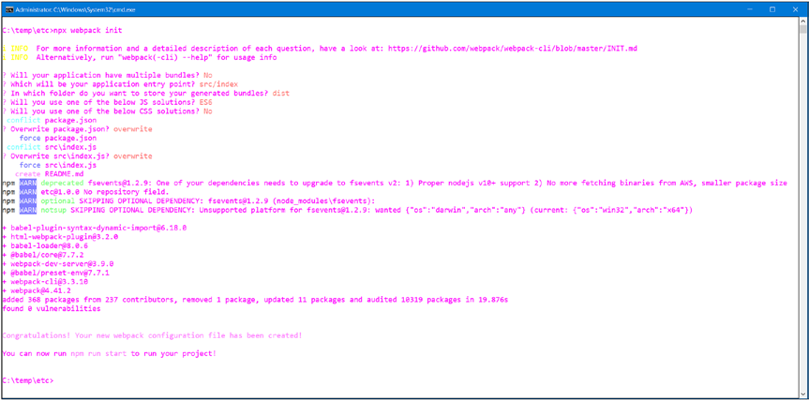

Slide 20
npm run start
console.log("Hello World from your main file!");

Slide 21
Configuration
const path = require('path');
const webpack = require('webpack');
const HtmlWebpackPlugin = require('html-webpack-plugin');
module.exports = {
mode: 'development',
entry: './src/index.js',
output: {
filename: '[name].[chunkhash].js',
path: path.resolve(__dirname, 'dist')
},
plugins: [
new webpack.ProgressPlugin(), new HtmlWebpackPlugin()
],

Slide 22
module: {
rules: [
{
test: /.(js|jsx)$/,
include: [path.resolve(__dirname, 'src')],
loader: 'babel-loader',
options: {
plugins: ['syntax-dynamic-import'],
presets: [
[
'@babel/preset-env',
{
modules: false
}
]
]
}
}
]
},

Slide 23
optimization: {
splitChunks: {
cacheGroups: {
vendors: {
priority: -10,
test: /[\\/]node_modules[\\/]/
}
},
chunks: 'async',
minChunks: 1,
minSize: 30000,
name: true
}
},
devServer: {
open: true
}
};

Slide 24
Using Modules
Index.js with the following:
import getA from "./module1";
import getB from "./module2";
alert(getA() * getB());
Next, create a file in the src directory named module1.js and in it put this:
export default function getA() { return 20; }
create a file named module2.js, again in the src directory, and in it put
export default function getB() { return 30; }

Slide 25
Wither TypeScript?
npm install --save-dev typescript ts-loader
npx tsc –init
{
test: /\.ts?$/,
use: 'ts-loader',
exclude: /node_modules/,
}

