Slide 1
Node.js

Slide 2

The idea behind node.js….
  Perform asynchronous processing on single thread instead of classical multithread processing, minimize overhead & latency, maximize scalability
  Scale horizontally instead of vertically
  Ideal for applications that serve a lot of requests but dont use/need lots of computational power per request
  Not so ideal for heavy calculations, e.g. massive parallel computing
  Also: Less problems with concurrency

Slide 3
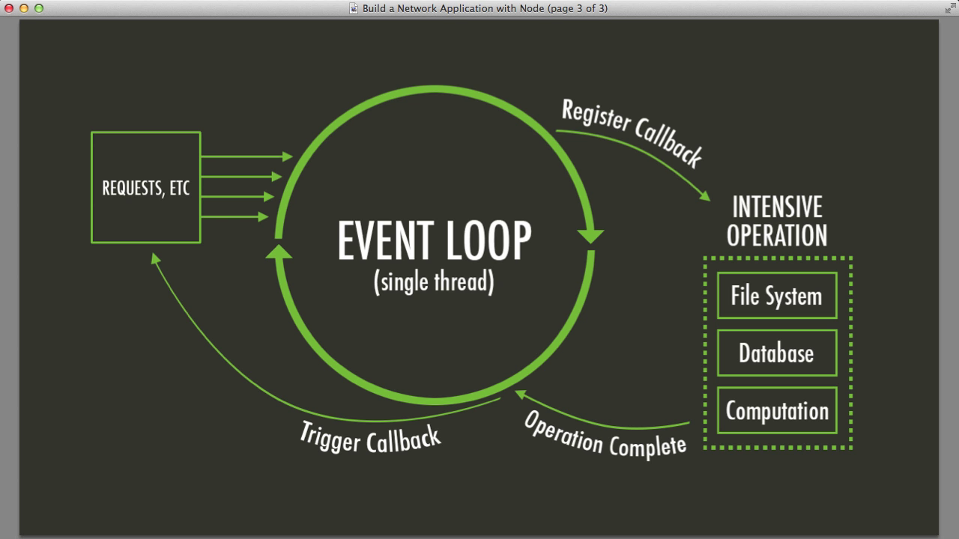
Node.js Event Loop
There are a couple of implications of this apparently very simple and basic model
  Avoid synchronous code at all costs because it blocks the event loop
  Which means: callbacks, callbacks, and more callbacks

Slide 4
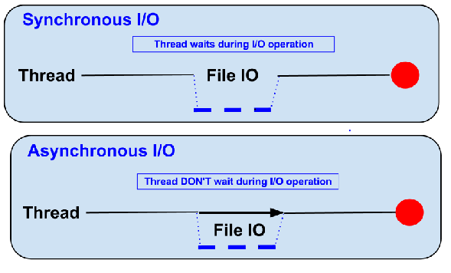
Blocking vs Non-Blocking……
Example :: Read data from file and show data

Slide 5
Blocking…..
● Read data from file
● Show data
● Do other tasks
var data = fs.readFileSync( “test.txt” );
console.log( data );
console.log( “Do other tasks” );

Slide 6
Non-Blocking……
Callback
● Read data from file
When read data completed, show data
● Do other tasks
fs.readFile( “test.txt”, function( err, data ) {
console.log(data);
});

Slide 7
When to use it ?
• Chat/Messaging
• Real-time Applications
• Intelligent Proxies
• High Concurrency Applications
• Communication Hubs
• Coordinators

Slide 8
Node.js for….
● Web application
● Websocket server
● Ad server
● Proxy server
● Streaming server
● Fast file upload client
● Any Real-time data apps
● Anything with high I/O

Slide 9
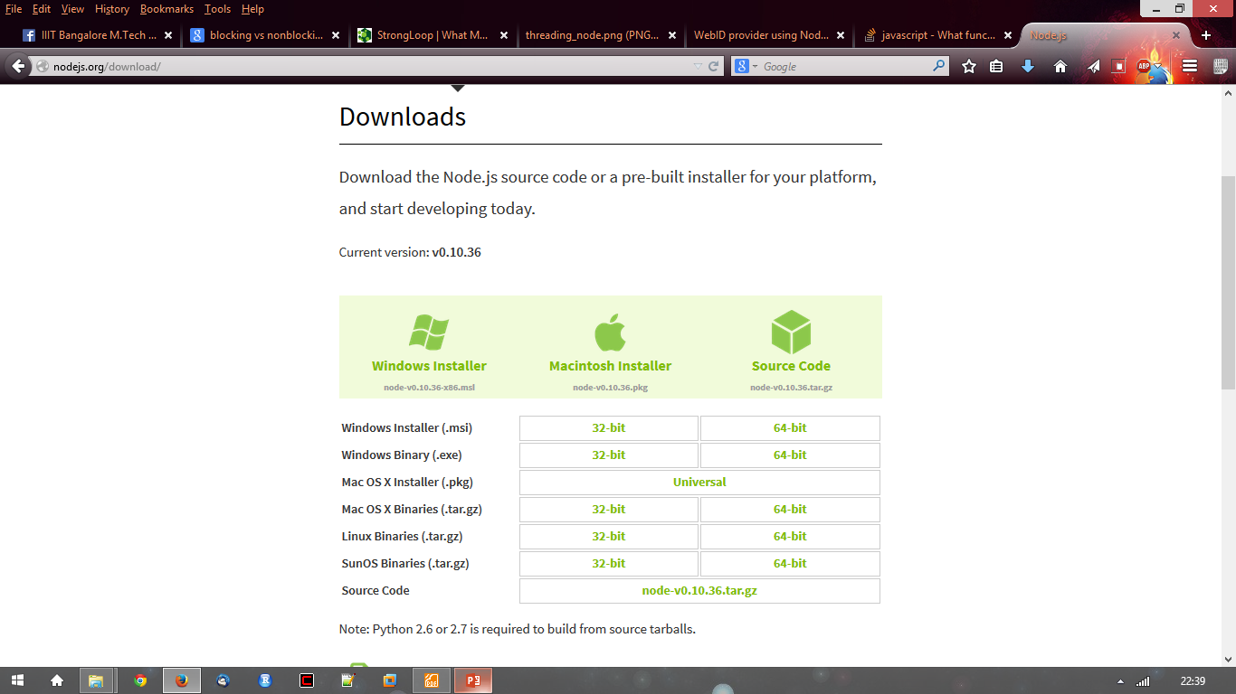
Getting Started…..
http://nodejs.org/ and Download tar.gz
Extract to any directory
$ ./configure && make install

Slide 10
File package.json…..
Project informations
• Name
• Version
• Dependencies
• Licence
• Main file
Etc...

Slide 11
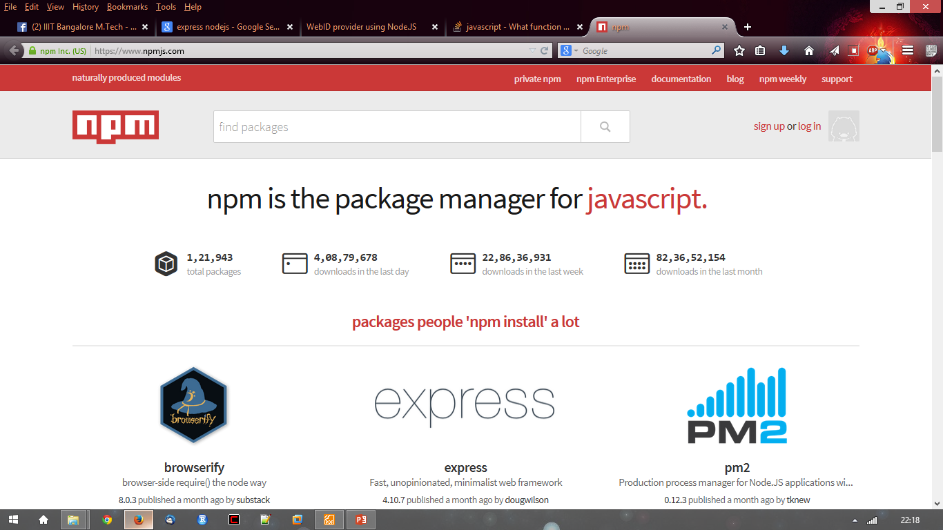
Node.js Modules…..
● https://npmjs.org/
● # of modules = 1,21,943

Slide 12
Install module…..
$npm install <module name>

Slide 13
Using module…..
var http = require(‘http’);
var fs = require(‘fs’);
var express = require(‘express’);

Slide 14
Node.js at a glance - agenda
Async Read/Write
Sync Read/Write
Node.js Network call (“net”)
Node.js modules
Web – Node.js (“http”)
Web – Node.js (“express”) (html form with get/post)
Web – Node.js (“express”) (routing)
Web – Node.js (“express”) (middleware)
Web – Node.js (“express”) (router)

Slide 15
Node.js – fs (Async Read)
var fs = require('fs');
var in_data;
fs.readFile('./fn_input.txt', function (err, data) {
if (err) return console.error(err);
in_data = data;
console.log('Async input file content: ' + in_data);
});
console.log('Program Ended.');

Slide 16
Node.js – fs (Async Write)
var fs = require('fs');
var out_data = 'Output line 1.\r\nOutput line 2.\r\nOutput last line.';
fs.writeFile('./async_output.txt', out_data, function (err) {
if (err) console.error(err);
console.log('Async output file content: ' + out_data);
});
console.log('Program Ended.');

Slide 17
Node.js – fs (Sync Read)
var fs = require('fs');
var in_data = fs.readFileSync('./fn_input.txt');
console.log('Sync input file content: ' + in_data);
console.log('Program Ended.');

Slide 18
Node.js – fs (Sync Write)
var fs = require('fs');
var out_data = 'Output line 1.\r\nOutput line 2.\r\nOutput last line.';
fs.writeFileSync('./sync_output.txt', out_data);
console.log('Sync output file content: ' + out_data);
console.log('Program Ended.');

Slide 19
Node.js – net (Network Server)
var net = require("net");
var server = net.createServer(function(connection) {
console.log('Client connected.');
connection.on('end', function() {
console.log('Client disconnected.');
});
connection.write('Hello World!\n');
connection.pipe(connection);
// send data back to connection object which is client
});
server.listen(8080, function() {
console.log('Server is listening.');
});
console.log('Server Program Ended.');

Slide 20
Node.js – net (Network Client)
var client = net.connect({port: 8080}, 'localhost', function() {
console.log('Connected to Server.');
});
client.on('data', function (data) {
console.log(data.toString());
client.end();
});
client.on('end', function () {
console.log('Disconnected from server.');
});
console.log('Client Program Ended.');

Slide 21
Node.js (Modules)
Module name | Description
buffer | buffer module can be used to create Buffer class.
console | console module is used to print information on stdout and stderr.
dns | dns module is used to do actual DNS lookup and underlying o/s name resolution functionalities.
domain | domain module provides way to handle multiple different I/O operations as a single group.
fs | fs module is used for File I/O.
net | net module provides servers and clients as streams. Acts as a network wrapper.
os | os module provides basic o/s related utility functions.
path | path module provides utilities for handling and transforming file paths.
process | process module is used to get information on current process.

Slide 22
Node.js – web module
Web server is a software application which processes request using HTTP protocol and returns web pages as response to the clients.
Web server usually delivers html documents along with images, style sheets and scripts.
Most web server also support server side scripts using scripting language or redirect to application server which perform the specific task of getting data from database, perform complex logic etc. Web server then returns the output of the application server to client.
Apache web server is one of the most common web server being used. It is an open source project.

Slide 23
Web server and Path
Web server maps the path of a file using URL, Uniform Resource Locator. It can be a local file system or a external/internal program.
A client makes a request using browser, URL: http://www.abc.com/dir/index.html
Browser will make request as:
  GET /dir/index.html HTTP/1.1
  HOST www.abc.com

Slide 24
Web Architecture
Web application are normally divided into four layers:
  Client: this layer consists of web browsers, mobile browsers or applications which can make HTTP request to server.
  Server: this layer consists of Web Server which can intercepts the request made by clients and pass them the response.
  Business: this layer consists of application server which is utilized by web server to do dynamic tasks. This layer interacts with data layer via database or some external programs.
  Data: this layer consists of databases or any source of data.

Slide 25
Web Architecture
Web server
Application server
Database
Client

Slide 26
Creating Web Server using Node (http module)
Create an HTTP server using http.createServer method. Pass it a function with parameters request and response.
Write the sample implementation to return a requested page.
Pass a port 8081 to listen method.
http_server.js
test.html
http_client.js

Slide 27
http_server.js
var http = require('http');
var fs = require('fs');
var url = require('url');
http.createServer(function (request, response) {
var pathname = url.parse(request.url).pathname;
console.log('Request for ' + pathname + ' received.');
fs.readFile(pathname.substr(1), function (err, data) {
if (err) { console.log(err.stack);
response.writeHead(404, {'Content-Type' : 'text/html'}); // HTTP status: 404 : NOT FOUND
} else { response.writeHead(200, {'Content-Type' : 'text/html'}); // HTTP status: 200 : OK
response.write(data.toString());
}
response.end(); // send the response body
});
}).listen(8081);
console.log('Server running at http://127.0.0.1:8081/test.html');
console.log('Server Program Ended.');

Slide 28
test.html
<!DOCTYPE html>
<html lang="en">
<head><meta charset="utf-8">
<title>Test Page</title>
</head>
<body>
Hello World!
</body>
</html>

Slide 29
http_client.js
var http = require('http');
var options = {
host: 'localhost’, port: '8081’, path: '/test.html'
};
var callback = function (response) { // callback function is used to deal with response
var body = '';
response.on('data', function (data) {
body += data;
});
response.on('end', function () {
console.log(body);
});
response.on(‘error’, (error) => {
console.error(error);
});
};
var req = http.request(options, callback);
req.end();

Slide 30
Node.js – Express
Express js is a very popular web application framework built to create Node.js Web based applications.
It provides an integrated environment to facilitate rapid development of Node based Web applications.
Express framework is based on Connect middleware engine and used Jade html template framework for HTML templating.
Core features of Express framework:
  Allows to set up middlewares to respond to HTTP Requests.
  Defines a routing table which is used to perform different action based on HTTP method and URL.
  Allows to dynamically render HTML Pages based on passing arguments to templates.

Slide 31
Installing Express
From the nodejs_workspace (working directory), un-install express if you install express locally from previous chapter.
  npm uninstall express
Create a directory myapp which is under the nodejs_workspace directory. (mkdir myapp, then cd myapp). [http://expressjs.com/en/starter/installing.html]
Use the npm init command under the new myapp folder to create a package.json file for your application – myapp.
  npm init
NOTE: you can hit RETURN to accept the defaults for most of them, except entry point is app.js:
  entry point: app.js
Install express locally in the nodejs_workspace directory, and save it in the dependencies list:
  npm install express --save
Install the Express framework globally using npm if you want to create web application using node terminal.
  npm install express -g --save

Slide 32
Node.js – Web Application with express
http://expressjs.com/en/starter/hello-world.html
In myapp directory, create a file named app.js and add the following codes:
var express = require('express');
var app = express();
app.get('/', function (req, res) {
res.send('Hello World!');
});
app.listen(3000, function () {
console.log('app.js listening to http://localhost:3000/');
});
Run the app.js in the server:
node app.js
Then, load http://localhost:3000/ in a browser to see the output.

Slide 33
Web application – get/post form (server.js)
var express = require('express');
var app = express();
app.get('/', function (req, res) { // To display index.html
res.sendFile(__dirname + "/index.html");
});
app.get('/process_get', function (req, res) { // To process get method
var response = { fname: req.query.fname,
lname: req.query.lname }; // preparing the output in JSON format
console.log(response);
res.json(response);
});

Slide 34
Web application – get/post form (server.js)
var bodyParser = require('body-parser'); // To process post method
var urlenParser = bodyParser.urlencoded({ extended: false}); // creating the application/x-www-form-urlencoded parser
app.post('/process_post', urlenParser, function (req, res) {
var response = { fname: req.body.fname,
lname: req.body.lname }; // preparing the output in JSON format
console.log(response);
res.end(JSON.stringify(response));
});
var server = app.listen(8081, function () {
console.log('server.js is listening at http://127.0.0.1:8081/index.html or http://localhost:8081/index.html');
});
console.log('End of program');

Slide 35
Basic Routing
Routing refers to determining how an application responds to a client request to a particular endpoint, which is a URI (or path) and a specific HTTP request method (GET, POST, and so on).
Each route can have one or more handler functions, which are executed when the route is matched.
Route definition takes the following structure:
app.METHOD(PATH, HANDLER);
Where:
  app is an instance of express.
  METHOD is an HTTP request method, in lower case.
  PATH is a path on the server
  HANDLER is the function executed when the route is matched.

Slide 36
Route methods
A route method is derived from one of the HTTP methods, and is attached to an instance of the express class.
The following code is an example of routes that are defined for the GET and POST methods to the root of the app.
GET method route:
app.get('/', function (req, res) {
res.send('Get request to the homepage');
});
POST method route:
app.post('/', function (req, res) {
res.send('Post request to the hmoepage');
});
There is a special routing method, app.all(), which is not derived from any HTTP method. This method is used for loading middleware functions at a path for all request methods. In the following example, the handler will be executed for requests to “/secret” whether you are using GET, POST, PUT, DELETE, or any other HTTP request method that is supported in the http module.
app.all('/secret', function (req, res, next) {
console.log('Accessing the secret section ...');
next(); // pass control to the next handler
});

Slide 37
Node.js - routing (app_route.js)
var express = require('express');
var app = express();
// This route path will match requests to the root route, /
app.get('/', function (req, res) {
res.send('Hello World! get method');
});
// This route path will match requests to /user
app.all('/user', function (req, res) {
console.log('Accessing /user...');
res.send('Hello World! /user request...');
});

Slide 38
Node.js - routing (hkbu_app_route.js)
// This route path will match requests to /random.text
app.get('/random.txt', function (req, res) {
res.send('Hello World! get /random.text');
});
// To define routes with route parameters, simply specify the route parameters in the path of the route as shown below.
app.get('/users/:userId/books/:bookId', function(req, res) {
res.send(req.params);
});
app.get('/floats/:digit.:decimal', function(req, res) {
res.send(req.params);
});
app.listen(3000, function () {
console.log('app.js listening to http://127.0.0.1:3000/ or http://localhost:3000/');
});

Slide 39
Route paths
Route paths, in combination with a request method, define the endpoints at which requests can be made. Route paths can be strings, string patterns, or regular expressions.
The characters ?, +, *, and () are subsets of their regular expression counterparts. The hyphen (-) and the dot (.) are interpreted literally by string-based paths.
NOTE: Express uses path-to-regexp for matching the route paths; see the path-to-regexp documentation for all the possibilities in defining route paths. Express Route Tester is a handy tool for testing basic Express routes, although it does not support pattern matching.
NOTE: Query strings are not part of the route path.

Slide 40
Route paths based on strings
This route path will match requests to the root route, /.
app.get('/', function (req, res) {
res.send('root'); });
This route path will match requests to /about.
app.get('/about', function (req, res) {
res.send('about'); });
This route path will match requests to /random.text.
app.get('/random.text', function (req, res) { res.send('random.text'); });

Slide 41
Route paths based on string patterns
This route path will match acd and abcd.
app.get('/ab?cd', function(req, res) { res.send('ab?cd'); });
This route path will match abcd, abbcd, abbbcd, and so on.
app.get('/ab+cd', function(req, res) { res.send('ab+cd'); });
This route path will match abcd, abxcd, abRANDOMcd, ab123cd, and so on.
app.get('/ab*cd', function(req, res) { res.send('ab*cd'); });
This route path will match /abe and /abcde.
app.get('/ab(cd)?e', function(req, res) { res.send('ab(cd)?e'); });

Slide 42
Route paths based on regular expressions
This route path will match anything with an “a” in the route name.
app.get(/a/, function(req, res) {
res.send('/a/');
});
This route path will match butterfly and dragonfly, but not butterflyman, dragonfly man, and so on.
app.get(/.*fly$/, function(req, res) {
res.send('/.*fly$/');
});

Slide 43
Route Parameters
Route parameters are named URL segments that are used to capture the values specified at their position in the URL. The captured values are populated in the req.params object, with the name of the route parameter specified in the path as their respective keys.
Route path: /users/:userId/books/:bookId
Request URL: http://localhost:3000/users/34/books/8989 req.params: { "userId": "34", "bookId": "8989" }
To define routes with route parameters, simply specify the route parameters in the path of the route as shown below.
app.get('/users/:userId/books/:bookId', function(req, res) { res.send(req.params); });

Slide 44
Route parameters (continue…)
Since the hyphen (-) and the dot (.) are interpreted literally, they can be used along with route parameters for useful purposes.
Route path: /flights/:from-:to
Request URL: http://localhost:3000/flights/LAX-SFO
req.params: { "from": "LAX", "to": "SFO" }
Route path: /floats/:digit.:decimal
Request URL: http://localhost:3000/floats/123.45
req.params: { "digit": "123", "decimal": "45" }
NOTE: The name of route parameters must be made up of “word characters” ([A-Za-z0-9_]).

Slide 45
Route handlers
You can provide multiple callback functions that behave like middleware to handle a request. The only exception is that these callbacks might invoke next('route') to bypass the remaining route callbacks. You can use this mechanism to impose pre-conditions on a route, then pass control to subsequent routes if there’s no reason to proceed with the current route.
Route handlers can be in the form of a function, an array of functions, or combinations of both.

Slide 46
Route handlers samples
A single callback function can handle a route. For example:
app.get('/example/a', function (req, res) {
res.send('Hello from A!'); });
More than one callback function can handle a route (make sure you specify the next object). For example:
app.get('/example/b', function (req, res, next) {
console.log('the response will be sent by the next function ...'); next();
}, function (req, res) { res.send('Hello from B!'); });

Slide 47
Route handlers samples (continue…)
An array of callback functions can handle a route. For example:
var cb0 = function (req, res, next) { console.log('CB0'); next(); }
var cb1 = function (req, res, next) { console.log('CB1'); next(); }
var cb2 = function (req, res) { res.send('Hello from C!'); }
app.get('/example/c', [cb0, cb1, cb2]);
A combination of independent functions and arrays of functions can handle a route. For example:
var cb0 = function (req, res, next) { console.log('CB0'); next(); }
var cb1 = function (req, res, next) { console.log('CB1'); next(); } app.get('/example/d', [cb0, cb1], function (req, res, next) {
console.log('the response will be sent by the next function ...'); next();
}, function (req, res) { res.send('Hello from D!'); });

Slide 48
Response Methods
The methods on the response object (res) in the following table can send a response to the client, and terminate the request-response cycle. If none of these methods are called from a route handler, the client request will be left hanging.

Slide 49
Response Methods (continue…)
Method | Description
res.download() | Prompt a file to be downloaded.
res.end() | End the response process.
res.json() | Send a JSON response.
res.jsonp() | Send a JSON response with JSONP support.
res.redirect() | Redirect a request.
res.render() | Render a review template.
res.send() | Send a response of various types.
res.sendFile() | Send a file as an octet stream.
res.sendStatus() | Set the response status code and send its string representation as the response body.

Slide 50
Express Middleware
Middleware functions are functions that have access to the request object (req), the response object (res), and the next middleware function in the application’s request-response cycle. The next middleware function is commonly denoted by a variable named next.
Middleware functions can perform the following tasks:
  Execute any code.
  Make changes to the request and the response objects.
  End the request-response cycle.
  Call the next middleware in the stack.
If the current middleware function does not end the request-response cycle, it must call next() to pass control to the next middleware function. Otherwise, the request will be left hanging.

Slide 51
Express Middleware (continue…)
The following shows the elements of a middleware function call:
var express = require('express');
var app = express();
app.get('/', function(req, res, next) {
next();
});
app.listen(3000);
Where get: HTTP method for which the middleware function applies.
'/': Path (route) for which the middleware function applies.
function (): The middleware function.
req: HTTP request argument to the middleware function.
res: HTTP response argument to the middleware function.
next: Callback argument to the middleware function.

Slide 52
app.use() method
app.use([path,] function [, function...])
Mounts the specified middleware function or functions at the specified path. If path is not specified, it defaults to '/'.
NOTE: A route will match any path that follows its path immediately with a “/”. For example, app.use('/apple', …) will match “/apple”, “/apple/images”, “/apple/images/news”, and so on.
app.use('/admin', function(req, res, next) {
// GET 'http://www.example.com/admin/new'
console.log(req.originalUrl); // '/admin/new'
console.log(req.baseUrl); // '/admin'
console.log(req.path); // '/new'
next(); });
Mounting a middleware function at a path will cause the middleware function to be executed whenever the base of the requested path matches the path.

Slide 53
app.use() (continue…)
Since path defaults to “/”, middleware mounted without a path will be executed for every request to the app.
// this middleware will be executed for every request to the app
app.use(function (req, res, next) {
console.log('Time: %d', Date.now());
next(); });
Middleware functions are executed sequentially, therefore, the order of middleware inclusion is important:
// this middleware will not allow the request to go beyond it
app.use(function(req, res, next) {
res.send('Hello World'); });
// requests will never reach this route
app.get('/', function (req, res) {
res.send('Welcome');
});

Slide 54
Using Middleware
Express is a routing and middleware web framework that has minimal functionality of its own: An Express application is essentially a series of middleware function calls.
Middleware functions are functions that have access to the request object (req), the response object (res), and the next middleware function in the application’s request-response cycle. The next middleware function is commonly denoted by a variable named next.
Middleware functions can perform the following tasks:
  Execute any code.
  Make changes to the request and the response objects.
  End the request-response cycle.
  Call the next middleware function in the stack.
If the current middleware function does not end the request-response cycle, it must call next() to pass control to the next middleware function. Otherwise, the request will be left hanging.
An Express application can use the following types of middleware:
  Application-level middleware
  Router-level middleware
  Error-handling middleware
  Built-in middleware
  Third-party middleware
NOTE: You can load application-level and router-level middleware with an optional mount path. You can also load a series of middleware functions together, which creates a sub-stack of the middleware system at a mount point.

Slide 55
Application-level Middleware
Bind application-level middleware to an instance of the app object by using the app.use() and app.METHOD() functions, where METHOD is the HTTP method of the request that the middleware function handles (such as GET, PUT, or POST) in lowercase.
See app4.js. This example shows a middleware function with no mount path. The function is executed every time the app receives a request.
This example shows a middleware function mounted on the /user/:id path. The function is executed for any type of HTTP request on the /user/:id path.
app.use('/user/:id', function (req, res, next) {
console.log('Request Type:', req.method);
next(); });
This example shows a route and its handler function (middleware system). The function handles GET requests to the /user/:id path.
app.get('/user/:id', function (req, res, next) { res.send('USER'); });

Slide 56
Application-level Middleware 2
Here is an example of loading a series of middleware functions at a mount point, with a mount path. It illustrates a middleware sub-stack that prints request info for any type of HTTP request to the /user/:id path.
app.use('/user/:id', function(req, res, next) {
console.log('Request URL:', req.originalUrl); next();
}, function (req, res, next) { console.log('Request Type:', req.method); next();
});
Route handlers enable you to define multiple routes for a path. The example below defines two routes for GET requests to the /user/:id path. The second route will not cause any problems, but it will never get called because the first route ends the request-response cycle.
This example shows a middleware sub-stack that handles GET requests to the /user/:id path.
app.get('/user/:id', function (req, res, next) {
console.log('ID:', req.params.id); next();
}, function (req, res, next) { res.send('User Info'); });
// handler for the /user/:id path, which prints the user ID
app.get('/user/:id', function (req, res, next) { res.end(req.params.id); });

Slide 57
Application-level Middleware 3
To skip the rest of the middleware functions from a router middleware stack, call next('route') to pass control to the next route.
NOTE: next('route') will work only in middleware functions that were loaded by using the app.METHOD() or router.METHOD() functions.
This example shows a middleware sub-stack that handles GET requests to the /user/:id path. (See app5.js)
app.get('/user/:id', function (req, res, next) {
// if the user ID is 0, skip to the next route
if (req.params.id == 0) next('route');
// otherwise pass the control to the next middleware function in this stack
else next(); //
}, function (req, res, next) {
res.end('regular'); // render a regular page
});
// handler for the /user/:id path, which renders a special page
app.get('/user/:id', function (req, res, next) { res.end('special'); });

Slide 58
Middleware sample
http://expressjs.com/en/guide/writing-middleware.html
Middleware function requestTime add the current time to the req (the request object).
hkbu_app_middleware.js

Slide 59
Node.js (middleware – hkbu_app_middleware.js)
var express = require('express');
var app = express();
var requestTime = function (req, res, next) { // create an application level middleware; add a field to req which contains request time
var d = new Date();
req.requestTime = d.toString();
next();
};
// default path is '/'
app.use(requestTime);
// This route path will match requests to the root route, /
app.get('/', function (req, res) {
var responseText = 'Hello World! called middleware requestTime <br>';
responseText += '<small>Requested at: ' + req.requestTime + '</small>';
res.send(responseText);
});

Slide 60
Node.js (middleware – hkbu_app_middleware.js)
// application level middleware for '/user/:id' route
app.get('/user/:id', function (req, res, next) {
if (req.params.id == 0) { // if the user ID is 0, skip to the next route
next('route');
} else {
next();
}
}, function (req, res, next) { // render a regular page
res.end('user id is: ' + req.params.id);
});
app.get('/user/:id', function (req, res, next) { // handler for the /user/:id path, which renders a special page.
res.end('**Error: user id is: ' + req.params.id + ' **');
});
app.listen(3000, function () {
console.log('hw4_03_middleware.js listening to http://127.0.0.1:3000/ or http://localhost:3000/');
});

Slide 61
Express Routers
A router object is an isolated instance of middleware and routes. You can think of it as a “mini-application,” capable only of performing middleware and routing functions. Every Express application has a built-in app router.
A router behaves like middleware itself, so you can use it as an argument to app.use() or as the argument to another router’s use() method.
The top-level express object has a Router() method that creates a new router object.
var express = require('express');
var app = express();
var router = express.Router();

Slide 62
Express Routers 2
Once you’ve created a router object, you can add middleware and HTTP method routes (such as get, put, post, and so on) to it just like an application. For example: (See app6.js)
// invoked for any requests passed to this router
router.use(function(req, res, next) {
// .. some logic here .. like any other middleware
next(); });
// will handle any request that ends in /events
// depends on where the router is "use()'d"
router.get('/events', function(req, res, next) {
// .. });
You can then use a router for a particular root URL in this way separating your routes into files or even mini-apps.
// only requests to /calendar/* will be sent to our "router"
app.use('/calendar', router);

Slide 63
Router Methods
router.all(path, [callback, …] callback)
This method is extremely useful for mapping “global” logic for specific path prefixes or arbitrary matches. For example, if you placed the following route at the top of all other route definitions, it would require that all routes from that point on would require authentication, and automatically load a user. Keep in mind that these callbacks do not have to act as end points; loadUser can perform a task, then call next() to continue matching subsequent routes.
router.all('*', requireAuthentication, loadUser);
Another example of this is white-listed “global” functionality. Here the example is much like before, but it only restricts paths prefixed with “/api”:
router.all('/api/*', requireAuthentication);

Slide 64
Router Methods 2
router.METHOD(path, [callback, ...] callback)
The router.METHOD() methods provide the routing functionality in Express, where METHOD is one of the HTTP methods, such as GET, PUT, POST, and so on, in lowercase. Thus, the actual methods are router.get(), router.post(), router.put(), and so on.
You can provide multiple callbacks, and all are treated equally, and behave just like middleware, except that these callbacks may invoke next('route') to bypass the remaining route callback(s). You can use this mechanism to perform pre-conditions on a route then pass control to subsequent routes when there is no reason to proceed with the route matched.
router.get('/', function(req, res){
res.send('hello world');
});

Slide 65
Router Methods 3
router.use([path], [function, ...] function)
Uses the specified middleware function or functions, with optional mount path path, that defaults to “/”.
This method is similar to app.use(). A simple example and use case is described in app7.js. See app.use() for more information.
Middleware is like a plumbing pipe: requests start at the first middleware function defined and work their way “down” the middleware stack processing for each path they match.
The order in which you define middleware with router.use() is very important. They are invoked sequentially, thus the order defines middleware precedence. For example, usually a logger is the very first middleware you would use, so that every request gets logged.

Slide 66
Router-level Middleware
Router-level middleware works in the same way as application-level middleware, except it is bound to an instance of express.Router().
var router = express.Router();
Load router-level middleware by using the router.use() and router.METHOD() functions.
The following example code replicates the middleware system that is shown above for application-level middleware (See app5.js), by using router-level middleware (See app8.js).

Slide 67
Node.js (router – hkbu_app_router.js)
var express = require('express');
var app = express();
var router = express.Router();
/* router level middleware with no mount path, all requests to this router will first hit this middleware */
router.use(function(req, res, next) {
var d = new Date();
console.log('Time: ', d.toString());
next();
});

Slide 68
Node.js (router – hkbu_app_router.js)
// a middleware sub-stack to handle root path
// (router should mount to /user/:id)
router.get('/', function (req, res) {
console.log('wrong format');
res.end('** Wrong Format ** use http://localhost:3000/user/28');
});
// a router middleware sub-stack that handle /user/:id path
router.use('/user/:id', function (req, res, next) {
console.log('Request URL: ', req.originalUrl);
next();
}, function (req, res, next) {
console.log('Request Type: ', req.method);
next();
});

Slide 69
Node.js (router – hkbu_app_router.js)
// a middleware sub-stack that handle GET requests to the /user/:id path
router.get('/user/:id', function (req, res, next) {
if (req.params.id == 0) {
next('route');
} else {
next();
}
}, function (req, res, next) {
// render a regular page
res.end('user id is: ' + req.params.id);
});

Slide 70
Node.js (router – hkbu_app_router.js)
// handler for the /user/:id path, which renders a special page.
router.get('/user/:id', function (req, res, next) {
res.end('**Error: user id is: ' + req.params.id + ' **');
});
// router mount to root path '/' by default
// or app.use('/', router);
app.use(router);
app.listen(3000, function () {
console.log('listening to http://127.0.0.1:3000/ or http://localhost:3000/');
});

Slide 71
Error-handling Middleware
Define error-handling middleware functions in the same way as other middleware functions, except with four arguments instead of three, specifically with the signature (err, req, res, next)):
app.use(function(err, req, res, next) {
console.error(err.stack);
res.status(500).send('Something broke!');
});
NOTE: Error-handling middleware always takes four arguments. You must provide four arguments to identify it as an error-handling middleware function. Even if you don’t need to use the next object, you must specify it to maintain the signature. Otherwise, the next object will be interpreted as regular middleware and will fail to handle errors.
For details about error-handling middleware, see: Error handling.

Slide 72
Built-in Middleware
Starting with version 4.x, Express no longer depends on Connect. With the exception of express.static, all of the middleware functions that were previously included with Express’ are now in separate modules. Please view the list of middleware functions.
The only built-in middleware function in Express is express.static. This function is based on serve-static, and is responsible for serving static assets such as HTML files, images, and so on.
The function signature is:
express.static(root, [options])
The root argument specifies the root directory from which to serve static assets.
For information on the options argument and more details on this middleware function, see express.static.

Slide 73
Built-in Middleware 2
Here is an example of using the express.static middleware function with an elaborate options object:
var options = { dotfiles: 'ignore',
etag: false,
extensions: ['htm', 'html'],
index: false, maxAge: '1d',
redirect: false,
setHeaders: function (res, path, stat) { res.set('x-timestamp', Date.now()); }
}
app.use(express.static('public', options));
You can have more than one static directory per app:
app.use(express.static('public'));
app.use(express.static('uploads'));
app.use(express.static('files'));
For more details about the serve-static function and its options, see: serve-static documentation.

Slide 74
Serving Static files in Express
To serve static files such as images, CSS files, and JavaScript files, use the express.static built-in middleware function in Express.
Pass the name of the directory that contains the static assets to the express.static middleware function to start serving the files directly. For example, use the following code to serve images, CSS files, and JavaScript files in a directory named public: (See app9.js)
app.use(express.static('public'));
Now, you can load the files that are in the public directory:
http://localhost:3000/images/kitten.jpg
http://localhost:3000/css/style.css
http://localhost:3000/js/app.js
http://localhost:3000/images/bg.png
http://localhost:3000/hello.html
To use multiple static assets directories, call the express.static middleware function multiple times:
app.use(express.static('public'));
app.use(express.static('files'));

Slide 75
Serving Static files in Express 2
Express looks up the files in the order in which you set the static directories with the express.static middleware function.
To create a virtual path prefix (where the path does not actually exist in the file system) for files that are served by the express.static function,specify a mount path for the static directory, as shown below:
app.use('/static', express.static('public'));
Now, you can load the files that are in the public directory from the /static path prefix.
http://localhost:3000/static/images/kitten.jpg
http://localhost:3000/static/css/style.css
http://localhost:3000/static/js/app.js
http://localhost:3000/static/images/bg.png
http://localhost:3000/static/hello.html
However, the path that you provide to the express.static function is relative to the directory from where you launch your node process. If you run the express app from another directory, it’s safer to use the absolute path of the directory that you want to serve:
app.use('/static', express.static(__dirname + '/public'));

Slide 76
Third-party Middleware
Use third-party middleware to add functionality to Express apps.
Install the Node.js module for the required functionality, then load it in your app at the application level or at the router level.
The following example illustrates installing and loading the cookie-parsing middleware function cookie-parser.
$ npm install cookie-parser
var express = require('express');
var app = express();
var cookieParser = require('cookie-parser');
// load the cookie-parsing middleware
app.use(cookieParser());
For a partial list of third-party middleware functions that are commonly used with Express, see: Third-party middleware.

Slide 77
Express application generator
Follow instructions from http://expressjs.com/en/starter/generator.html
Use the application generator tool, express-generator, to quickly create an application skeleton.
Install express-generator in myapp directory:
npm install express-generator -g
Display the command options with the –h option:
express -h
Create an Express app named firstApplication in the current working directory:
express firstApplication
Then, install dependencies:
    cd firstApplication
    npm install
    set DEBUG=firstApplication:* & npm start
Then load http://localhost:3000/ in your browser to access the app.

Slide 78
References
Node.js the Right Way, Jim R. Wilson, The Programatic Bookshelf, ISBN 978-1-937785-73-4
NodeJS: Practical Guide for Beginners, Matthew Gimson, ISBN 978-1-519354-07-5
Express.js: Node.js Framework for Web Application Development, Daniel Green, ISBN 978-1-530204-06-9
Express.com
Tutorials Point
The Node Beginner Book, Manuel Kiessling, Leanpub, Link.

