Slide 1







YouTube Comment Analysis
BY
BHUVANA S
20BAD004

Slide 2






ABSTRACT
YouTube is one of the largest online video-sharing platforms with billions of users and videos across a multitude of genres.
YouTube Comment Analysis aims to explore various aspects of YouTube comments, including sentiment analysis, topic modeling, user behavior analysis, word frequency analysis, and spam detection.
By leveraging the power of PySpark and other Python libraries, we will uncover valuable insights from YouTube comments, providing a comprehensive understanding of user interactions.

Slide 3
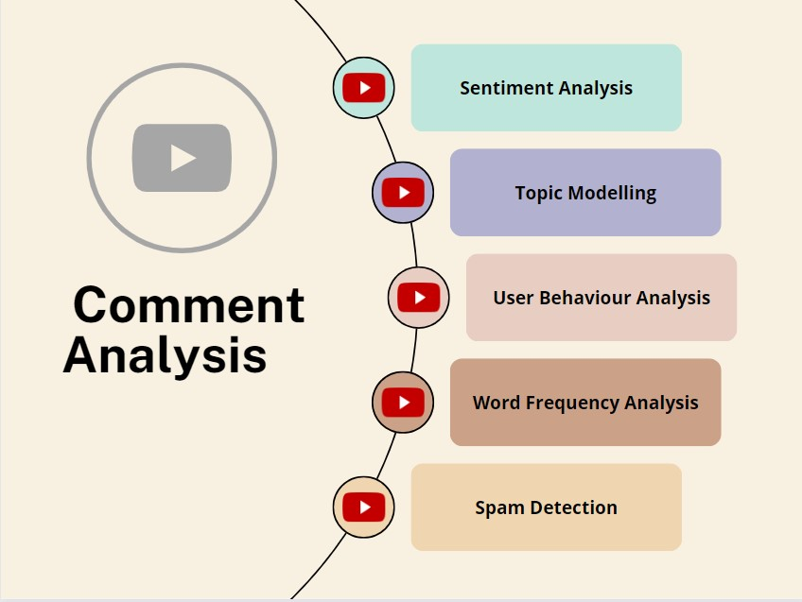

Slide 4
MODULES
Data Collection
Data Preprocessing
Sentiment Analysis
Topic Modelling
User Behaviour Analysis
Word Frequency Analysis
Spam Detection
Visualization and Reporting

Slide 5



DATA COLLECTION
The Data Collection module involves gathering comments from YouTube using the YouTube Data API. This API allows access to publicly available comments on YouTube videos.
Data collection is the foundational step, providing the raw material for subsequent analysis. It enables researchers to analyze the sentiment, topics, and user interactions within the YouTube community.

Slide 6
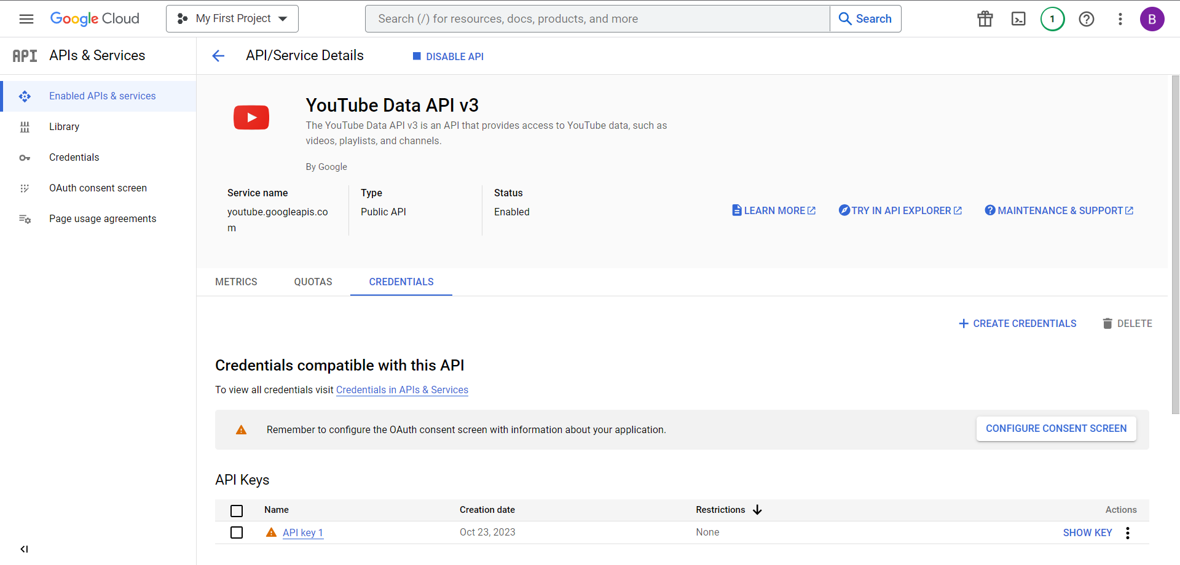

2007
2010
2014
2018

Slide 7




DATA PREPROCESSING
Data Preprocessing focuses on cleaning and structuring the collected comment data. It includes tasks such as removing irrelevant characters, handling missing data, and ensuring consistency.
Preprocessing ensures the data is in a suitable format for analysis. Clean data leads to more accurate and meaningful results in downstream modules.

Slide 8
SENTIMENT ANALYSIS
Sentiment Analysis determines the sentiment (positive, negative, or neutral) of comments. This module employs natural language processing techniques to understand the emotional tone within comments.
By assessing sentiment, we can gauge the general emotional response to videos and assess the impact of content on the audience
TextBlob for Sentiment Scoring

Slide 9
SENTIMENT ANALYSIS
TextBlob for Sentiment Scoring
Random Forest Classifier for Prediction

Slide 10
TOPIC MODELLING
Topic Modeling groups comments into topics or themes. This is done using techniques like Latent Dirichlet Allocation (LDA) or Non-Negative Matrix Factorization (NMF).
Topic Modeling reveals what subjects or themes are most commonly discussed, helping content creators and researchers understand the interests of the YouTube community.

Slide 11
TOPIC MODELLING
Count Vectorization for Feature Engineering
Latent Dirichlet Allocation (LDA)

Slide 12
USER BEHAVIOUR ANALYSIS
User Behavior Analysis involves examining user interactions with comments, such as likes, replies, and comment length. It can identify which users are most engaged and the nature of their interactions.
Understanding user behavior helps content creators and platform administrators tailor content and interactions to suit the community's preferences.

Slide 13
USER BEHAVIOUR ANALYSIS
Distribution of Like Counts
Comment Frequency Over Time
Comment Length Analysis

Slide 14
WORD FREQUENCY ANALYSIS
Word Frequency Analysis identifies the most frequent words in comments. It involves preprocessing text and extracting high-frequency terms.
This analysis provides insights into the vocabulary used by the audience and highlights popular keywords, which can inform content creators' strategies.

Slide 15
WORD FREQUENCY ANALYSIS
Tokenization
StopWord Removal
Word Frequency Count

Slide 16
SPAM DETECTION
Spam Detection uses machine learning models to identify and filter out spam comments. It involves labeling comments as spam or non-spam and automating the moderation process.
Spam Detection protects the community from irrelevant or harmful content and enhances the quality of interactions.

Slide 17
SPAM DETECTION
Logistic Regression
Naïve Bayes

Slide 18
VISUALIZATION
Visualization and Reporting involve creating visual representations of the analysis results. This can include charts, word clouds, and summary reports.
Visualization simplifies the communication of findings to stakeholders, making complex data more accessible and actionable.

Slide 19


RESULTS

Slide 20

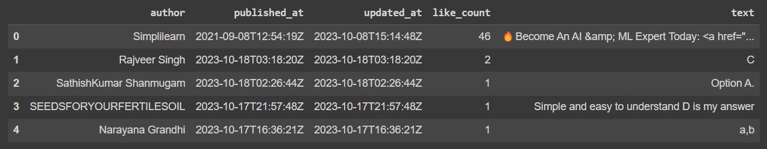


Sample Data from YouTube API

Slide 21
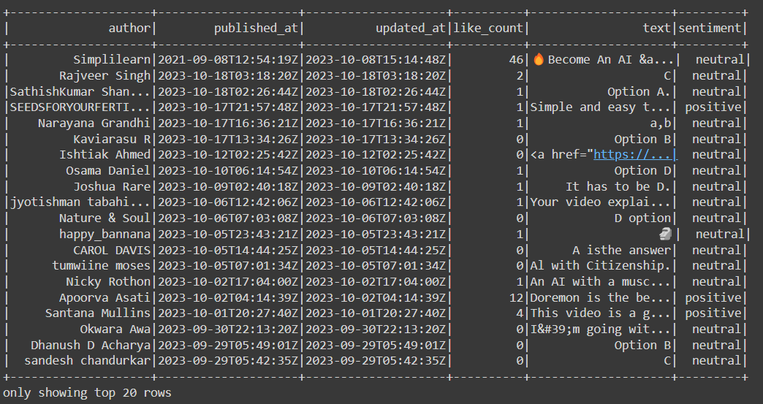
Sentiment Analysis

Slide 22
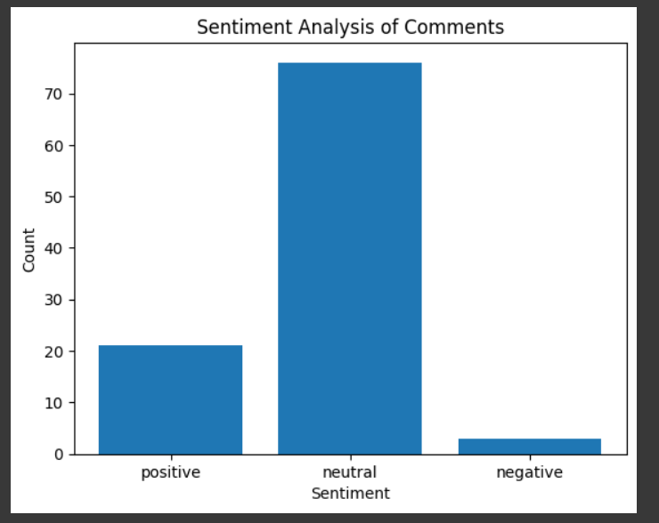

Slide 23
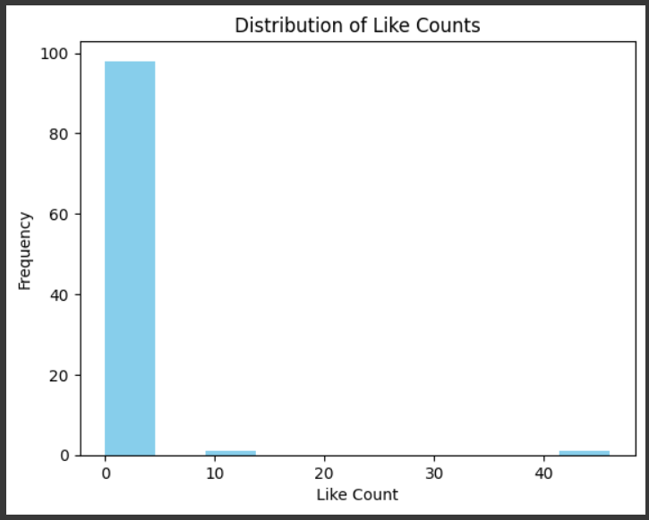
User Behaviour Analysis

Slide 24
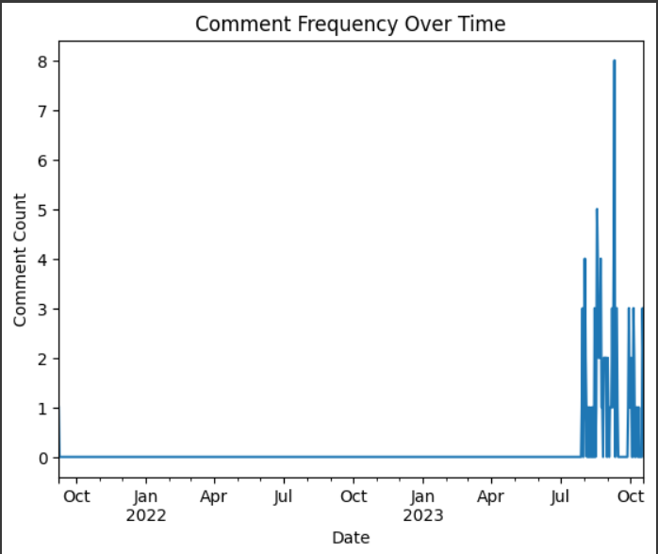
User Behaviour Analysis
User Behaviour Analysis

Slide 25
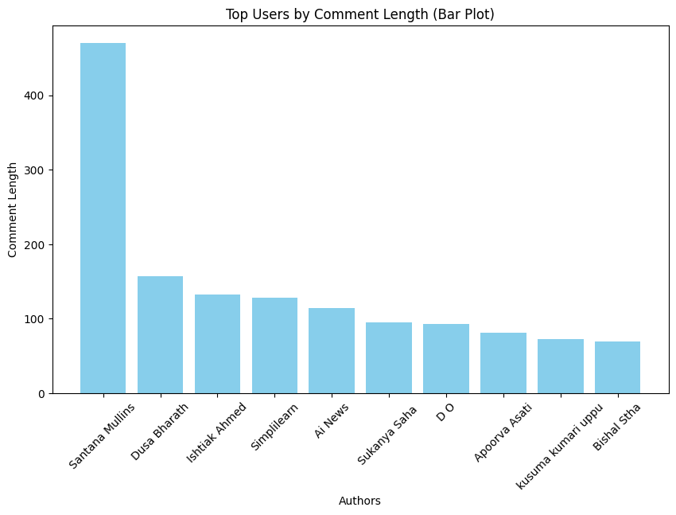
User Behaviour Analysis

Slide 26
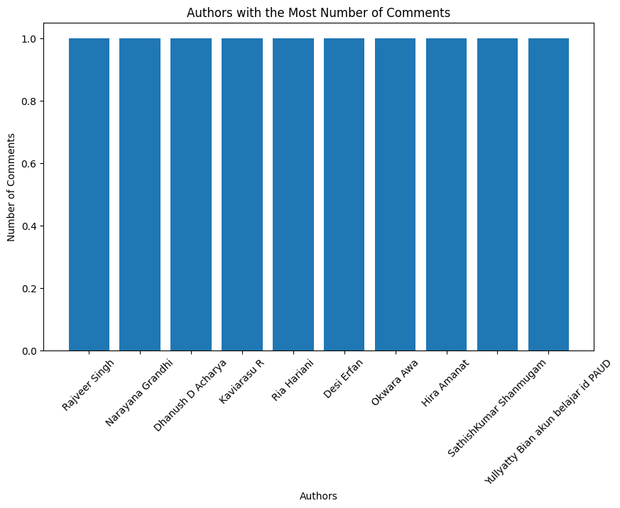
User Behaviour Analysis

Slide 27
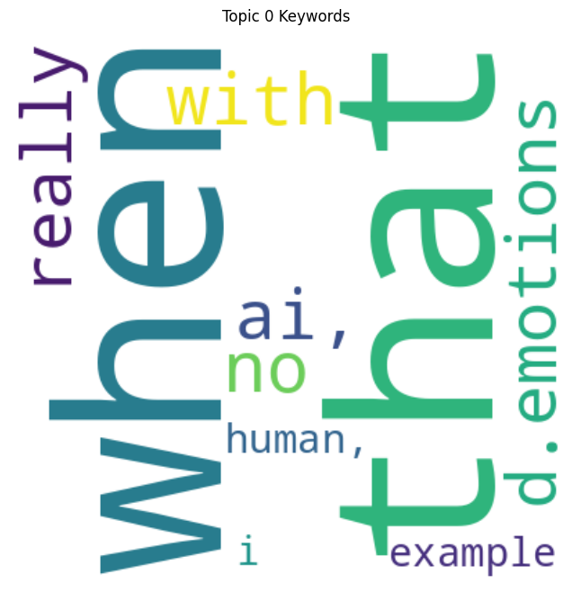
Topic Modelling

Slide 28
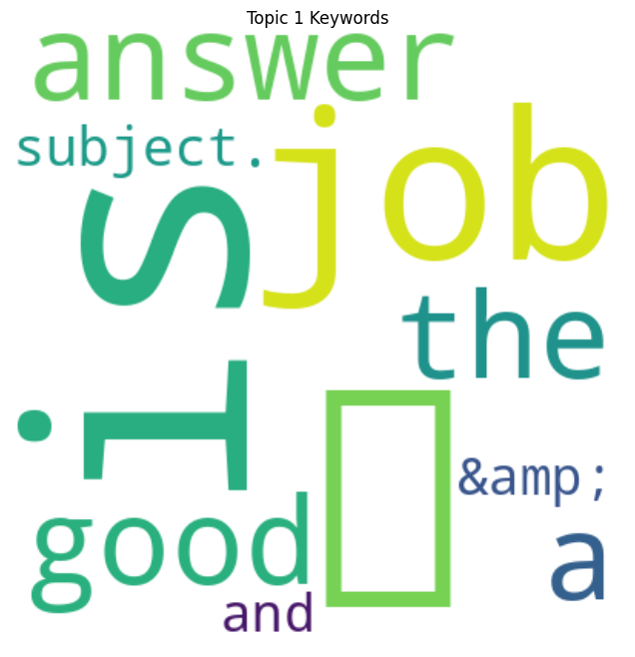
Topic Modelling

Slide 29
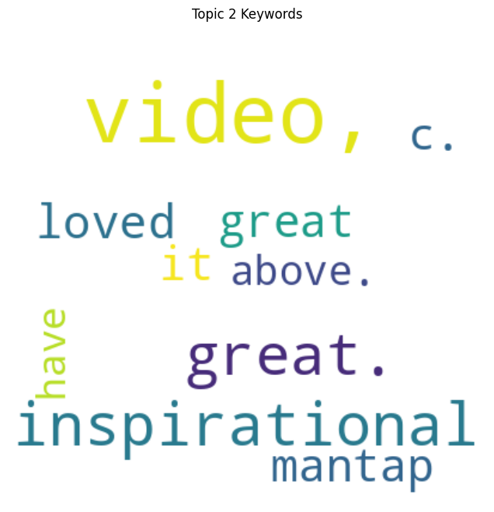
Topic Modelling

Slide 30
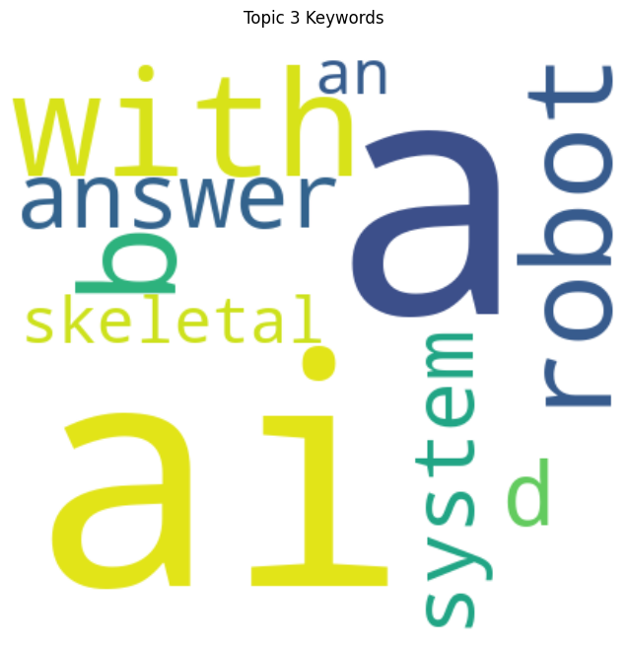
Topic Modelling

Slide 31
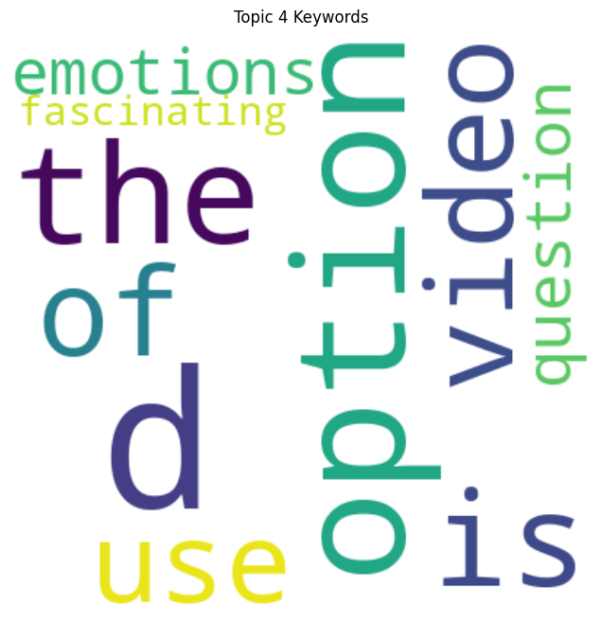
Topic Modelling

Slide 32
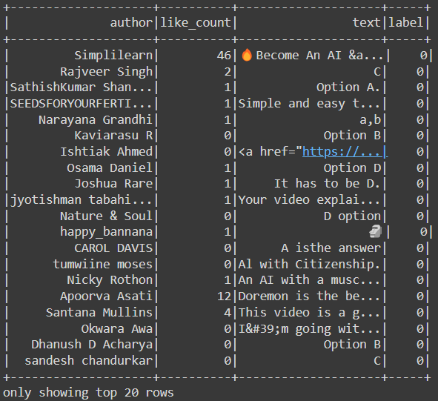
Spam Detection

Slide 33
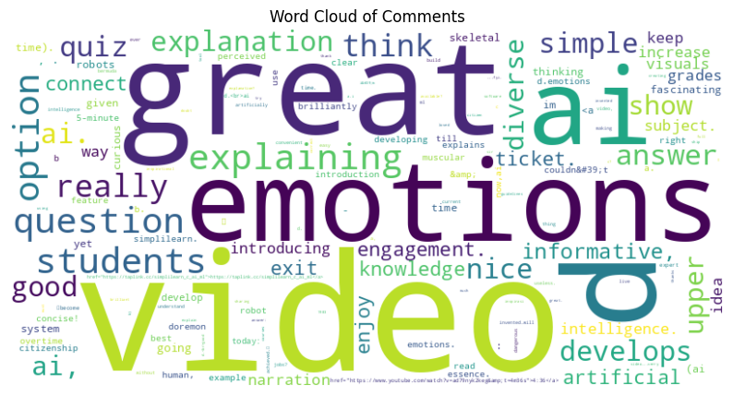
Word Frequency Analysis

Slide 34
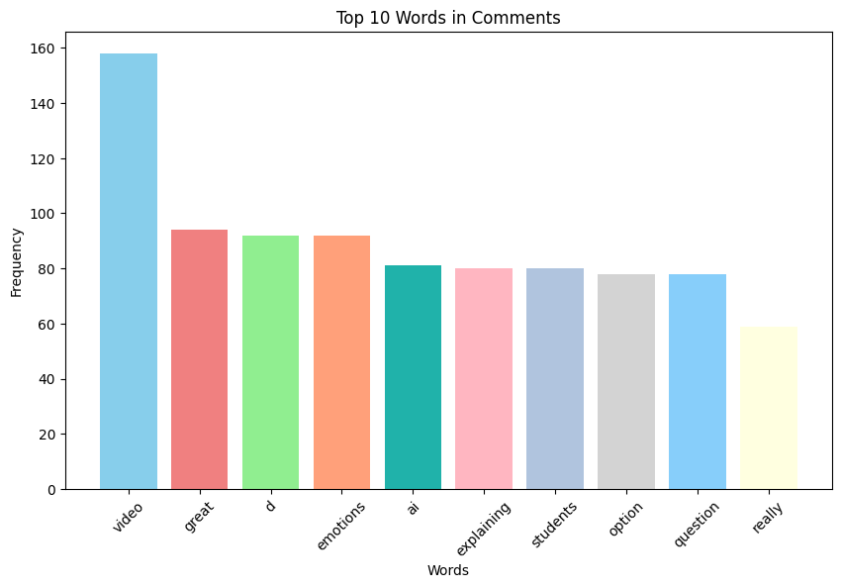
Word Frequency Analysis

Slide 35





Thank You

