Slide 1
Java I/O Stream
Presented by
Bhuvaneswari E

Slide 2
Stream
sequence of data
Two kinds of streams
1. Output Stream - used for writing data to a destination. 2. Input Stream - used to read data from a source
Source
Program
Destination

Slide 3
Types of streams
Byte stream - used to perform input and output of bytes.
Character stream - used to perform input and output of Character.
Data stream - used to perform input and output of primitive data type values as well as String values.
Buffered stream - used to perform input and output of bytes
Object stream - used to perform input and output of objects.
Note:
Byte stream – Transfer 2 bytes at a time
Buffered stream – Transfer 1024 bytes at a time

Slide 4
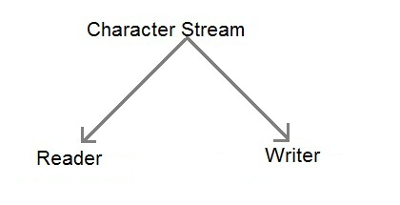
Character Stream

Slide 5
Writer
To Write a data into file there are three ways
1. File Writer
2. Buffered Writer
3. Print Writer
File Writer:
Stores only character
No newline
Example:
FileWriter fw=new FileWriter (“Myfile.txt”);
fw.write(“abc”);

Slide 6
Buffered Writer
Stores only character
No newline
Example:
FileWriter fw=new FileWriter (“Myfile.txt”);
BufferedWriter bw=new BufferedWriter (fw);
bw.write(“abc”);

Slide 7
Print Writer
Stores any type of data.
No need of calling newLine .
Syntax:
FileWriter fw= new FileWriter(“Myfile.txt");
PrintWriter out=new PrintWriter(fw);

Slide 8
Reader
To read a data from file there are two ways
File Reader
Buffered Reader
File reader
Read character by character
Takes time
Buffered reader
Read line by line

Slide 9


