Slide 1
AI-Powered Collections Strategy
Leveraging Agentic AI for Scalable, Fair, and Effective Debt Management at Geldium

Slide 2
How the System Works :
Customer Data Input: Repayment history, credit score, income, customer interactions.
Decision Logic Engine: AI model predicts risk and suggests actions.
Action Module: Sends personalized reminders, plans, or escalations.
Learning Loop: Continuously refines decisions based on outcomes.
Notes:
Prompts to try:
Generate a simple outline for an AI collections system workflow, including inputs, decision logic, action triggers, and learning loop.
List 3–5 key customer attributes that would be most predictive for collections decision-making, and explain why each one matters.
Suggest examples of business rules and AI-driven actions the system could use at different risk levels (e.g., low, medium, high risk).
Create a rough sketch or step-by-step description of how customer data flows through the system from intake to action.

Slide 3
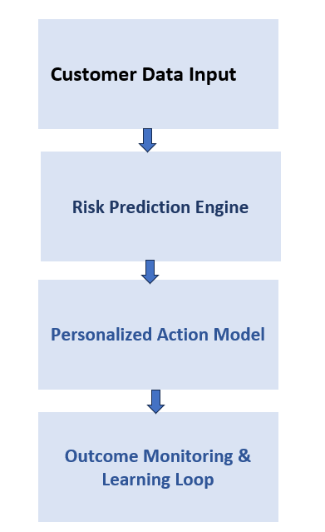
System Workflow Diagram:

Slide 4
Role of Agentic AI :
Autonomous AI: Predicting risk, sending reminders, adapting messages, learning from data.
Human Oversight: Approving payment plans, reviewing edge cases, handling disputes, auditing fairness.
Notes:
Prompts to try:
Explain how agentic AI could automate financial collections while keeping humans in critical decision points.
List 3–5 examples of collection actions, and classify each as best suited for full automation or requiring human oversight, with a brief reason why.

Slide 5
Responsible AI Guardrails:
Fairness Checks: Detect and mitigate bias across segments.
Explainability: Clear, understandable decisions for customers.
Compliance: Meets regulatory standards like GDPR, ECOA.
Human-in-the-Loop: Agents involved in critical decisions.
Notes:
Prompts to try:
List key fairness, transparency, and compliance practices to build into an AI-powered credit collections system.
Suggest specific ways to monitor and audit the system over time to ensure it stays fair, compliant, and effective.

Slide 6
Expected Business Impact:
Business KPIs: Lower delinquency (↓25%), cost savings, better recovery rates, scalable ops.
Customer Outcomes: Personalized plans, increased trust, fairness, transparent process.
Notes:
Prompts to try:
Suggest KPIs for an AI-powered collections strategy that balances business outcomes with customer fairness.
Describe 2–3 ways an AI collections system could improve both operational efficiency and customer experience.

Slide 7
THANK YOU
Bhuvana J

