Slide 1
NOVA 2026 / DOORDASH BACK HOUSE / THE PITCH
ProfitShield
Good food.
Stronger margins.
Restaurant financial intelligence.
From scattered records to an evidence-backed next move.
IMPORT → EXPLAIN → SIMULATE → REVIEW
PROFITSHIELD · GOOD FOOD. STRONGER MARGINS.
01
Notes:
A restaurant owner should not need five tabs to understand what the business keeps. ProfitShield brings payouts, sales and supplier evidence into one workflow, then helps the owner inspect a finding and decide what to do next.

Slide 2
NOVA 2026 / DOORDASH BACK HOUSE / THE PROBLEM
Five reports. One unanswered question.
“What did I actually keep—and what needs my attention?”
Delivery payouts
POS sales
Supplier invoices
Fees, promotions, refunds
A different view of revenue
Prices, quantities, document copies
The back-house challenge: less manual stitching.
Clearer decisions from records owners already have.
PROFITSHIELD · GOOD FOOD. STRONGER MARGINS.
02
Notes:
The DoorDash back-house prompt is about records scattered across sales reports, invoices, receipts and payouts. Owners spend time combining them before they can even ask what changed. Our focus is the financial decision: show the baseline, show the evidence, and keep the next action under the owner’s control.

Slide 3
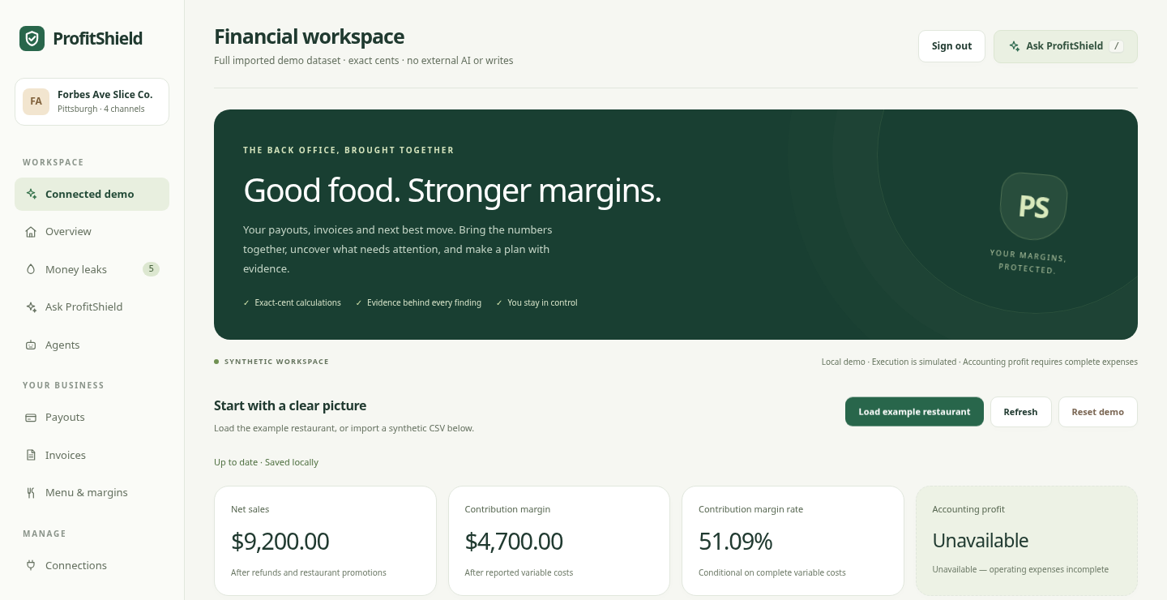
NOVA 2026 / DOORDASH BACK HOUSE / THE PRODUCT
One workspace. A decision you can inspect.
A guided journey from imported records to a reviewed next move.
01 Bring the records
Synthetic CSV + known platform exports
02 Follow the evidence
Auditor finding → exact source row
03 Compare the tradeoff
Scenario → assumptions → approval
LIVE DEMO · localhost:8000/#demo
PROFITSHIELD · GOOD FOOD. STRONGER MARGINS.
03
Notes:
Switch to the demo for about 45 seconds. Load the example restaurant. Show the financial summary, open the commission finding, then click Explain finding. Point out that the source row and the same baseline appear together. If time is short, use this actual screenshot. Do not enable external services during judging.

Slide 4
NOVA 2026 / DOORDASH BACK HOUSE / THE BASELINE
Start with a number you can defend.
Synthetic reference dataset · exact cents · all figures from the backend
GROSS SALES
NET SALES
CONTRIBUTION MARGIN
$10,000
$9,200
$4,700
Before refunds and restaurant promotions
After $300 refunds and $500 merchant promotions
After $1,500 commissions, $2,800 food, $200 other variable costs
51.09% margin rate · Accounting profit unavailable: operating expenses are incomplete.
PROFITSHIELD · GOOD FOOD. STRONGER MARGINS.
04
Notes:
The golden dataset has ten thousand dollars in gross sales. Refunds and restaurant-funded promotions bring net sales to nine thousand two hundred. Commissions, food and other variable costs leave four thousand seven hundred in contribution margin. That is 51.09 percent of net sales. We do not call that accounting profit: operating expenses are incomplete. Platform-funded promotions are informational, and commission discrepancies are not deducted twice.

Slide 5
NOVA 2026 / DOORDASH BACK HOUSE / THE EVIDENCE
A $100 question. With the receipts.
Example: DoorDash:G-DD · supplied contract terms, not independently verified
CHARGED COMMISSION
EXPECTED AT SUPPLIED 20%
CONDITIONAL EXPOSURE
$900
$800
$100
Recorded against $4,000 gross sales
20% × $4,000, rounded per transaction
Review contract + payout before claiming
A duplicate invoice is a second document—not proof of a second payment.
PROFITSHIELD · GOOD FOOD. STRONGER MARGINS.
05
Notes:
Here is the evidence-first behavior. A four-thousand-dollar DoorDash row records nine hundred in commission. At the supplied twenty-percent contract rate, the expected amount is eight hundred. The one-hundred-dollar difference is conditional exposure, not money recovered. The owner can prepare a draft with that row and assumption. And two invoice copies produce an inquiry, not an invented duplicate-payment claim.

Slide 6
NOVA 2026 / DOORDASH BACK HOUSE / THE TRADEOFF
What if menu prices increased by 5%?
A conditional comparison on the same synthetic baseline—not a demand forecast.
BEFORE
SCENARIO
$4,700.00
$5,127.50
+$427.50 contribution margin, if the assumptions hold.
Same demand & quantities · Refunds/promotions fixed in dollars · No platform price changed
PROFITSHIELD · GOOD FOOD. STRONGER MARGINS.
06
Notes:
The owner can test a five-percent menu price increase against exactly the same records. With demand and quantities held constant, the engine returns five thousand one hundred twenty-seven dollars and fifty cents in contribution margin—a four-hundred-twenty-seven-dollar-and-fifty-cent improvement. Refunds and promotions stay fixed in dollars. This is conditional arithmetic, not a forecast or a live menu change. Approval is explicit and the result is labeled Simulated.

Slide 7
NOVA 2026 / DOORDASH BACK HOUSE / THE ENGINE
Interpretation. Arithmetic. Approval.
Three jobs, with clear boundaries.
INTERPRET
CALCULATE
DECIDE
Explain the records
Code owns the math
The owner approves
Optional AI assists mapping, receipt reading and Q&A in the historical path.
Python Decimal + integer cents. One baseline feeds findings and scenarios.
Review the evidence and assumptions. Exact confirmation before a simulated action.
This connected demo uses a labeled deterministic Guru fallback. External AI is privacy-gated.
PROFITSHIELD · GOOD FOOD. STRONGER MARGINS.
07
Notes:
Our product direction puts AI around interpretation, code around money, and the owner around decisions. Financial arithmetic runs in Python Decimal and integer cents. The connected demo uses a clearly labeled deterministic Guru; it does not pretend to be a live language model. Optional AI mapping, receipt extraction and Q&A exist in the historical path and are privacy-gated. The useful result is a repeatable workflow with evidence and review controls.

Slide 8
NOVA 2026 / DOORDASH BACK HOUSE / WHY PROFITSHIELD
See the leak.
Understand the tradeoff.
Own the decision.
Built for the restaurant owner behind the counter.
Aligned with DoorDash’s back-house challenge.
ProfitShield / Good food. Stronger margins.
PROFITSHIELD · GOOD FOOD. STRONGER MARGINS.
08
Notes:
ProfitShield connects the records behind the restaurant to a decision the owner can inspect. It fits the DoorDash back-house challenge by reducing the manual work between scattered reports, financial understanding, and a reviewed next action. Our next step is a pilot workflow with reviewed contracts and complete cost records—not claims of recovery or autonomous production changes. Good food. Stronger margins.

Slide 9
NOVA 2026 / DOORDASH BACK HOUSE / APPENDIX / ARCHITECTURE
Two experiences. One financial core.
Use the connected workspace as the primary judge journey.
CONNECTED WORKSPACE
HISTORICAL EXPLORER
Normalized CSV → prototype.py
→ financial_engine.py → evidence / scenarios
CSV / POS / receipts → server.py
→ legacy_finance.py → financial_engine.py
SQLite persistence · Python standard-library HTTP server
Owner sessions + CSRF on the UI branch · Vanilla HTML / CSS / JavaScript
PROFITSHIELD · GOOD FOOD. STRONGER MARGINS.
09
Notes:
The code contains two experiences. The connected path uses normalized financial records, prototype workflow tables and the canonical cents engine. The historical path uses platform imports, ingredient recipes and an adapter with explicit estimation assumptions. Both are served by the Python server and stored locally in SQLite. Reviewers should use the tested UI branch, not assume development and main contain the same application.

Slide 10
NOVA 2026 / DOORDASH BACK HOUSE / APPENDIX / WHAT IS REAL
What we can demonstrate—and what comes next.
A working local prototype, with explicit limits.
WORKING LOCAL FLOW
SIMULATED OR OPTIONAL
NEXT TO BUILD
CSV import + dedupe; evidence; exact-cent baseline; scenarios; saved drafts and state.
Connected execution is simulated. Guru is rule-based. External AI and Square sandbox are separate paths.
Complete costs + payment reconciliation; tenant/location isolation; privacy-reviewed AI; owner pilots.
No production deployment, guaranteed recovery, causal forecast, or multi-location isolation is claimed.
PROFITSHIELD · GOOD FOOD. STRONGER MARGINS.
10
Notes:
Working means the local synthetic workflow is implemented and tested. It does not mean money was recovered, production menus changed, external AI ran, or multiple locations are isolated. The next work is complete cost inputs and payment reconciliation, tenant isolation, privacy-reviewed AI, and owner validation. Sources: repository at github.com/bhuvanakanakam/profitshield; NOVA context and palette from nova.scottylabs.org; DoorDash track wording from the participant-provided brief. Product screenshot from feat/uiux-latest at 7c5b6c6.

