Slide 1

E-Commerce Management System
Presented By: Bhuvana Mandli
Batch No. 493

Slide 2

About me
Background?
B.Tech in Computer Science
Any work experience
Worked as Software Engineer at Sutisoft and TCS
Built and maintained web applications
Why you want to learn Data Science
With my background in Python-Django development, I want to upskill and learn Data Science to improve my skills and work more with data.
LinkedIn URL:
www.linkedin.com/in/bhuvana-mandli-18b980220
GitHub URL:
https://github.com/bhuvanamandli

Slide 3
Agenda
Business Problem
Project Objective
Project Flow
Project steps and screenshots
Business Insights and Recommendations
Experience/challenges faced
Conclusion

Slide 4
Business Problem
Small businesses lack a structured system to manage products, customer orders, and purchase records efficiently.
Manual or unorganized tracking makes it difficult to monitor user purchase history and identify the most purchased products.
There is a need for a simple digital solution that allows smooth shopping for users while providing sales insights for administrators.

Slide 5
Project Objective
Manages users (Admin & Customers)
Displays product catalog
Handles cart operations
Processes orders
Tracks order history
Provides admin analytics (Most Purchased Product)

Slide 6
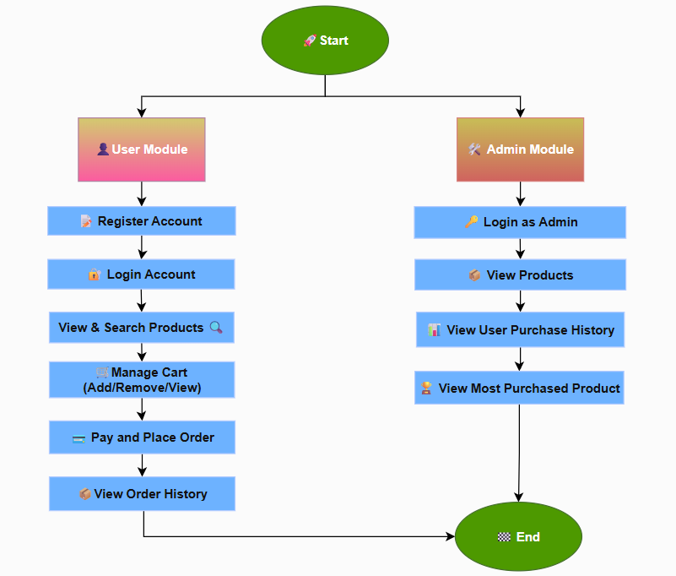
Project Flow

Slide 7
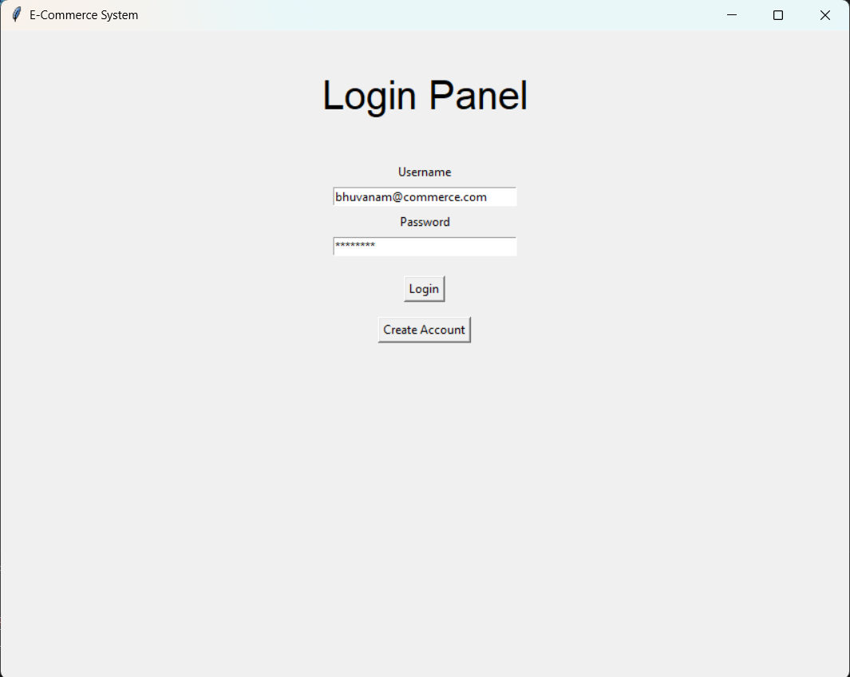
Project Steps and Screenshots
Login Panel
Users enter their username and password to log in.
If details are correct, they can access the shopping panel.

Slide 8
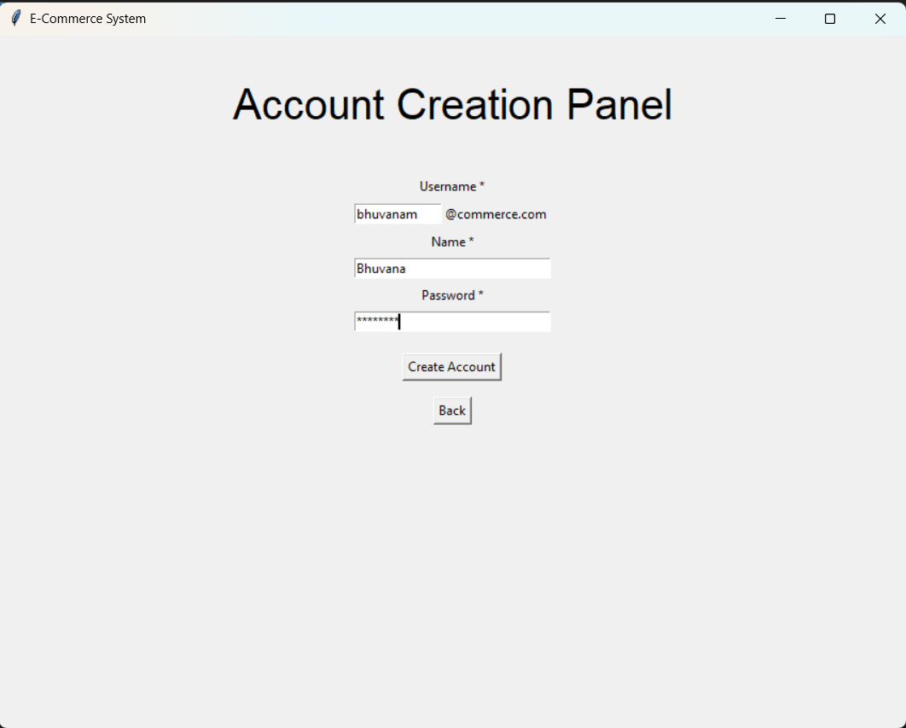
User Registration
Users can create an account by entering basic details.
The account is saved to allow login and access.

Slide 9
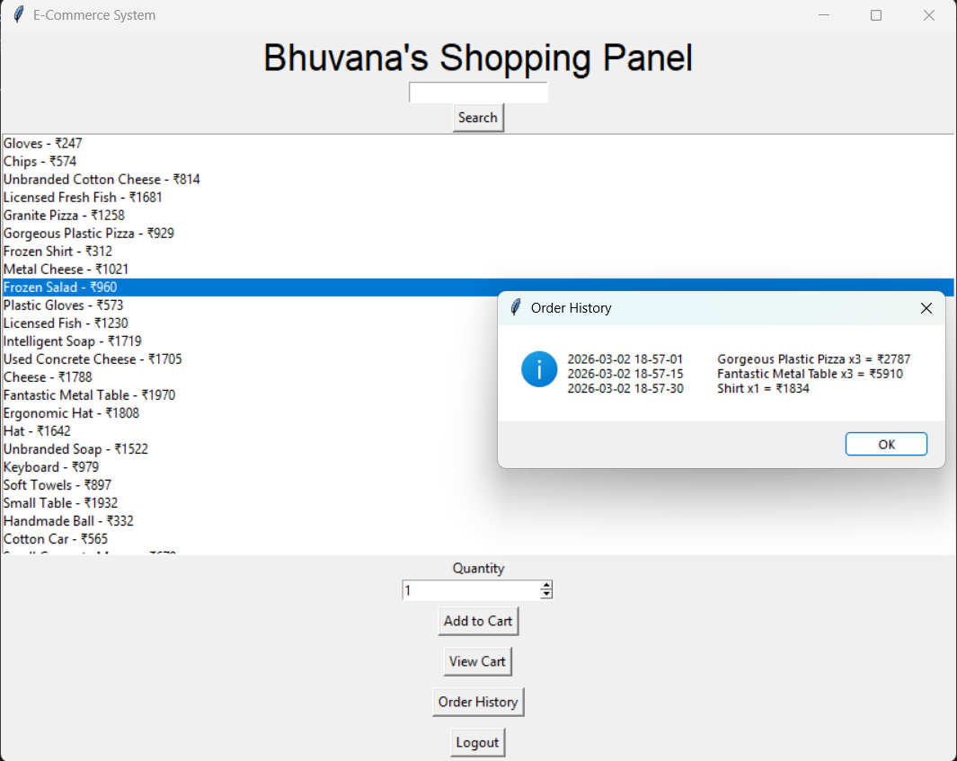
User Dashboard
Users can view and search products, and add items to the cart with the required quantity.
Users can place orders and view their order history anytime from the dashboard.

Slide 10
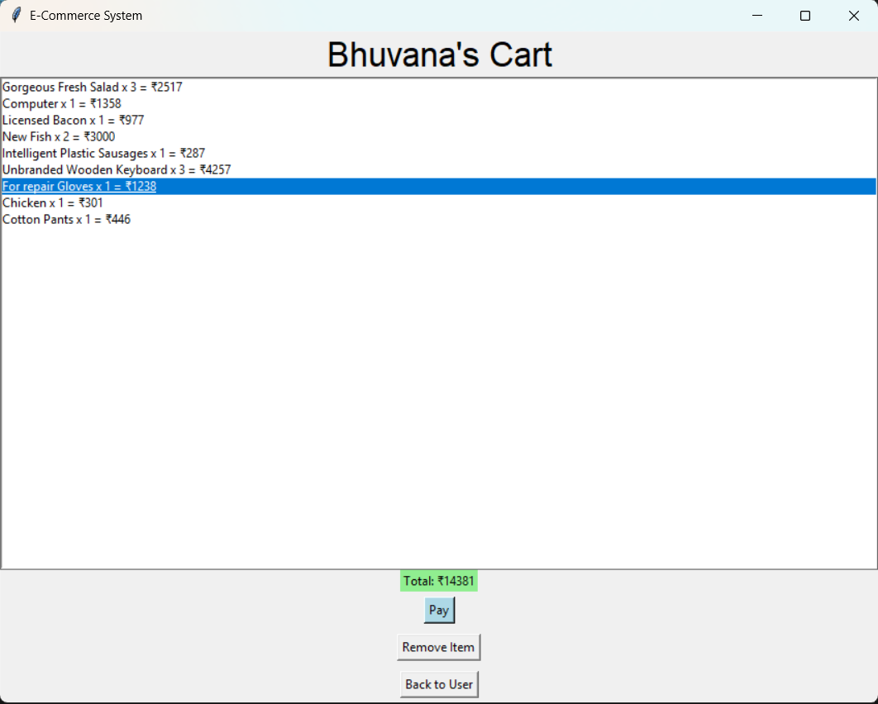
User Cart
Users can view cart items with quantity, individual amount, and total amount.
Users can remove items from the cart.
Users can proceed to payment and place the order.

Slide 11
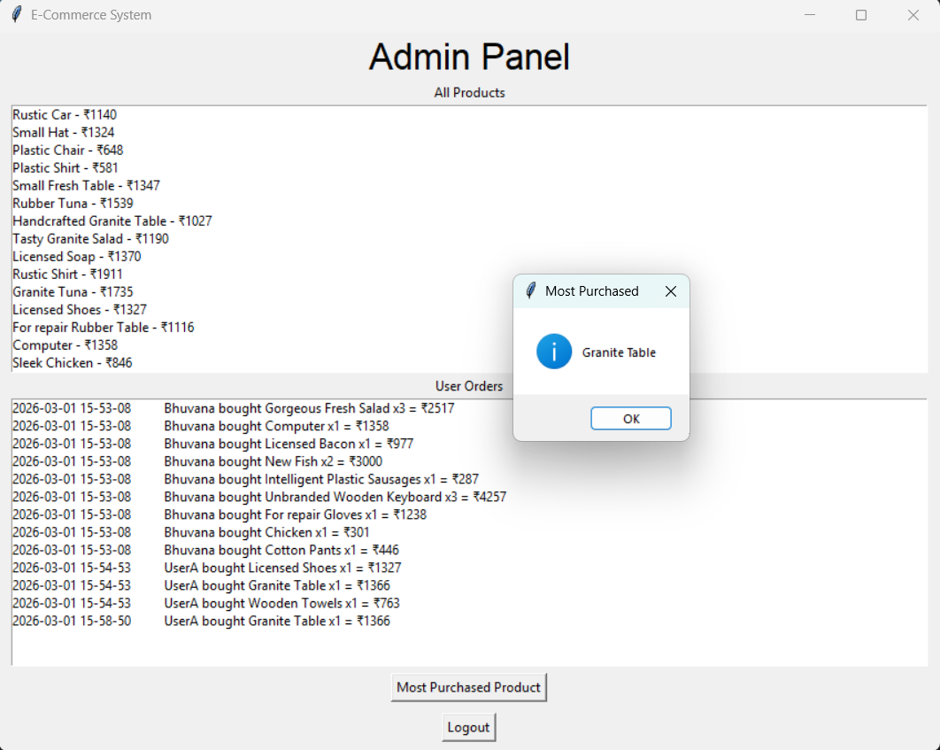
Admin Panel
Admin can view all products with their respective prices.
Admin can view all user purchases with timestamp.
Admin can see the most purchased product.

Slide 12
Business Insights and Recommendations
📊 Insights
User can register and login to the purchase products
The system successfully tracks users and their purchase behavior
Admin can identify:
Most purchased product
Active customers and customer purchase details
💡 Recommendations
Add database (MySQL / PostgreSQL)
Add payment gateway simulation
Add product categories
Add stock management
Add data visualization dashboard

Slide 13
Experience/Challenges faced
Managing state between frames
Handling multiple users in memory
Designing logical relationships without database
Implementing analytics without SQL
Handling edge cases in cart, login/registering & search product

Slide 14
Conclusion
Built a functional E-commerce system using Python and tkinter
Applied OOP principles
Implemented business logic without SQL
Created Admin analytics feature
Data handling

Slide 15

?

Slide 16


