Slide 1

Grammar Error Detection
✅
❌
✍️
📝
🔤
❓
Presented By: Bhuvana Mandli
Batch No. 493

Slide 2

ROADMAP
Agenda
01
02
03
Introduction
Business Problem
Dataset Overview
04
05
06
Data Preprocessing
Tokenization Strategy
Model Architecture
07
08
09
Model Training
Model Evaluation
Sample Predictions
10
11
12
Deployment
Challenges
Conclusion & Future Work
02
Grammar Error Detection with BERT

Slide 3
PROJECT METHODOLOGY
CRISP-ML(Q) Framework
This project follows CRISP-ML(Q) — the Cross-Industry Standard Process for Machine Learning with Quality assurance — an iterative framework that builds quality checks into every stage.
1
Business & Data Understanding
2
Data Preprocessing
3
Model Building
Define the goal — flag ungrammatical sentences and the exact wrong word — and inspect the FCE learner-essay corpus for how errors are annotated.
Split essays into sentences, label every word by whether an edit overlaps it, then filter, dedupe, and stratify-split.
Fine-tune a pretrained distilbert-base-uncased for token classification — a CORRECT / INCORRECT label for every word.
4
ML Model Evaluation
5
Deployment
6
Monitoring & Maintenance
Assess word-level accuracy, per-class precision/recall/F1, and macro F1 against a quality bar before release.
Save the model and tokenizer, then serve them in a Streamlit app that highlights the flagged words.
Track live predictions for gaps (e.g. missed errors, low INCORRECT recall) and extend the model as needed.
03
Grammar Error Detection with BERT

Slide 4
INTRODUCTION
Why Grammar Error Detection Matters
Bad grammar undermines writing before a reader gets to the ideas inside it. This project builds a model that reads a sentence and predicts whether it is grammatically CORRECT or INCORRECT — and which word is wrong.
She goes to school every day.
She go to school every day.
✅
❌
About the Corpus
Why It's Hard
The Goal
FCE learner-English exam essays with every human correction recorded as a character-level edit.
Errors are annotated at the essay level, not per word, and only ~13% of words are actually incorrect.
Fine-tune DistilBERT to classify every word, so one model flags both the sentence and the wrong word.
04
Grammar Error Detection with BERT

Slide 5
BUSINESS PROBLEM
Where Grammar Checking Creates Value
Manually proofreading thousands of essays, emails, or support tickets doesn't scale. An automated model can flag grammar issues the moment text is written.
✍️
🎓
🎧
📰
Writing Assistants
Education Tools
Support & Content QA
Publishing & Editing
Underline likely grammar mistakes in real time, the way a tutor would.
Give English learners instant, judgment-free feedback on their sentences.
Flag poorly-written tickets or listings for review before they reach customers.
Pre-screen submissions so human editors focus on style, not typos.
Goal: Predict whether a sentence is grammatically CORRECT or INCORRECT and at which word the error is, and deploy it as a live prediction tool.
05
Grammar Error Detection with BERT

Slide 6
DATA DESCRIPTION
Dataset Overview
25,596
2
21,756
3,840
Sentences after splitting essays
Classes: CORRECT / INCORRECT (389,696 words)
Training sentences (85%)
Test sentences (15%)
Sentence Distribution — All Labeled Sentences
Source
• FCE (Cambridge First Certificate in English) learner-essay corpus, annotated with character-level human corrections.
• Each essay is split into sentences and words; a word is INCORRECT only if an edit overlaps it, and a sentence is INCORRECT if any word is.
• INCORRECT sentences outnumber CORRECT ones ~1.9:1, but at word level only 12.9% (50,253) of words are incorrect.
06
Grammar Error Detection with BERT

Slide 7
DATA PREPROCESSING
From Essays to Labeled Words
Split into Sentences
A lightweight regex splitter breaks each essay into sentences and records each one's character start/end position.
1
Extract Edit Spans
Each annotator correction in the raw data has a (start, end) character span marking exactly where a mistake was made.
2
Label Every Word
Each sentence is split into words (with character positions); a word is tagged 1 (incorrect) only if an edit span overlaps it, else 0.
3
Clean & Split
Drop fragments under 3 words, remove duplicates, then take an 85/15 split stratified on the sentence label (INCORRECT if any word is).
4
07
Grammar Error Detection with BERT

Slide 8
FEATURE ENGINEERING
Tokenization: No Manual Embeddings Needed
Unlike a from-scratch embedding model, DistilBERT already understands language — so this project skips building a vocabulary or training word vectors entirely.
Tokenizing, Padding & Label Alignment
Why Subwords Matter Here
Tokenizer
A fixed word-list model treats any misspelled or unusual word as one generic <OOV> token — losing exactly the signal grammar detection needs.
AutoTokenizer for distilbert-base-uncased (WordPiece subwords)
Max length
32 tokens — padded to max length, truncated (words pre-split)
DistilBERT's WordPiece tokenizer instead splits an unfamiliar or misspelled word into known sub-pieces, so the model still sees useful structure — no OOV problem to design around.
Batch size
32 for training, 64 for evaluation
Example: "She go to school" → subwords → padded 32-length sequence; label on 1st subword only, rest = -100
08
Grammar Error Detection with BERT

Slide 9
MODEL BUILDING
DistilBERT for Token Classification
Input
DistilBERT
Token Classifier
Word Labels
Tokenized words
→
Pretrained encoder
→
Dense (2) per token
→
First subword → word
(32 subword tokens)
6 transformer layers
CORRECT / INCORRECT
-100 positions ignored
Cross-Entropy
Adam
1
32
distilbert-base-uncased
Loss
Optimizer
Epochs
Batch Size
Base Model
Note: only the token-classification head is newly initialized (weight decay 0.01) — everything else in DistilBERT is reused from pretraining and lightly fine-tuned.
09
Grammar Error Detection with BERT

Slide 10
MODEL EVALUATION
Word-Level Performance on the Held-Out Test Set
Class | Precision | Recall | F1-score | Support
CORRECT | 0.90 | 0.99 | 0.94 | 48,725
INCORRECT | 0.79 | 0.28 | 0.42 | 7,174
Macro avg | 0.84 | 0.64 | 0.68 | 55,899
Weighted avg | 0.89 | 0.90 | 0.88 | 55,899
Reading the numbers
• CORRECT words: precision 0.90, recall 0.99 — the model almost never flags a correct word (support = words, not sentences).
• INCORRECT words: precision 0.79 but recall only 0.28 — flagged words are usually right, but many errors are missed (only ~13% of words are incorrect).
90%
0.68
0.88
Overall Accuracy
Macro Avg F1-score
Weighted Avg F1-score
• Macro F1 (0.68) is the fairer summary — 90% accuracy is inflated by the dominant CORRECT class.
10
Grammar Error Detection with BERT

Slide 11
MODEL IN ACTION
Sample Predictions
“She go to school every day.”
“She goes to school every day.”
“I have went to the store yesterday.”
“He doesn't like coffee.”
❌
✅
✅
✅
INCORRECT · flagged: “go”
CORRECT
CORRECT
CORRECT
The model flags the wrong word in subject-verb agreement errors (“go”), and clean sentences pass — but it misses “have went”, consistent with the low INCORRECT recall (0.28).
11
Grammar Error Detection with BERT

Slide 12
MODEL DEPLOYMENT
A Live Streamlit Prediction App
The fine-tuned model and tokenizer were saved and served through a lightweight Streamlit app for real-time grammar checking.
1
2
3
4
Save Artifacts
Build the UI
Tokenize & Predict
Display Result
model.save_pretrained() / tokenizer.save_pretrained() write config, weights & tokenizer into distilbert_ged_token_model1/.
A Streamlit text area collects a sentence, styled with a background image and a "Check Grammar" button.
The sentence is split into words and run through the same tokenizer; the model predicts CORRECT/INCORRECT for each word (first subword).
Any INCORRECT word makes the sentence INCORRECT, and the flagged word(s) are shown; otherwise the sentence is CORRECT.
12
Grammar Error Detection with BERT

Slide 13
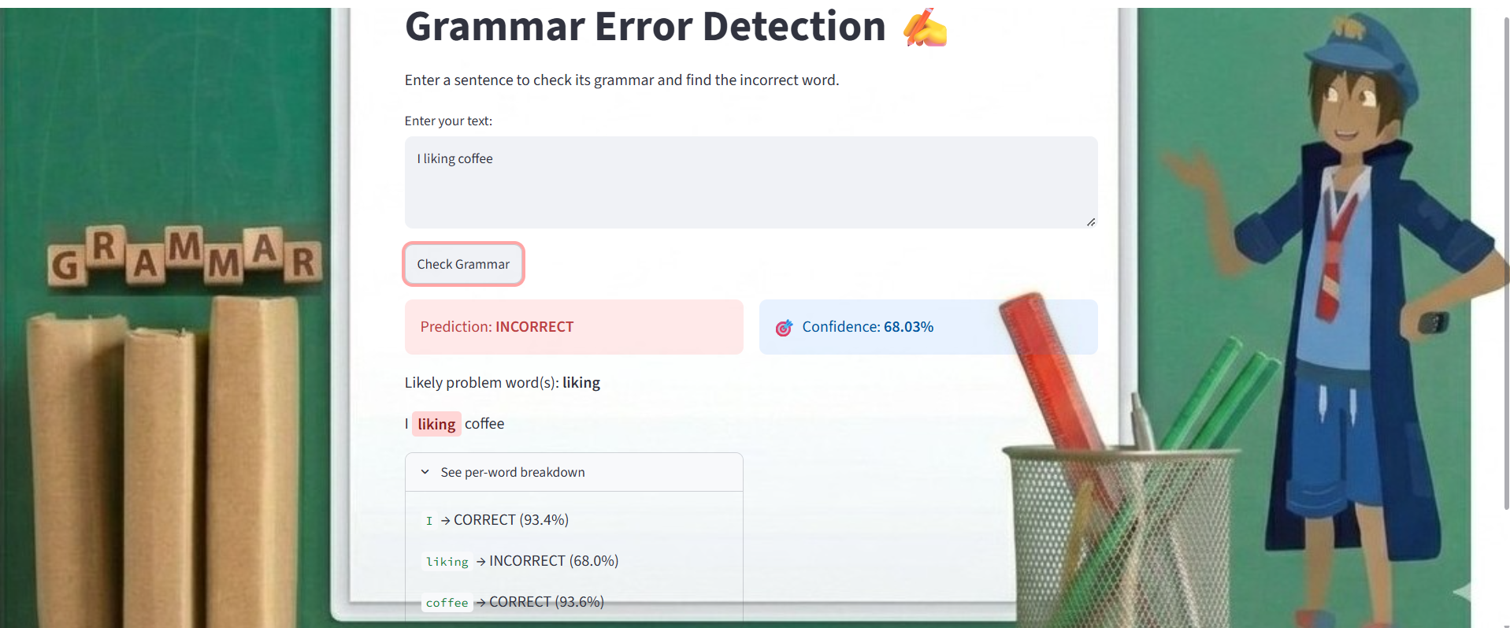
Streamlit Prediction Screenshot

Slide 14
CHALLENGES
What Made This Harder Than It Looks
📐
⚖️
🐢
Essay-Level Labels
Class Imbalance
CPU-Only Training
The dataset only marks edits at the essay level — word-level labels had to be built by overlapping edit character spans with each word's span.
Only ~13% of words are INCORRECT, so the model favors CORRECT — recall on INCORRECT words is just 0.28.
No GPU was available, so max sequence length, batch size, and epoch count all had to be tuned down to keep training feasible.
13
Grammar Error Detection with BERT

Slide 15
CONCLUSION
From Raw Essays to a Deployed Grammar Checker
90%
0.68
2
25,596
Word-Level Accuracy
Macro F1-score
Classes Predicted
Sentences Used
Built end-to-end: essay parsing → sentence splitting & word labeling → DistilBERT token classification → word-level evaluation → Streamlit deployment.
Future Work
Improve recall on INCORRECT words (e.g. class weighting or oversampling), since only 28% of errors are caught.
Apply Encoder-Decoder for this architecture to correct the sentences.
Train for more epochs on a GPU for a stronger overall macro F1.
14
Grammar Error Detection with BERT

Slide 16
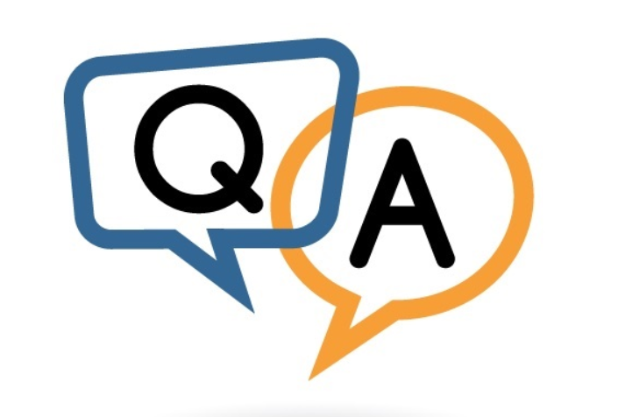
?

Slide 17
✅
❌
✍️
📝
🔤
❓
Thank You

