Slide 1

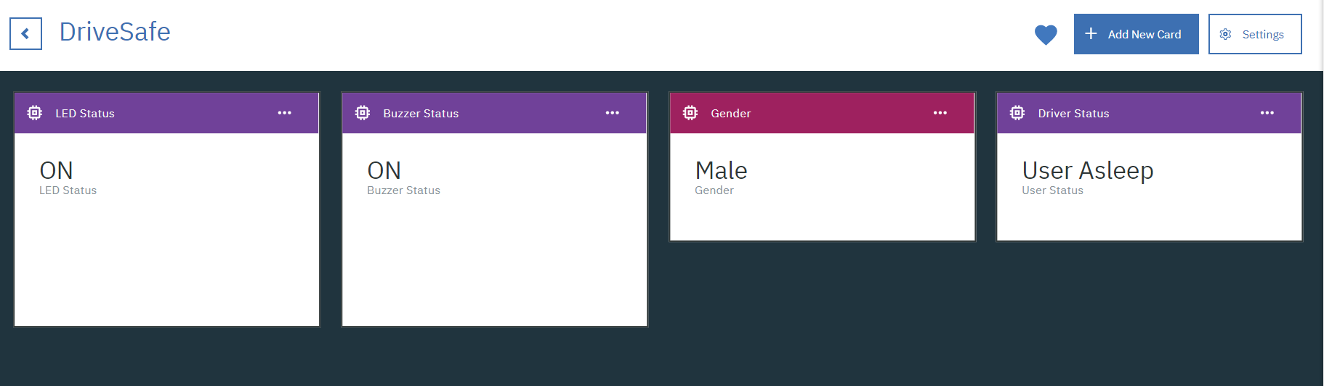
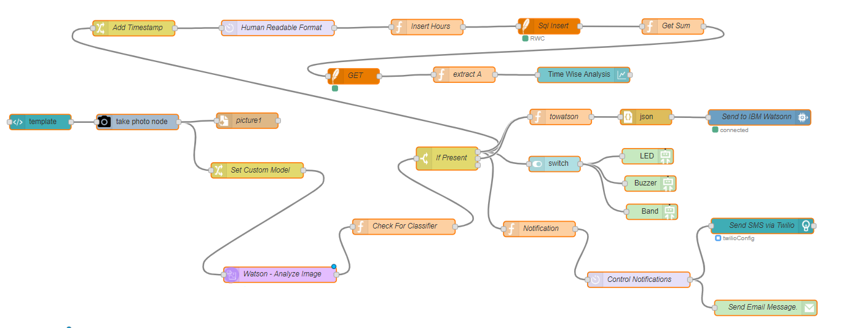
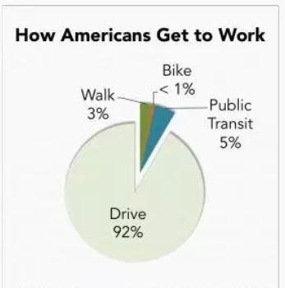
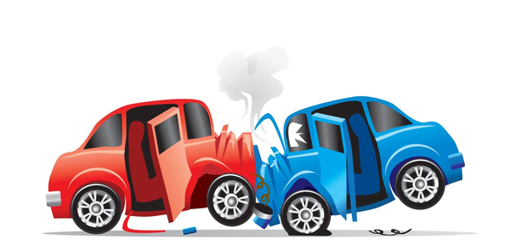
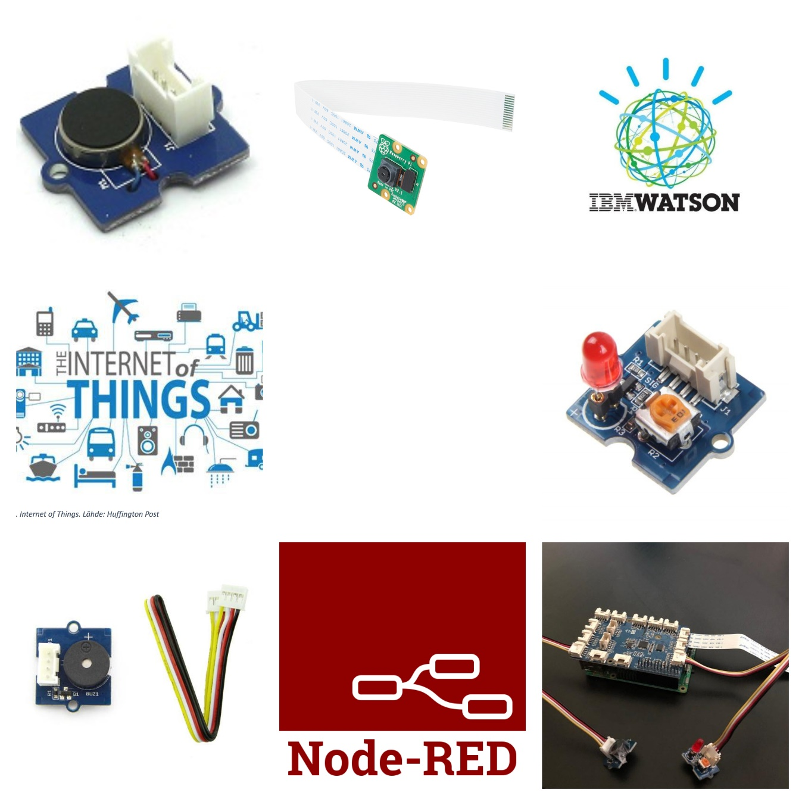
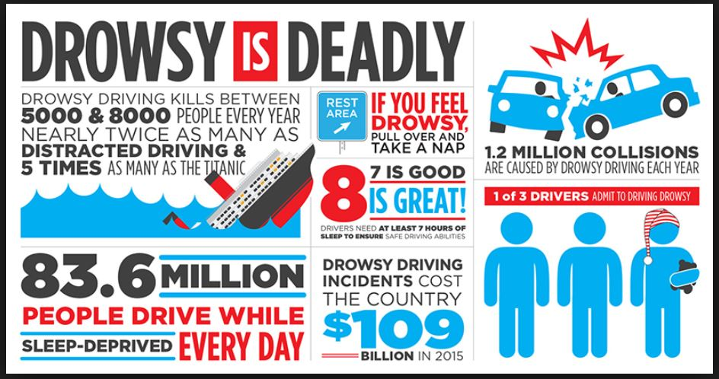

DriveSafe
Bhuvaneswari Keerthivasan, Poornima Dixith
University of Washington
Introduction
Proposed System vs Existing Solutions
Approximately 50% of car accidents are due to distracted driving. Driving is a routine daily life activity for many people. Studies have shown that driver drowsiness is one of the main reasons for many major accidents which often result in physical injury or loss of life and loss of money. With the increasing urban population, distracted driving detection becomes increasingly useful to avoid or minimize loss of life on roads. According to a survey by the National Highway Traffic Safety Administration of the United States of America (USA), police studied more than hundred thousand crashes that occurred due to the driver distraction or drowsiness that led to major losses such as 71,000 wounds, $12.5 billion budgetary mishap and over 1,550 deaths. Keeping track of driver capabilities can help alert drivers who are distracted or falling asleep while driving and enables insurance companies to detect distracted behaviors in an attempt to reduce crashes and claims. Our proposed solution consists of a device that contains sensors and a camera to be used for detecting distracted driving behavior. The device will continuously capture images and uses sensor data to determine if a driver is distracted or falling asleep. The system will help insurance companies build distracted driving capabilities profile for drivers (or potential drivers who are likely to be distracted while driving) and notify them in case of distracted behavior detection. This will include the duration and the severity level of the pattern. In addition, the system will alert the driver when such patterns are discovered in an attempt to provide driving coaching and safety awareness while driving.
Here is where our proposed solution stands out with respect to the following:
Cost is comparatively much less than existing ones.
The device is hardware independent - can be adapted to any car (unlike existing ones which are often proprietary).
This solution can connect to insurance companies in a service-oriented approach and hence will support insurance companies get the data they need and provide them insights about driving patterns.
Existing solutions often connect to cloud to store data which is not feasible as we would like to build an edge-based device that can process data locally and alert drivers accordingly while minimizing network traffic and faster notifications.
The proposed solution is intended to reduce driving accidents in urban cities to a very low rate to avoid significant accidents and reduces driving behavior which often leads to these accidents. By keeping track of driving patterns, insurance companies can also attain a lower insurance claims by a much lower number than current ones. In addition, helping reduce car accidents will improve urban transportation and enable people to have safer commutes without delay to a great extent. Furthermore, it will help police and emergency response personnel to use their resources (e.g. police officers) in other tasks than writing police accident reports.
Chart : Male/Female ratio and Time Wise Analysis.
Tools and Technologies
Commute to work
Results
Enabling police and insurance companies to track a safety score for potential drivers who are likely to be distracted or get drowsy while driving we believe is of tremendous value to help make roads safer. Through this system, insurance companies, for example, can infer about bad driving behavior and potentially include other parameters that can contribute to his behavior such as day of the week, commuting distance, driver’s speed, braking, among others. Having an individualized safety score will help make roads safer and will eventually force distracted drivers to be more committed as well help those that may have medical conditions or uncontrollable drowsiness to be alerted before danger or car accident can happen. Therefore, we believe that this system is innovative and will help make urban transportation safer, help save lives and reduce delays caused by the accidents on the roads.
Contact
Bhuvaneswari Keerthivasan, Poornima Dixith
University of Washington
bkeerthi@uw.edu , pdixith@uw.edu
Phone: +1 480-930-3916 , +1 206-499-8790

