Slide 1

DataSpark - Illuminating Insights for Global Electronics
Capstone Project – 2
By:
Bhuvaneswaran R

Slide 2

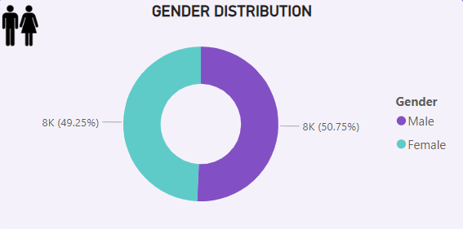
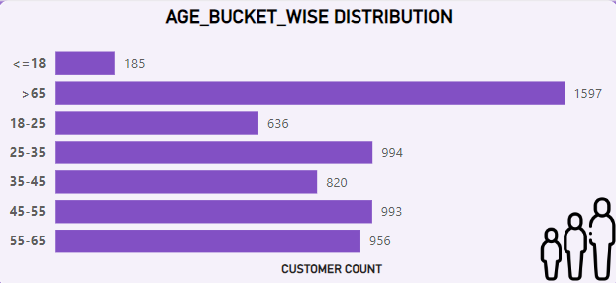
Customer Analysis
Gender Analysis:
We can see the male customers are dominating in number when compared to female
Female targeted advertisements can help us fight this imbalance and grow overall sales
Age Analysis:
The customers are bucketed based on their age and then visualised using the bar chart.
We can see that the people above 65 years are higher in counts than others

Slide 3
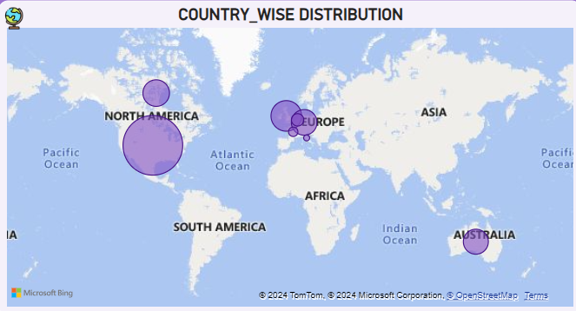
Customer Analysis
The locations wise analysis was represented using the world map.
The size of the bubble says about the intensity of sales from that area.
The country wise analysis suggests that the North America is having Highest sales.

Slide 4
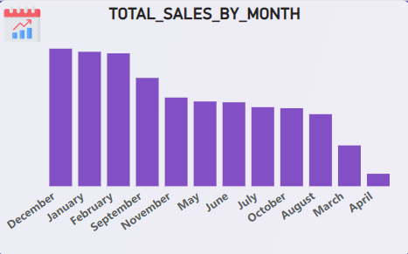
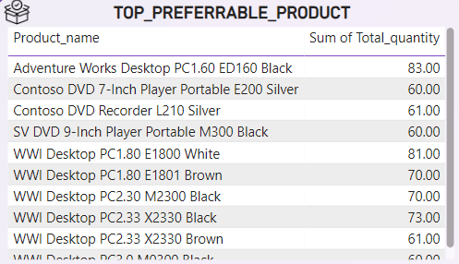
Sales Analysis
Sales Analysis
Monthly sales:
We can see the highest sales are there in Jan, Feb and Dec for which the inventory should be ready to face the hike in demand.
The April and march month has recorded the lowest sales which can be overcome by doing proper marketing and maintaining good product portfolio
Top Performers:
We can see that the computers are the top performers maintaining good SKU based on colours is important as we can see god proportion in each color

Slide 5
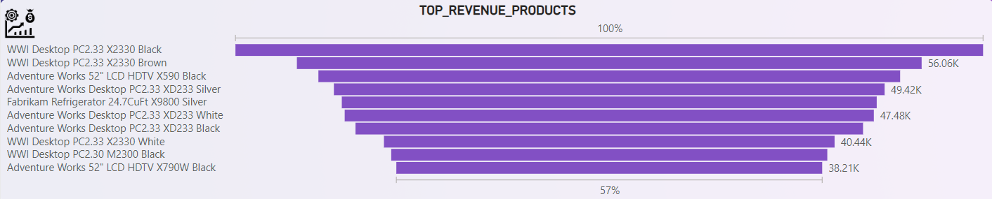
Sales Analysis
Sales Analysis
Sales Analysis

Slide 6
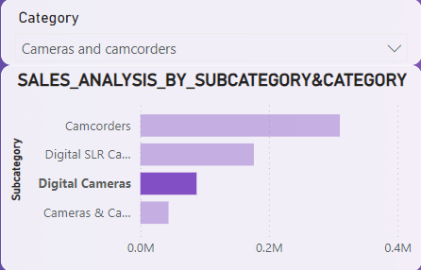
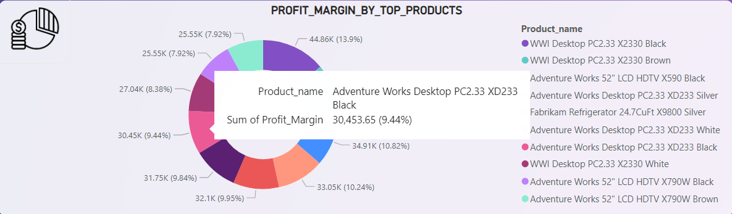
Product Analysis
Product Analysis
Product Analysis
Profit Margin by Top Products:
From the Donut chat that has been shown for the top 10 products ti has been understood that the 10 tier products are not non uniformly distributed, they are properly distributed suggesting good signs.

Slide 7
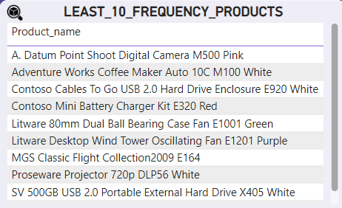
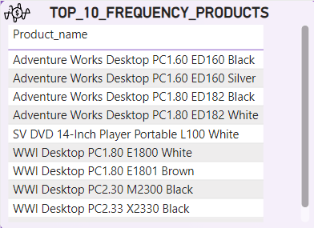
Sales Analysis
Sales Analysis
Sales Analysis
Least 10 Frequency Products:
We can see that the larger proportion of the least 10 products are from home appliances, camera segment.
Making the competitor analysis will help us understand the gaps in our current products.
Top 10 Frequency Products:
The top selling products are from the Desktop and computer segment.
It’s recommended to maintain sufficient inventory to meet the customer demand

Slide 8
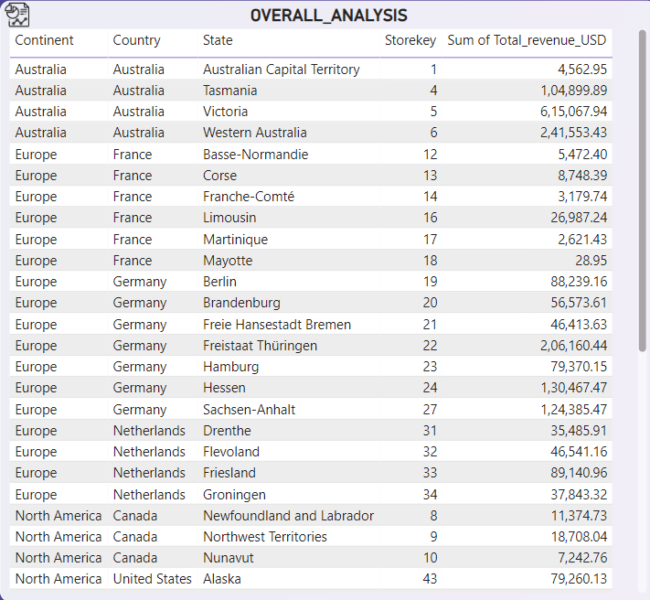
Store Analysis
Store Analysis
Store Analysis
Overall Analysis:
After seeing the total revenue, it has been understood that the sales from north American stores are the highest.
There are very less number of stores in Australia which can cost us the opportunity.
Spreading the company across the Australia can help the company grow its sales well

Slide 9
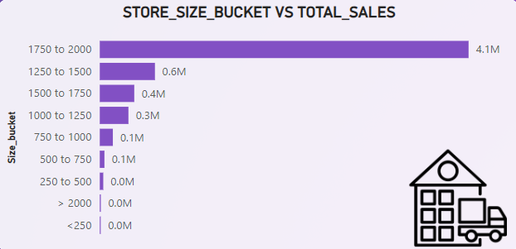
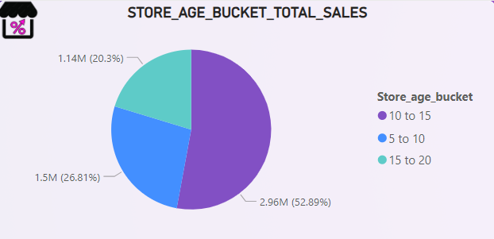
Store Analysis
Store Analysis
Store Analysis
Store Size analysis:
We can see that the stores with the area between 1750 to 2000 are contributing to morethan 50% of the entire sales.
We can see the stores with the highest area are not the highest selling.
Store Age analysis:
If the age of the store is between 10-15 then they are contributing to the highest amount of sales.

Slide 10
Thank You!!

