Slide 1


SkyTalker: Bridging the Cosmos and Earth
SkyTalker is an innovative platform designed to answer all your astronomical questions while contributing to the fight against global warming.

Slide 2
Unveiling the Wonders of the Universe
Comprehensive Astronomical Knowledge
Educational Platform
SkyTalker serves as a hub for detailed insights into celestial bodies, astronomical phenomena, and space exploration.
Its user-friendly interface makes it easy for anyone to explore the vast universe of astronomy.

Slide 3


Beyond the Stars: Environmental Sustainability
Ecosia Search Engine Integration
SkyTalker incorporates Ecosia's search engine model, enabling users to plant trees with every search they make.

Slide 4



A Fusion of Knowledge and Action
1
Curiosity
2
Learning
3
Action

Slide 5

Your Curiosity, Our Planet
Explore the cosmos
Make a positive impact
Dive deep into fascinating celestial bodies, phenomena, and space missions.
Every search you make contributes to tree planting worldwide.

Slide 6
SkyTalker: Connecting Stars and Sustainability
1
Astronomy
2
Education
3
Action

Slide 7

Empowering a Brighter Future
By fostering a deeper understanding of our universe, SkyTalker inspires us to protect and preserve our planet for generations to come.

Slide 8
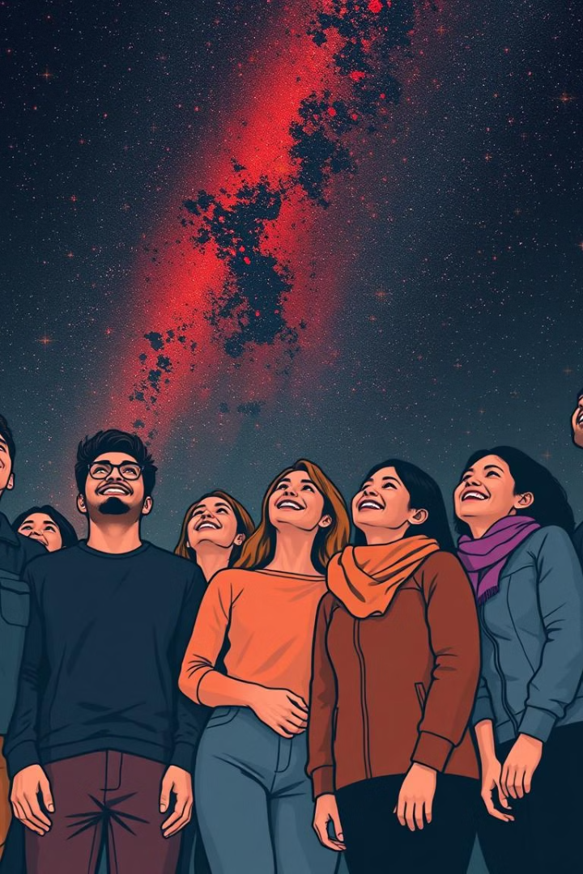
Join the SkyTalker Community
Explore the wonders of the universe and make a difference on Earth. Start your journey with SkyTalker today!

