Slide 1
Demo: Deploying Infrastructure using Terraform
Notes:
Let me show you how this works.

Slide 2
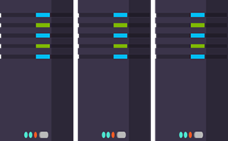
Terraform is an open-source infrastructure as code software tool created by HashiCorp. It enables users to define and provision a datacenter infrastructure using a high-level configuration language known as Hashicorp Configuration Language or optionally JSON.
Terraform WorkFlow
Plan
Write
Apply

Slide 3
Basic commands
Terraform init: initialize the required plugin to run the terraform code ​
Terraform plan: Used to create an execution plan.​
+ indicates resources creation ​ - indicates resources destroyed​ ~ indicates resources will be updated in plan​ -/+ indicates resources destroyed and re-created​
Terraform apply: command is used to apply the changes required to reach the desired state of the configuration​
Terraform destroy: command used to destroy all running infrastructure which are created by terraform

Slide 4
Key Concepts in terraform
Providers: A source of resources. [With an API endpoint and authentication. E.g AWS]
Resource: Everything that has a set of configurable attributes and a lifecycle such as create,read, update, delete. [aws ec2 instance] -- impies id and state
Data : information read from providers. E.g. lookup from own AWS account for ami_id or keypairs.
Provisioner: initialize a resource from a local or remote script.
Output: Shows values that are highlighted after terraform applies. Can be seen by running command: terraform output

Slide 5
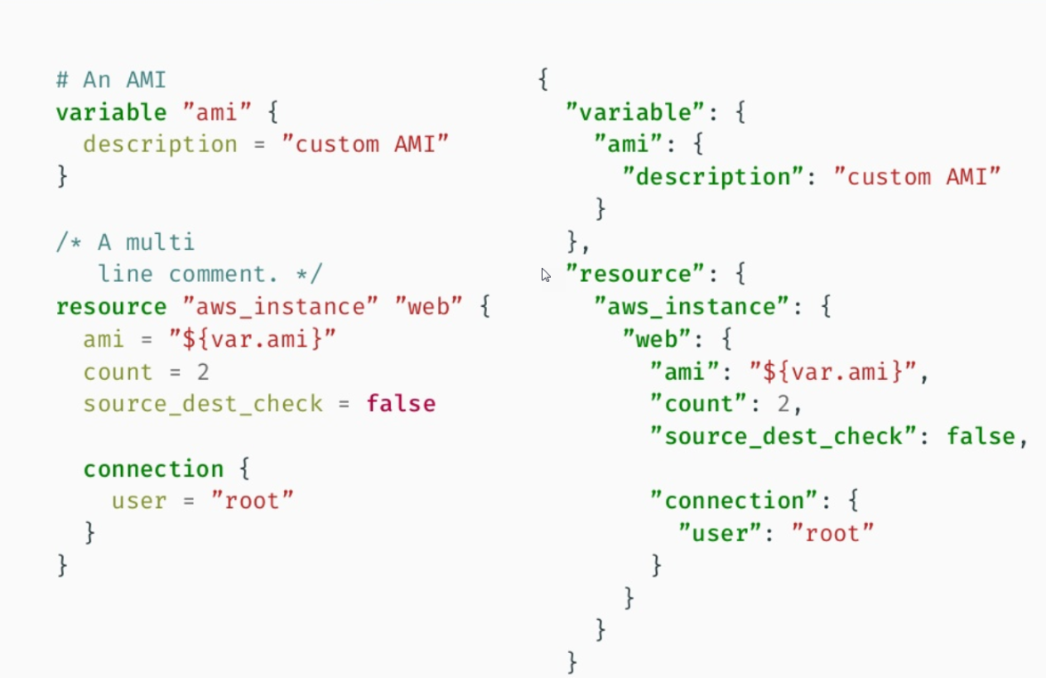
HCL VS JSON Terraform format ends in : .tf and .tf.json

Slide 6
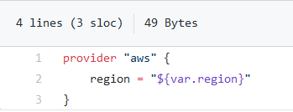
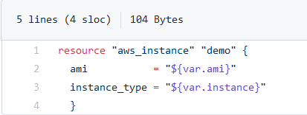
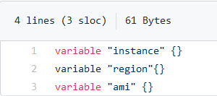
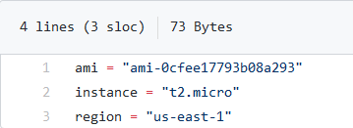
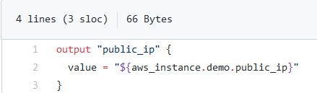
Configuration
The set of files used to describe infrastructure in Terraform is simply known as a Terraform configuration. Here we have some templates.
provider.tf resources.tf variable.tf
terraform.tfvars outputs.tf

