Slide 1
Detection and Exploitation of HTML Injection Vulnerability (Reflected XSS)

Slide 2


Slide 3

RESEARCH
Name: PortSwigger Web Security Academy Lab
URL: Lab: Reflected XSS into HTML context with
nothing encoded | Web Security Academy
Category: Cybersecurity Training Platform
Type: Vulnerable Web Application (Lab Environment)
Popularity:The platform is widely used by cybersecurity
learners and professionals for practicing real-world
vulnerabilities.

Slide 4
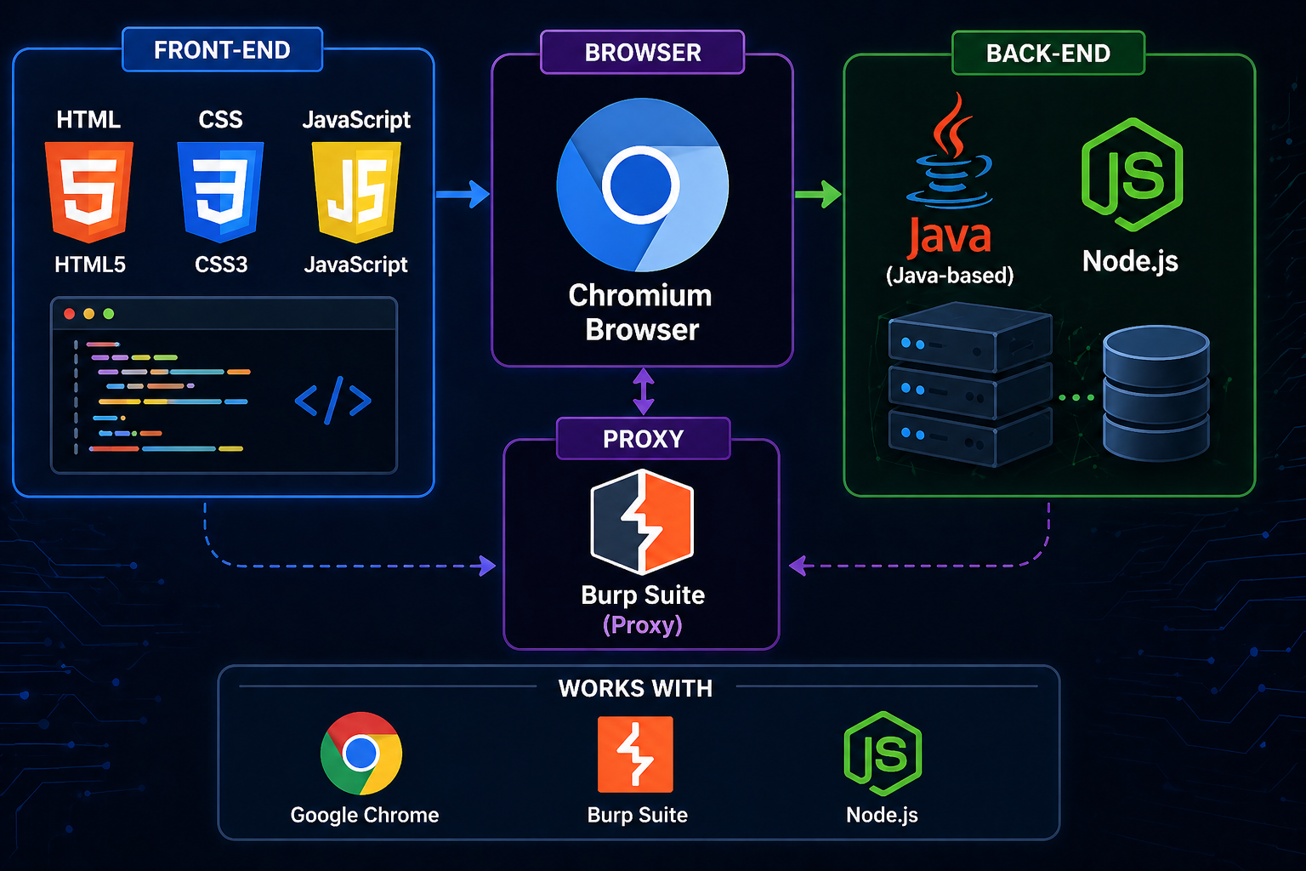
TECHNOLOGY STACK
Frontend: HTML, CSS, JavaScript
Backend: Likely Java-based or Node.js (Lab environment)
Browser Used: Chromium (via Burp Suite)
Testing Tool: Burp Suite (Proxy Browser)

Slide 5
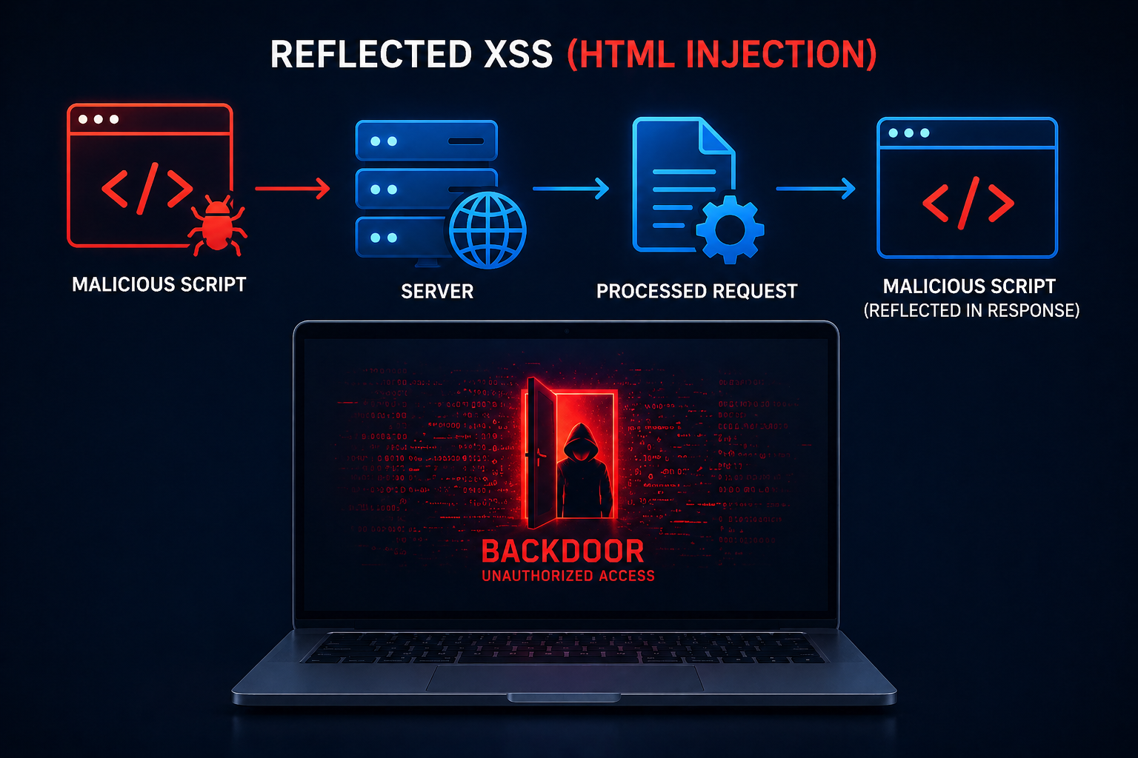
VULNERABILITY DESCRIPTION
Type: Reflected XSS (HTML Injection)
Explanation:The application takes user input from the search field and directly reflects it in the response without encoding.
This allows attackers to inject malicious scripts such as:
</> HTML
<script>alert(1)</script>

Slide 6
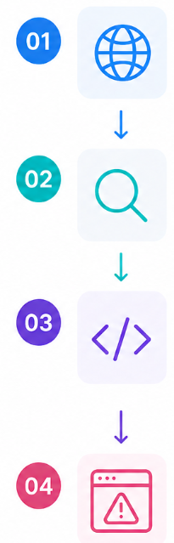
PROOF OF CONCEPT (PoC)
Step-by-Step Attack:
Open the lab website
Go to the search bar
Enter payload: <script>alert(1)</script>
Submit the request
Observe JavaScript execution (popup alert)

Slide 7
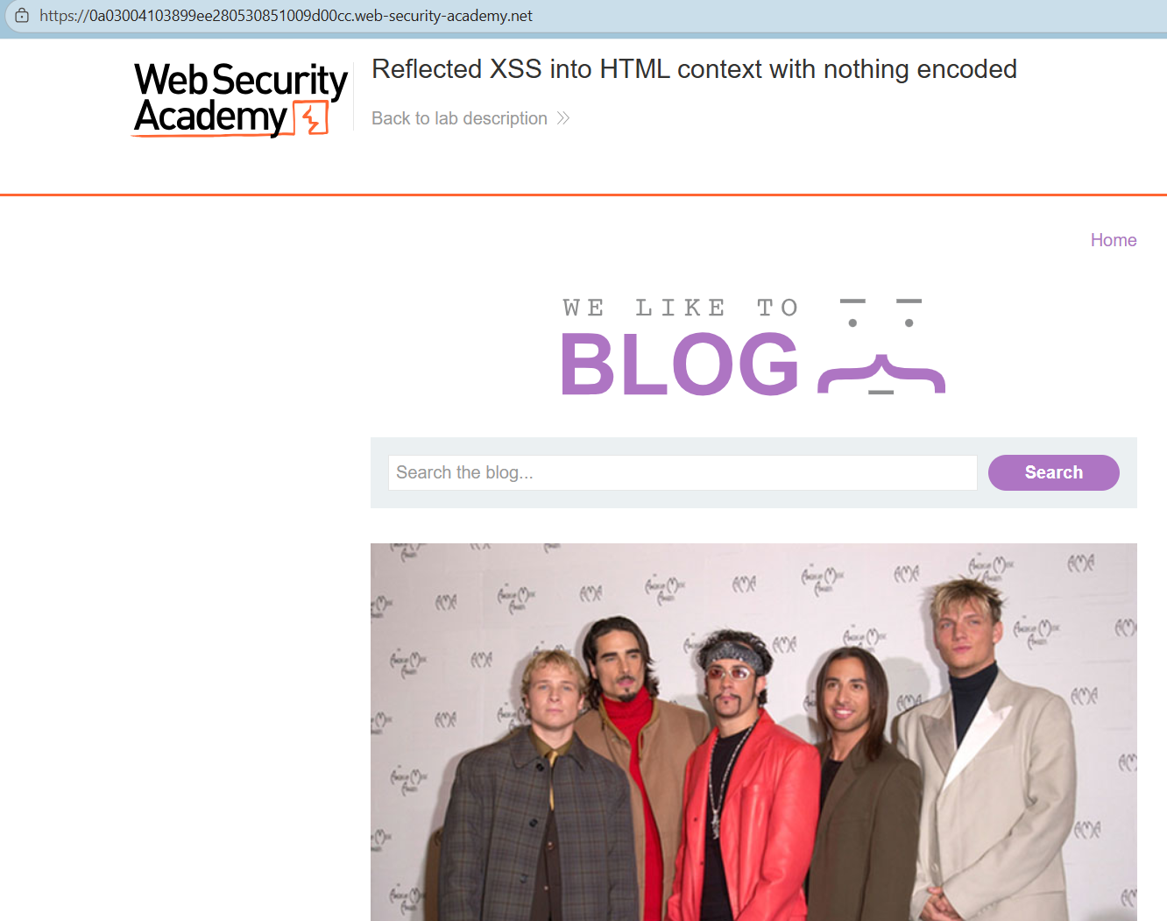
Figure 1: Initial vulnerable website homepage

Slide 8
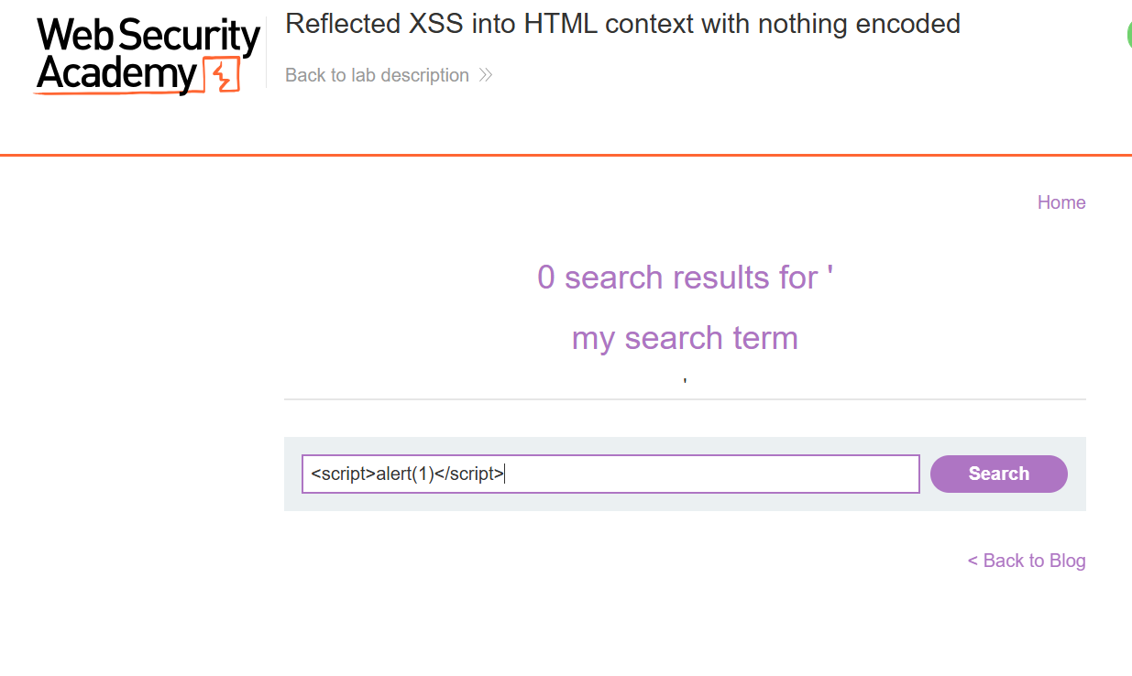
Figure 2: Injecting malicious script into search field

Slide 9
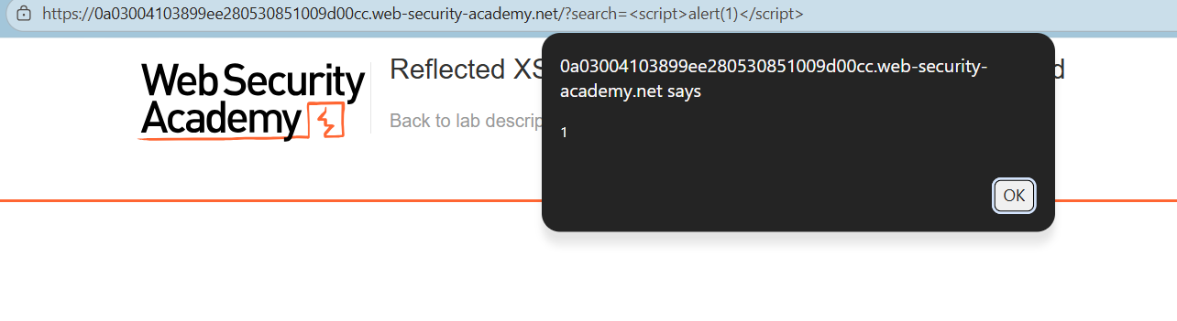
Figure 3: Successful execution of injected script (alert box)

Slide 10
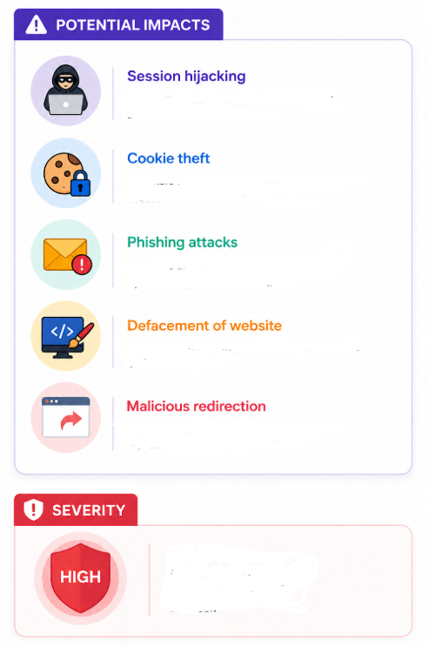
IMPACT ANALYSIS
This vulnerability is classified under: OWASP Top 10 - A03: Injection
Potential Impacts:
Session hijacking
Cookie theft
Phishing attacks
Defacement of website
Malicious redirection
Severity:
High, because attacker-controlled scripts execute in the victim’s browser.

Slide 11
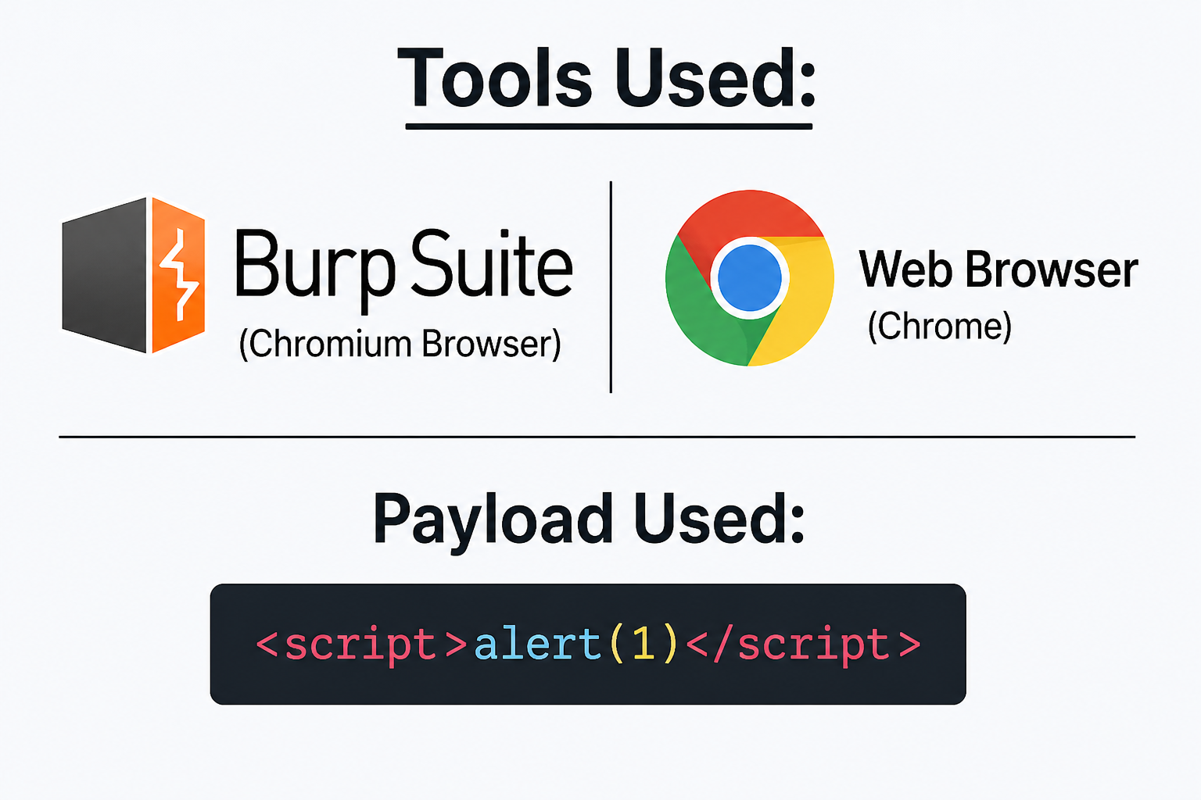
CODE / TOOLS USED
Tools:
Burp Suite (Chromium Browser)
Web Browser (Chrome)
Payload Used:
<script>alert(1)</script>

Slide 12
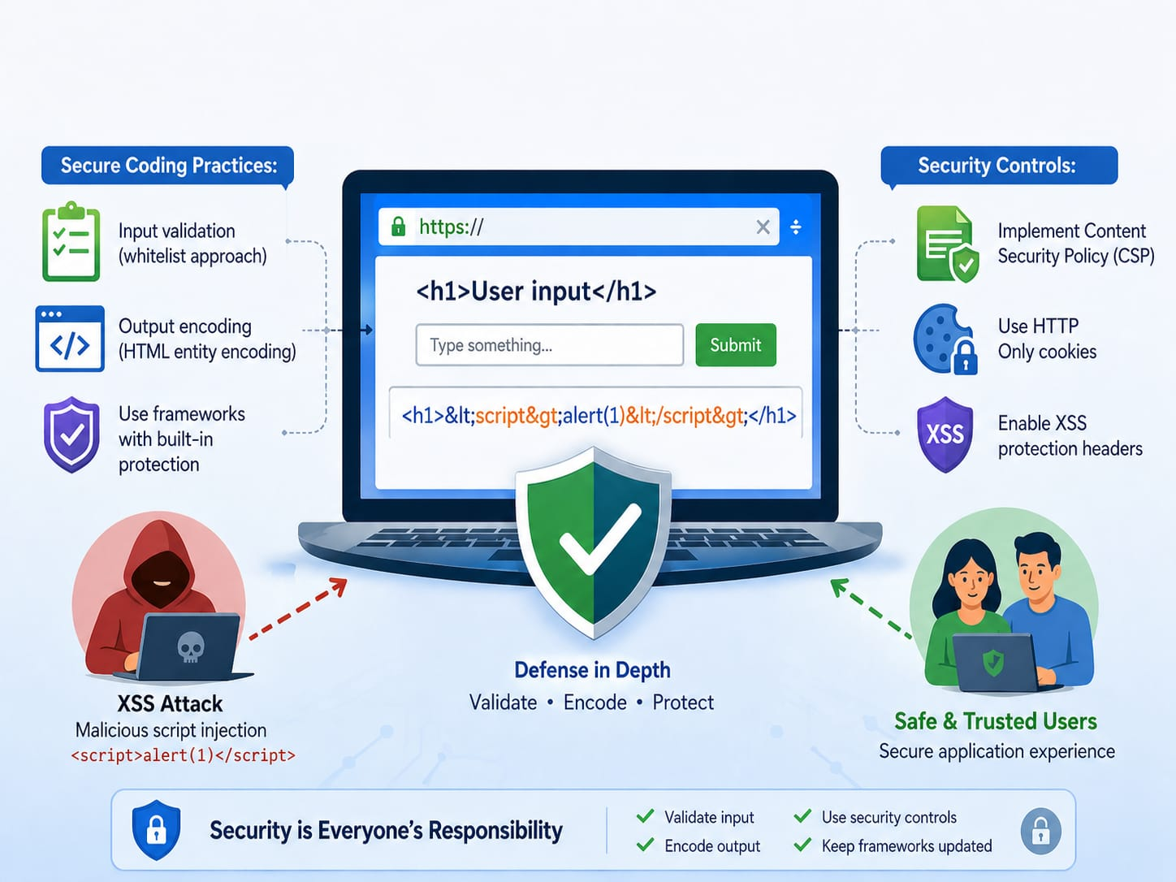
RECOMMENDATIONS (MITIGATION)
Secure Coding Practices:
Input validation (whitelist approach)
Output encoding (HTML entity encoding)
Use frameworks with built-in protection
Security Controls:
Implement Content Security Policy (CSP)
Use HTTP Only cookies
Enable XSS protection headers
Example Fix:
Instead of:
<h1>User input</h1>
Use:
<h1>&lt;script&gt;alert(1)&lt;/script&gt;</h1>

Slide 13
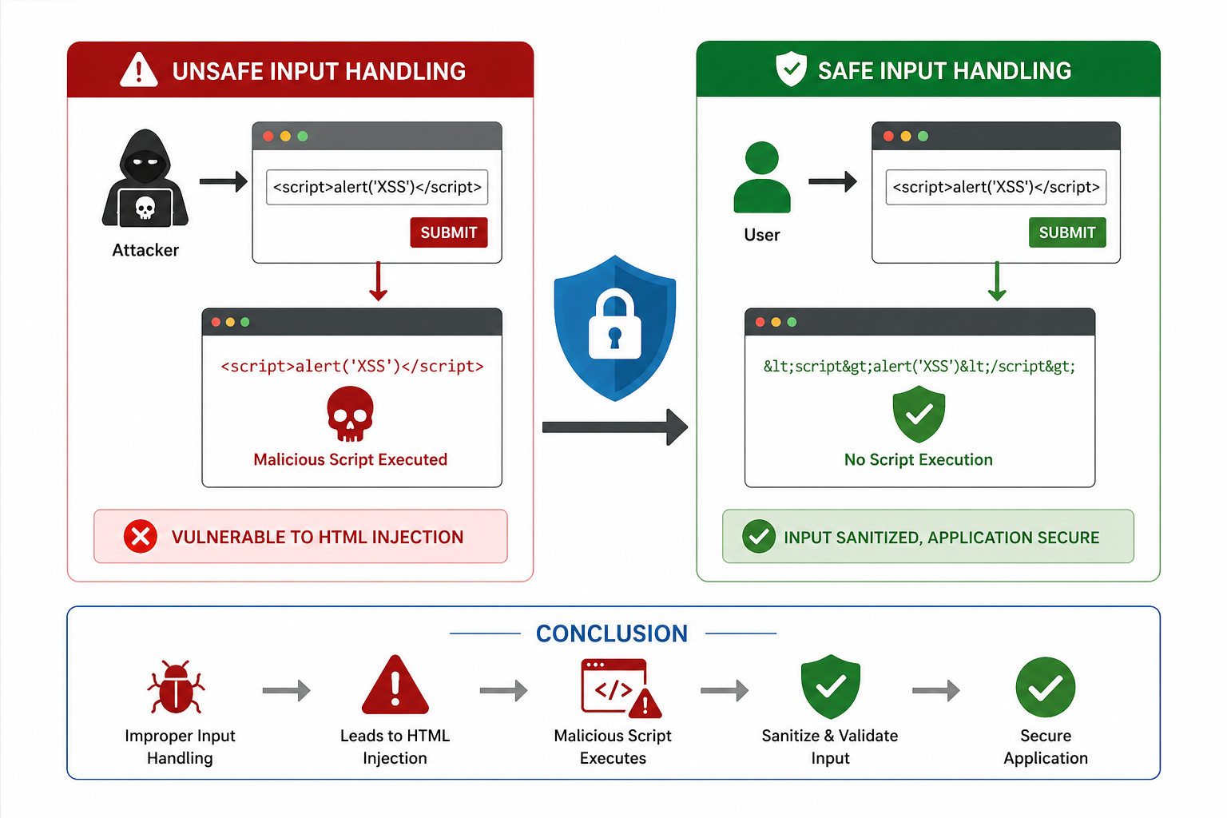
CONCLUSION
This project successfully demonstrated
how improper input handling leads to HTML Injection vulnerabilities.
The PoC confirmed that malicious scripts can execute in a user’s browser,
highlighting the importance of secure coding and input sanitization.

Slide 14
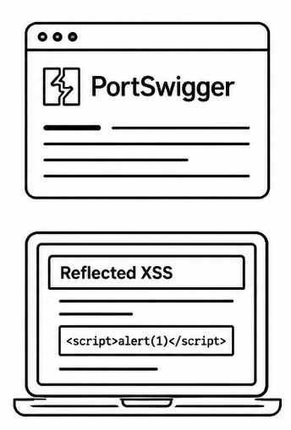
REFERENCES
PortSwigger – https://portswigger.net/web-security
Reflected XSS Documentation – https://portswigger.net/web-security/cross-site-scripting/reflected

Slide 15
Thank You!

