Slide 1
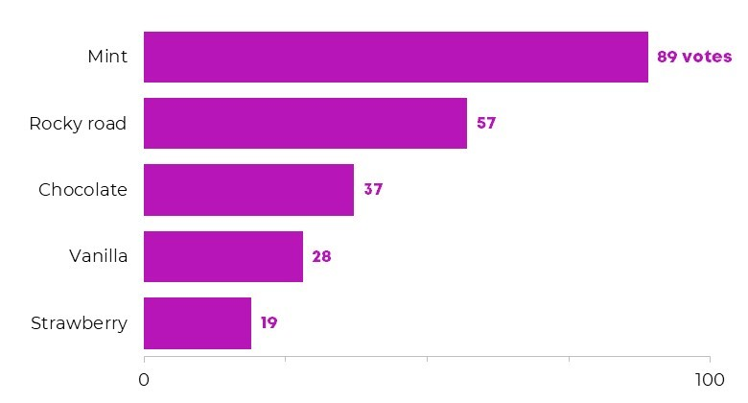
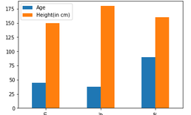
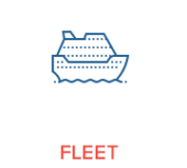
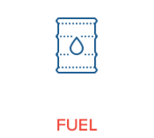

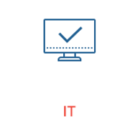
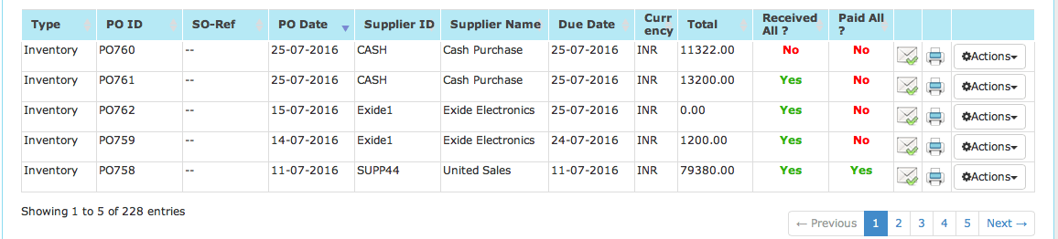

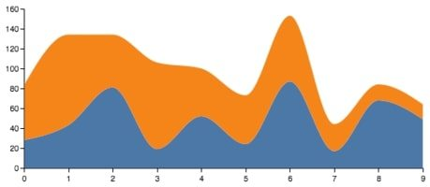
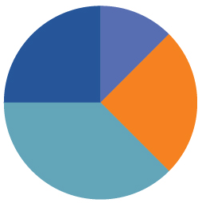
Pending Approval
Category/ Vendor Group summary
32
64
57
19
Vendor Spend
Purchase order Summary
Purchase order Filters
Date from:
Date To:
PO No. from:
PO No. To:
Category :
Sub-category:
Budget
Fleet
Total Budget: $10,000,000
Budget Utilized: $6,500,000
Budget Remaining: $3,500,000
Budget
Utilized
Status
Type

