Slide 1

Azure Virtual Machine Extension Standardisation
Project 24CC3046-P090 — Category: Operations. Cross-team initiative between T090 and T192 to ensure consistent, reliable VM extension state across subscriptions.
OPERATIONS
T090 • T192

Slide 2




Problem Statement & Key Use Cases
Problem
VMs sometimes have missing or failed extensions leaving machines partially configured. Multiple agents may conflict and consume CPU, memory and network.
Use Case — Detection
Detect VMs missing required monitoring or security agents across subscriptions and resource groups.
Use Case — Remediation
Automated, policy-driven remediation to install or repair approved extensions and verify success.

Slide 3
Objectives — What Success Looks Like
Discover
Inspect
Check
Automatically find all Azure VMs using Resource Graph + tags.
Enumerate installed extensions, versions, and statuses.
Compare installed extensions against the standard compliance baseline.
Detect
Remediate
Verify & Report
Flag missing, failed, or conflicting agents for action.
Apply approved extensions via automation runbooks or Azure SDK.
Confirm state post-remediation and generate compliance reports.
Main flow: Discover → Inspect → Check → Detect → Remediate → Verify → Report

Slide 4

Proposed System Architecture
Azure Subscription
Azure VMs
Extension Inspection
Compliance Engine
Centralised compliance engine driven by discovery feeds, inspection agents (read-only + remediation), and monitoring pipelines feeding dashboards and alerts.

Slide 5

Azure Requirements & Supporting Services
Core services required:
Azure VMs — target machines for standardisation
Virtual Network & Subnets — ensure reachability for agents
VM Extensions — the objects being standardised
Azure Monitor Agent + Log Analytics — monitoring & evidence
Resource Graph — fast VM/resource discovery
Python + Azure SDK — automation and orchestration
Optional supporting services: Azure Automation, Defender for Cloud, Key Vault (secrets), Storage accounts for artefacts.

Slide 6
Functional Requirements (FR)
1
FR-01 Discover VMs
Scheduled and on-demand scans via Resource Graph.
2
FR-02 Inspect Extensions
Collect extension name, version, publisher, status and timestamp.
3
FR-03 Check Compliance
Compare against an approved extension manifest per workload type.
4
FR-04 Detect Missing/Failed
Generate tickets/alerts for non-compliant VMs.
5
FR-05 Remediate
Automated install/repair using managed identity or runbooks.
6
FR-06 Verify
Re-inspect post-remediation to confirm healthy extension state.
7
FR-07 Report
Compliance reports per subscription, RG, tag and team.
8
FR-08 Dashboard
Visual summary: compliance %, failing extensions, remediation backlog.
9
FR-09 Alerts
Actionable alerts to teams with remediation links.
10
FR-10 Scheduled Scans
Configurable cadence with throttling and delta-only scans.

Slide 7


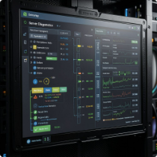





Project Modules & Responsibilities
M1 — VM Discovery
Resource Graph queries, tag-based filters, scheduler service.
M2 — Extension Inspection
Gather extension inventory and health metadata.
M3 — Compliance Engine
Ruleset evaluation, baseline manifests and policy definitions.
M4 — Remediation
Runbooks / SDK actions to apply or fix extensions.
M5 — Verification
Post-action checks and automated rechecks.
M6–M9 — Monitoring, Dashboard, Reporting, Alerts
Telemetry ingestion, visualisation, scheduled reports and notifications.
M10 — Testing
Test harness for failure modes: missing/failed/conflict cases.

Slide 8
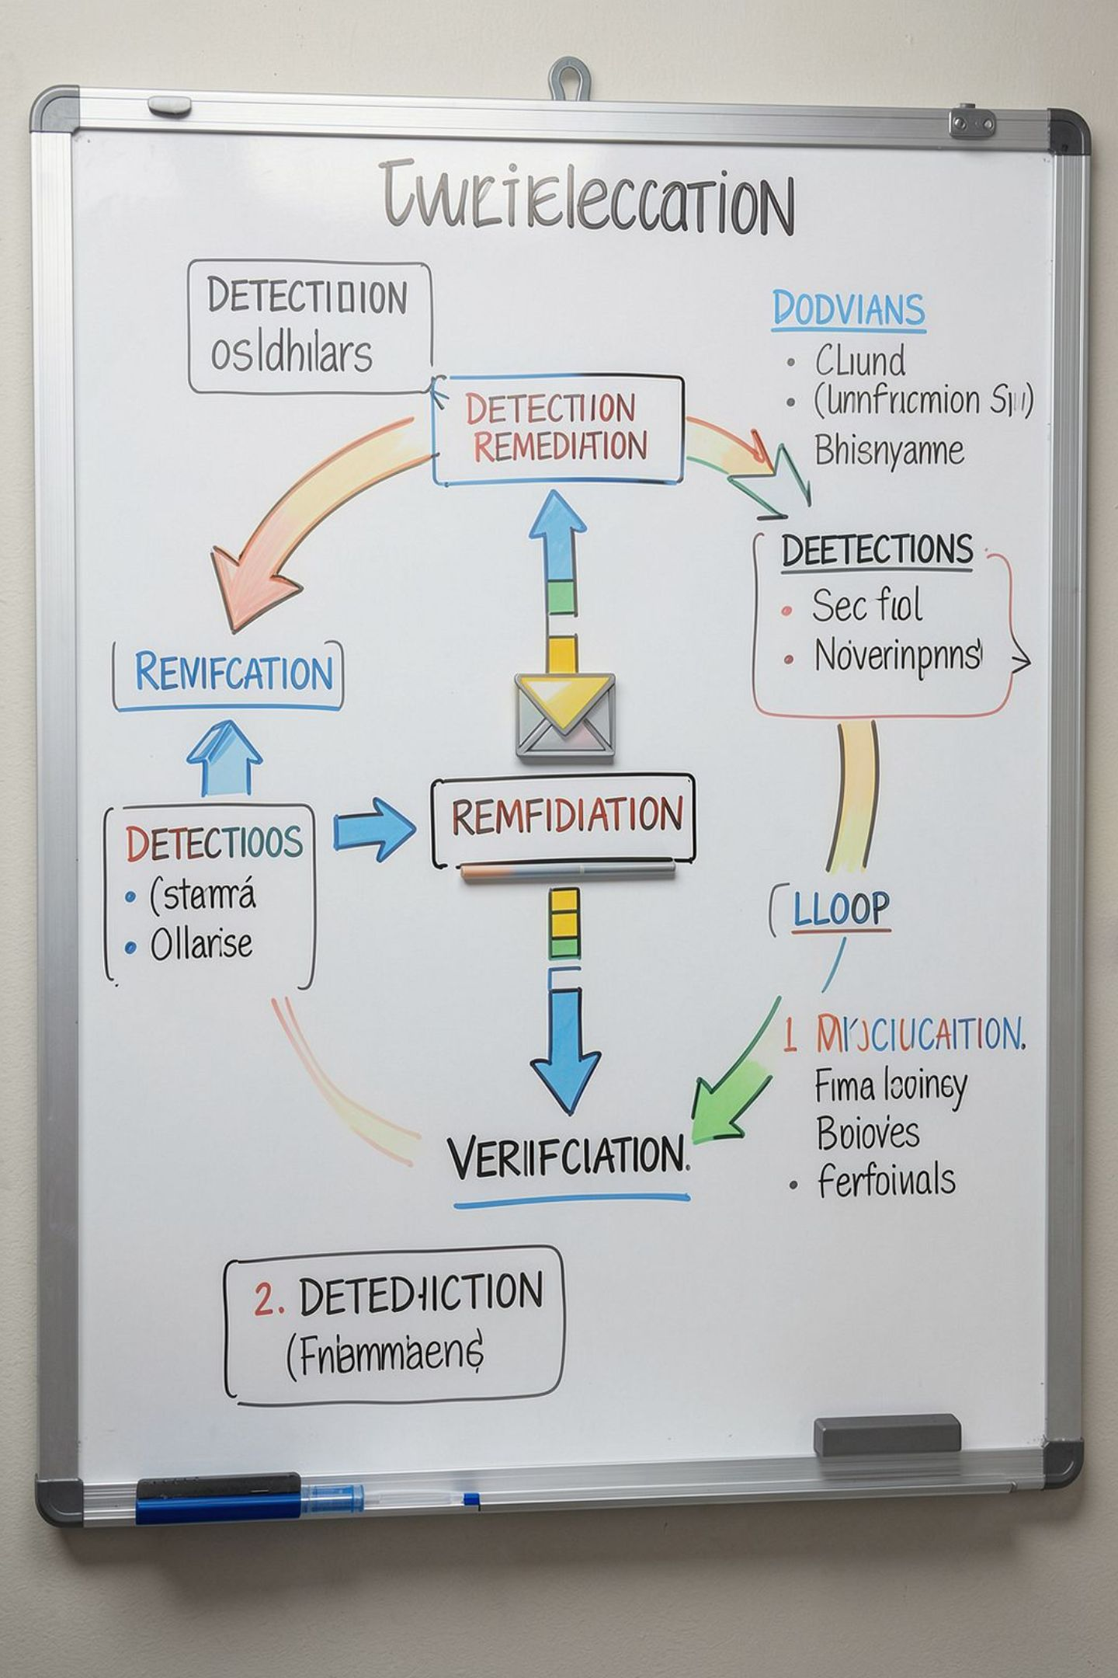

Compliance & Automated Remediation Flow
VM Discovery
Extension Inspection
Compliance Check
Remediate & Verify
Built-in safeguards: dry-run mode, approval gates for remediation, retry with exponential back-off, and detailed audit logs for every action.

Slide 9
Risks, Cost Controls & Low-cost Alternatives
Top Risks
Controls & Cost Options
Extension deployment failures
Conflicting agents causing instability
Insufficient RBAC/permission errors
Network egress/IMDS restrictions
Unexpected operational costs
Retry + verification and rollback on failure
Least-privilege managed identities for actions
Monitor cost with budgets and alerting
Use small test VMs, student subscriptions or limited Log Analytics tiers
Option: Managed Identity instead of Key Vault for simple secrets

Slide 10


Testing Plan, Deliverables & Next Steps
Testing
Run scenarios: compliant VM, missing extension, failed extension, remediation success/failure, verification step.
Deliverables
Azure test environment, Python source code, compliance/remediation module, scheduled reports, test evidence, GitHub repo and documentation.
Next Steps
Finalise extension baseline and approval list
Build discovery + inspection PoC
Implement remediation runbooks and verification
Deploy dashboard and schedule reports
Recommendation: start with a limited-scope pilot (1–2 subscriptions, 10–20 VMs) to validate safety and metrics before broad rollout.

