Slide 1
EDA on IPL

Slide 2
Project analysis slide 4
Project Analysis
Data Acquisition
Data Pre-profiling
Data pre- Processing
Data Post-profiling
Tasks
Plotting graphs/ Inferences
Univariate/Bivariate Analysis
Conclusions
Schedules
Customer Objectives
Resources

Slide 3
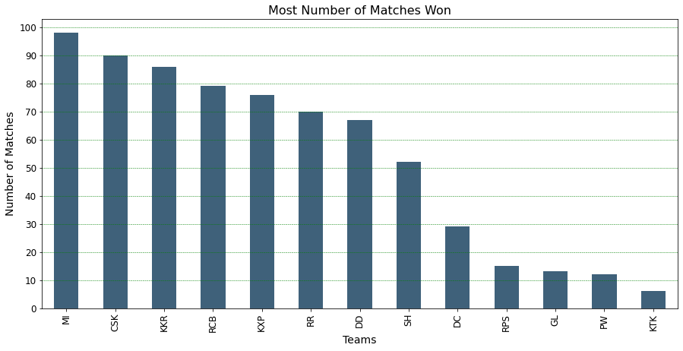
Project analysis slide 5
Most number of matches won
MI have won the most number of matches followed by CSK

Slide 4
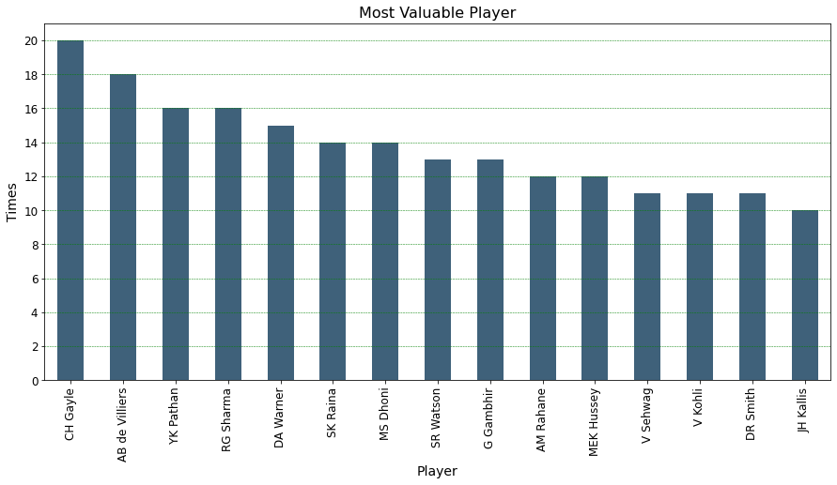
Project analysis slide 5
Most valuable player
Chris Gayle is the most valuable player followed by ABD.

Slide 5
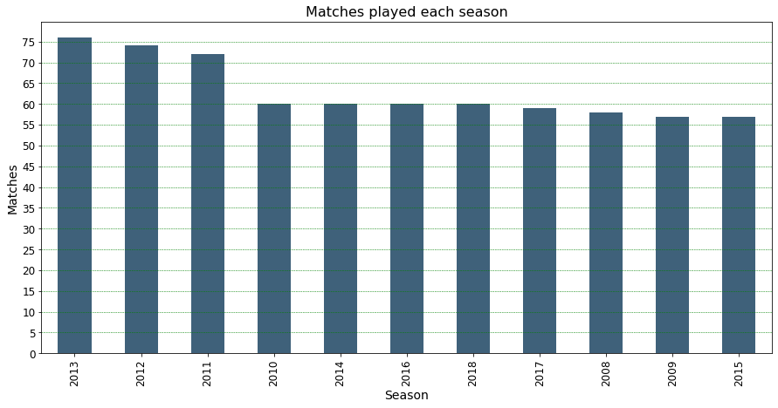
Project analysis slide 5
Matches Played each season
Most number of matches were played in the 2013 season

Slide 6
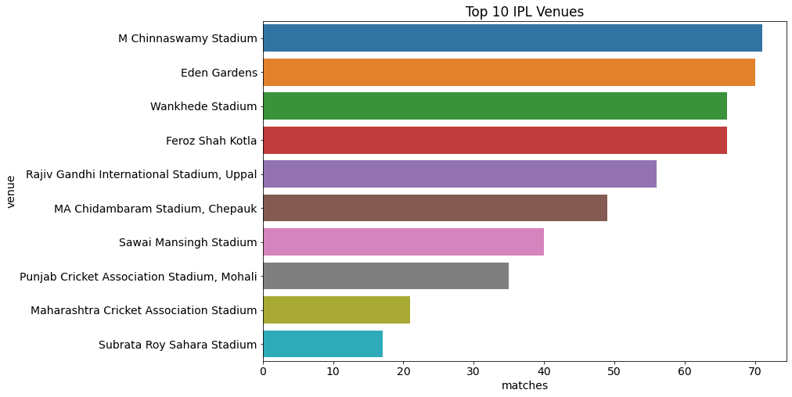
Project analysis slide 5
Top 10 IPL Venues
Chinnaswamy Stadium has hosted the maximum number of matches

Slide 7
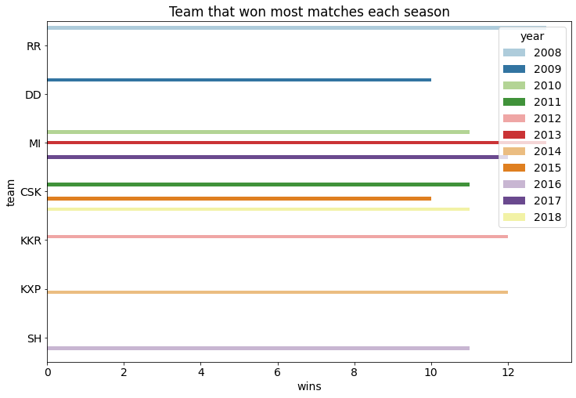
Project analysis slide 5
Team Winning most matches each season
Mumbai Indians and Chennai Super Kings have secured the most wins

Slide 8
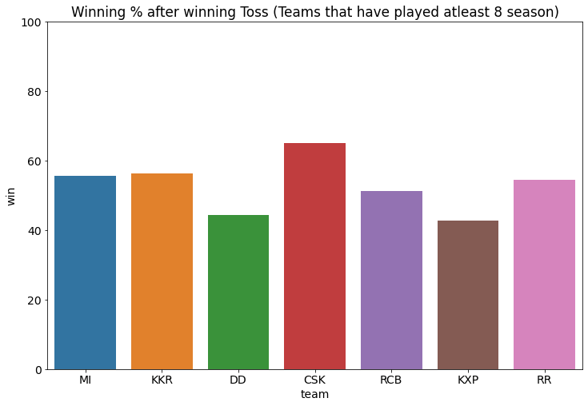
Project analysis slide 5
Team Winning most matches each season
CSK has the highest winning % after winning Toss

Slide 9
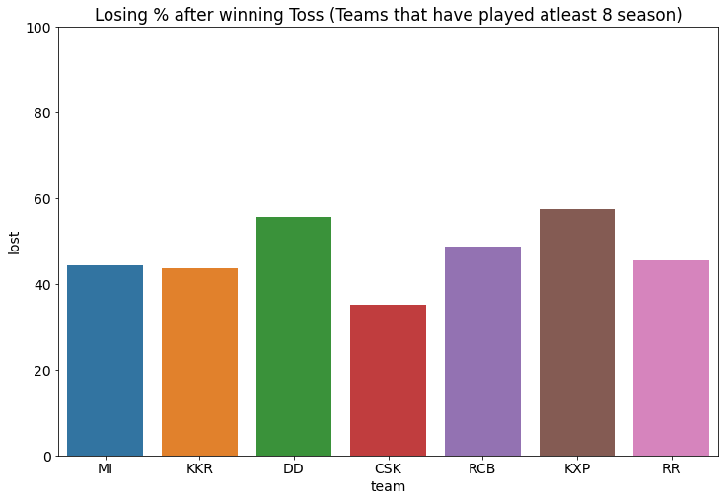
Project analysis slide 5
Team Winning most matches each season
KXP has the highest losing % after winning Toss

Slide 10
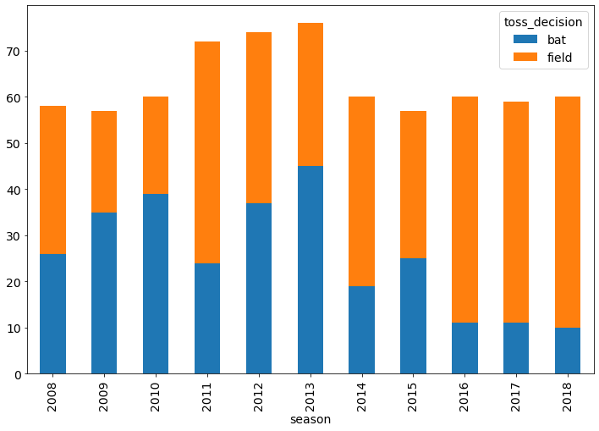
Project analysis slide 5
Toss Decision
As the season progressed teams have opted to field more on winning toss

