Slide 1


QK AI
By Bhuvan K K
What We Are Solving ?
"Insurance is critical, but complexity in selection and slow, manual claims processing are driving down customer trust and creating massive inefficiency. We need personalized guidance and automated claim verification to fix this."

Slide 2
What is Our Solution ?
QK.ai – Insurance Claims Intelligence Platform
QK.ai transforms the 7-day insurance claim journey into a 2-minute AI-driven processes.
It introduces a simple 3-step claim flow : Upload Policy Upload FIR + Photos Describe Accident The system uses AI to instantly parse policies, verify evidence, cross-check stories with FIRs, and generate a CLAIM code with approval likelihood.
Users get real-time clarity on coverage, missing documents, and claim eligibility—all on mobile .
Insurers receive pre-validated claim packages, reducing manual work by 70%, speeding approvals to 2–4 hours, and improving accuracy and fraud detection.QK.ai = Faster claims, fewer rejections, lower costs, and complete transparency

Slide 3
Technologies We Used
QK.ai uses React frontend on Vercel with backend now deployed on Render, plus Firebase authentication.
​Frontend (Vercel)
React + Vite + Tailwind CSS + React Router
React Icons + React Markdown
Environment: VITE_API_URL points to Render backend URL
Backend (Render)
Node.js / Express.js (server.js with /api / gemini-chat, /api/claim-check,
/api/claim-story)
node-fetch, pdf-parse, multer, dotenv, cors
Handles PDF processing, file uploads, Gemini AI integrationlibrary+1​
Deployment Setup
Frontend: Vercel (GitHub auto-deploy on push to main)
Backend: Render (custom Node server, set npm start in build settings)
Connection: Frontend fetches from Render URL via VITE_API_URL
Component: Policy Claim Processing Module
Functionality: Verify policy docs, FIR, & photos → Capture user story → Generate case summary → Assign claim ID
Tech Stack: Vector database-powered chatbot for intelligent data processing & matching

Slide 4
Advantages :
QK.ai AdvantagesQK.ai streamlines insurance claims by combining AI analysis with document verification, reducing processing time from days to minutes through automated policy review, evidence upload, and claim eligibility checks.
Speed: Instant AI feedback on claim viability vs. waiting for insurer review
​Accessibility: Mobile-first responsive design works on phones for on-scene uploads
​Accuracy: Gemini AI + PDF parsing cross-references policy terms with user story/FIR/photos
User-Friendly: Simple 3-step flow (policy → evidence → story) with clear guidance
Cost-Effective: No human underwriter needed for initial screening
Real-Life ImpactAccident Victims: Bike crash? Upload FIR + damage photos → Get "CLAIM-123456" code + next steps in 30 seconds
Policyholders: Paste policy text → Ask "Does this cover theft?" → Get markdown summary + claim advice
​Insurers: Pre-filter valid claims, reduce fraudulent submissions through evidence validation
​Daily Use: "Best car insurance 2025" queries return personalized recommendations

Slide 5
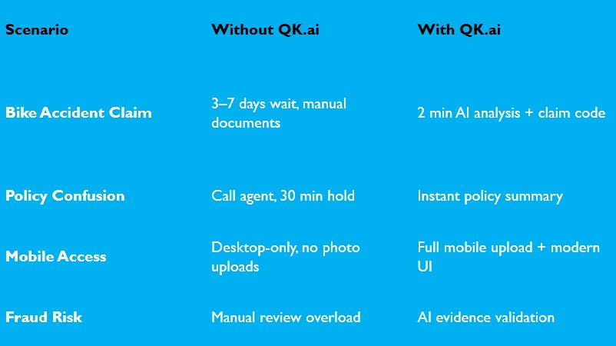
Example Scenarios :

Slide 6
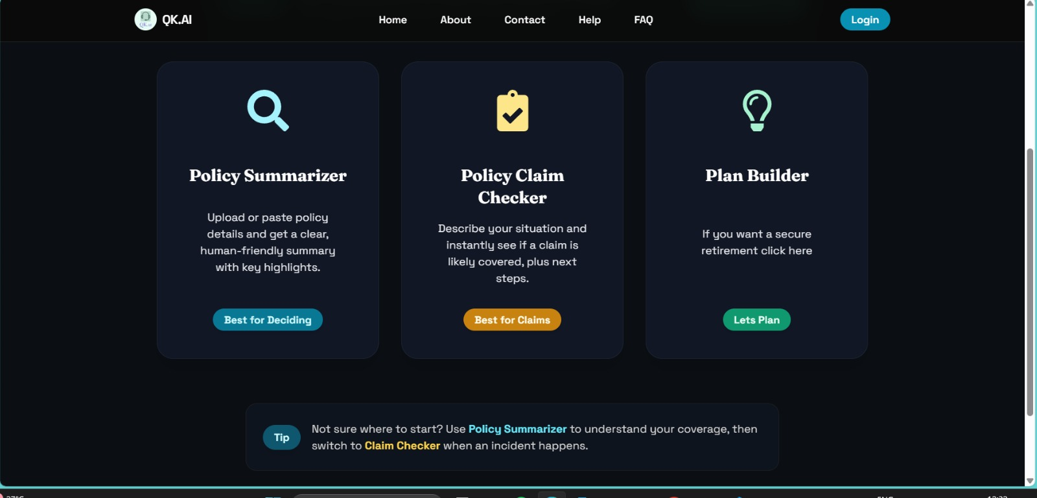

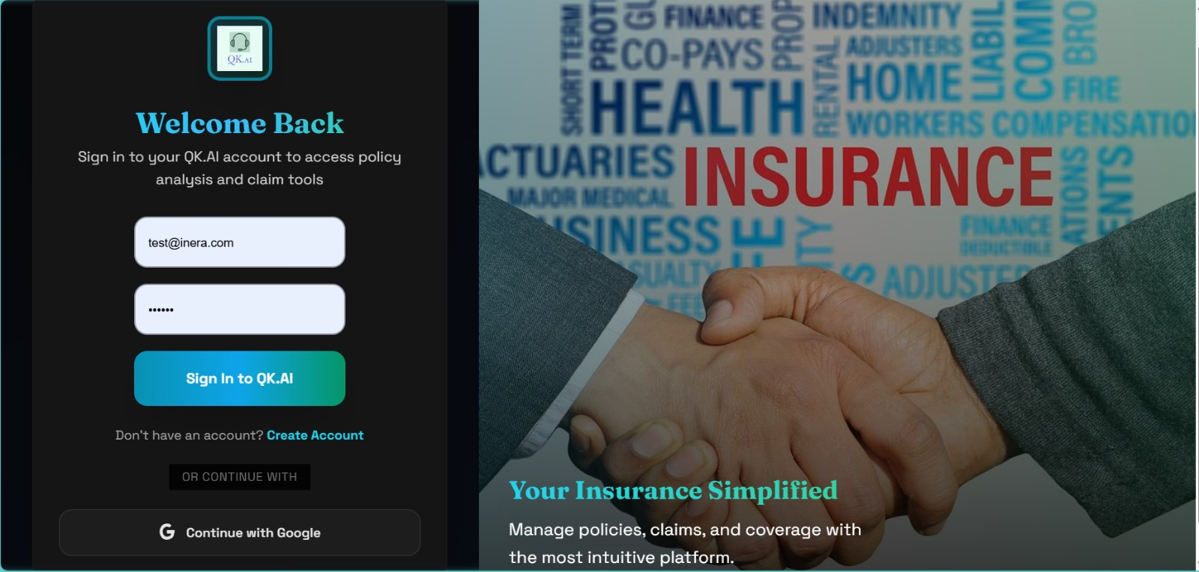
Policy Summarizer Upload PDFs or paste text for instant, human-readable summaries. Get key insights and highlights immediately.
Ideal for understanding complex new policies quickly.
Claim Checker Describe your situation. Our AI assesses likely coverage and provides tailored recommendations to help you navigate next steps.
Future-proof your life with guided support.
Plan Builder Access personalized financial planning tools designed to help you secure your retirement and long-term goals

Slide 7
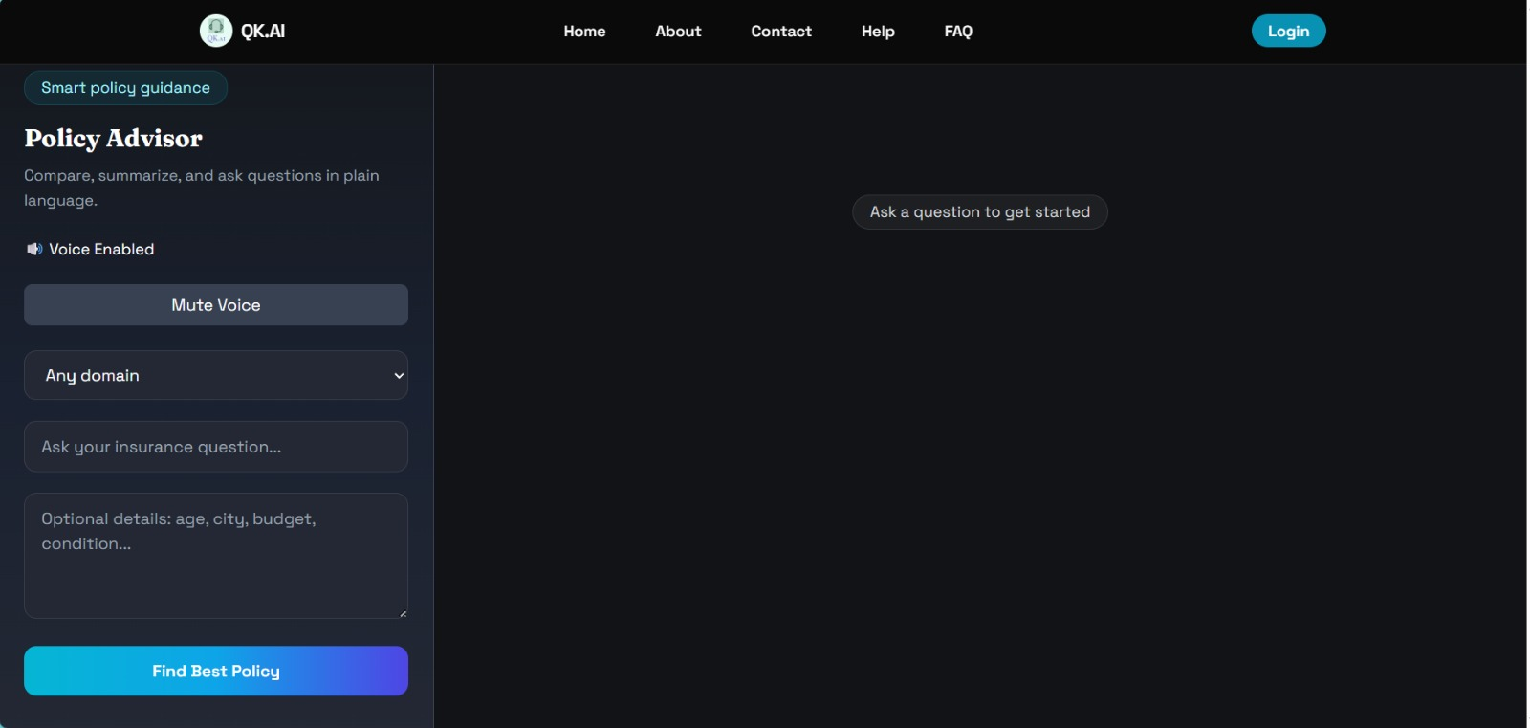
Policy Suggester Module (Personalized Selection)
Problem Solved: Policy Complexity & Confusion
Intelligent Matching: Matches user inputs (budget, age, risk preference) with optimal available policies.
Outcome: Provides ranked, personalized recommendations to ensure customers get the right coverage.

Slide 8
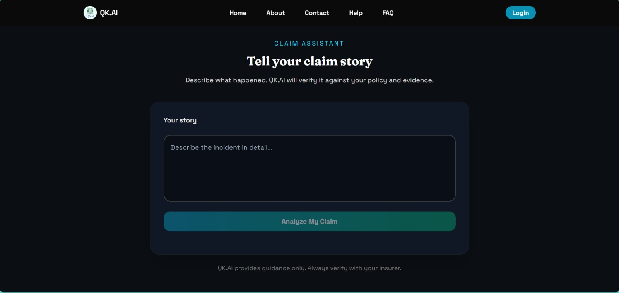
Claim Checker Module (Instant Verification)
Problem Solved: Slow, Manual Claims & Lack of Trust
Automated Verification: Instantly analyzes uploaded claim documents for accuracy.
Fraud Detection:
Employs Anomaly Detection techniques to flag and prevent fraudulent claims.

Slide 9
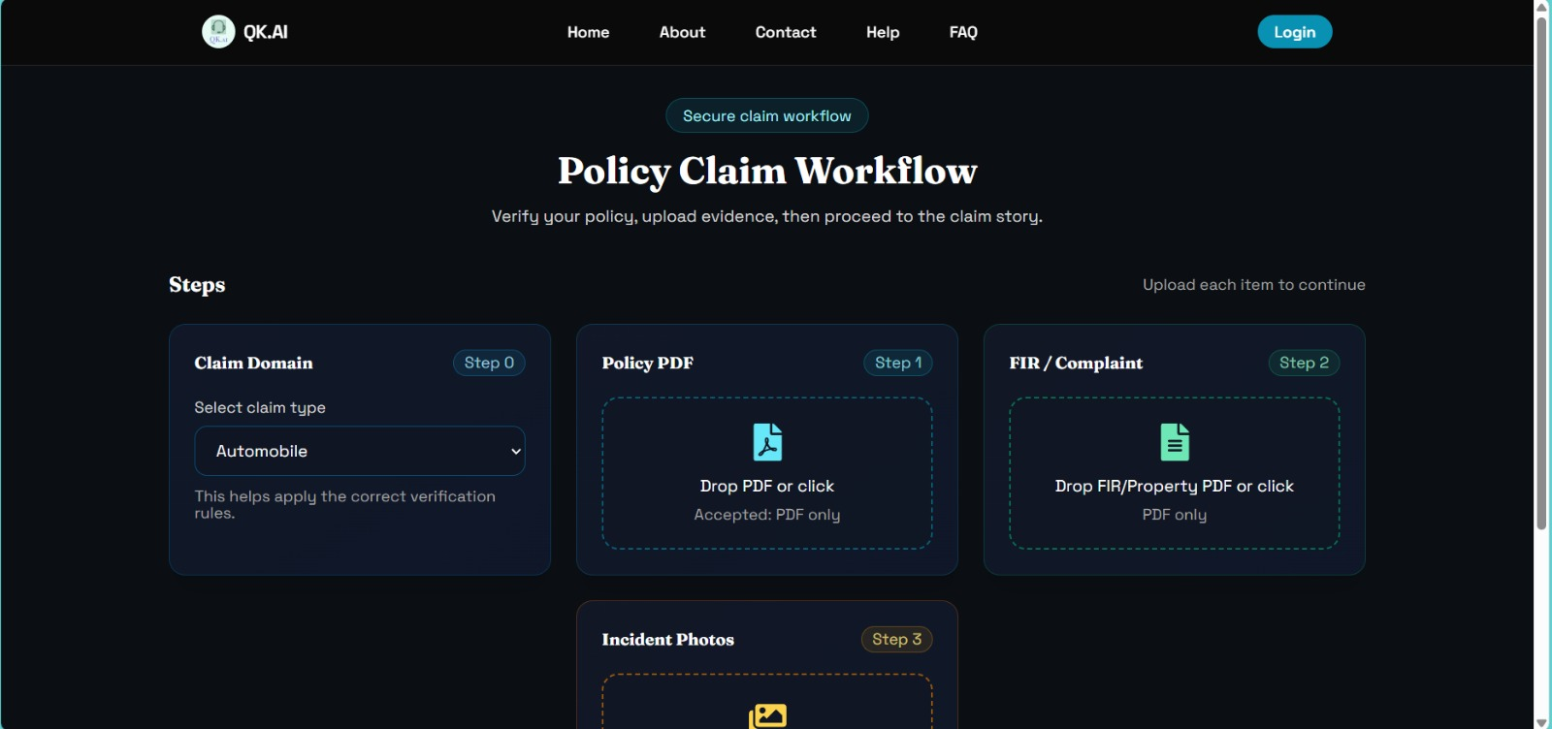
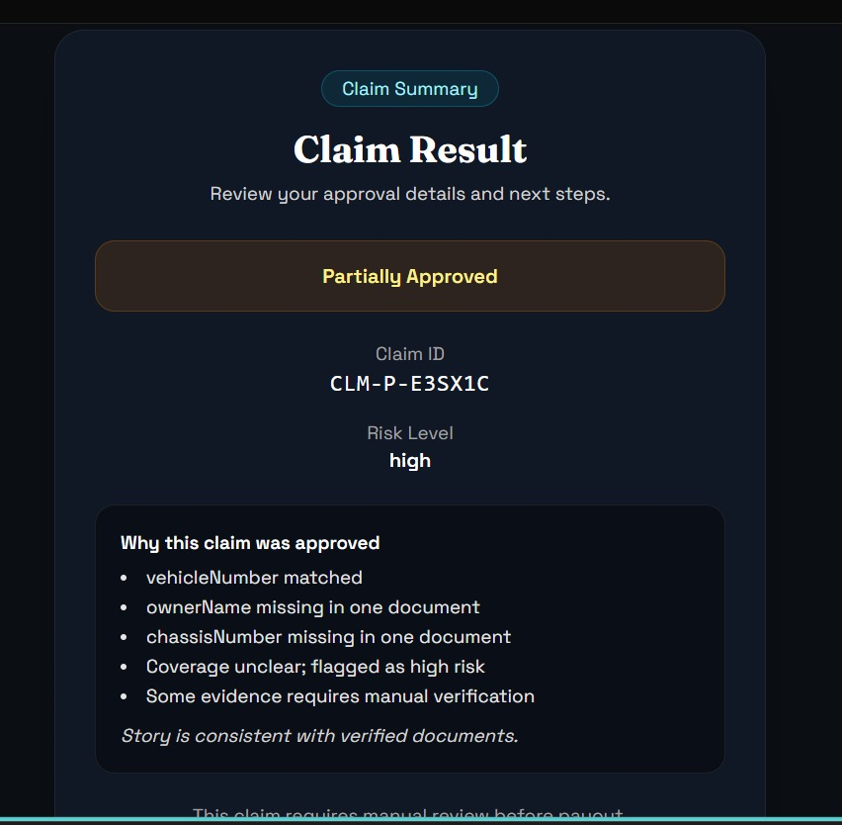

Slide 10
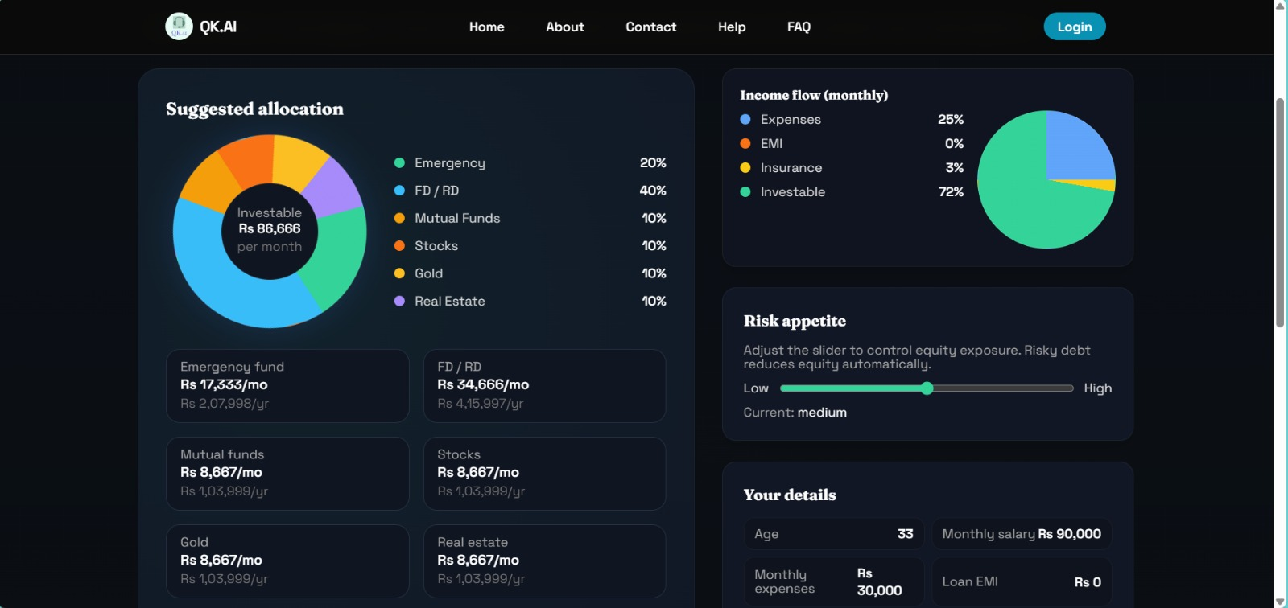
Plan Builder
Goal-Oriented Setup: Define clear objectives for retirement and long-term milestones.
Sustainable Growth: Create a balanced roadmap focused on steady, low-risk wealth building.
Progress Tracking: Monitor your journey and stay aligned with your original growth targets.
Strategic Allocation: Tools to help you distribute resources effectively for long-term stability.

