Slide 1
G.S.K.S.J.T.I
COLLEGE
Presenting you by:-
Bhuvan k k
Deeksha H S
Sneha N
Anirudh P
Project guide :-
Dr.Nagaraj B patil
Head of the CSE department

Slide 2
Problem Statement:
The insurance industry plays a critical role in providing financial protection and risk management. However, customers often face challenges in choosing the most suitable insurance policy due to the wide variety of options and complex terms and conditions. Similarly, the claims process is traditionally time-consuming, involving manual checks, paperwork, and delays, which frustrates policyholders and reduces trust in insurers.
There is a lack of personalized guidance for customers in policy selection and automated systems for quick and transparent claim verification. This creates inefficiencies for both customers and insurance companies.

Slide 3
Solution:
The project proposes an AI-powered system that:
Policy Suggester Module
  Uses Machine Learning / Natural Language Processing (NLP) to understand customer requirements (e.g., health, life, vehicle, travel).
  Matches user inputs (budget, age, risk preferences, coverage needs) with available policies.
  Provides personalized insurance recommendations ranked by suitability.
2. Claim Checker Module
  Uses AI models (possibly rule-based + LLMs) to check claim eligibility against policy terms.
  Automates verification by analyzing uploaded claim documents.
  Detects fraudulent claims using anomaly detection techniques.
  Provides instant feedback on claim status (approved, rejected, or requires manual review).
3.System Features
  User-friendly website interface.
  Integration with insurance datasets for training AI models.
  Real-time chatbot for customer queries.
  Transparency and faster processing for improved user trust.

Slide 4
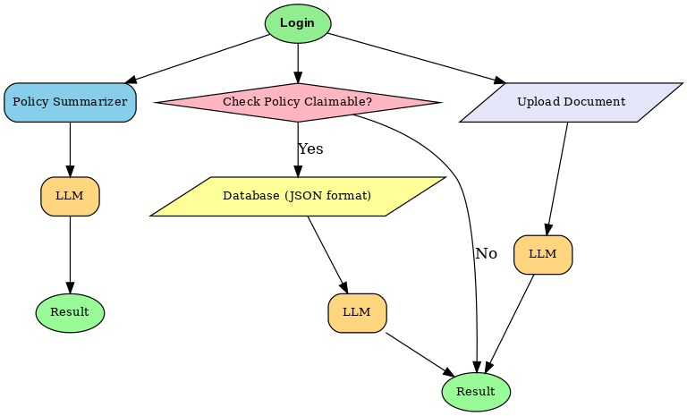

Slide 5
Application of Artificial Intelligence in the Banking Sector(research paper):-
Introduction
Artificial Intelligence (AI) is transforming the banking sector by driving efficiency, enhancing customer experience, and strengthening risk management. Through advanced data analysis and automation, AI helps banks streamline operations, detect fraud, and deliver personalized services.
Key Applications
Customer Service: AI-powered chatbots and voice assistants provide 24/7 support, while recommendation engines offer personalized financial advice and credit decisions.
Fraud Detection: Machine learning algorithms flag anomalies, enable real-time transaction monitoring, and reduce false positives, thereby enhancing security.
Risk Management: AI tools analyze patterns, detect anomalies, and leverage biometric and cognitive analytics to minimize losses and improve compliance.
Strengths
Increases efficiency and reduces human errors.
Enables real-time data analysis for decision-making.
Improves customer satisfaction through personalization and faster services.

Slide 6
Weaknesses
Lacks emotional intelligence and empathy.
Requires human oversight for critical decisions.
Prone to bias and failures if trained on flawed data.
Challenges
Potential job displacement due to automation.
Over-reliance on AI systems may reduce human control.
Risks of system errors, security breaches, and misuse of data.
Building and maintaining public trust in AI-driven banking.
Conclusion
AI offers significant benefits for banking, from improved efficiency and fraud detection to enhanced customer experiences. However, responsible use requires balancing automation with human oversight, ensuring ethical practices, transparency, and trust. A collaborative approach between humans and AI can unlock innovation while safeguarding the banking sector’s integrity.

Slide 7
Insurance policy summarizer(research paper):-
Problem
Insurance policies are long, complex, and full of legal jargon.
Hard for customers to understand.
Manual/rule-based summarization is slow, inconsistent, and often misses meaning.
Approach
Tested Large Language Models (LLMs): GPT-3.5, GPT-4, and fine-tuned BART.
Applied to different policy types: life, health, auto, and property.
Summaries constrained to ~200 words, optimized for clarity.
Evaluation
Quantitative: ROUGE, BERT Score, factual accuracy checks.
Qualitative: Reviews by domain experts and normal users.
Findings
GPT-4: Best overall, clear and accurate summaries.
Fine-tuned BART: Better with insurance-specific terminology.
User preference: GPT-4 (readability).
Expert concern: GPT-4 occasionally missed important details.

Slide 8
AI powered LLM using RAG(research paper):-
Problem with Traditional Methods
Manual claims adjudication is slow, costly, and prone to errors.
AI-Powered Solution
Combines Large Language Models (LLMs) with Retrieval-Augmented Generation (RAG) and Robotic Process Automation (RPA).
Automates document analysis, fraud detection, and decision-making.
Benefits
Faster claim settlements.
Improved fraud prevention.
Enhanced accuracy in processing.
Better customer experience.

Slide 9
Applications
Claims automation.
Categorization of unstructured content.
Challenges
Handling complex and varied data.
Ensuring data privacy and regulatory compliance.
Risk of LLM hallucinations (inaccurate outputs).
Future Directions
Increase transparency, explainability, and robustness of AI models.
Integrate blockchain for secure, auditable claim processing.

Slide 10
APPLICATIONS OF ARTIFICIAL INTELLIGENCE IN COMPANY MANAGEMENT,
E-COMMERCE, AND FINANCE(research paper):-
Overall Scope
AI/ML applied in business management, e-commerce, and finance.
Enhances customer experience, supply chain management, operational efficiency, and cost reduction.
Techniques Used
Deep Learning and Neural Networks.
Clustering, Support Vector Machines.
Applied for classification, prediction, fraud detection.
Applications in Finance
Credit scoring & loan underwriting.
Portfolio management & risk assessment.
Fraud detection.
Algorithmic trading.

Slide 11
Challenges
High Research & Development costs.
Fragmented & inconsistent data(unorganized).
Lack of understanding of Key Performance Indicators (KPIs).
Future Impact
Stronger forecasting & predictive analytics.
Improved security.
Enhanced customer engagement.
Greater automation → more intelligent, efficient systems.

Slide 12
ADVANTAGES:-
Personalization – Matches policies to individual needs, improving customer satisfaction.
Time-saving – Reduces the need to manually compare dozens of policy documents.
Better decision-making – Helps users understand complex policy terms in simple language.
Higher sales conversion – Tailored recommendations increase the chance of customers buying policies
Faster claim settlement – Automates eligibility checks and document verification.
Fraud detection – Protects insurance companies from financial losses caused by fraudulent claims.
Consistency – Eliminates human bias/errors in claim evaluation.
Instant feedback – Customers know claim status immediately, improving transparency.
User convenience – Accessible via mobile or web apps anytime, anywhere.
Improved customer trust – Transparency and faster processing builds reliability.
Scalability – Can handle large volumes of customers and claims simultaneously.
Cost efficiency – Reduces administrative workload and operational costs.
Real-time support – Chatbot handles FAQs, reducing call center dependency.

Slide 13
REAL-LIFE difference created by our application: -
“Reduces claim rejection confusion by 40%”
“Helps 70% of rural users find a relevant policy within 3 clicks”
“Cuts manual paperwork by 30% for insurance officers”

Slide 14
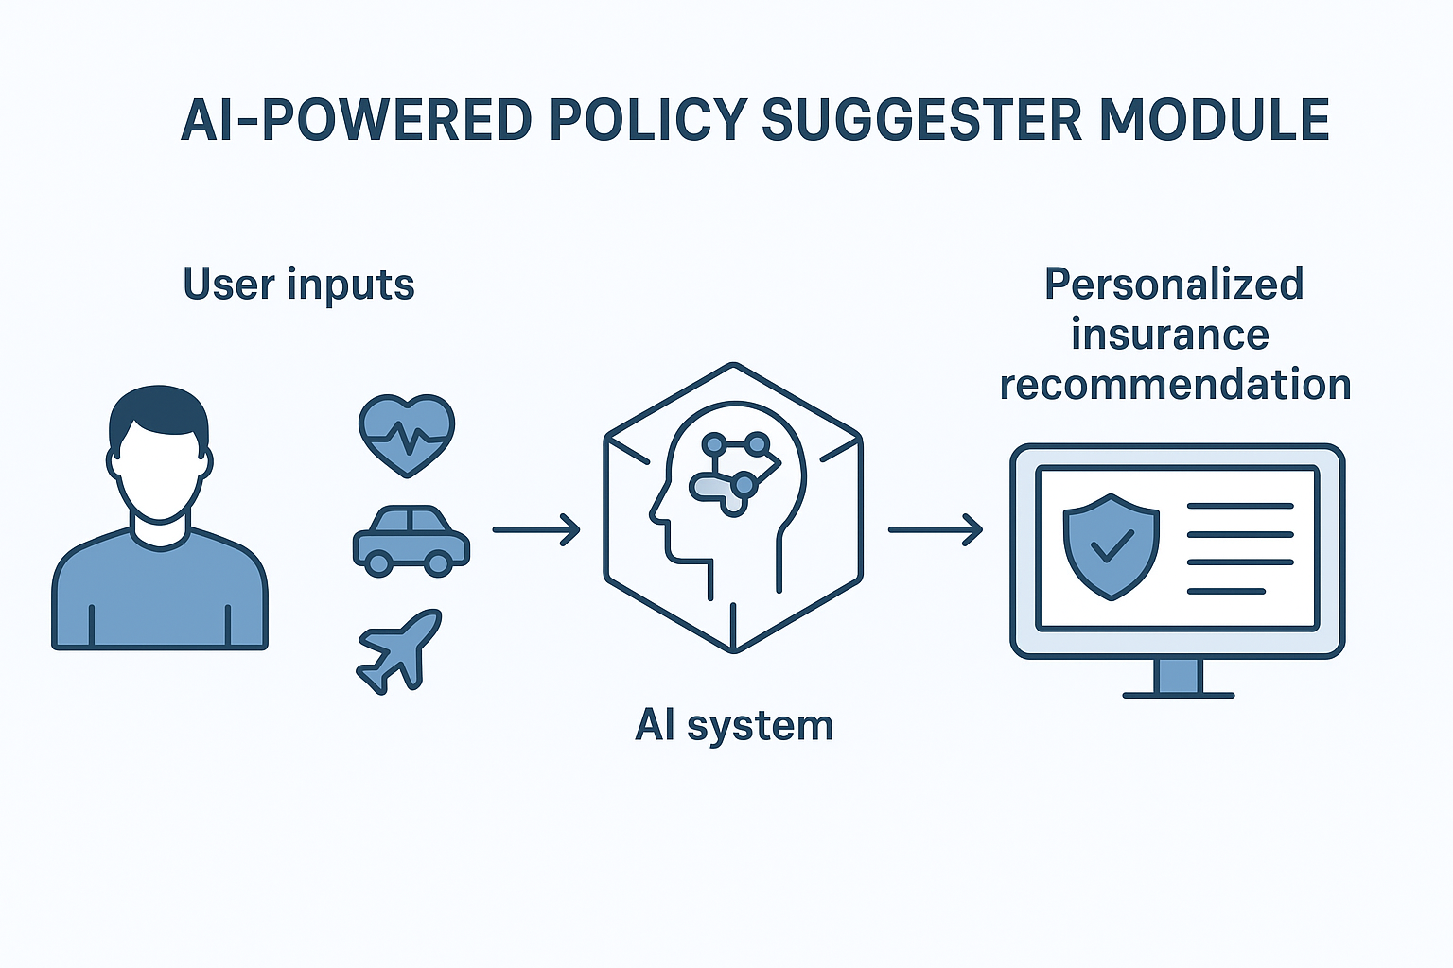
THANK YOU

