Slide 1
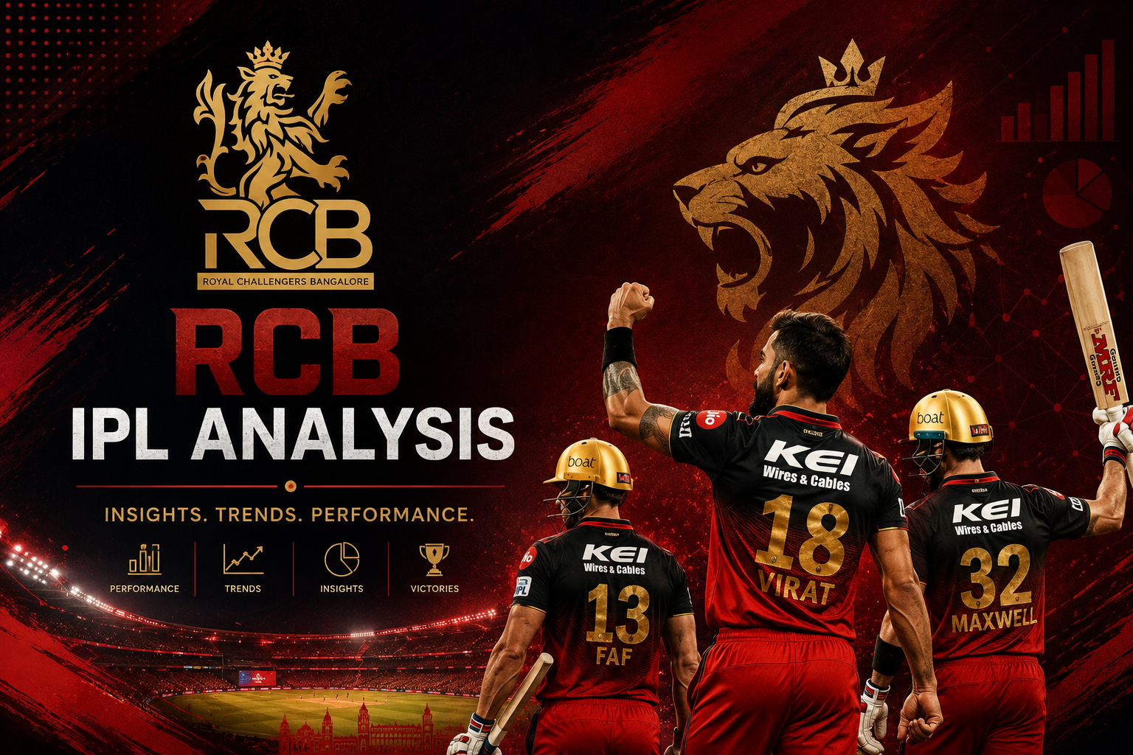
BHUVAN P

Slide 2

AGENDA
Problem Statement
ER Diagram
Data Description
Data visualization
Conclusion
Final Recomandations

Slide 3
Problem Statement:
RCB needs a data-driven strategy to build a stronger, more reliable and well-balanced squad. The main challenge is to identify players who consistently perform well, understand their overall impact across batting and bowling, and determine which players provide the best value for the auction investment. This project aims to analyze player performance and reliability, identify top-performing and high-impact players, optimize the allocation of the auction budget, and understand key squad requirements. By using historical IPL data and performance insights, the objective is to support smarter auction decisions and help RCB build a balanced squad capable of delivering consistent results.

Slide 4
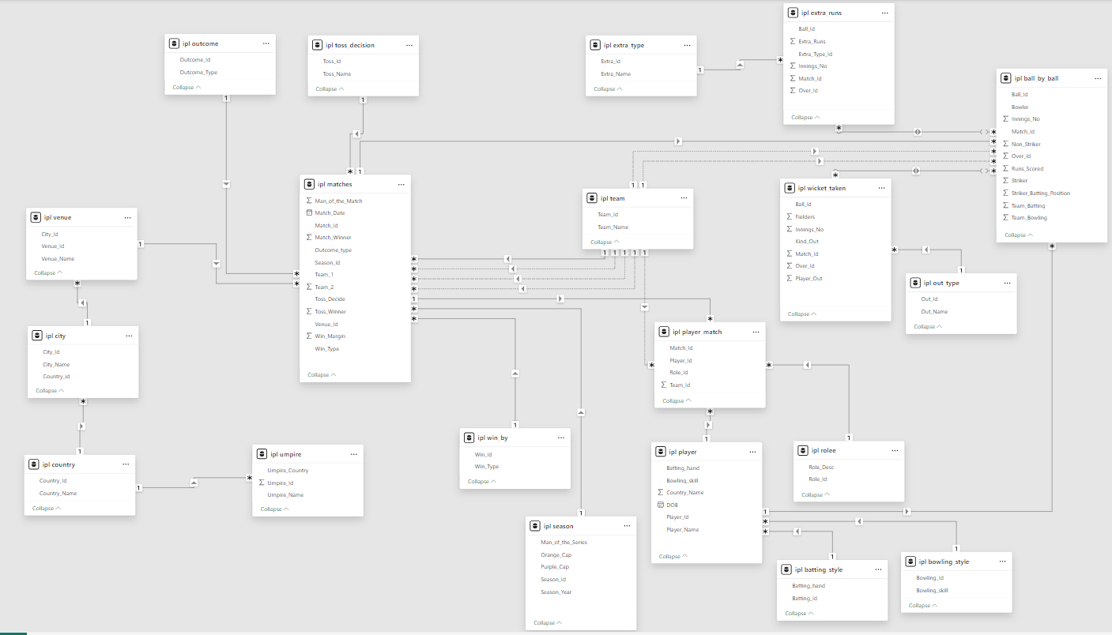
ER DIAGRAM

Slide 5
Batting style
Batting_id: Unique identifier for a batsman's batting record
Batting_hand: The batting hand (right or left) of a batsman
Bowling style
Bowling_id: Unique identifier for a bowler's bowling record
Bowling_skill: The bowling skill (e.g., right-arm fast, left-arm spin) of a bowler
City
City_id: Unique identifier for a city
City_Name: The name of a city
Country_id: Unique identifier for a country
Data Description
Ball by Ball
Match_id: Unique identifier for a cricket match
Over_id: Unique identifier for an over in a cricket match
Ball_id: Unique identifier for a ball in an over
Innings_No: The innings number in a cricket match
Team_Batting: The team batting in a particular innings
Team_Bowling: The team bowling in a particular innings
Striker_Batting_Position: The batting position of the striker batsman
Striker: The batsman currently on strike
Non_Striker: The batsman currently at the non-striker's end
Bowler: The bowler bowling the current delivery

Slide 6
Matches
Match_Id: Unique identifier for each match.
Match_Date: The date when the match took place.
Match_Winner: The team that won the match.
Outcome_Type: Type of result (win, tie, etc.).
Toss_Winner: The team that won the toss.
Win_Type: The method by which the match was won (e.g., runs or wickets).
Win_Margin: The margin by which the match was won.
Venue_Id: Reference to the venue where the match was played.
Season_Id: The season in which the match occurred.
Venue
Venue_Id: Unique identifier for each venue.
Venue_Name: Name of the venue.
City_Id: Reference to the city where the venue is located.
Country
Country_Id: Unique identifier for each country.
Country_Name: Name of the country.
Player Match
Match_Id: Reference to the match in which the player participated.
Player_Id: Reference to the player.
Role_Id: Role of the player (e.g., batsman, bowler).
Team_Id: Team that the player represented in the match.
Wickets Taken
Ball_Id: Reference to the specific ball during which the wicket was taken.
Fielder: Reference to the player who fielded the ball.
Bowler: Reference to the bowler who took the wicket.
Player_Out: Reference to the player who was dismissed.

Slide 7
Extra Type
Extra_Type_Id: Unique identifier for the type of extra runs scored in a cricket match.
Extra_Runs: The number of extra runs scored in a particular delivery.
Innings_No: The innings number in a cricket match.
Extra_Id: Unique identifier for an instance of extra runs scored.
Extra_Name: The name or description of the type of extra runs scored (e.g., byes, leg byes, wides, no-balls).
Season
Season_Id: Unique identifier for a particular season or tournament.
Venue_Id: Unique identifier for the venue or stadium where the match is played..
Win_By
Win_Type: The type of win (e.g., runs, wickets) achieved by the winning team.
Win_Margin: The margin of victory (e.g., runs or wickets) for the winning team.
Outcome
Outcome_type: The type of outcome or result of the match (e.g., win, loss, tie, no result).
Match_Winner: The team that won the match.
Man_of_the_Match: The player awarded the Man of the Match award.
Out_Type
Out_Id: Unique identifier for the type of dismissal or way a batsman got out.
Out_Name: The name or description of the type of dismissal (e.g., caught, bowled, lbw, run out).
Outcome_Id: Unique identifier for the outcome or result of a match.

Slide 8
Rolee
Role_Id: Unique identifier for a player's role or skills (e.g., batsman, bowler, all-rounder).
Role_Desc: Description of a player's role or skills.
Man_of_the_Series: The player awarded the Man of the Series award for a particular tournament.
Orange_cap: The player awarded the Orange Cap (for most runs scored) in a particular tournament.
Purple_cap: The player awarded the Purple Cap (for most wickets taken) in a particular tournament.
Team
Team_Id: Unique identifier for a team.
Team_Name: The name of a team.
Umpire
Umpire_id: Unique identifier for an umpire officiating the match.
Umpire_name: The name of an umpire.
Umpire_country: The country or nationality of an umpire.
Toss Decision
Toss_Name: The name or description of the toss (e.g., heads or tails).
Player
Player_Id: Unique identifier for a player.
Player_Name: The name of a player.
Extra Runs
Ball_Id: Reference to the specific ball during which extra runs were conceded.
Extra_Type_Id: Type of extra run (e.g., wide, no-ball).
Innings_No: The innings number during which the extra run occurred.
Match_Id: Reference to the match in which the extra runs were conceded.

Slide 9
RCB Season-wise Performance
Insights:-This visualization shows how RCB's performance changed across different seasons. We can see that the team had some strong periods, but maintaining consistency was a challenge. This suggests that RCB should focus not only on individual performance, but also on maintaining a balanced and consistent team throughout the season.
Some seasons show strong performance, while in others the team struggled to maintain the same level.
A team cannot depend on good performance in only a few seasons; regular performance is important for winning the tournament.
Good batting alone is not enough if the bowling unit cannot control the opposition.
This suggests that RCB may have struggled to maintain momentum throughout the seasons.
RCB should have a proper combination of reliable batsmen, wicket-taking bowlers, and quality all-rounders.

Slide 10
RCB Wins by Venue
Insights:-
M Chinnaswamy Stadium clearly stands out, with 16 wins, showing that RCB has performed strongly at its home venue.
Other venues have comparatively fewer wins, which indicates that home advantage may have played an important role.
RCB's performance away from home has been more mixed, so the team should focus on adapting to different pitch and ground conditions.
RCB should not depend only on home-ground advantage; building a team that can perform consistently at different venues is important for winning the tournament.
When I looked at RCB's wins venue-wise, the first thing that stood out was the strong performance at M Chinnaswamy Stadium. However, wins at other venues are much lower. This tells us that RCB should focus on becoming more adaptable to different conditions rather than depending heavily on home advantage

Slide 11
Toss vs Match Result
Insights:- Out of 153 matches, the toss winner won 85 matches, giving a 55.56% success rate.
This shows that winning the toss gives some advantage, but it does not guarantee winning the match.
The remaining 68 matches were won by the team that lost the toss, which shows that team performance is still more important than the toss.

Slide 12
Top Players Recommended for RCB
Insights:-I would not select a player just by looking at total runs, A good player should be able to contribute to the team in different situations.
CH Gayle stands out because of his strong batting contribution, which makes him a valuable option for the team.
JH Kallis and KA Pollard offer more balanced value because they can contribute with both bat and ball.
RA Jadeja and NLTC Perera bring versatility to the squad, which can help the team maintain balance.
A Mishra can add value mainly through his bowling contribution, especially when the team needs wickets.

Slide 13
Top Players by Total Runs
Insights:- I would not select a player based on one parameter, A combination of batting, bowling, consistency and versatility gives a better picture of a player's actual value to the team.
I would not select a player based only on the number of runs, Runs are important, but they do not tell the complete story.
For batsmen, I would focus on runs, batting average and strike rate to understand consistency and scoring ability.
For bowlers, wickets, economy rate and bowling average are important to understand their effectiveness.
For all-rounders, I would look at their contribution with both bat and ball.

Slide 14
Conclusion
The project also helped me understand that good individual performances do not always guarantee a trophy. RCB's performance should be analyzed season by season, including consistency and performance in important matches. If a team performs well in the league but struggles in crucial matches, factors such as team balance, batting, bowling, and all-round performance need to be examined.
If I had not been given the objective and subjective questions, I would start by understanding the database first. I would identify the important tables and columns, calculate basic KPIs such as matches, wins, losses, runs, wickets, and win percentage, and then look for unusual or interesting patterns. From those patterns, I would create my own questions and investigate them using SQL and visualizations.

Slide 15
Final Recommendation
If I were managing RCB, my main focus would be to build a balanced and consistent team rather than simply collecting star players. I would use data to identify weaknesses, select players according to team requirements, prepare venue-specific strategies, and focus strongly on performing in pressure situations. This approach can help RCB turn individual talent into stronger overall team performance.
Select players based on overall performance, not only runs or wickets. Batting average, strike rate, economy rate, bowling average, consistency, and role should all be considered.
Players who can contribute with both bat and ball give the captain more options and help the team handle different match situations.
RCB should consider venue history, pitch conditions, dew, weather, and team strengths before deciding whether to bat or field.
RCB should maintain a proper combination of batsmen, bowlers, all-rounders, and match-winning players instead of spending too much on one category.

