Slide 1


Dept. of CSA – BCA
I Year – I Semester
Library Book Management
Team Name: Double Trouble
K. Bhuvan Sai Kumar
J. Prasanth Pavan
R.No: 2620520023
R.No: 2610520021
Abhinav Joshi
Veeran Reddy Hari Krishna
R.No: 2620520003
R.No: 2610520052

Slide 2
Library Book Management
LINUX MINI PROJECT
$ ./library.sh
Choice: 1 (Add Book)
Book ID: B104
Title: Clean Code
Author: R. C. Martin
Added successfully!
Status: Available
books.txt saved
A Beginner-Level Bash Shell Scripting Project
Notes:
Introduce the Library Book Management mini project. It is a Bash script for the Linux terminal. The sample shows a new book being added and saved in books.txt.

Slide 3



1. Introduction
Libraries need a reliable way to track books and their availability.
Bash can automate common library tasks from the terminal.
This project uses a simple text file to store book records.
Users can add, view, search, issue, return and delete books.
Input
Book ID, title, author and borrower
Process
Search records and update book status
Output
Book details and availability status
Notes:
Explain that libraries need to find books and track whether they are available or issued. The program takes user choices, works with a text file, and prints clear results.

Slide 4





2. Problem Statement
Manual registers can make book searches, issuing and returns slow. Records may be duplicated or availability may not be updated on time. A simple terminal-based system can reduce this work.
The system should:
Add a book with its ID, title and author
Display all stored books
Search by Book ID or title
Issue an available book to a borrower
Return an issued book to available status
Delete a selected book record
Notes:
Describe the manual problem and walk through the six requirements: add, list, search, issue, return, and delete.

Slide 5
3. Objectives
1
Understand the Linux terminal and basic Bash scripting
5
Apply case and if conditions for decisions
2
Use variables and read for user input
6
Validate book IDs and required text fields
3
Use functions to organize menu operations
7
Build a working command-line library application
4
Read and update records in a text file
read case if/else
while chmod +x
Notes:
The project teaches terminal use, variables, functions, file handling, conditions, validation, and a complete working menu.

Slide 6
4. Scope of the Project
6
book management actions
Platform
Ubuntu Linux / WSL
Interface
Command-line terminal
1
text file for records
Input
Book ID, title, author and borrower name
Output
Book details, status and messages
0
databases or GUIs needed
Users
Students or faculty learning basic shell scripting
Notes:
The scope is six management actions, a simple text file, no database, and a command-line interface running on Ubuntu or WSL.

Slide 7


5. Existing System
Limitations
Manual searching takes extra time
Manual method
Duplicate or incomplete entries can occur
Books are recorded in registers or spreadsheets. Staff search for titles and update issue/return details manually.
Availability may not be up to date
Changes are not automated in Linux
Notes:
In the existing system, books are written in registers or spreadsheets. Searching and updating manually takes time and can leave stale records.

Slide 8
6. Proposed System
1
2
3
4
Start the Bash script
Display the main menu
Choose an operation
Add or view book records
5
6
7
8
Search by Book ID or title
Issue or return a book
Update books.txt after changes
Repeat the menu or exit
Notes:
The proposed workflow starts at the menu. The user selects an operation, the script reads or changes the book file, shows a result, and returns to the menu.

Slide 9


7. Requirements
Hardware
Software
Computer or laptop
Keyboard and display
Minimum 4 GB RAM recommended
Ubuntu Linux or Ubuntu through WSL
Bash shell and terminal
Text editor such as nano or vim
A writable project folder
Notes:
A standard laptop is enough. The software needed is Bash on Ubuntu Linux or WSL and a text editor such as nano.

Slide 10
8. System Design
Input
Processing
Output
Book ID, title and author
Borrower name for issue
Read and write books.txt
Check for duplicate Book IDs
Search by ID or title
Update Available / Issued status
Book list and details
Search results
Issue / return confirmation
Availability and borrower
Success or error messages
Notes:
Input contains book and borrower details. Processing searches the record file and updates status. Output includes book details and confirmation messages.

Slide 11

8. System Design: Book Operations
Operation | Input | System action
Add Book | ID, title, author | Save new book as Available
View All | None | List every stored book
Search | ID or title | Show matching records
Issue | ID and borrower | Available -> Issued
Return | Book ID | Issued -> Available
Delete | Book ID, confirm | Remove the selected record
Exit | None | End the program
Storage rule
Each row in books.txt stores ID, title, author, status and borrower. Issue and return actions update the status; a return clears the borrower.
Notes:
The record file is pipe-delimited. The table explains what each menu operation takes as input and how it changes the file.

Slide 12
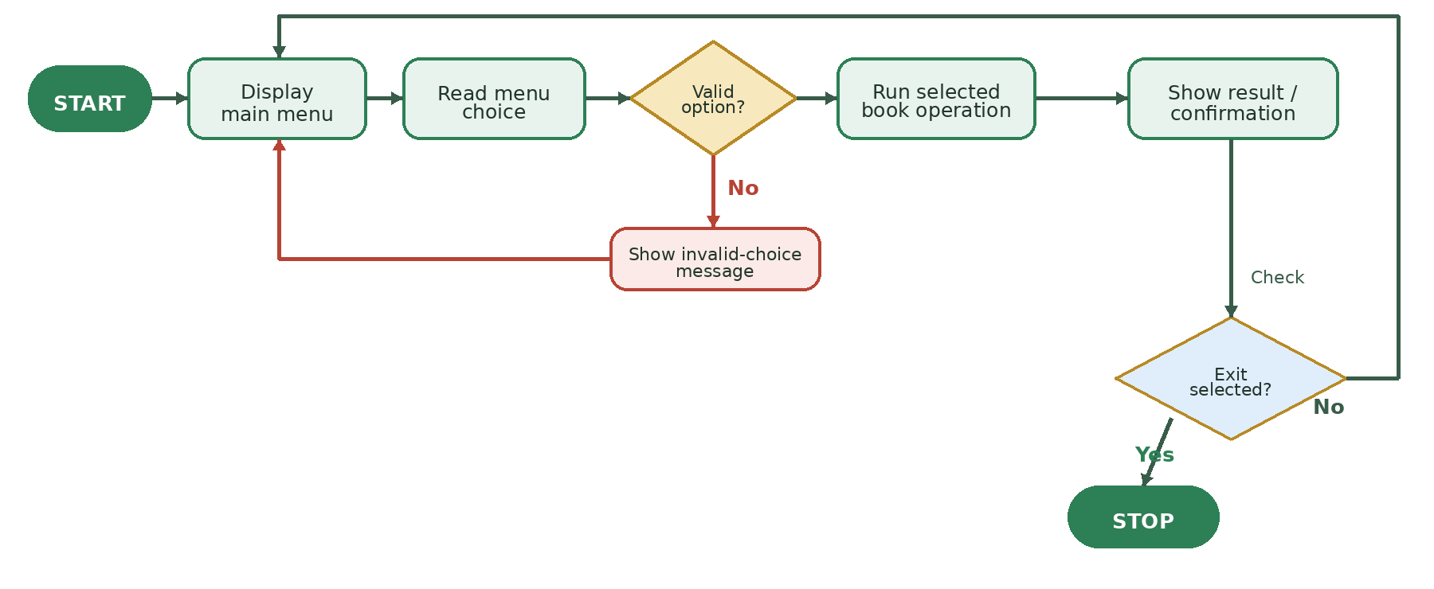
8. System Design: Flowchart
Notes:
Follow the workflow: show menu, validate a choice, run an operation, display the result, then repeat or exit. Invalid choices return to the menu.

Slide 13
9. Algorithm
1
Start
6
Search the stored records
2
Open or create books.txt
7
Perform the selected operation
3
Display the main menu
8
Save changes to books.txt
4
Read and validate the choice
9
Display the result and repeat
5
Read the required book details or ID
10
Stop when Exit is selected
Notes:
The algorithm opens the data file, shows the menu, reads an option, performs the selected action, saves changes, and repeats until Exit.

Slide 14
10. Implementation
1
Create the project directory
2
Create the Bash file
$ mkdir library_book_project
$ cd library_book_project
$ nano library.sh
3
Prepare the record file
4
Make executable and run
$ touch books.txt
$ chmod +x library.sh
$ ./library.sh
Notes:
Create a folder, open library.sh in nano, create books.txt if needed, give execute permission, and run the script.

Slide 15
11. Source Code
read -r -p "Choose an option (1-7): " choice
Reads the menu choice from the keyboard
while IFS='|' read -r id title author status borrower
Splits a stored line into its five book fields
printf '%s|%s|%s|Available|-\n' "$id" "$title" "$author"
Adds a new book record to books.txt
mv "$temp_file" "$DB_FILE"
Saves updated records after issue / return
case "$choice" in 1) add_book ;; ...
Calls the correct function for the chosen option
The complete working Bash script is provided in the report.
Notes:
Explain the key statements: read takes input, the while/read loop parses each record, printf stores a record, mv replaces the file after updates, and case selects the operation.

Slide 16

12. Sample Execution
6
TXT
$ ./library.sh
=======================================
LIBRARY BOOK MANAGEMENT
=======================================
1. Add 2. View 3. Search
4. Issue 5. Return 6. Delete 7. Exit
Choose an option (1-7): 1
Enter Book ID: B104
Enter Book Title: Clean Code
Enter Author Name: Robert C. Martin
Book added successfully. Status: Available.
Data saved in books.txt
Choose an option (1-7): 7
Thank you for using Library Book Management!
$
Actions
Storage
Available
Issued
Status
On loan
Input validation
Blocks duplicate IDs and invalid status changes.
Notes:
Demonstrate adding Clean Code as B104. The cards summarize the available actions, text-file storage, and the two book statuses.

Slide 17
13. Testing
Test | Operation | Input | Expected behavior | State | Result
1 | Add | B104, valid text | Record added | Available | Pass
2 | Add duplicate | B101 | Duplicate rejected | Unchanged | Pass
3 | Search | Atomic | Matching title shown | Unchanged | Pass
4 | Issue | B101, Asha | Issue confirmed | Issued | Pass
5 | Return | B101 | Return confirmed | Available | Pass
6 | Issue unknown | B999 | Book not found | Unchanged | Pass
Tests cover record creation, duplicate prevention, search, issue/return status and unknown IDs.
Notes:
Testing checks new records, duplicate IDs, title search, issue, return, and an unknown ID. Each operation should show the expected message and state.

Slide 18
14. Team Member Responsibilities
Student 1
Students 2-3
Responsibilities
Responsibilities
Menu design, Bash functions, record file and add/search operations
Test cases, issue/return/delete functions, documentation and presentation
Deliverables
Deliverables
Source code and algorithm
Testing table and project report
Notes:
Describe how the work is divided across coding, file handling, testing, documentation, and presentation. Replace roles if your team division differs.

Slide 19
15. Advantages and Limitations
Advantages
Limitations
Simple menu for beginner users
Runs in the Linux terminal
Searches records and tracks availability
Stores data between executions
Uses no database server
Text-file storage only
One copy of the script edits the same file
No user login or access control
No fine or due-date calculation
Notes:
Advantages are simple automation and saved records. Limitations are text-file storage, no login, and no fines or due-date tracking.

Slide 20







16. Future Enhancements
Store member and contact details
Add book category and ISBN
Record issue date and due date
Calculate late-return fines
Support edit and update operations
Use CSV or a database for larger libraries
Build a graphical or web interface
Notes:
Future versions can add member records, ISBN/category, due dates, fines, editing, larger data storage, and a GUI.

Slide 21
17. Learning Outcomes
Navigate directories using Linux commands
Store records in a text file
Create and edit script files in terminal
Apply if, case and while statements
Change file permissions with chmod
Create and call Bash functions
Write and execute a Bash application
Validate input and check record status
Use variables and read for input
Test, debug and explain the project
Notes:
The project gives practice with Linux commands, Bash control flow, input, functions, file handling, validation, and testing.

Slide 22
18. Conclusion
Library Book Management demonstrates how Bash can automate common book-record tasks from the Linux terminal.
A foundation for future improvements:
Member records
Due dates and fines
It combines menu-driven logic, file handling, search, validation and status updates in a simple working project.
Reports and search filters
Database integration
GUI or web version
Notes:
Conclude that the project automates core book tracking and provides a foundation for a more complete library application.

Slide 23

19. References
GNU Bash Reference Manual
Linux man-pages: read, chmod, mkdir, mv, mktemp
Ubuntu Linux documentation
Course notes and laboratory material provided by the faculty
Notes:
Mention the Bash manual, Linux man-pages, Ubuntu documentation, and faculty course notes as references.

Slide 24
Thank You
LINUX MINI PROJECT
$ echo "Thank you!"
Thank you!
$
K. Bhuvan Sai Kumar
J. Prasanth Pavan
Abhinav Joshi
Veeran Reddy Hari Krishna
Notes:
Thank the audience and invite questions. Be ready to explain the record format, how a book is issued or returned, why chmod +x is used, and how data stays in books.txt.

Slide 25


