Slide 1
STATISTICS IN DATA SCIENCE
TITANIC SURVIVAL ANALYSIS

Slide 2
ABSTRACT and INTRODUCTION to the DATASET
This project explores and analyses various factors in the titanic dataset. The columns which are of less relevance are dropped. The missing values are handled. Using graphs (such as box plot, sns plot, histograms, lmplot, etc.) we visualize and infer various possibilities. We then remove the outliers by calculating the quartiles and removing any data outside the inter-quartile range. Then we calculate the mean and variance of numerical columns. Then by using min-max scalar method we normalize and standardize the numerical data columns. Then using statistical tests, we check our research hypothesis which states that female passengers were more likely to survive than the male passengers onboard. Then by finding the correlation between the variables of the dataset, we can infer how one variable affects another (positive or negative correlation).
The sinking of the Titanic is one of the most infamous shipwrecks in history. On April 15, 1912, during her maiden voyage, the Titanic sank after colliding with an iceberg. Unfortunately, there weren’t enough lifeboats for everyone onboard, resulting in the death of many passengers and crew. A dataset has various variables related to this shipwreck. From this dataset we analyse various factors affecting the survival of a passenger on the titanic. Referring to the various graphs we can visualize and infer various statements.

Slide 3
DATASET COLLECTION
Name of the dataset: Titanic (Analysis of survival)
Source of the dataset: Kaggle.com(kaggle.com/rahulsah06/titanic?select=train.csv)
Number of Features: 12
Number of Record: 891
Number of Missing Values: 864
The 12 variables are, PassengerId (ID allotted to a passenger), Survived (states whether a passenger had survived or not – 0:not survived ; 1:survived), Pclass (indicates the socio-economic status of ticket purchased i.e. 1-Upper class 2-Middle class 3-Lower class), Name (name of the passenger), Sex (gender of the passenger), Age (age of the passenger), SibSp (number of siblings/spouses of the passenger onboard), Parch (number of parents/children of the passenger onboard), Ticket (passenger’s ticket number), Fare (cost of the ticket purchased by passenger), Cabin (passenger’s cabin number), Embarked (port of embarkation can be C=Cherbourg, Q=Queenstown or, S = Southampton ).

Slide 4
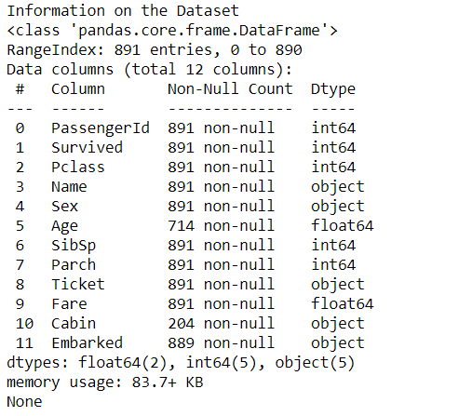
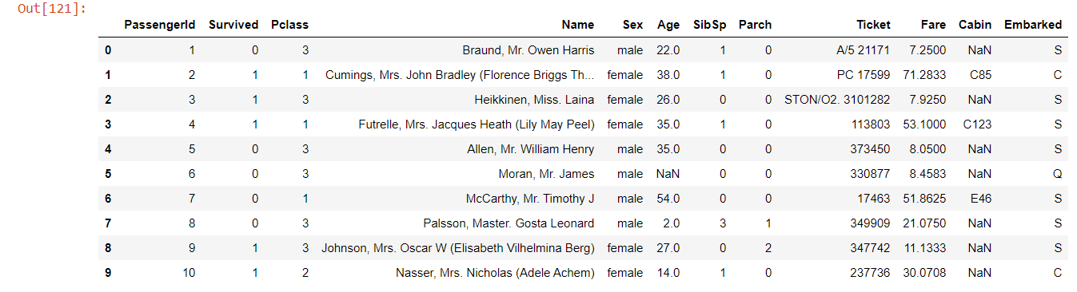

Slide 5
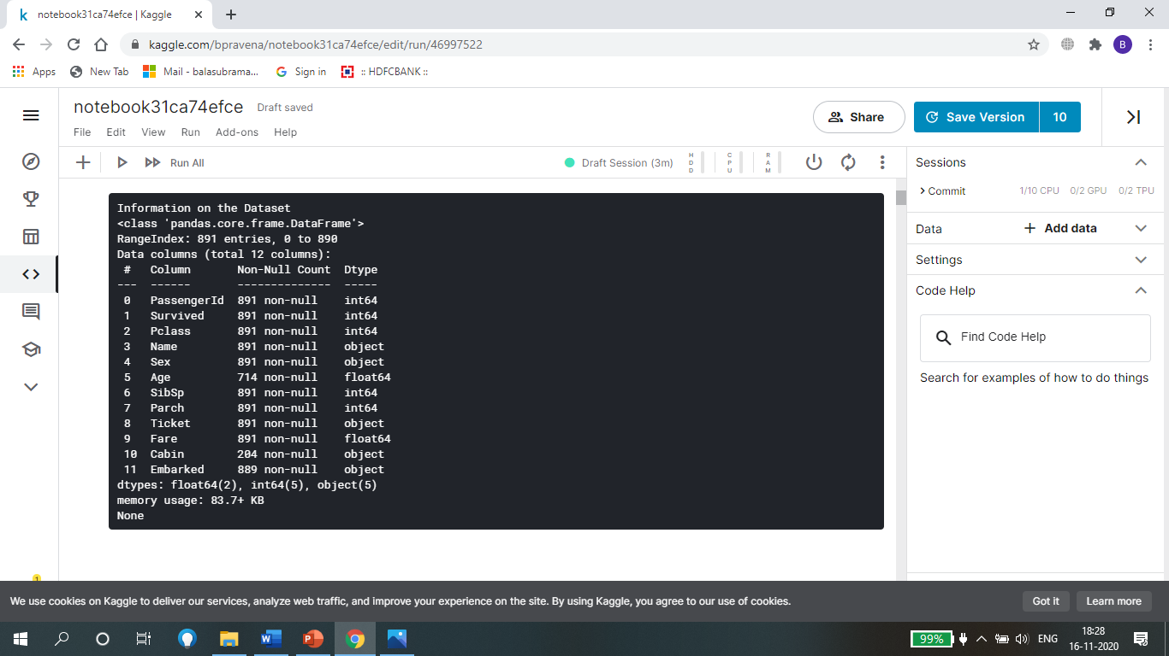
Data Cleaning
In this part the missing observations are handled.
The columns of less relevance to our analysis are dropped.
Before cleaning,

Slide 6
In ‘Age’ column we handle them by interpolating (taking average of the cells above and below) them. In column ‘Cabin’ we have too many null values and its not of much relevance to us, so we drop that column. Similarly, the column ‘Embarked’ has some null values, which we replace with ‘S’ as it is the port where maximum number of passengers boarded. The columns ‘Name’ and ‘Ticket’ are also dropped as they don’t have much relevance to our analysis. The columns ‘Age’ and ‘Fare’ have outliers, which should be removed after calculating the inter-quartile range for both the columns and removing any data outside the range.

Slide 7
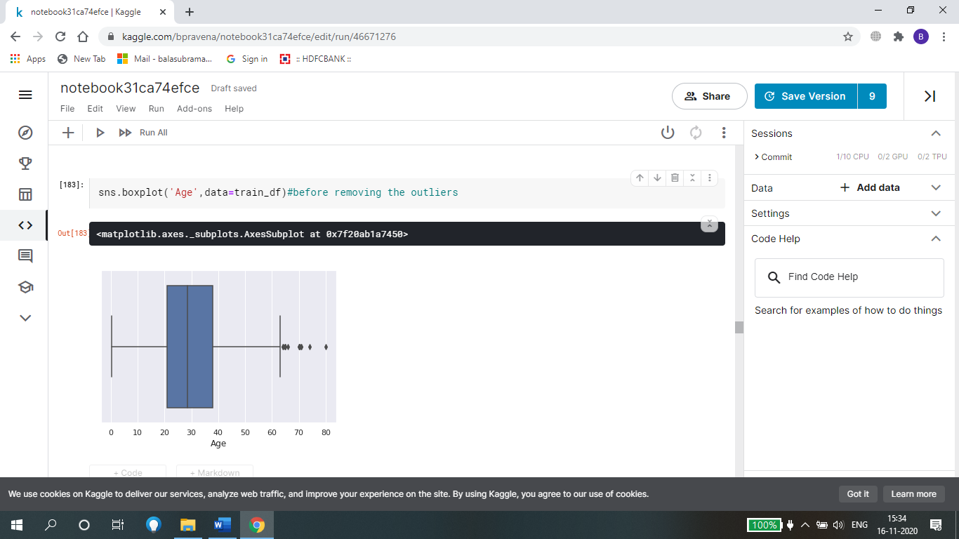
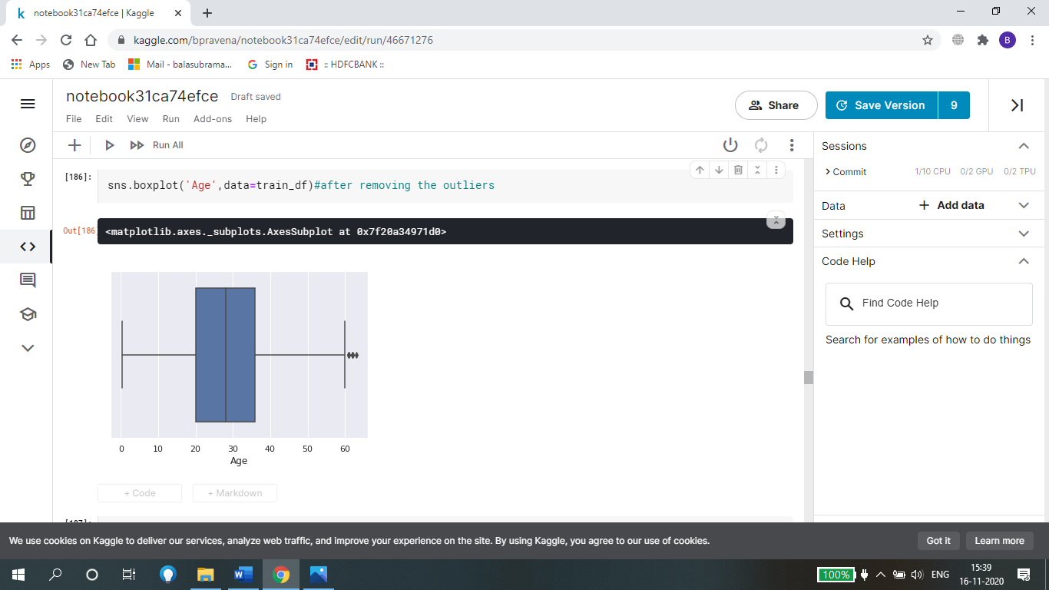
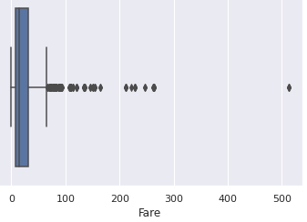
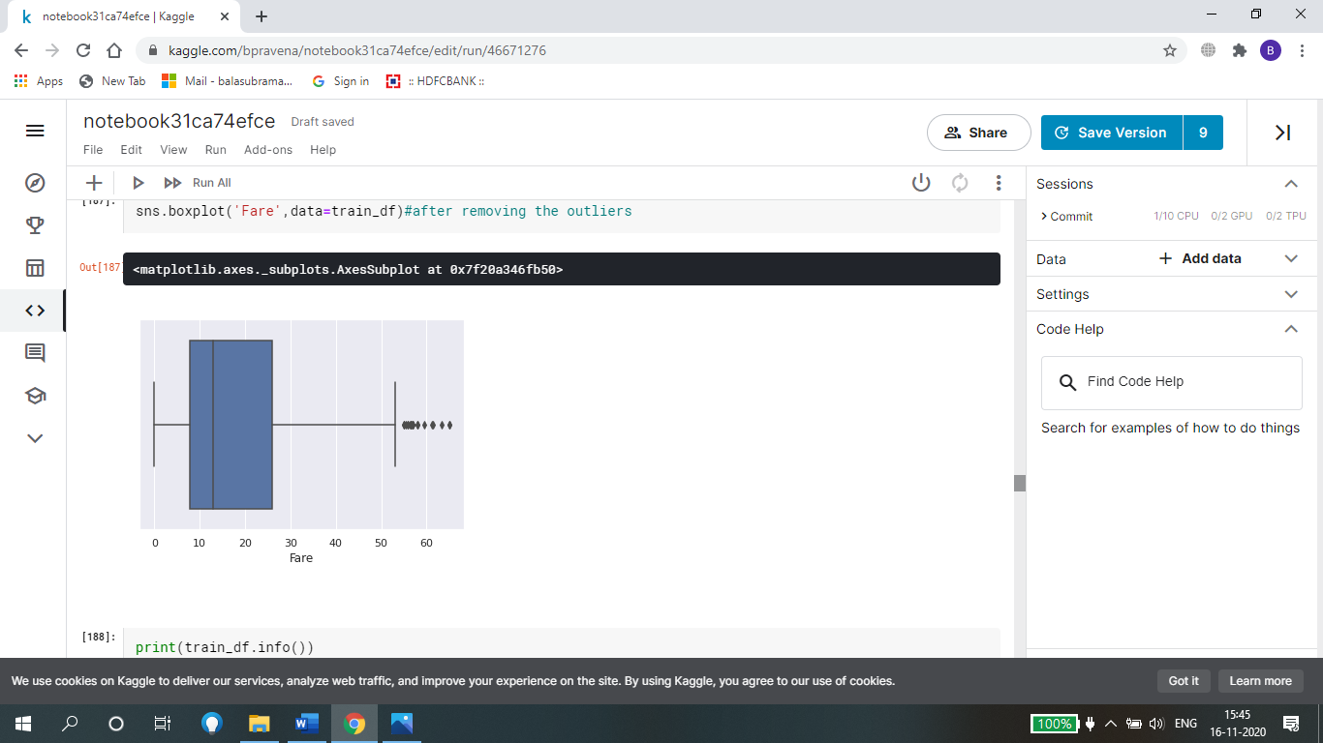
Before and after removing outliers in Age and Fare columns

Slide 8
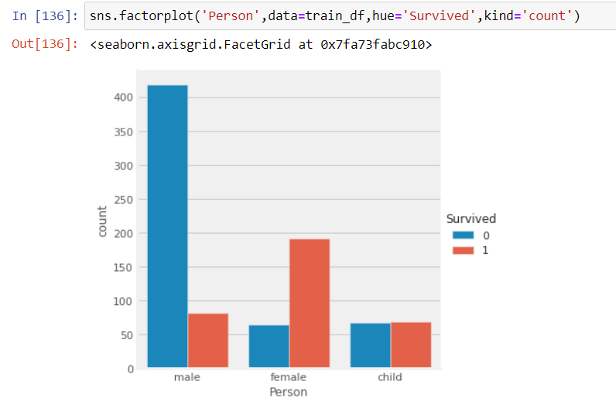
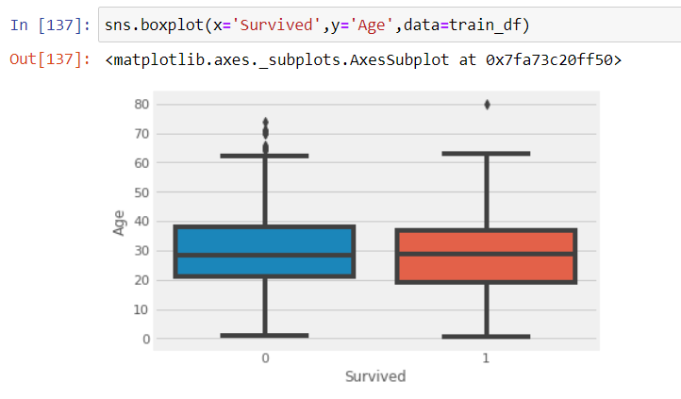
3) GRAPH VISUALIZATION
Graph showing survival -> Boxplot showing various age
among people:- groups who survived

Slide 9
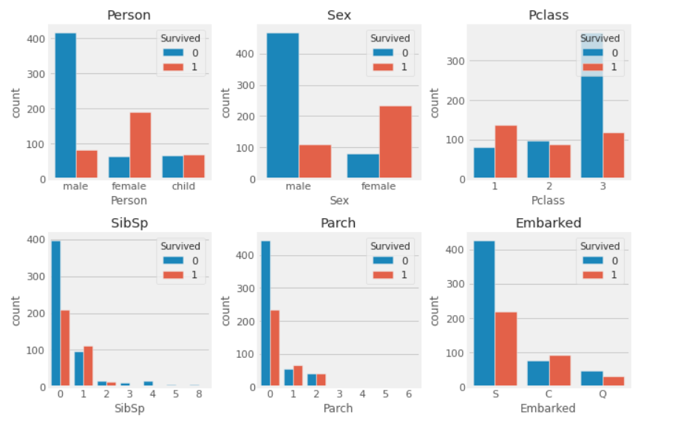
Visualizing the count of survivors in 'Person','Sex','Pclass','Sibsp','Parch','Embarked’.
The subplot grid and figure size of each graph:

Slide 10
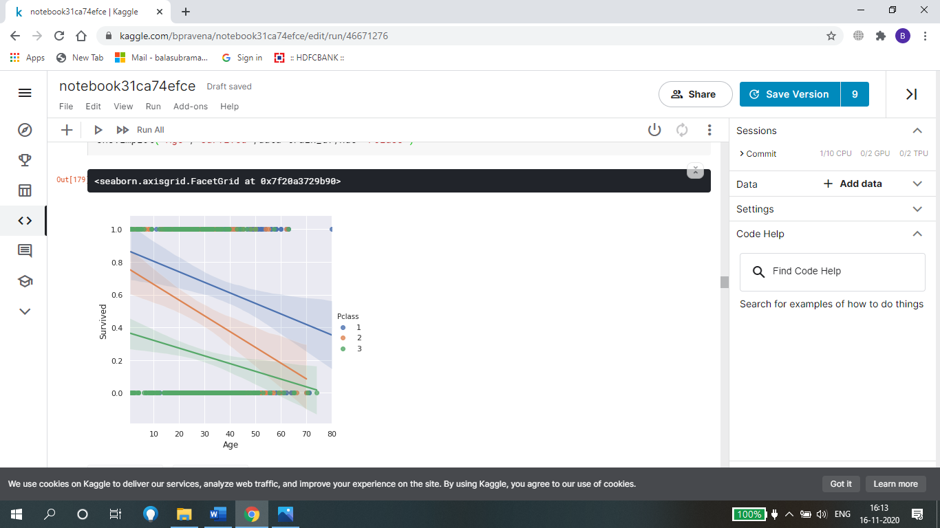
This is a lmplot. From this we can infer that, greater a passenger’s age less likely that they survive. Also chances survival of passengers from passenger class (Pclass) 1 and 2 is more than those from Pclass 3.

Slide 11
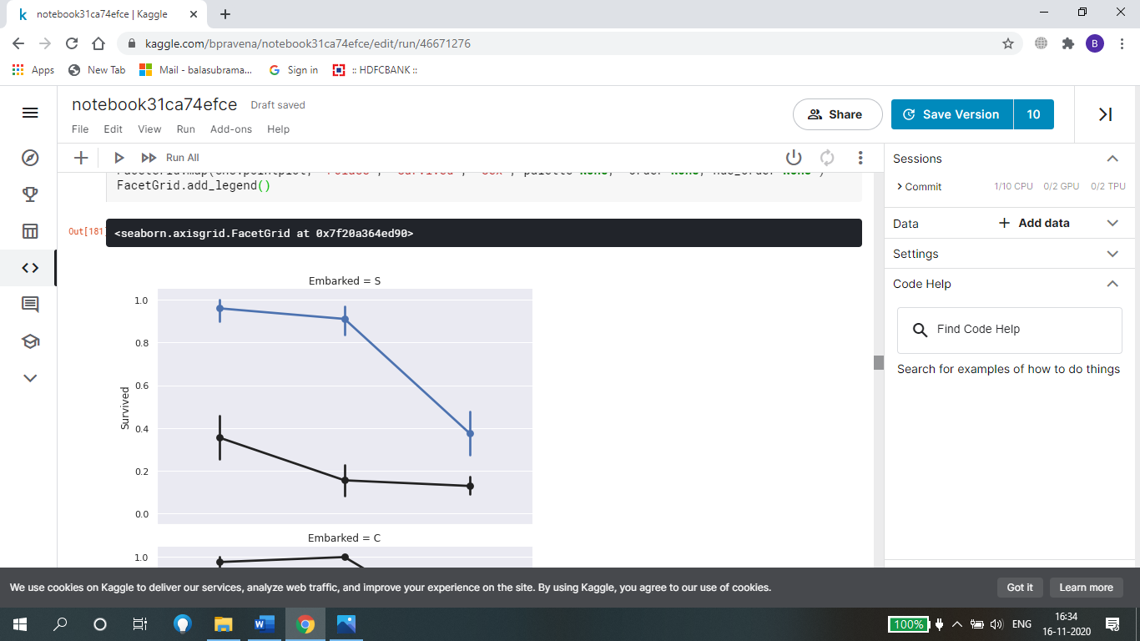
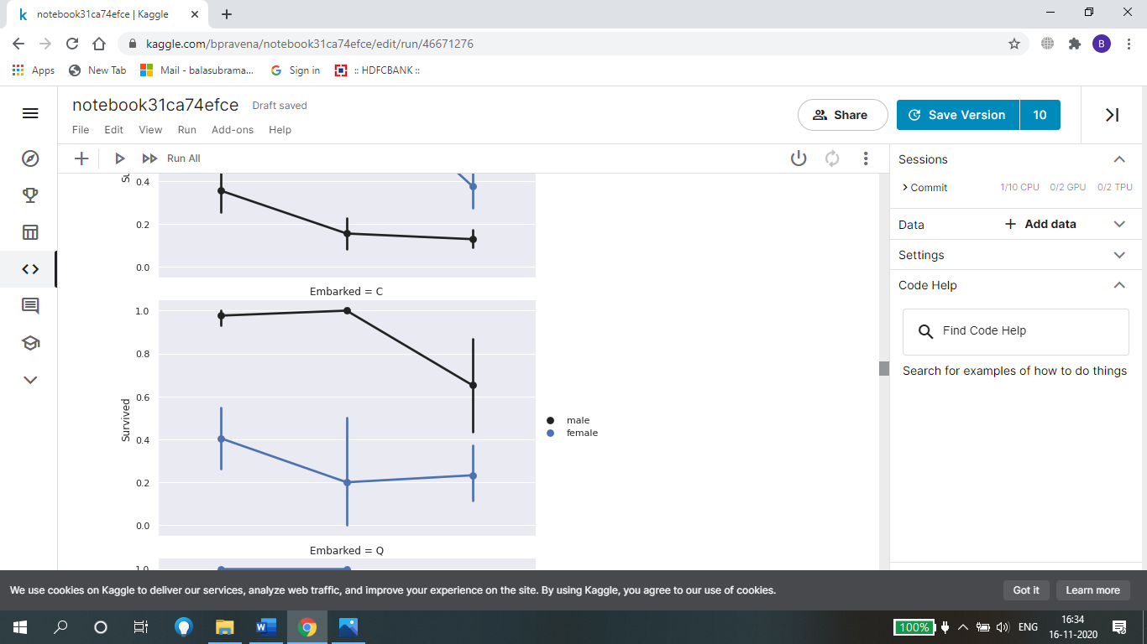
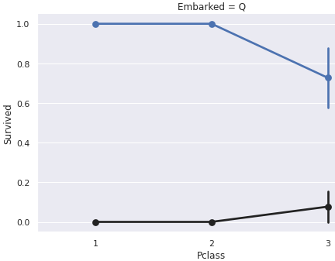
This is a Facet Grid. From this graphs, we can infer that women who boarded on port Queenstown and on port Southampton are most likely to survive. Men have a high survival probability if they boarded on port Cherbourg, but a low probability of survival, if they boarded on port Queenstown or Southampton.

Slide 12
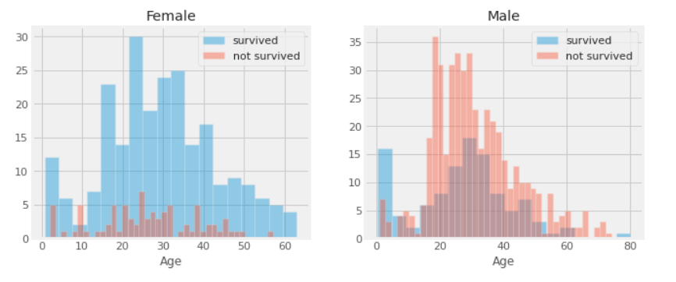
From the above graph we can conclude that
men have a high probability of survival when they are between 18 and 30 years old.
For women the survival chances are higher between 14 and 40.

Slide 13
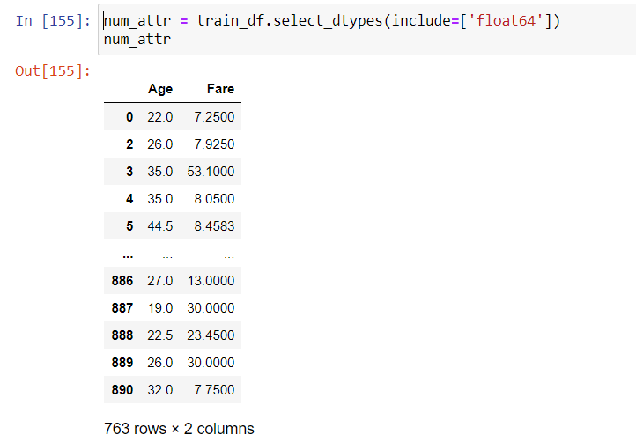
NORMALIZATION AND STANDARDIZATION
Selecting only the numeric attributes for normalization by min-max scalar form

Slide 14
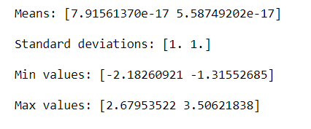
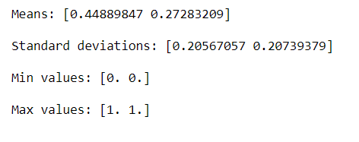
Above is the mean, standard deviation and variance for each of the columns Age, Fare
Dataset after standardization:- Dataset after Normalization:-

Slide 15
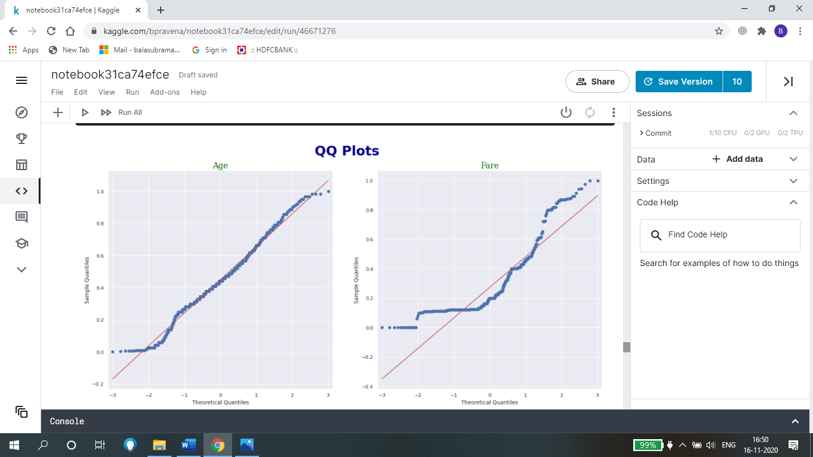
The QQ plots for ‘Age’ and ‘Fare’ after normalization and standardization is as seen above. We can infer that none of the variables have a normal distribution. Although, age shows distributions very close to the straight line it deviates near the tail which might indicate that the distribution is not normal.
There are many other graphs in the notebook which help us to infer various statements and conclusions.

Slide 16
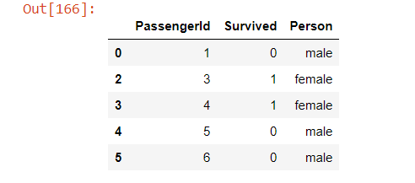
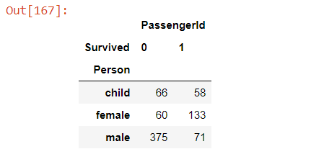
5)HYPOTHESIS TESTING
Research Hypothesis: The proportion of females onboard who survived the sinking of the Titanic was higher than the proportion of males and children onboard who survived the sinking of the Titanic.
Null Hypothesis: There is no relation between the 'Sex' and 'Survived' variables.
Alternative hypothesis: There is a relation between the 'Sex' and 'Survived' variables.

Slide 17
Since, the data type of our features to be tested and the target variable are both of categorical type we can use Chi-Squared test.
Results of chi_squared test on gender to survival:
chi-Squared score =177.93293973476872
pvalue=2.3033135484113575e-39
As the p-value is very small(p<0.05), we can reject our Null hypothesis.

Slide 18
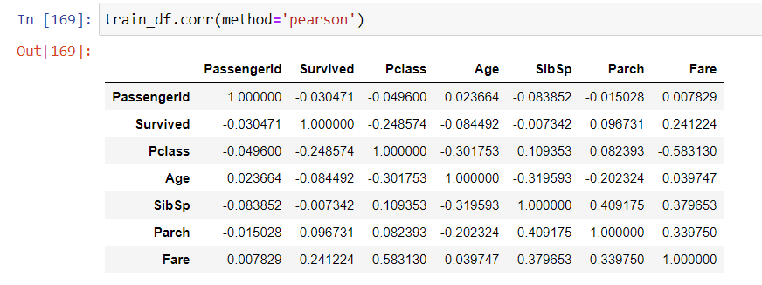
6) CORRELATION

Slide 19
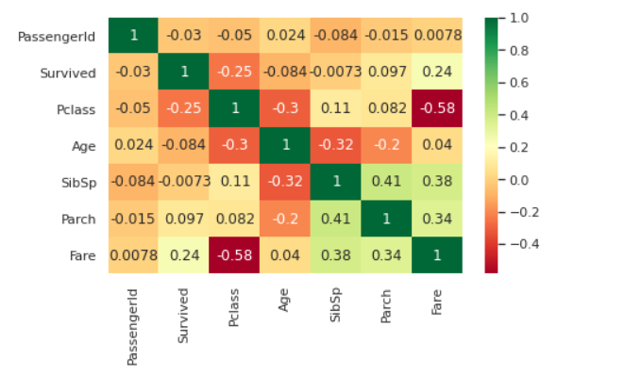
The heat map shows the correlation between different variables.
Positively corelated variables:
SibSp and Parch - This means more the number of sibling or spouses more were the number of parents or children.
Parch and Fare - This means greater the number of parents or children for a particular passenger, greater were their charges/fare.
Negatively correlated -:
Pclass and Fare - This means greater the passenger class, lesser the fare. I.e it would cost a passenger lesser if they were in class 3 rather than 2 or 1.
SibSp and Age - This means that greater the number of siblings or spouses for a passenger, lesser was their age.
Pclass and Age - This means greater the passenger class, lesser the age of the passenger.

Slide 20
TEAM MEMBERS
1)B. PRAVENA (SRN: PES2UG19CS076)
2)BHARATH KUMAR.S.P (SRN: PES2UG19CS087)
3)BHUVANTEJ.R (SRN: PES2UG19CS092)
4)DISHA B.S(SRN: PES2UG19CS116)
-------------------------------------------------------------------------------
THANK YOU

