Slide 1
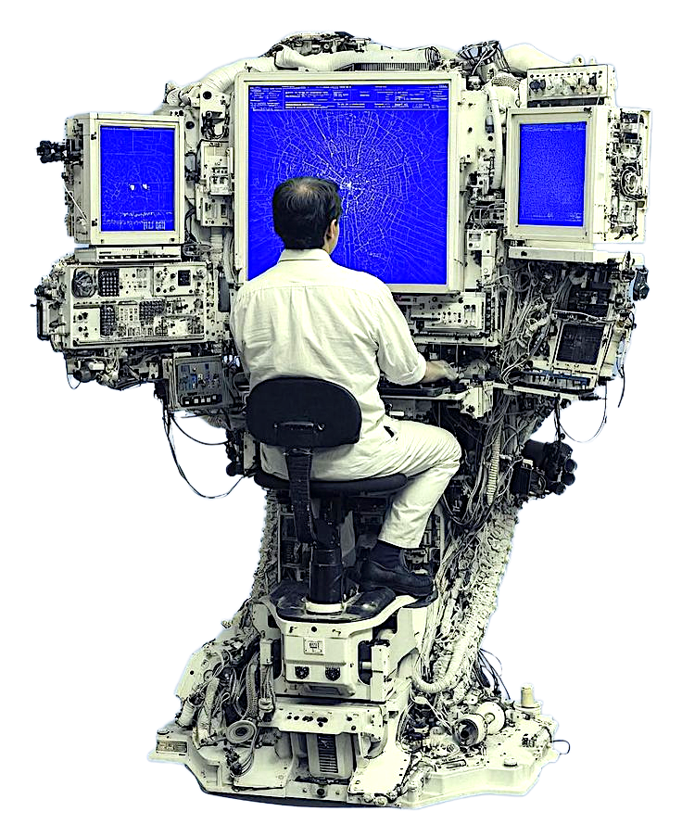
NUS-ISS · PATTERN RECOGNITION SYSTEMS
MACHINESENSE
Multi-sensor fault diagnosis for rotating machinery, from a five-second reading to an evidence-supported inspection decision.
Bhuvesh Kumar · A0243823H
MTech AI Systems · Practice Module
Notes:
The system answers three questions about a recording, and then shows the evidence behind each answer.

Slide 2
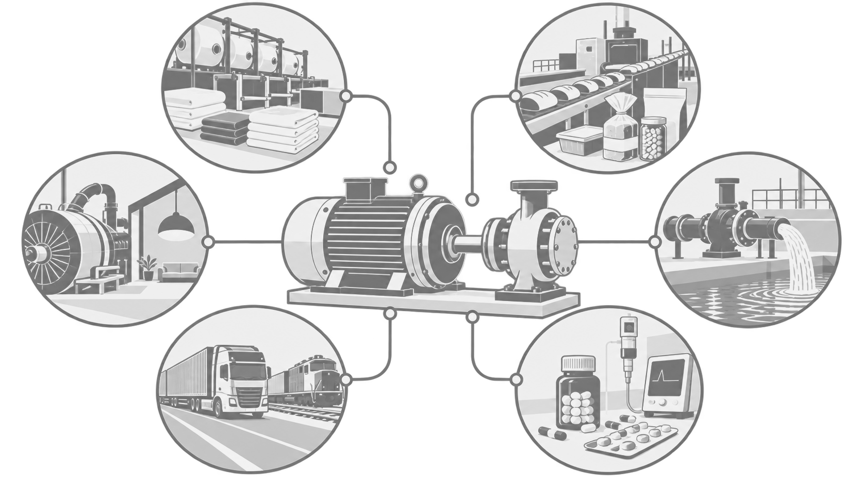
MACHINESENSE
MOTIVATION
Machines keep our lives moving
The clothes we wear, the food on the shelf, the power in the socket, the water in the tap, everything that moves and every hospital that stays open all run on rotating machinery.
02
Notes:
Open here, not on the architecture. Everything on this picture stops if the motor in the middle stops, and that is the whole reason the project exists.

Slide 3
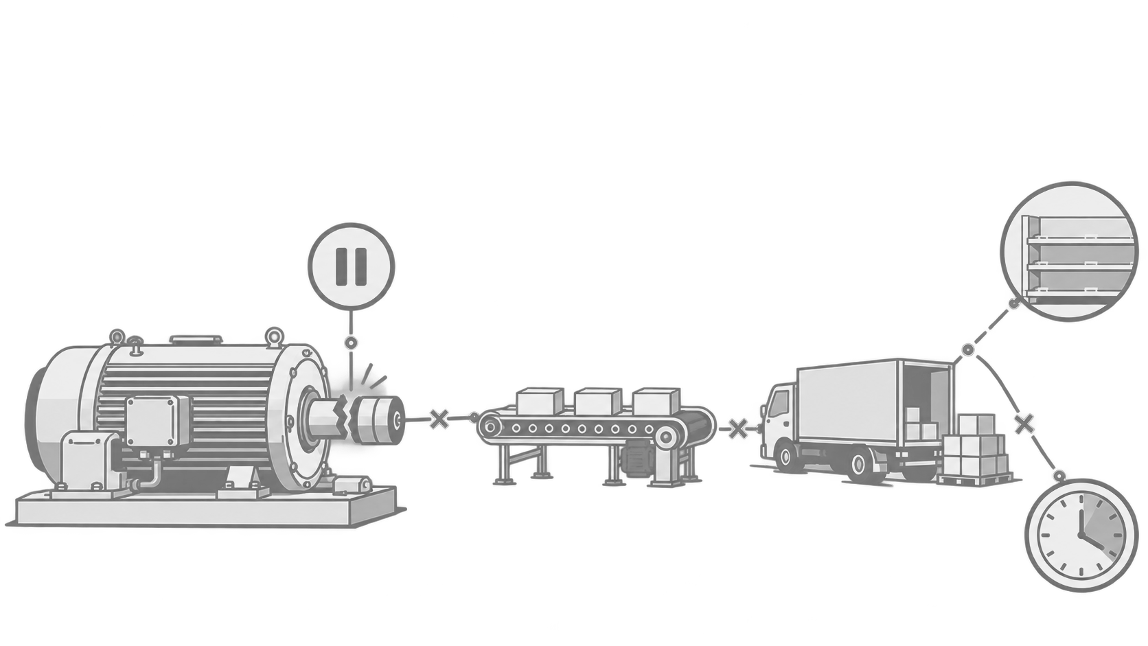
MACHINESENSE
What happens when a machine breaks down without warning?
One bearing gives way and the line stops. Production halts, deliveries are late, shelves empty, and the repair costs far more than it would have before the failure.
03
Notes:
The cost is never just the bearing. It is the stopped line, the late delivery and the empty shelf, and it is many times the cost of the part.

Slide 4
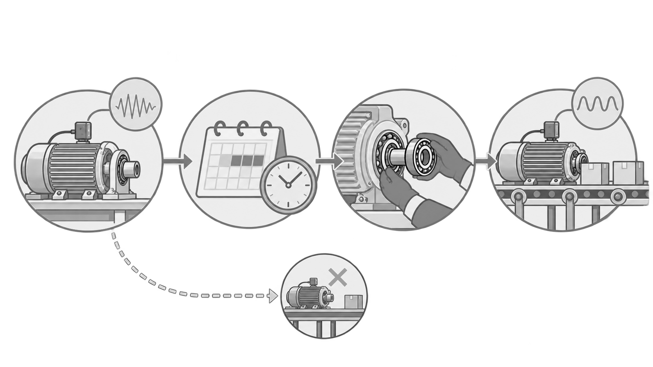
MACHINESENSE
PREVENTIVE MAINTENANCE
Most of this is preventable
Measure the machine while it is still running, plan the work, replace the part before it fails, and the machine goes back into service. Preventive maintenance turns a breakdown into a scheduled job.
04
Notes:
The dashed path at the bottom is the failure that never happens. Preventive maintenance is what turns an emergency into a scheduled job.

Slide 5
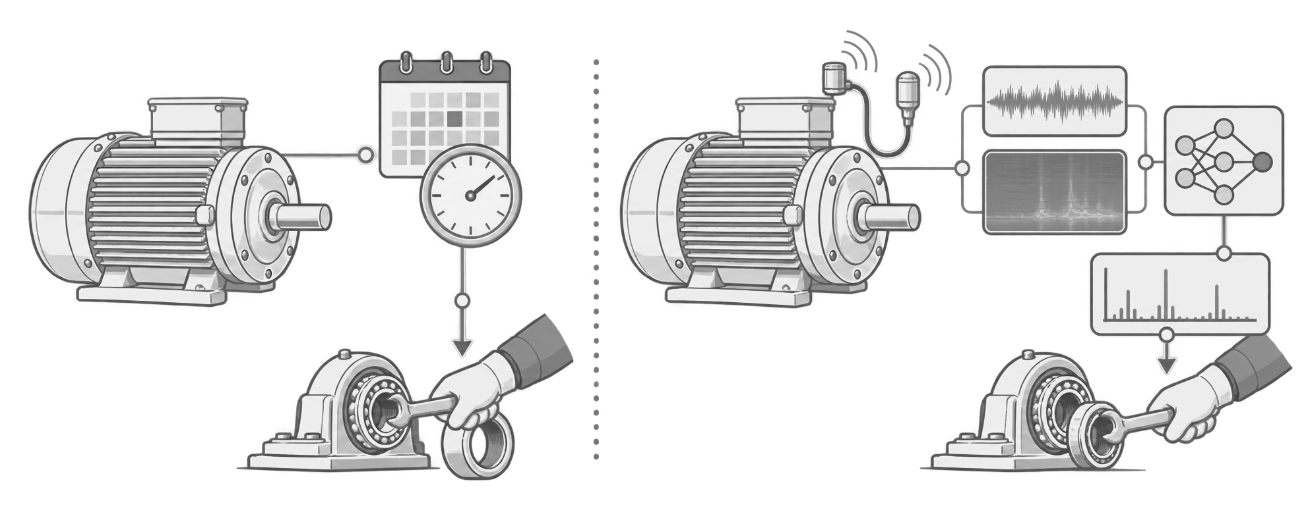
MACHINESENSE
CLASSIC VERSUS MACHINE LEARNING
Two ways to decide when to intervene
Classic preventive maintenance replaces parts on a fixed schedule, so healthy parts are discarded and some faults still arrive early. A machine-learning approach listens to the machine itself and acts on what the signal says.
05
Notes:
The weakness of the calendar is on the left: healthy parts thrown away, and faults that still arrive early. The right-hand side acts on what the machine is actually doing.

Slide 6
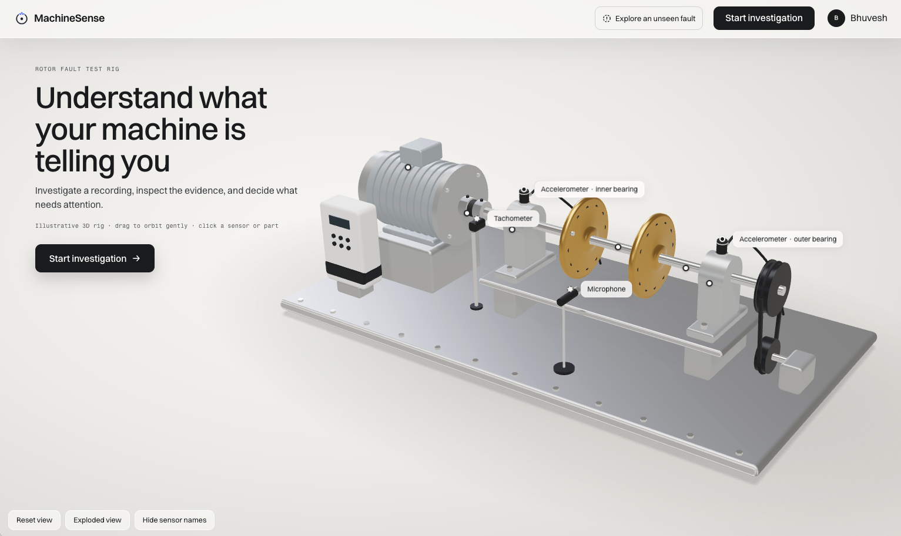

MACHINESENSE
MachineSense and its objective
What is it?
MachineSense is a research prototype that uses vibration, sound, and rotation data to detect known faults and flag unfamiliar patterns. An interactive report presents the evidence, while an Investigation Assistant helps users explore the findings and ask follow-up questions.
The data used in this project.
MAFAULDA, the Machinery Fault Database from the Universidade Federal do Rio de Janeiro: 1,951 recordings of one rig run under ten deliberately induced conditions.
06
Notes:
Introducting machine sense, which takes the route of ML use for this Use case. It uses the Mafaulda dataset , as I dnt have my own dataset from any real machine.
This will be a web app, that will alos host an agnet, so the agent can help the mechanic to answer the different questions aboyt the machine condition.

Slide 7
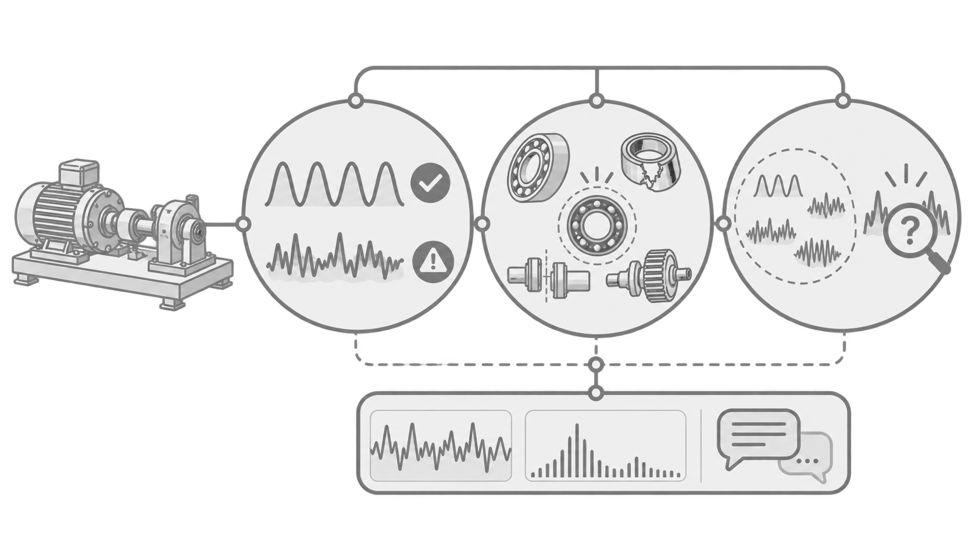
MACHINESENSE
What MachineSense answers?
Objectives
Q1
Q3
Healthy or faulty?
Unfamiliar fault?
Detect an abnormal recording. Healthy-only checks provide a separate signal alongside the trained classifier.
Request further inspection when a recording does not fit the learned conditions. (Open-set recognition)
Q2
Which familiar condition?
Name a condition the classifier has learned.
(Closed-set classification)
Every objective is studied on MAFAULDA recordings from one test rig.
07
Notes:
Machine sense will be able to give answers to these 3 questions absed on the data /recoridngs of the machine

Slide 8
MACHINESENSE
Problem and solution
PROBLEM
SOLUTION
Published scores answer different questions
MachineSense evaluated with stricter rig tests
Recording-level, folder-grouped splits, with reserved partitions for held-out severity and held-out speed, sealed until a single declared final run.
Evaluation leakage: Segmenting a recording before splitting can put related pieces in both training and testing. Such scores can overstate performance on new recordings.
A hybrid approach: MachineSense combines physics-based features and a classical reference model with a CNN trained on order spectrograms. A healthy-only anomaly detector and a distance-based check help flag recordings that may not match any known fault.
Operating conditions: Speed and fault setting can change the signal. Random partitions alone do not show how a model behaves at unseen settings.
Unknown faults: A closed-set classifier must choose a learned class, even when a recording comes from a condition it has not seen.
Closed set and open set are both reported, so declining to name a fault is a measured behaviour rather than a missing capability.
Explanation gap: A mechanic needs the evidence and uncertainty behind a suggested condition.
A saved evidence report that a mechanic can inspect. A bounded investigation assistant is proposed for follow-up questions.
08
Notes:
If we have to see the project from problem and solution POV, we can talk about this

Slide 9
MACHINESENSE
Literature review and benchmarking
Earlier research shows that machine signals can classify familiar faults. MachineSense asks an additional question: when should the system stop naming a fault and request inspection?
What the field has established
Where the reported numbers break down
What is rarely asked
Most studies emphasize familiar-fault classification. MachineSense also measures the cost of declining to name an unfamiliar condition.
Vibration and acoustic signals separate the standard rotating-machinery faults well, with both engineered features and learned representations, on this dataset and its neighbours.
Segmentation before splitting can put related parts of one recording into different folds. Published scores require careful reading of each study’s split and class definitions.
Benchmarking principle
On comparing numbers
Windows from the same recording stay together and results are reported per recording. Held-out operating settings test how performance changes beyond familiar examples.
Published accuracy figures should not be ranked against MachineSense unless the classes and the evaluation protocol match. Where they do not, the comparison is stated as unavailable rather than made anyway.
09
Notes:
Be careful with comparisons. Where the protocol does not match, say the comparison is unavailable rather than making it anyway.

Slide 10
MACHINESENSE
Where MachineSense differs
Rotating-machinery fault diagnosis on this benchmark and its neighbours.
WORK
DATA
SPLIT UNIT
OPEN SET
EXPLANATION
Ribeiro et al., SBrT 2017
similarity-based models
MAFAULDA
random sample split
no
none
Souza et al., Comp. & Ind. Eng. 2021
deep learning for rotating machinery
MAFAULDA
different protocol
no
none
Nascimento et al., arXiv 2022
T4PdM, transformer
MAFAULDA subset
different protocol
no
none
Ignjatovska et al., Sensors 2026
physics-informed feature sets
MAFAULDA
normal segments cross folds
no
feature sets only
Hendriks et al., MSSP 2022 · Matania et al., PHME 2024
CWRU and others
the subject of the work
not addressed
none
Hendrycks 2017 · Lee 2018 · Geng 2021
open-set recognition
vision benchmarks
not applicable
the subject
none
MachineSense
MAFAULDA
recording, folder-grouped
measured
per-value provenance
Published accuracy figures cannot be ranked against MachineSense without matching classes and splits. My contribution is a rigorously evaluated fault-diagnosis system that keeps recordings separate, tests unseen operating settings, and flags unfamiliar faults for further inspection.
10
Notes:
Sources: Ribeiro et al. (SBrT 2017), https://www.sbrt.org.br/sbrt2017/anais/1570359719.pdf; Ignjatovska et al. (Sensors 2026), https://www.mdpi.com/1424-8220/26/6/1876. Split methods and classes differ. The original slide’s blanket claim that no prior work used recording-level splits was unsupported.

Slide 11
MACHINESENSE
Project scope
MachineSense is a research-demo web application that helps a mechanic interpret machine vibration and sound recordings. It studies when to report a familiar condition and when to say further inspection needed.
IN SCOPE
OUT OF SCOPE
Preparing and checking sensor recordings
Predicting remaining useful life
Detecting healthy versus faulty operation
Confirming that a repair fixes the problem
Naming familiar machine conditions
Streaming live machine data or controlling equipment
Flagging unfamiliar patterns for inspection
Establishing reliability on machines other than this rig
Showing the evidence behind each result
Replacing the mechanic's judgement
A preview of a bounded investigation assistant agent
Independent diagnosis of simultaneous faults
Interactive report
Mechanic vs Developer view (UI/UX preferences and research)
MachineSense supports human inspection. Further inspection needed is an uncertainty verdict, not confirmation of a new fault.
11
Notes:
The last line matters most. Further inspection needed is an uncertainty verdict, not a claim that a new fault has been found.

Slide 12
MACHINESENSE
Techniques, limitations and constraints
TECHNIQUES
LIMITATIONS
CONSTRAINTS
Supervised: a convolutional network on order spectrograms, and logistic regression on physics features
One test rig: results cannot establish reliability on other machines
Input format: eight-channel, five-second recordings sampled at 50 kHz, in the MAFAULDA layout
Healthy recordings are scarce, so any false-alarm rate is known only to a wide interval
Unsupervised: an autoencoder and a speed-aware baseline fitted on healthy recordings only
Signal quality: unreliable speed estimates or sensor readings weaken interpretation, and the application shows a warning
Open-set trade-off: Catching more unfamiliar faults also risks rejecting more known faults. We show performance across decision thresholds, as well as the chosen operating point.
Open set: Mahalanobis distance on the network's own embeddings
Deployment: the demo accepts prepared recordings and CSV uploads; it does not stream live data or control equipment
Hybrid: a calibrated rule combines classifier confidence, embedding distance and healthy checks
Intelligent sensing: fusion across six vibration axes, a tachometer and a microphone
12
Notes:
The techniques column is where the module rubric is satisfied: supervised and unsupervised, classical and deep, a hybrid decision, multi-sensor fusion.

Slide 13

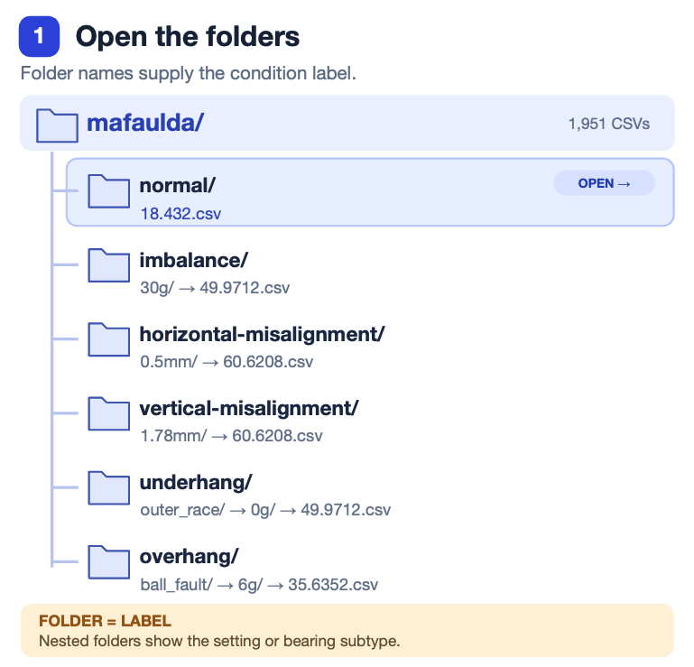
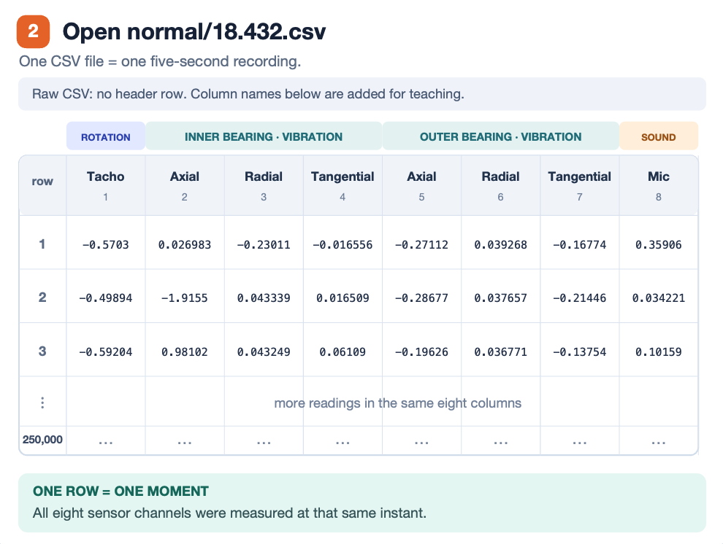
MACHINESENSE
What arrives on disk
One archive, six top-level folders, 1,951 CSV files, no index and no label file.
https://www.kaggle.com/datasets/vuxuancu/mafaulda-full
13
Notes:
The right-hand column is the one to dwell on. Severity is never predicted; it exists so that whole severity bands can be held out, which is how the system is tested against a familiar fault at an unfamiliar size.

Slide 14
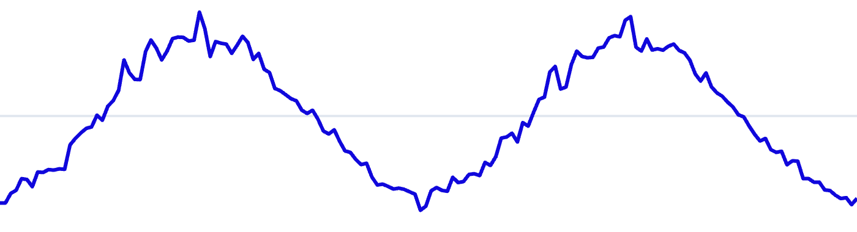
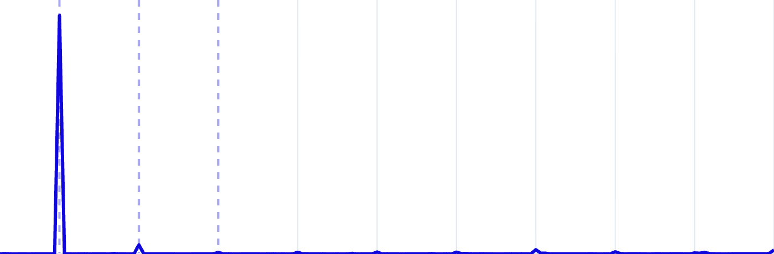
MACHINESENSE
Imbalance: one clean peak at shaft rate
imbalance / 35 g / 25.08 Hz measured
Left chart. The sensor voltage over time. One horizontal unit is a fraction of a second. Its shape tells you whether the machine is swaying smoothly or being struck.
Right chart. The same signal split into frequencies, but the axis is divided by the measured shaft speed. 1× means once per turn of the shaft, 2× twice per turn, and so on. A peak at a whole number means something happens at that rate every revolution.
Why divide by speed. A fault at 3× sits in the same place whether the shaft turns at 15 Hz or 60 Hz, so one picture serves every speed in the dataset.
Raw vibration, 80 ms of the five seconds
Energy against multiples of shaft speed
A smooth wave that rises and falls once per revolution. No sharp edges anywhere.
Almost all the energy sits at 1×. The higher orders are close to the floor.
1×
2×
3×
5×
10×
What causes it
What it looks like in numbers
Why it is the easy case
Extra mass on one side of the rotor pulls the shaft off centre. That pull rotates with the shaft, so it loads the bearings once per revolution.
High overall level, a dominant 1× peak, a low 2× to 1× ratio, and negative excess kurtosis because the signal is smoother than random noise.
The signature is one number in one place. Both the classical model and the network separate it with almost no error on development folds.
14
Notes:
Spend time on the legend before the charts. Once the audience understands that the right-hand axis counts turns of the shaft, the next three slides read themselves.

Slide 15
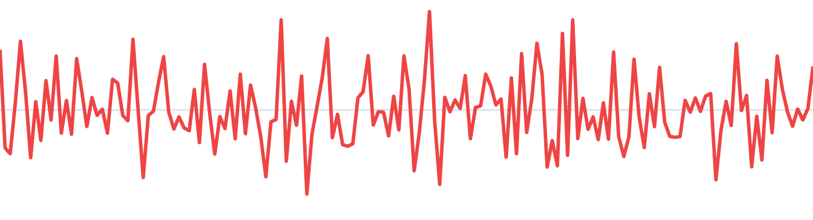
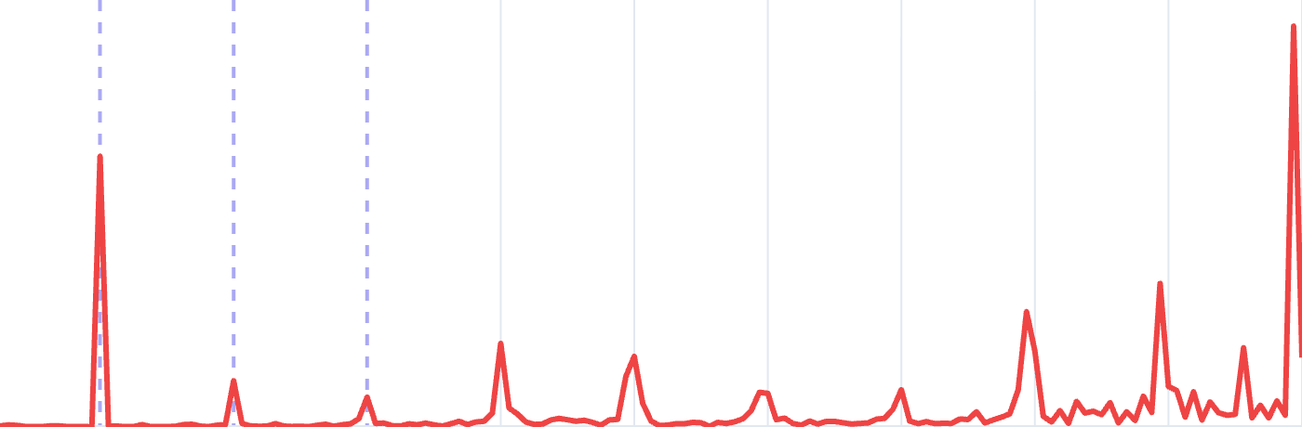
MACHINESENSE
Bearing fault: impacts across several orders
overhang / ball_fault / 0 g / 25.20 Hz measured
Raw vibration, 80 ms of the five seconds
Energy against multiples of shaft speed
Sharp spikes appear on the background. They are consistent with repeated contact involving the defect.
1×
2×
3×
5×
10×
Energy spread across many orders and rising toward the top, rather than concentrated anywhere.
What causes it
Why the peak is not at a whole number
How it is actually confirmed
A pit or spall on a rolling element, a raceway or the cage. Every time it passes through the loaded zone it strikes, and the bearing rings.
Not from this chart. The impacts modulate a high-frequency resonance, so the evidence comes from the envelope spectrum, where the defect rate appears as a comb of lines.
A rolling element does not complete one turn per shaft revolution, so its defect rate is a non-integer multiple of shaft speed that depends on the bearing geometry.
15
Notes:
The third card is the important one. This chart is not how a bearing fault is actually confirmed; the envelope spectrum is. Say so, because it motivates the second representation.

Slide 16
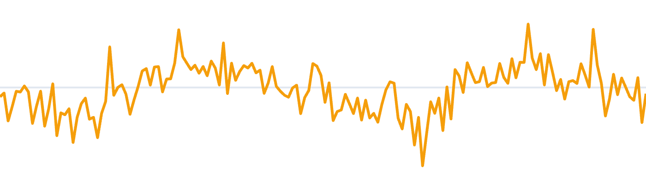
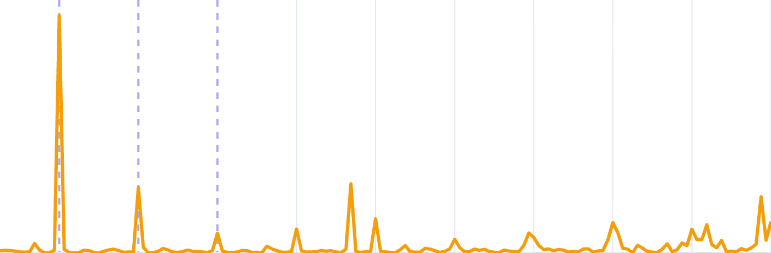
MACHINESENSE
Misalignment example: energy at 2×
horizontal-misalignment / 2.0 mm / 25.02 Hz measured
Raw vibration, 80 ms of the five seconds
Energy against multiples of shaft speed
Smooth like imbalance, but the repeating unit is shorter: the pattern completes twice per revolution.
1×
2×
3×
5×
10×
A visible component at 2× beside the one at 1×. That ratio is the main separator from imbalance.
What causes it
The axial giveaway
Where the system still struggles
The two shafts meeting at the coupling are offset or angled. The coupling is loaded and unloaded twice per revolution rather than once.
An angular misalignment pushes along the shaft as well as across it, so the axial channels carry a component that imbalance does not produce.
Horizontal and vertical misalignment can share this signature. Their direction-sensitive channels help distinguish them, but confusion remains possible.
16
Notes:
This is the pair the classifier still confuses. Horizontal and vertical misalignment differ mainly in direction, and the confusion runs mostly one way.

Slide 17
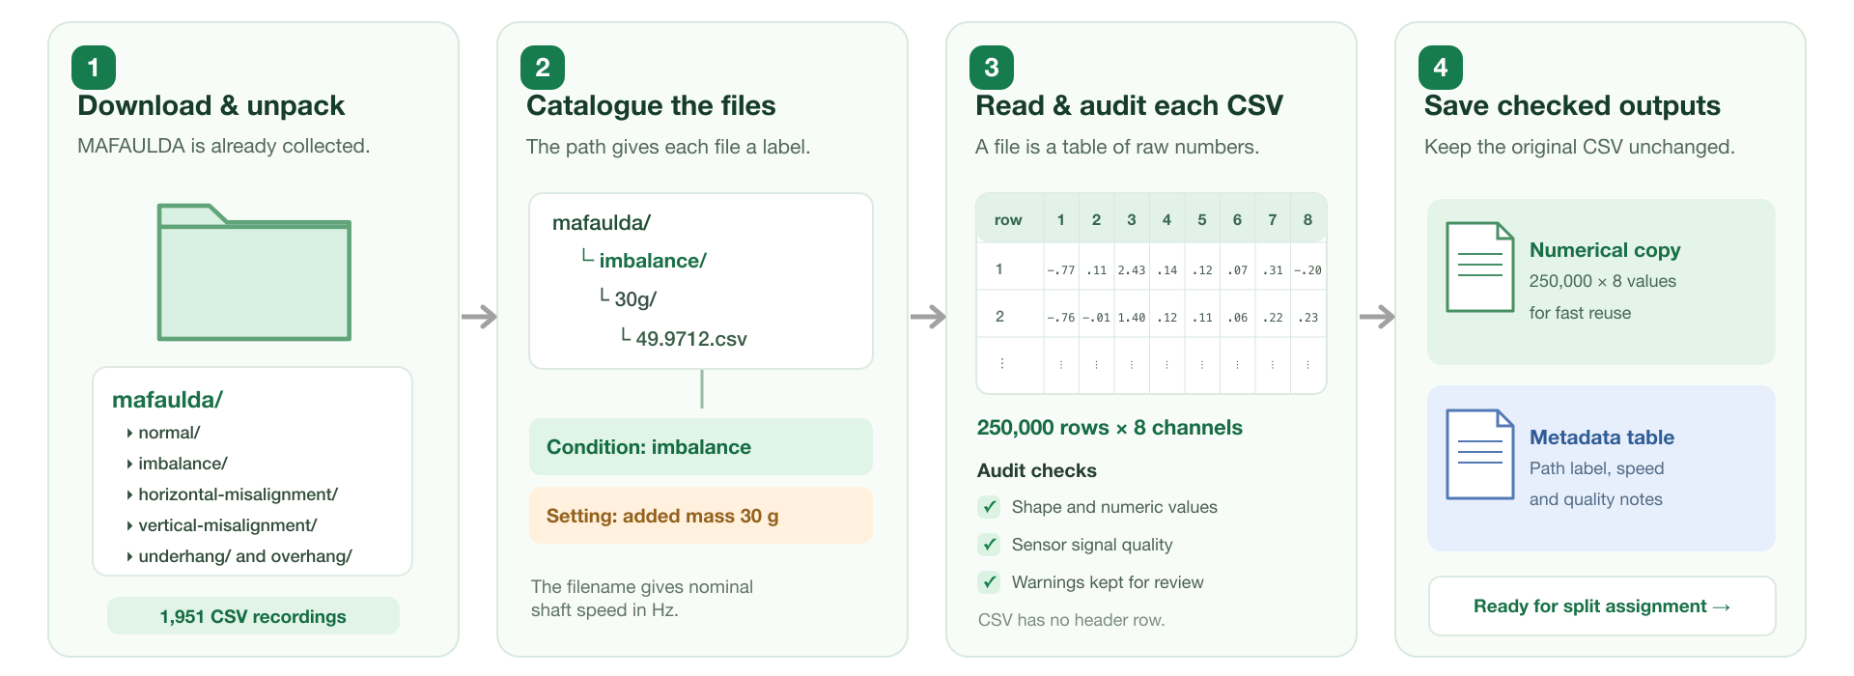
MACHINESENSE
Data intake and audit
17
Notes:
Three of the six conditions are nearly invisible to these three numbers. That failure is the argument for everything that follows.

Slide 18
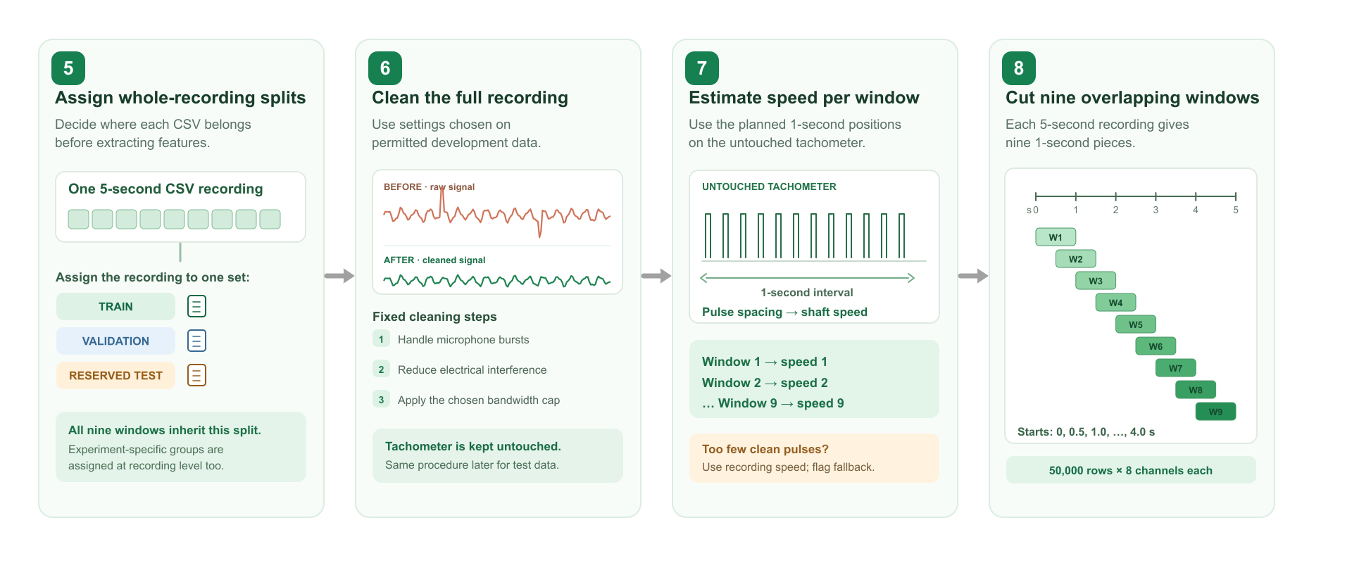
MACHINESENSE
Split, clean and window
18
Notes:
Three of the six conditions are nearly invisible to these three numbers. That failure is the argument for everything that follows.

Slide 19
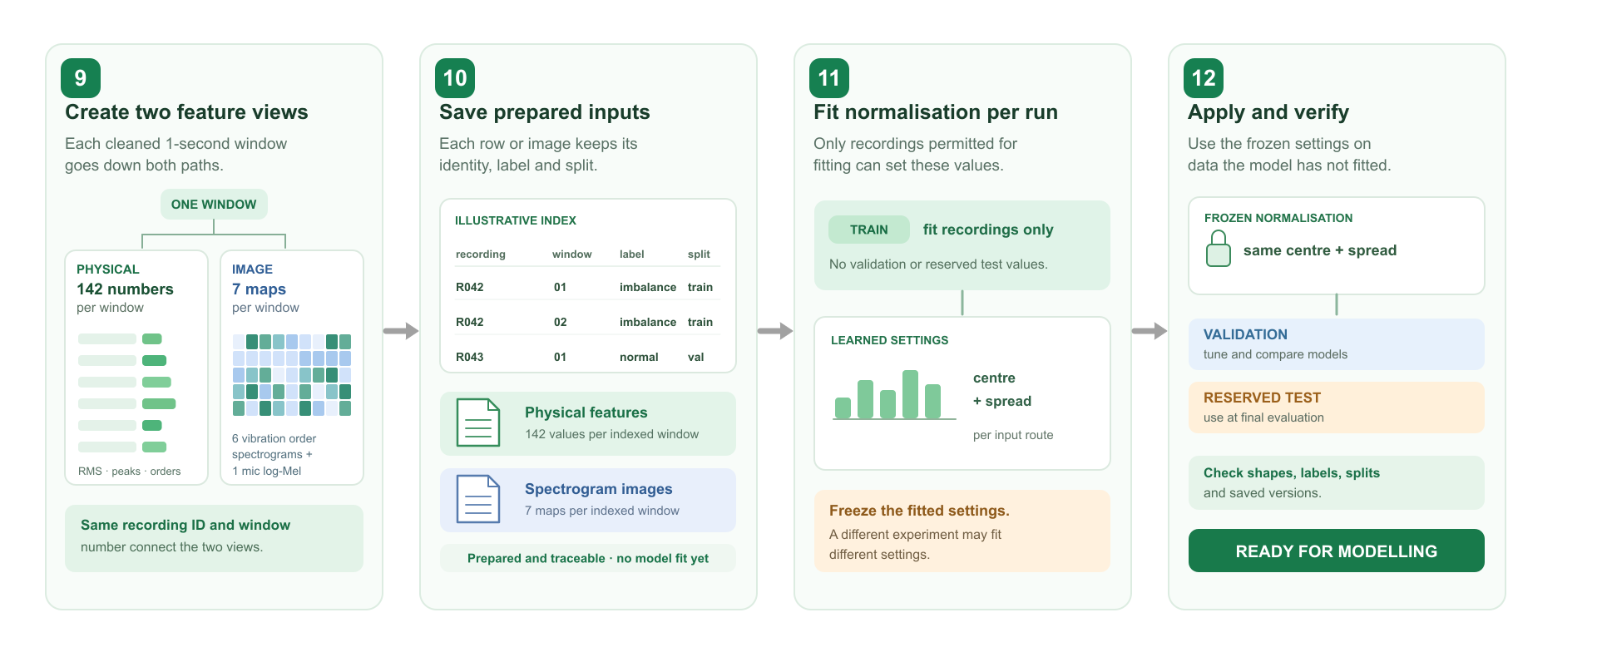
MACHINESENSE
Model input preparation
19
Notes:
Three of the six conditions are nearly invisible to these three numbers. That failure is the argument for everything that follows.

Slide 20
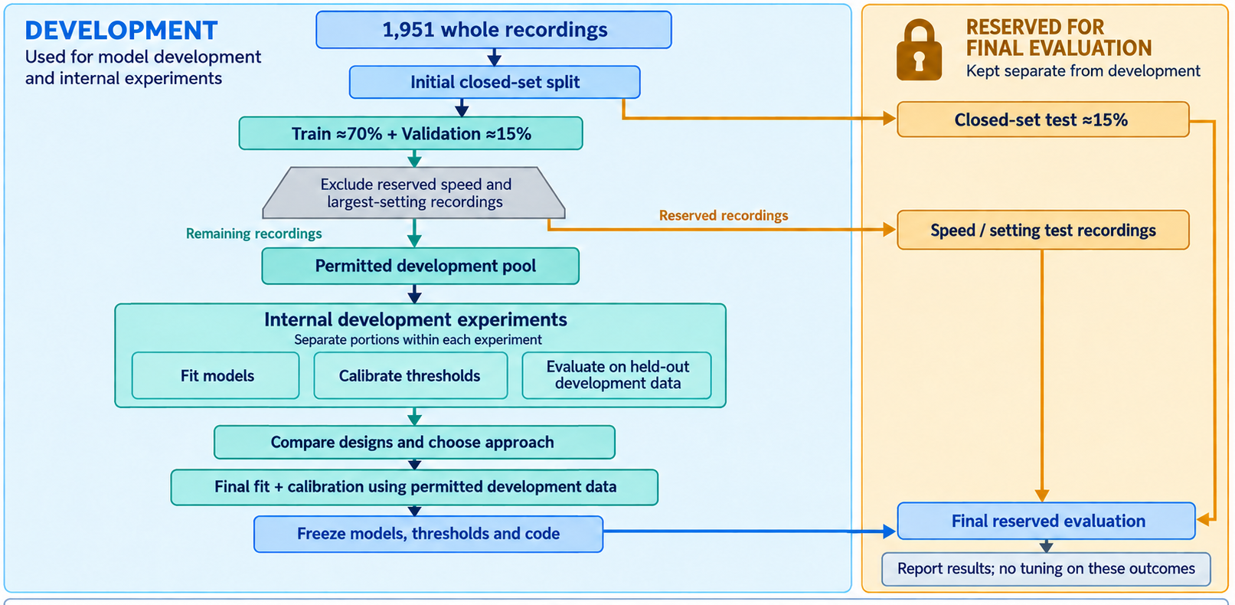
MACHINESENSE
Another view – to show how data leakage is prevented
20
Notes:
Three of the six conditions are nearly invisible to these three numbers. That failure is the argument for everything that follows.

Slide 21
MACHINESENSE
Challenges in the data itself
Recording glitch linked to certain fault labels.
Tachometer glitches
Saturation and drift
164 files carry microphone bursts of five to ten samples reaching about 160 V, against a median level of 0.13 V. They appear only in imbalance at 20 to 35 g and underhang cage at 6, 20 and 35 g, so a model could score well by detecting the artefact instead of the fault.
228 files show double triggers or dropouts, severe in 94 of them and concentrated in underhang ball. Since every order feature depends on the shaft speed, a bad speed corrupts the whole feature vector.
Nine overhang ball recordings clip at high speed, and 44 files carry up to 2.2 V of accelerometer offset. Both look like signal unless they are checked for.
Healthy data is scarce
Added mass is not defect size
49 normal recordings from one session. Every false-alarm figure this project reports rests on a few dozen recordings, and no threshold choice can narrow that interval.
In a bearing folder, 20 g is imbalance mass sitting on top of a defect whose severity is fixed. Only in the imbalance folder does the gram figure mean severity, which is easy to misread as a severity axis across the whole dataset.
21
Notes:
Source: SystemCode/results/audit_report.md, sections 4 and 8. Raw audit found 164 extreme microphone bursts. Fixed threshold flagged 168 files. Shortcut RandomForest macro-F1: 0.628 raw, 0.638 after cleaning. Cleaning may leave its own trace.

Slide 22
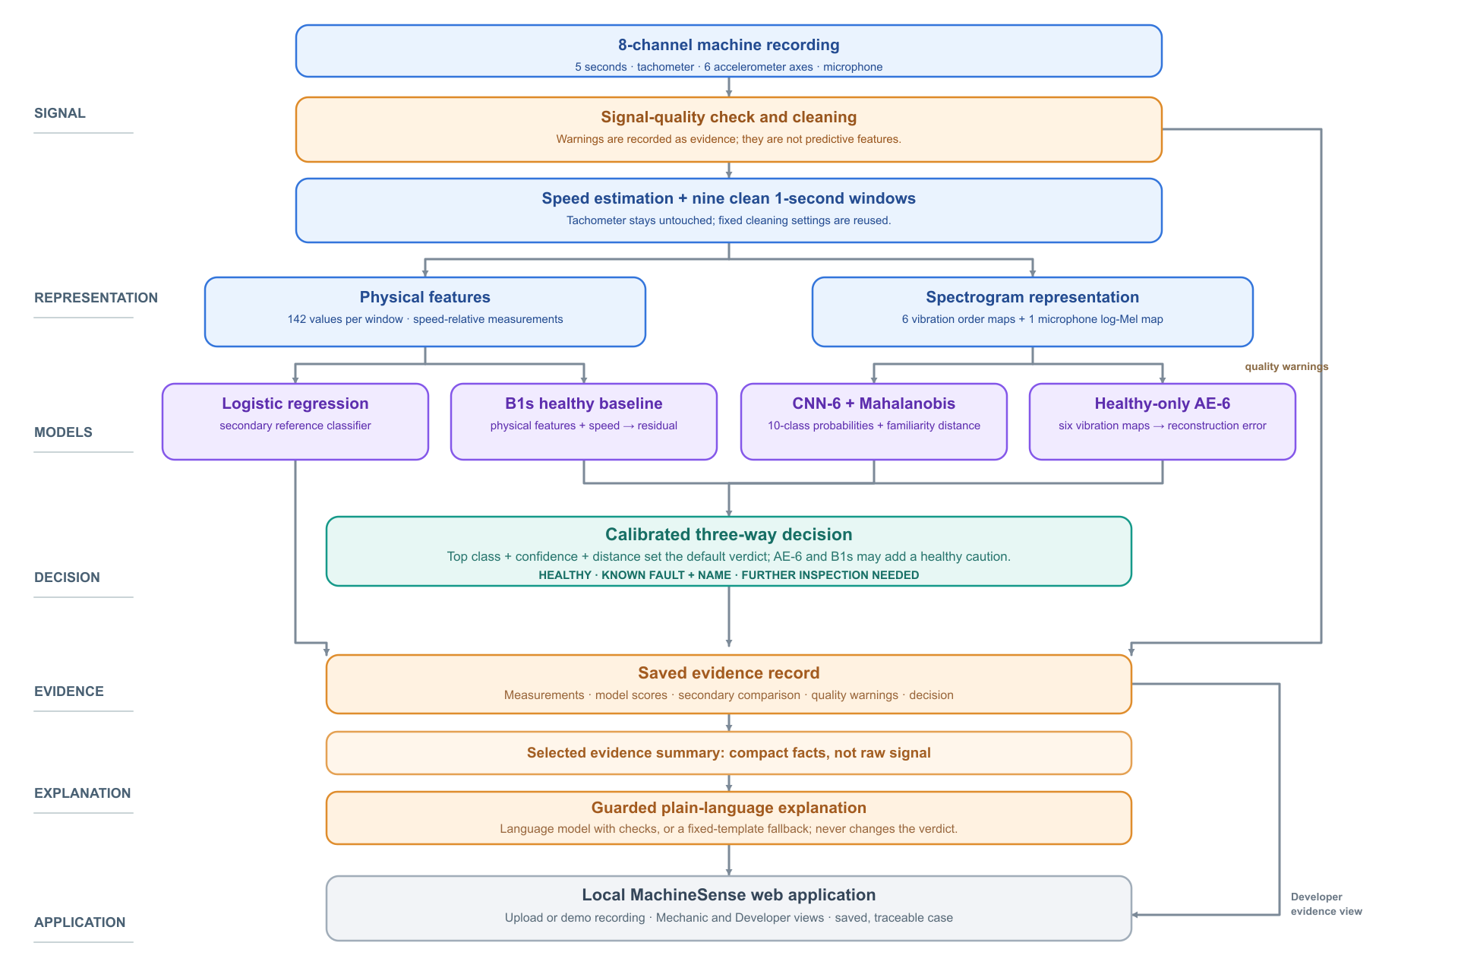
MACHINESENSE
System architecture
Experimentations to improve the eval metrics and design an appropriate system
22
Notes:
Point out that the arrows only go one way and that the ML core is the only place a number is produced. The dashed line on the right is the trace endpoint reading the core without re-running it.

Slide 23
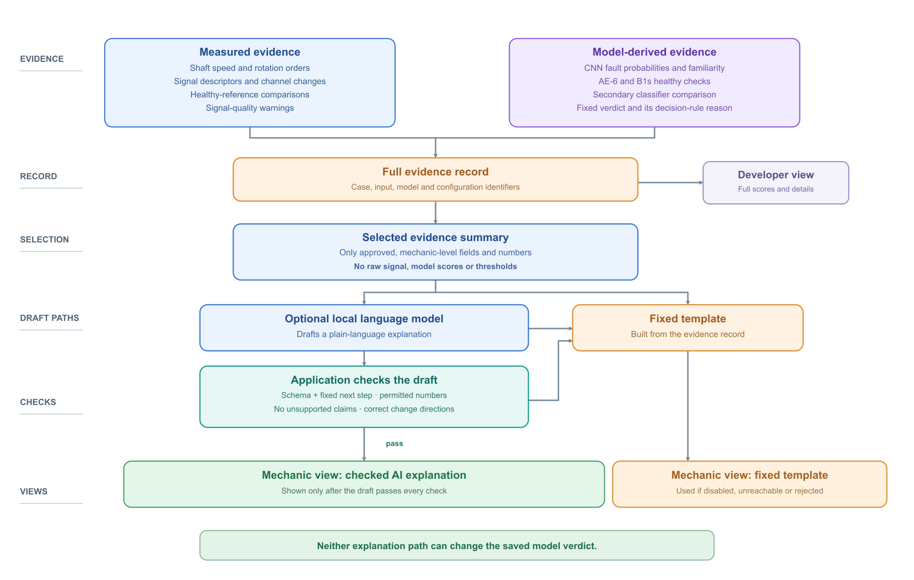
MACHINESENSE
Explanation architecture
23
Notes:
The dashed provenance lines are the point of the whole slide. Every value a person sees can be followed back to the stage that made it, which is what lets a mechanic disagree with the system.

Slide 24
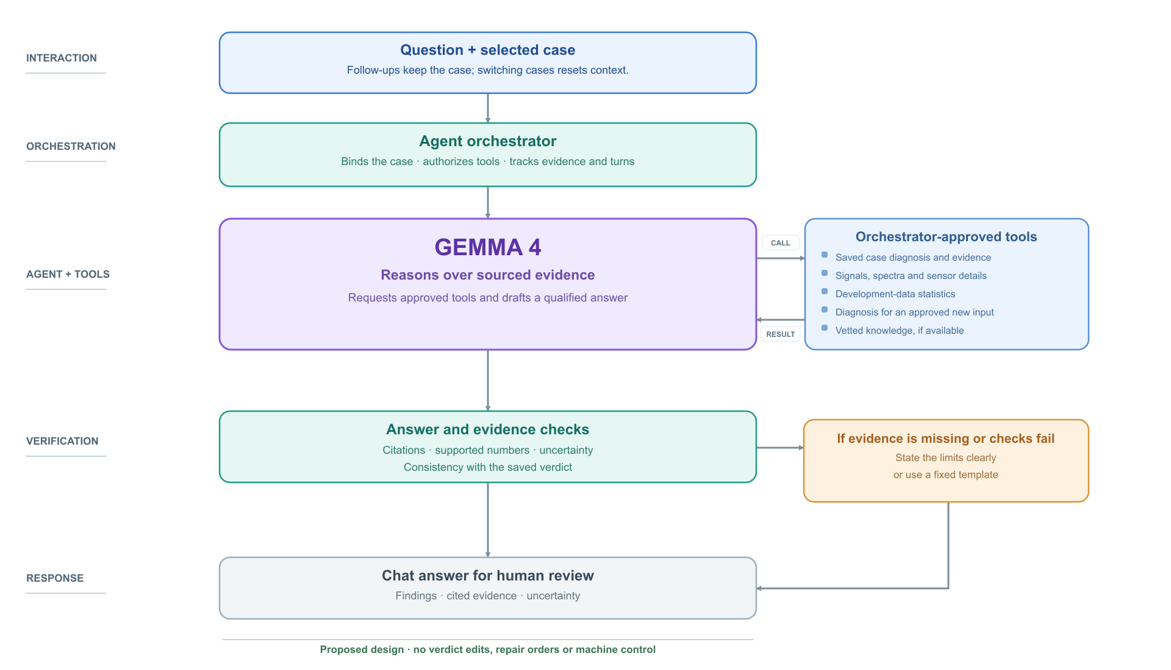
MACHINESENSE
Investigation assistant agent architecture
24
Notes:
Be clear this is a planned deliverable with a fallback, not a promise. The agents reason and delegate; the box on the right is where every number comes from.

Slide 25
MACHINESENSE
Final evaluation results
Reserved evaluation completed once. Rates below identify their test population.
Question | Evaluation metric | Results
Q1 · healthy or faulty | Fault detection rate (recall) Healthy false-alarm rate | Fault recall: 283/283 (100%); healthy false-alarm rate: 5/7 (71.4%)
Q2 · familiar condition | Macro-F1, closed test Macro-F1, held-out severity Confusion matrix | Closed-test macro-F1: 0.916; held-out-severity macro-F1: 0.747
Q3 · unfamiliar condition | Unknown recall Known-side rejection rate | Unknown recall: 925/1,123 (82.4%); known-side rejection: 765/2,327 (32.9%)
25
Notes:
Sources: SystemCode/results/final/q1.json, q2.json, q3.json and provenance.json. Q1 and Q2 closed-test results are per recording. Q3 values are pooled LOCO instances; known recordings can recur across runs.

Slide 26
Eight attempts, one confirmed gain
MACHINESENSE
Each declared in writing with its acceptance bar before it ran. Development data only.
STAGE
WHAT WAS TRIED
WHAT WAS OBSERVED
READING
D1
Learned combiner over the four decision scores
no gain over fixed thresholds
does not help
ML-5
ResNet-18 transfer learning
no gain over the 0.6 M-parameter CNN-6
does not help
R1
Speed-conditioned healthy thresholds
autoencoder AUROC 0.986 → 0.967
does not help
R3
Supervised contrastive encoder
macro-F1 −0.014; errors 8/11/4 → 21/19/14 of 804
does not help
R4
Bank of per-condition autoencoder specialists
recall tied (0.583 vs 0.582); 92 vs 19 unfamiliar called healthy
too thin to tell
E1
Healthy check first, then fault specialists only
+10.1 points mean recall, all 3 seeds; healthy calls unchanged
helps, confirmed
R6
Augmented, denoising and fault-only autoencoders
−1.1 to 0.0 points; fault-only AUROC 0.55
does not help
R7
Diagnostics on saved models, no training
mild misalignment covered by the gate; no collapse; max-logit +1.3
diagnostic
The bar for "helps": at least 5 points more unfamiliar faults caught at the same number of known recordings rejected, with no more unfamiliar faults called healthy, on every one of three seeds.
26
Notes:
One line per stage. The highlighted row is the result to land; everything else is reported because it was declared in advance, not because it worked.

Slide 27
MACHINESENSE
Investigation assistant evaluation plan
Proposed measures for the assistant after it is connected.
Agent evaluation metric | Calculation | What it checks
Grounded-Claim Precision (%) | Factual claims supported by evidence ÷ all factual claims | Whether Gemma 4 invents facts
Citation Precision (%) | Citations that support their associated claim ÷ all citations | Whether references are meaningful
Numeric Fidelity Rate (%) | Correct numbers, units and directions ÷ all numerical claims | Whether it reports measurements accurately
Verdict Consistency Rate (%) | Answers preserving the saved verdict ÷ all answers | Whether it changes “further inspection” into a claimed diagnosis
Case Isolation Rate (%) | Conversations with no cross-case evidence ÷ case-switch tests | Whether follow-ups use the right recording
Appropriate Abstention Rate (%) | Insufficient-evidence cases where it states the limit ÷ all such cases | Whether it knows when it cannot answer
Tool Policy Violation Count | Unapproved tool calls or actions | Target: zero
Fallback Success Rate (%) | Tool/model failures handled with a clear limited answer ÷ failure tests | Whether the chat remains safe and useful
P@5 | Relevant items among the top five retrieved references ÷ 5 | Optional: quality of the vetted-knowledge search
P95 Response Latency | Time within which 95% of answers finish | Whether the assistant is practical to use
27
Notes:
The investigation assistant is proposed, not connected. Current frontend/src/components/AgentChat.jsx displays a draft-only preview.

Slide 28
MACHINESENSE
What has been done so far?
Prepared the data: catalogued and audited 1,951 recordings, assigned recording-level splits, cleaned signals, and created windows.
Built two input types: 142 physics-based features per window and speed-relative spectrograms.
Trained the core models: a classical reference classifier, a CNN for known faults, and a healthy-only autoencoder / Specialist AEs.
Designed the decision system: combined classification, healthy-pattern checks, and Mahalanobis distance to allow an “unfamiliar-inspect further” outcome.
Ran development experiments: known-fault classification, healthy-versus-faulty detection, and leave-one-condition-out unfamiliar-fault evaluation.
Investigated alternatives: specialist autoencoders, data augmentation, denoising, a fault-only autoencoder, alternative confidence gates, and the gated E1 specialist approach.
Built the demonstration app: an interactive machine view and saved evidence reports. The Investigation Assistant remains proposed, not connected.
28
Notes:
Source: SystemCode/results/audit_report.md, section 8. The microphone-only shortcut test did not drop to chance after burst repair.

Slide 29
MACHINESENSE
Short Demo
github.com/bhuveshsharma09/MachineSense
Bhuvesh Kumar · NUS-ISS
29
Notes:
The dataset is the Machinery Fault Database from the Signal, Multimedia and Telecommunications Laboratory at the Universidade Federal do Rio de Janeiro.

Slide 30
MACHINESENSE
Say what the evidence supports, and no more
Three questions from one reading, a verdict that can decline to name a fault, and every number traceable to the stage that produced it.
github.com/bhuveshsharma09/MachineSense
Bhuvesh Kumar · NUS-ISS
30
Notes:
The dataset is the Machinery Fault Database from the Signal, Multimedia and Telecommunications Laboratory at the Universidade Federal do Rio de Janeiro.

