Slide 1
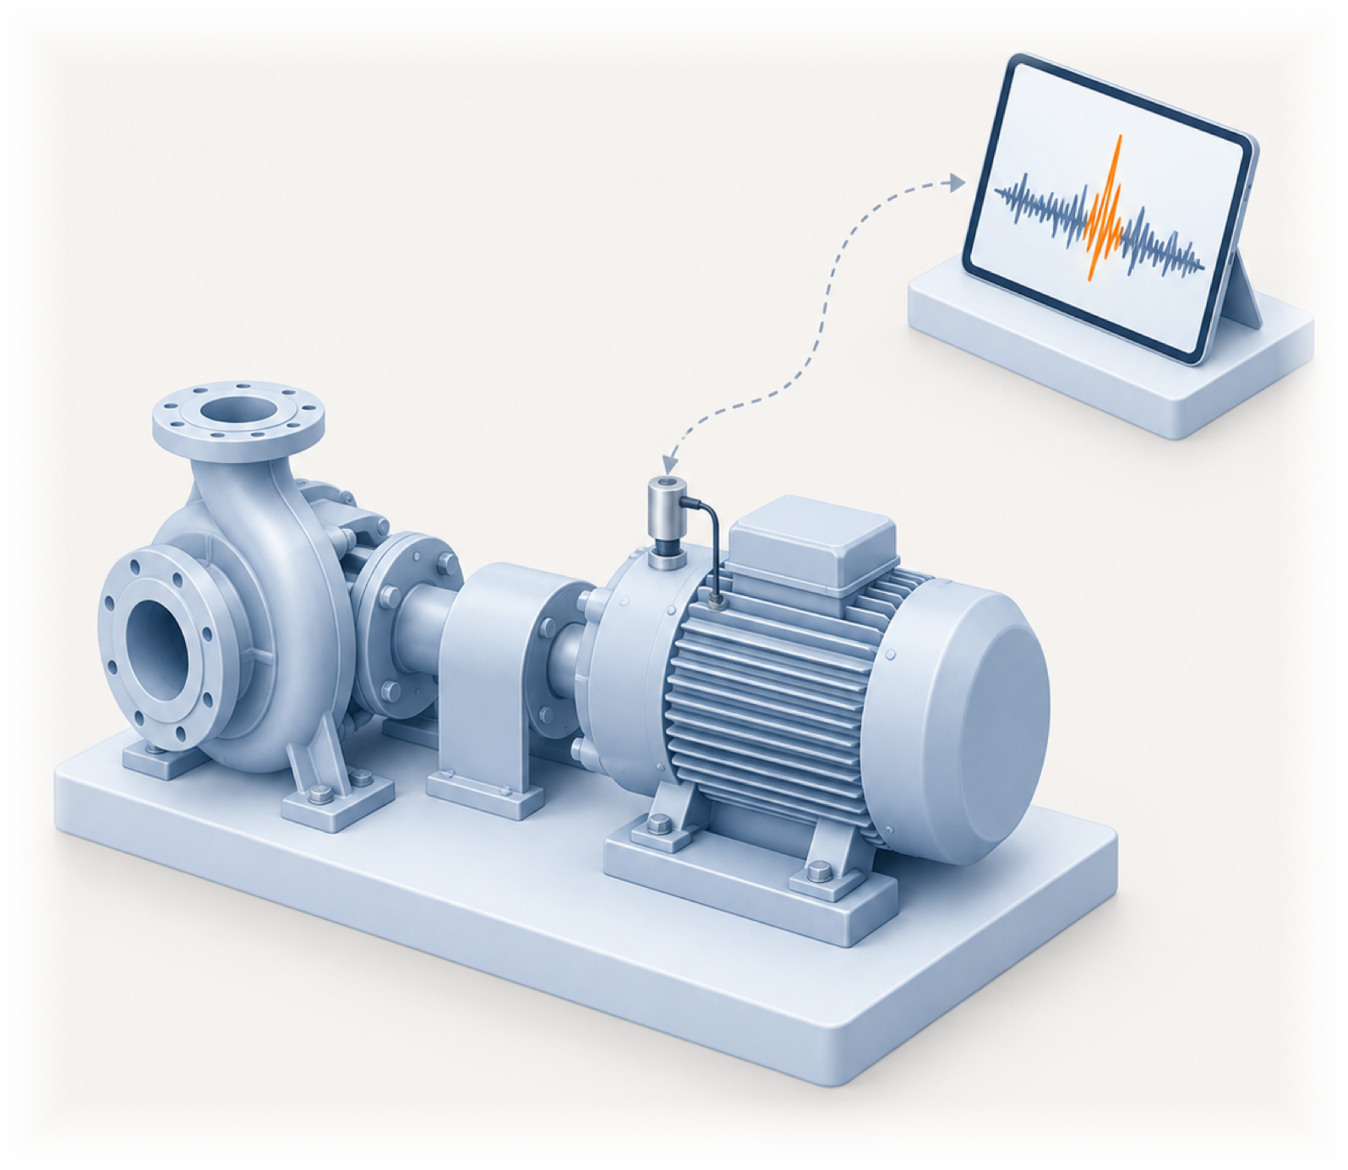
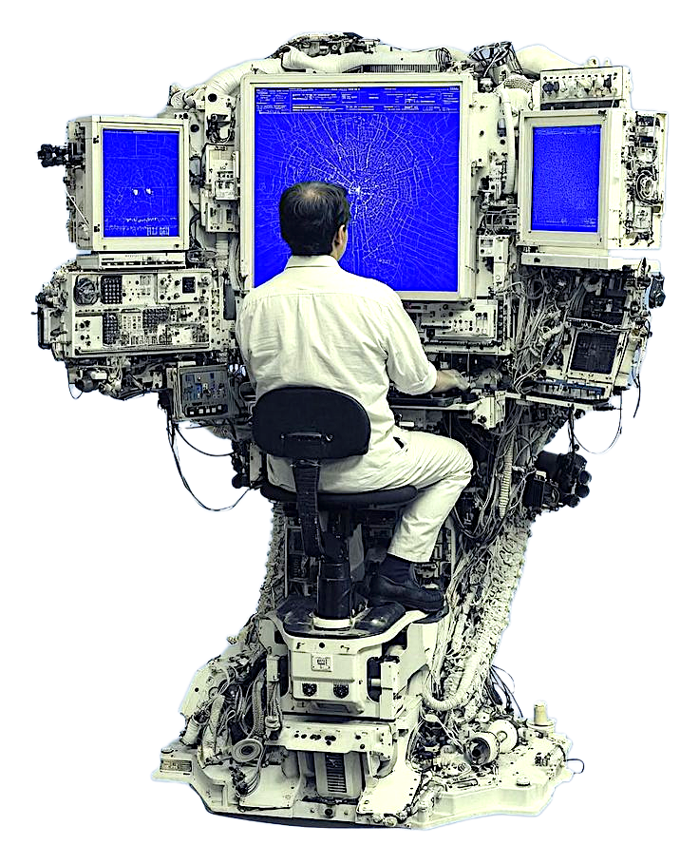
NUS-ISS · PATTERN RECOGNITION SYSTEMS
MACHINESENSE
Multi-sensor fault diagnosis for rotating machinery, from a five-second reading to an evidence-supported inspection decision.
Bhuvesh Kumar · A0243823H
MTech AI Systems · Practice Module
Notes:
[10 s]
Hi, I'm Bhuvesh Kumar. This is MachineSense, my practice module project for Pattern Recognition Systems. It takes a five-second recording from a rotating machine, works out whether something is wrong, and shows the evidence behind every answer.

Slide 2
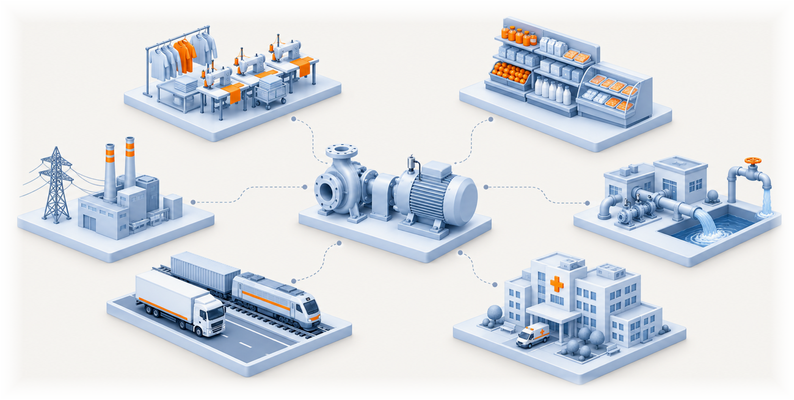
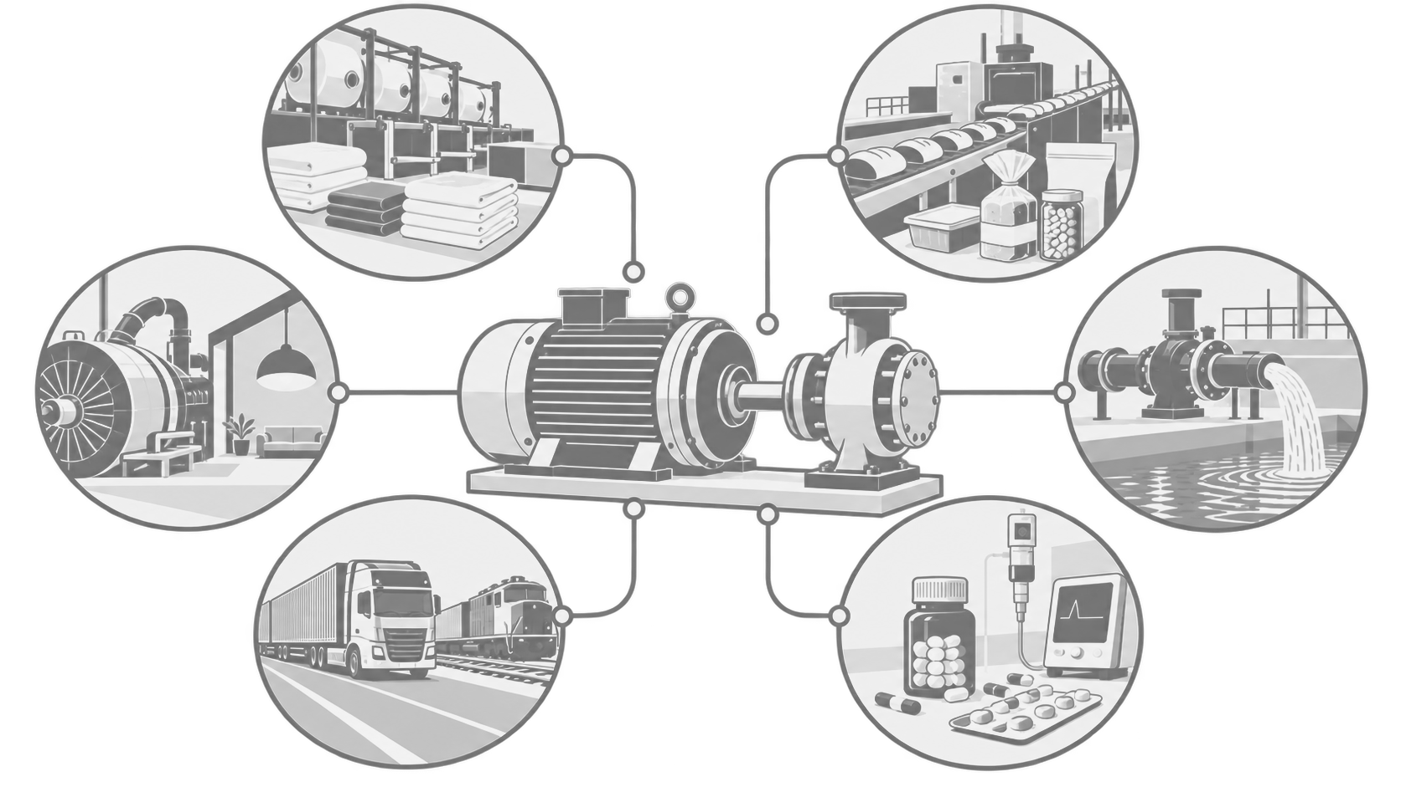
MACHINESENSE
MOTIVATION
Machines keep our lives moving
The clothes we wear, the food on the shelf, the power in the socket, the water in the tap, everything that moves and every hospital that stays open all run on rotating machinery.
02
Notes:
[15 s]
Let's start with why this matters. Almost everything we use depends on a motor somewhere. The clothes we wear, the food on the shelf, power, water, transport, hospitals. They all run on rotating machines.

Slide 3
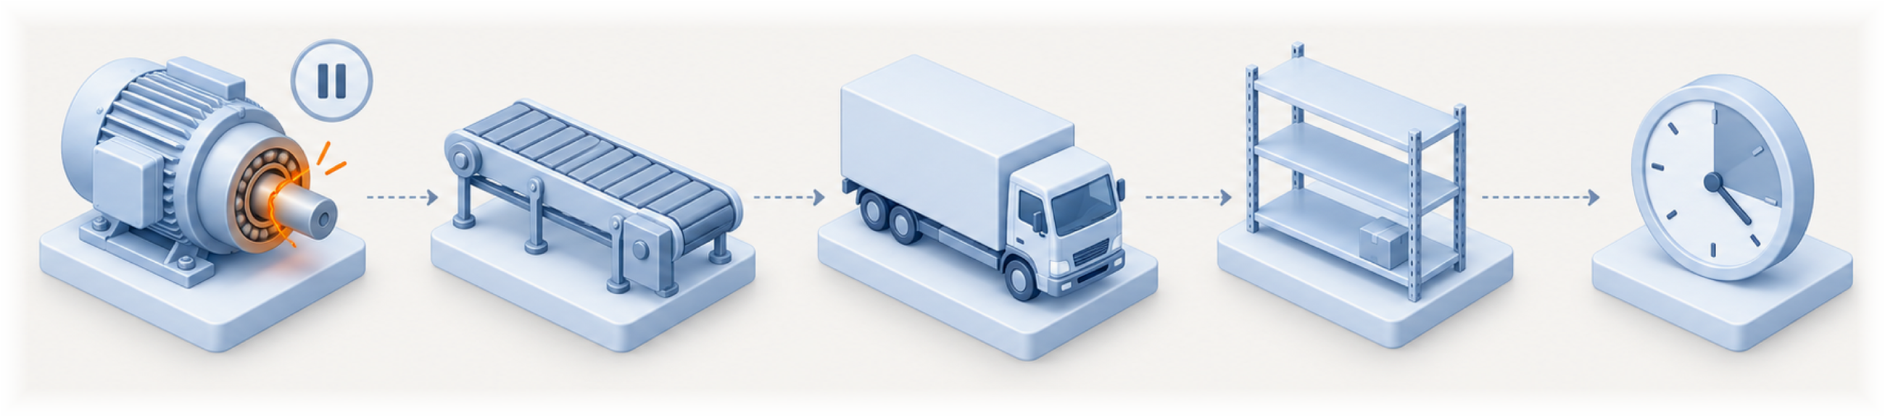
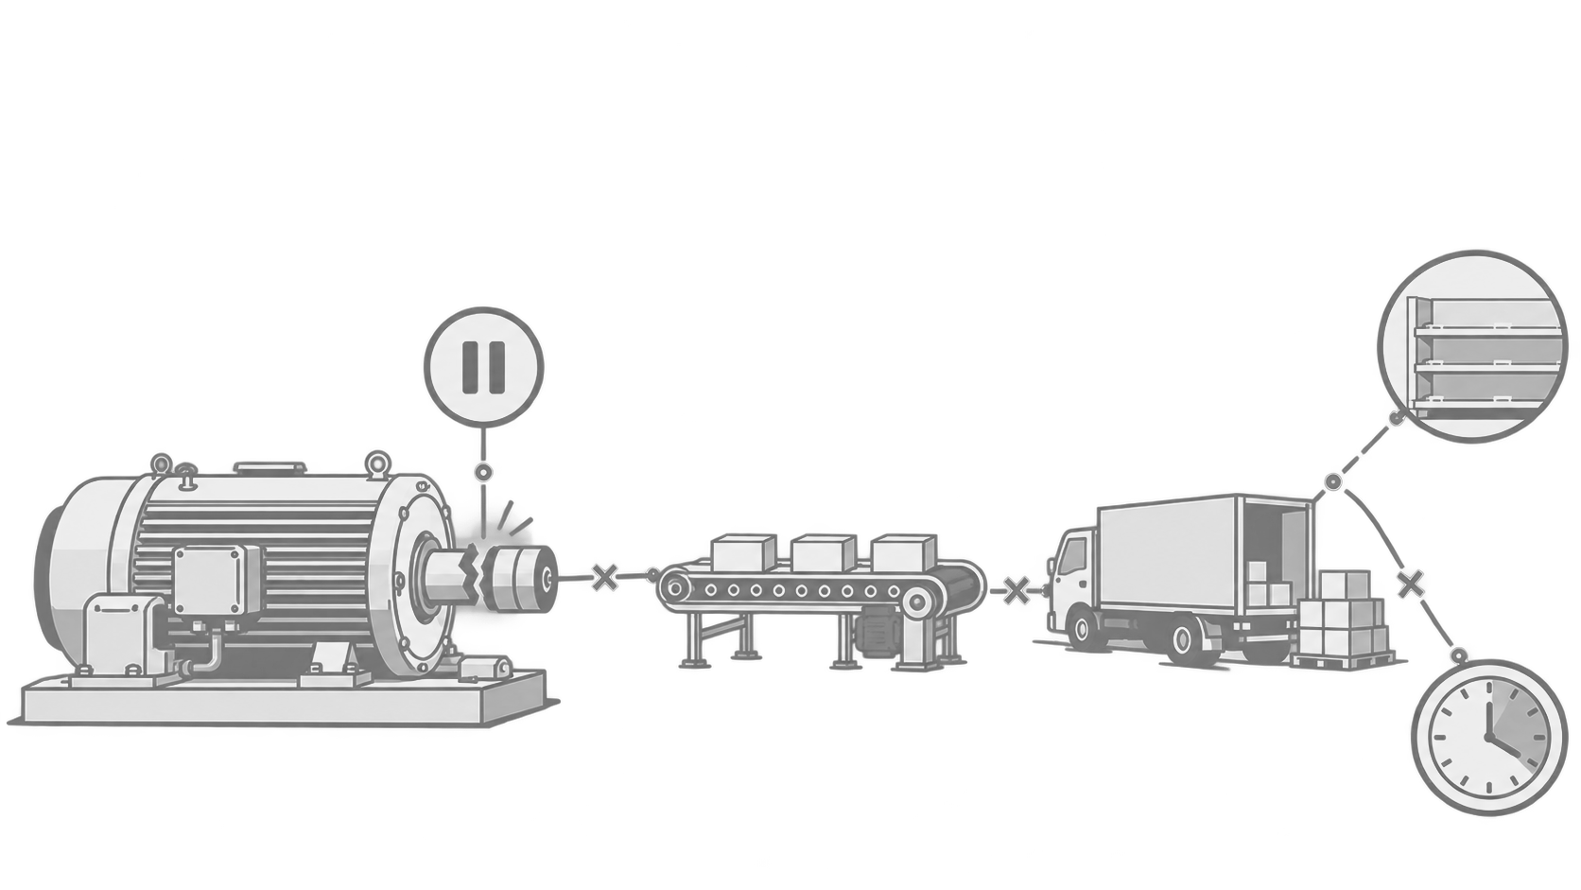
MACHINESENSE
What happens when a machine breaks down without warning?
One bearing gives way and the line stops. Production halts, deliveries are late, shelves empty, and the repair costs far more than it would have before the failure.
03
Notes:
[15 s]
When one of these machines fails without warning, the cost is never just one part. One bearing gives way, the line stops, deliveries are late, and shelves go empty. The repair ends up costing far more than catching it early would have.

Slide 4
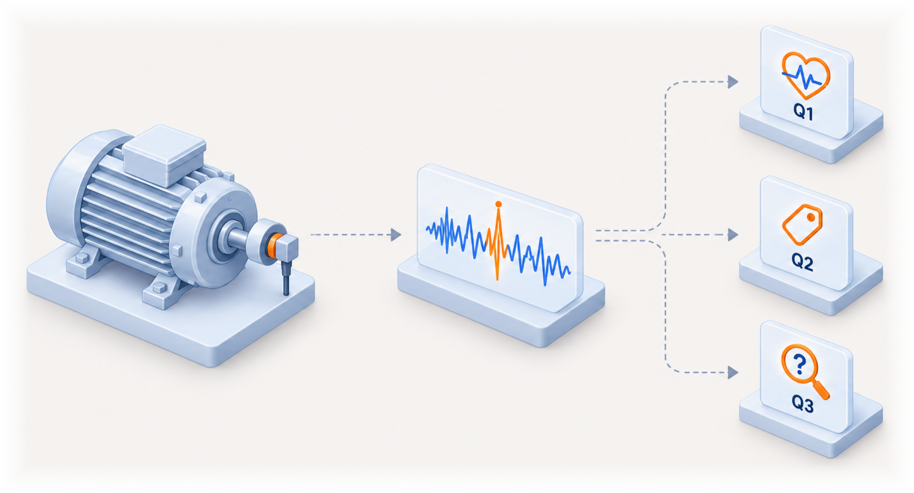
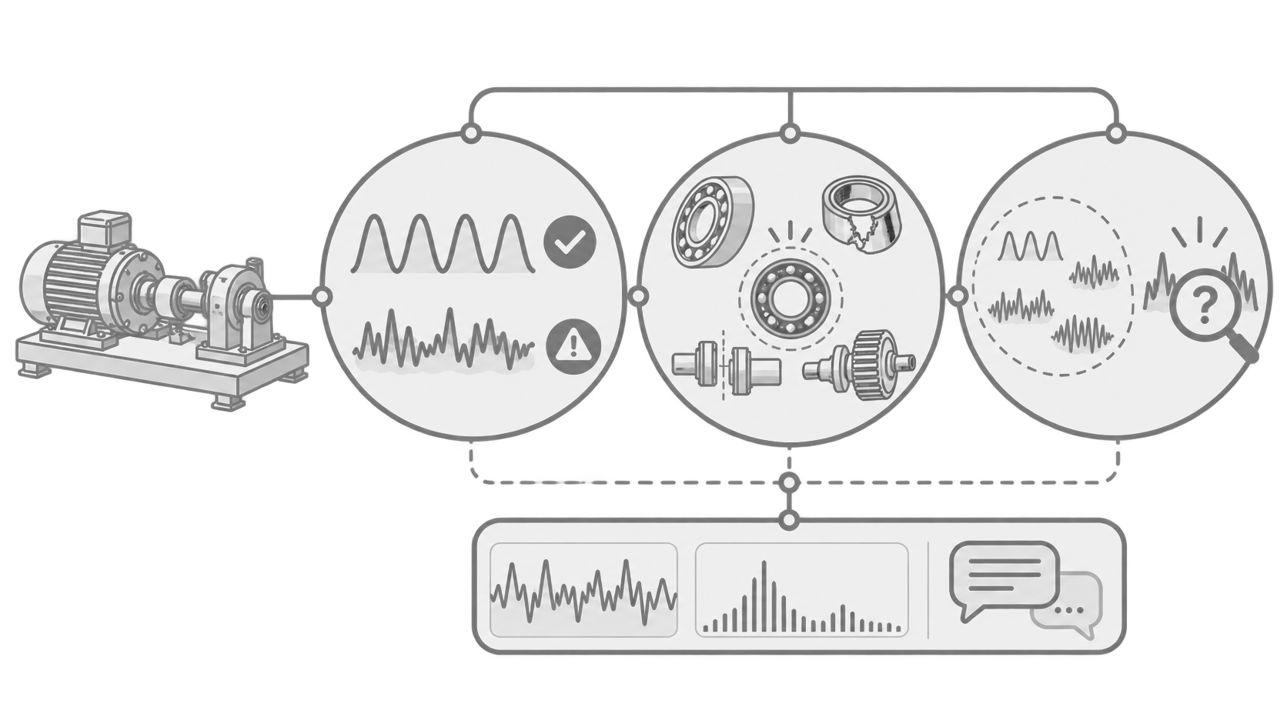
MACHINESENSE
The problem: three questions from one recording
Q1
Q3
Is it healthy?
Is it a fault never seen before?
Only 49 healthy recordings exist, all from one folder, and healthy vibration changes with shaft speed.
A closed-set classifier must pick a known label, so it can name an unseen fault wrongly, and confidently.
Q2
Which known fault is it?
Published scores are often inflated: windows of one recording end up in both training and testing.
And a mechanic needs the evidence and the uncertainty behind each answer, not just a label.
04
Notes:
[30 s]
So when a mechanic records a machine, what do they actually want to know? Three things.
First, is it healthy? That's hard here, because the dataset has only 49 healthy recordings.
Second, if it's faulty, which known fault is it? Published scores on this dataset are often inflated, because pieces of one recording end up in both training and testing.
Third, is it a fault the system has never seen? A normal classifier always picks a label, even for something it was never trained on.
And on top of all that, the mechanic needs the evidence and the uncertainty, not just a label.

Slide 5
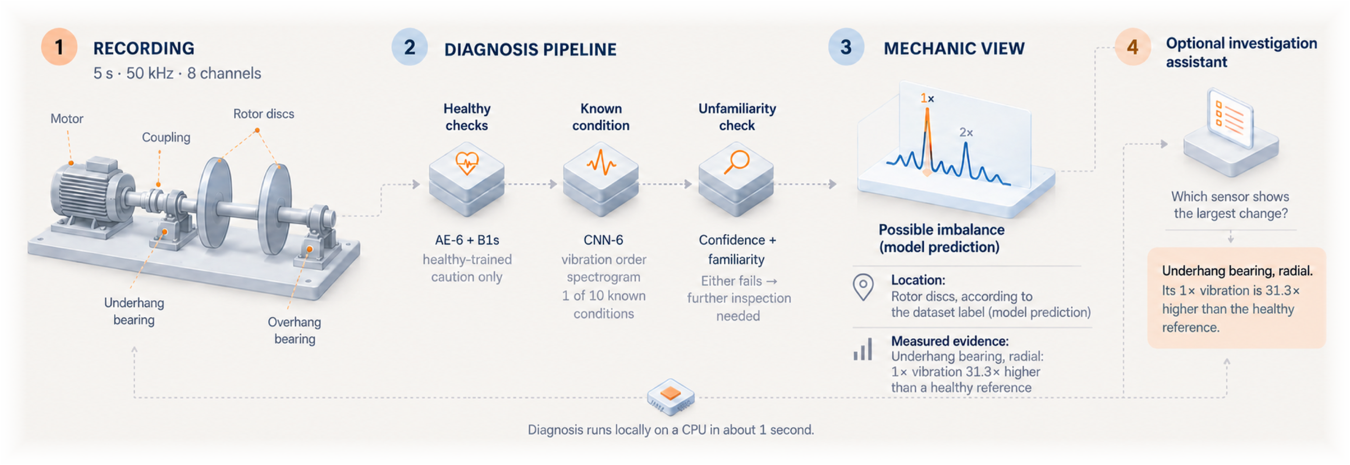
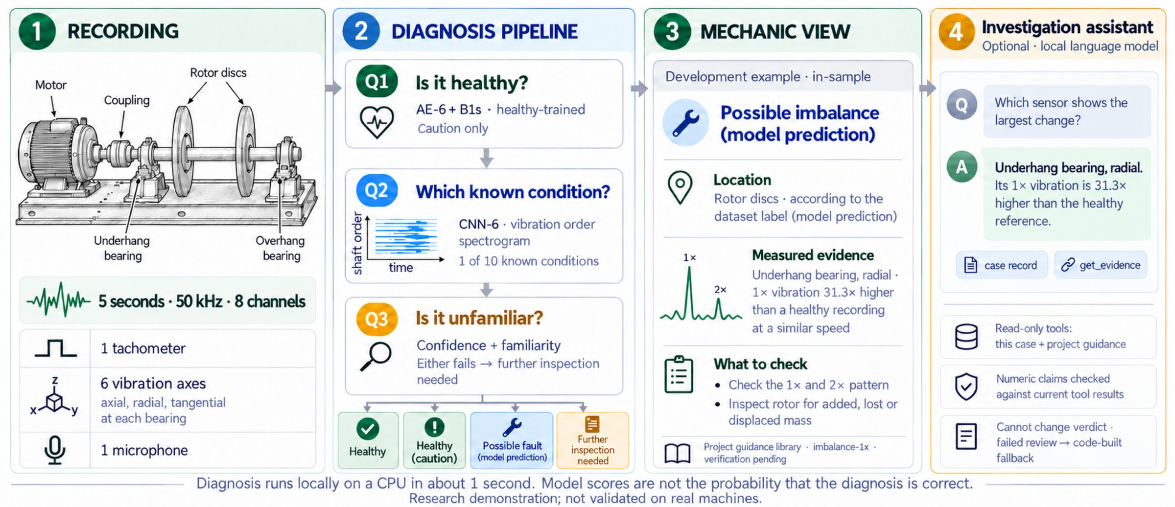
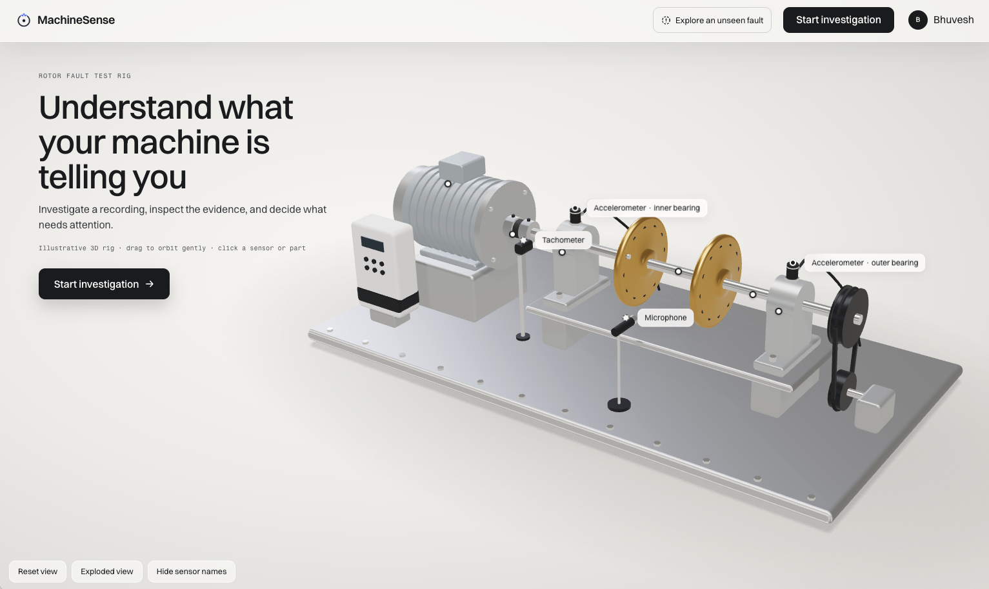

MACHINESENSE
Introducing MachineSense
05
Notes:
[25 s]
That's what MachineSense does. A recording goes in. The diagnosis pipeline answers the three questions with separate models. The Mechanic view shows the finding as a model prediction, together with the measured evidence and what to check. There's also an optional assistant, running on a local language model, for follow-up questions. The diagnosis itself runs on a normal laptop CPU in about one second.

Slide 6
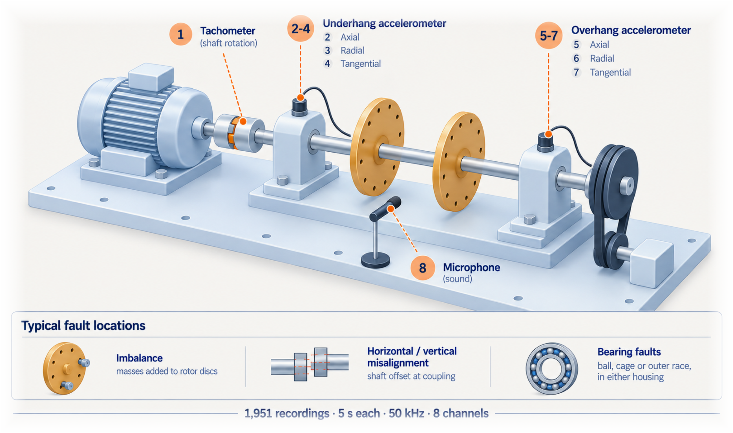
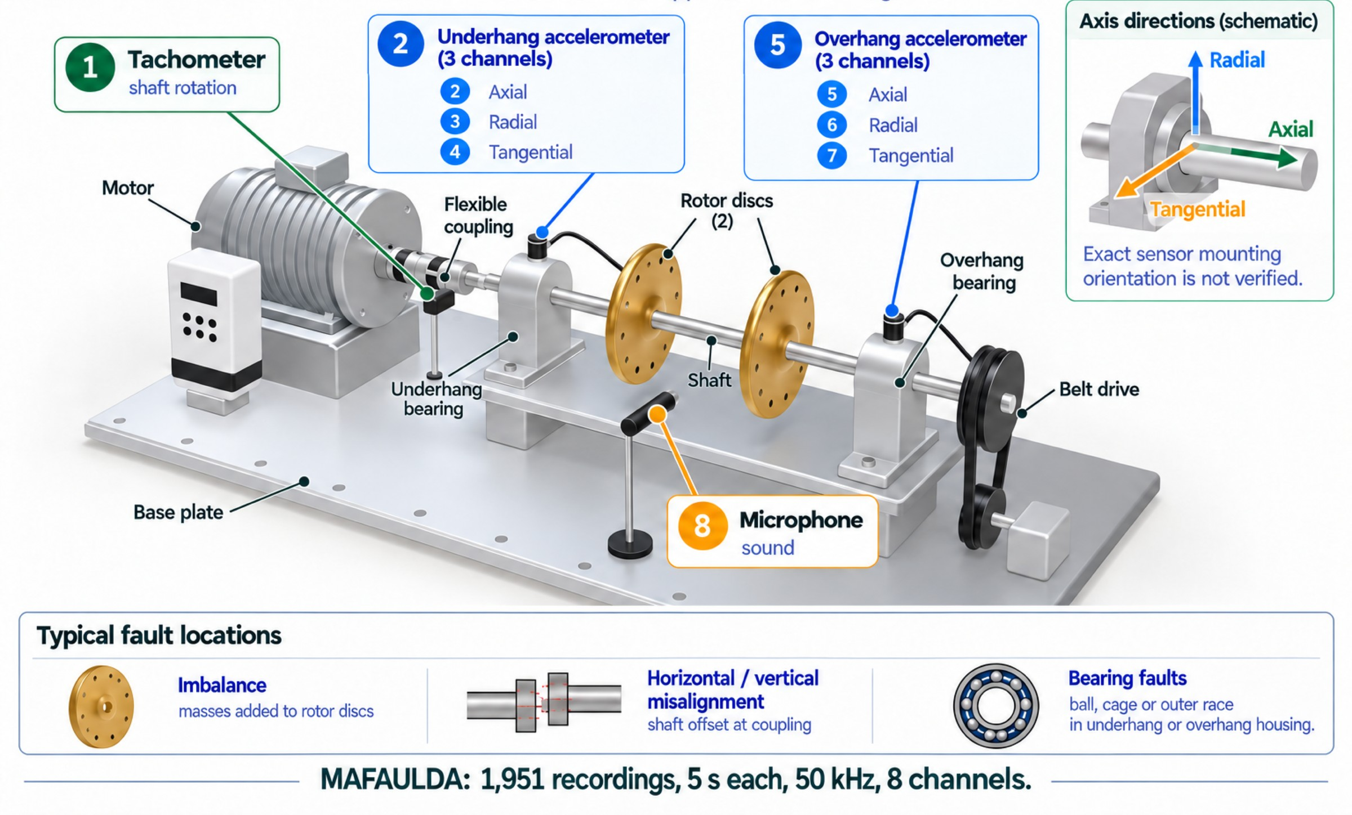
MACHINESENSE
The data: one test rig, 1,951 recordings
1,951
recordings, 5 s each at 50 kHz
8
channels: tachometer, 2 × 3-axis accelerometers, microphone
10
conditions: normal and 9 induced faults
49
healthy recordings only, all in one folder (333 imbalance)
Source: MAFAULDA, Federal University of Rio de Janeiro. Faults are deliberately induced on one bench-top rig.
06
Notes:
[20 s]
I don't have data from a real plant, so I used MAFAULDA. It's a public test rig from the Federal University of Rio de Janeiro. There are 1,951 recordings, five seconds each, at 50 kilohertz. Each one has eight channels: a tachometer, two three-axis accelerometers and a microphone. There are ten conditions: normal, plus nine induced faults.

Slide 7
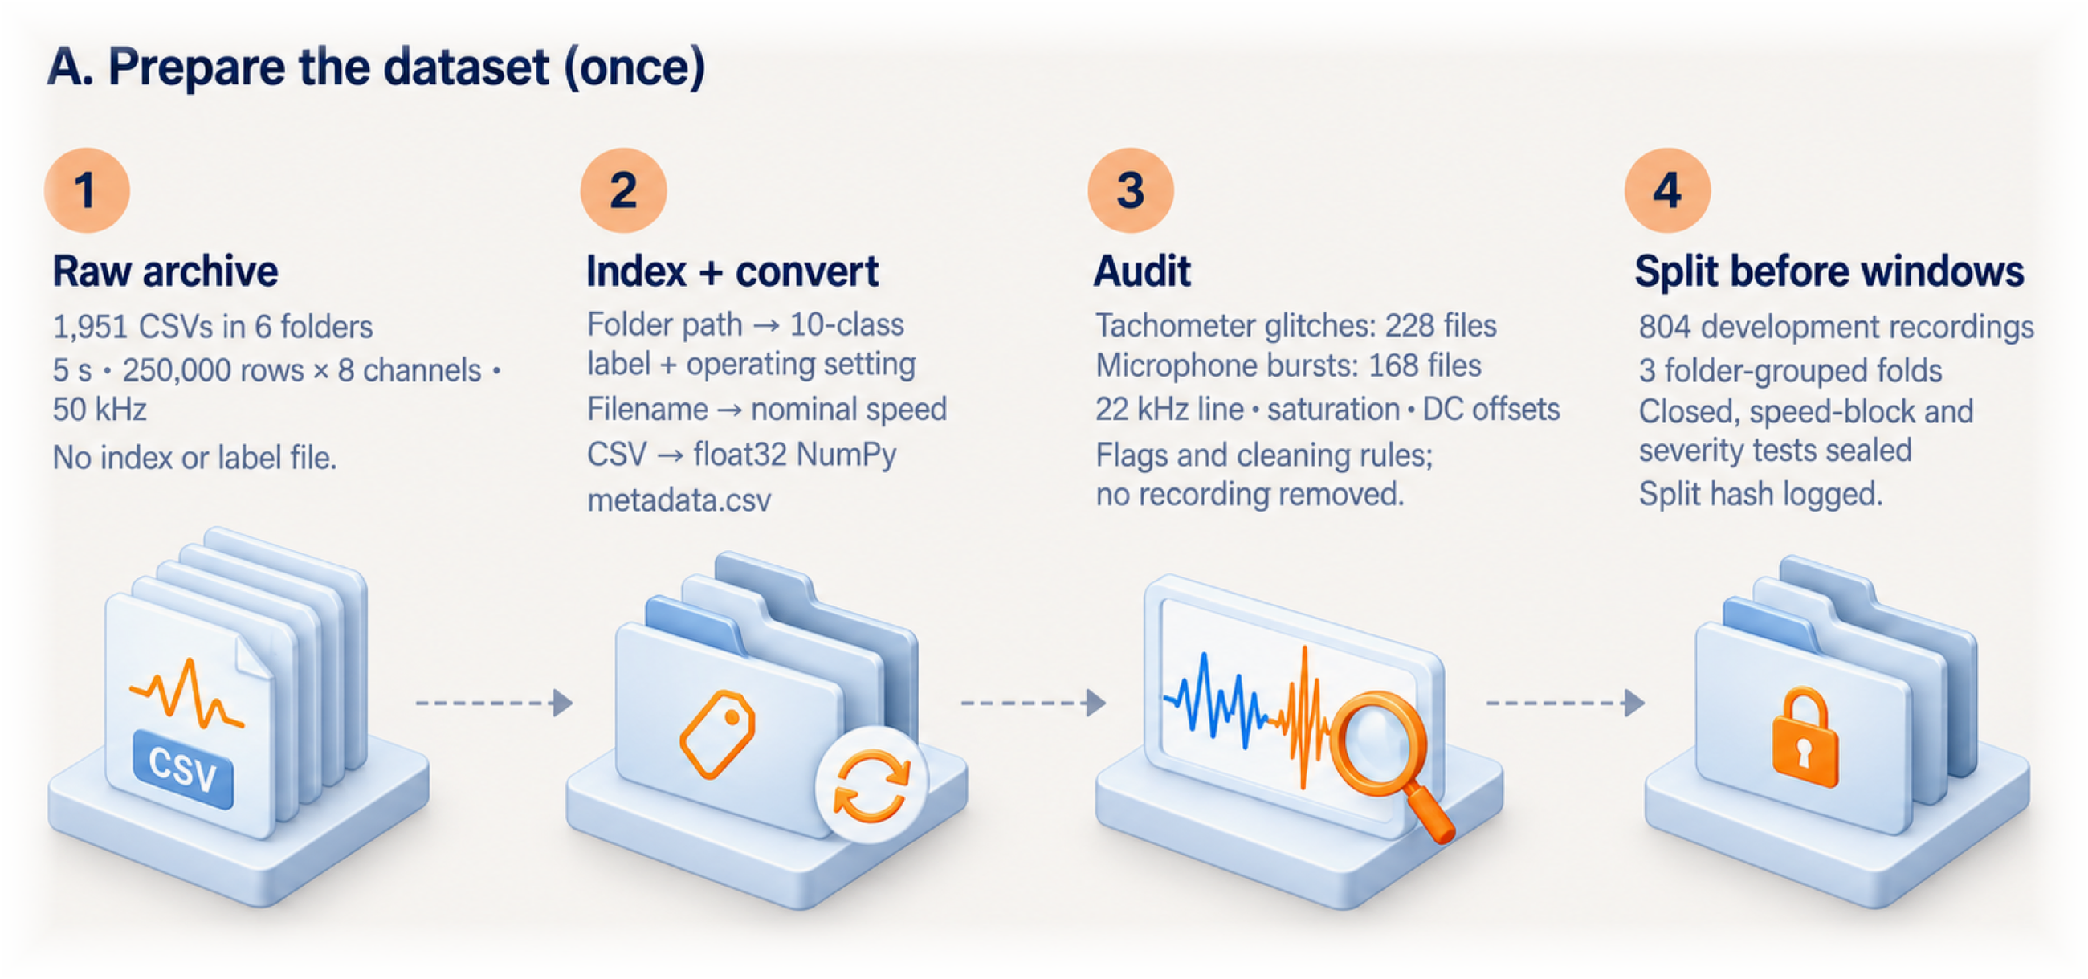
MACHINESENSE
Data pipeline, part A: prepare the dataset once
07
Notes:
[20 s]
Data preparation has two parts. Part A runs once. I indexed the files, then audited every single one before training anything. The audit found tachometer glitches, and also bursts in the microphone in 168 files. I didn't remove any recordings. Then I split by recording, before cutting any windows, and sealed the test sets.

Slide 8
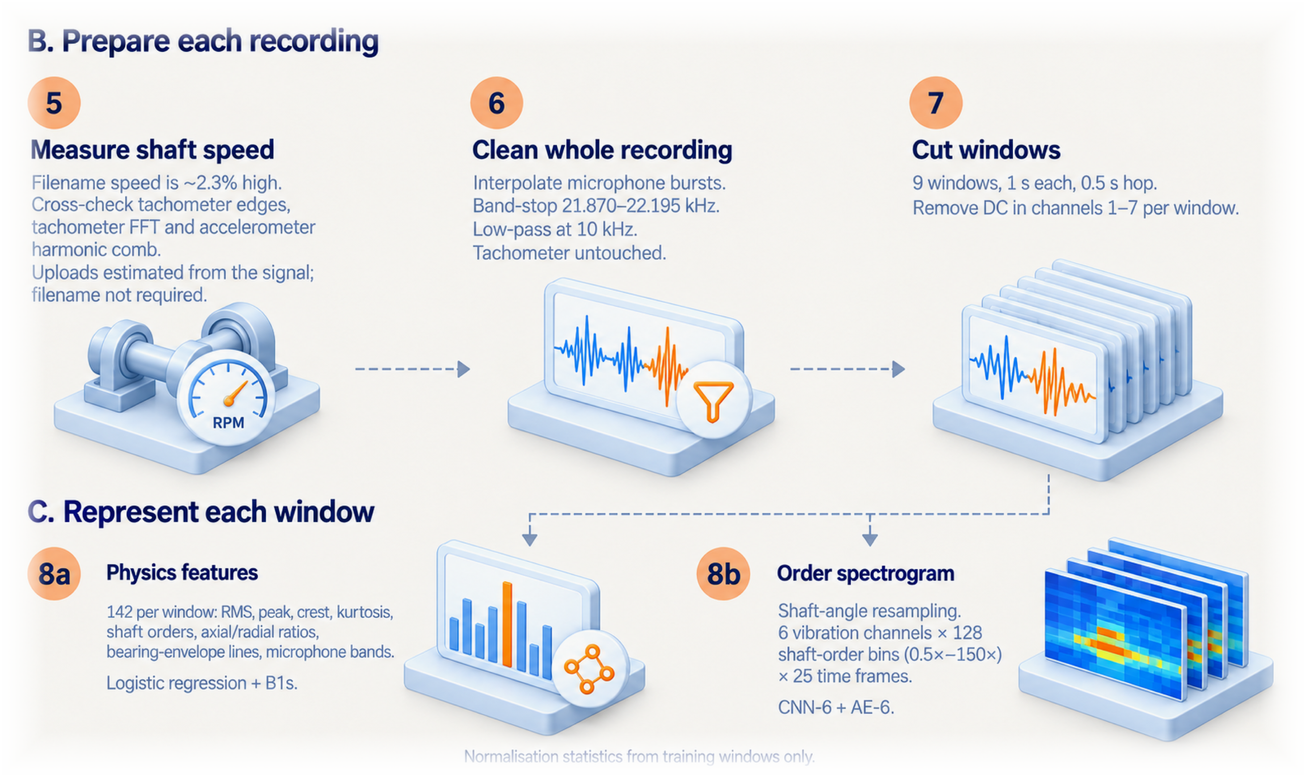
MACHINESENSE
Data pipeline, part B: recording to model inputs
08
Notes:
[20 s]
Part B runs for every recording, including uploads in the app. First I measure the shaft speed from the tachometer. Then I clean out the microphone bursts and a 22 kilohertz interference line, and cut the recording into nine one-second windows. Each window becomes two inputs: 142 physics features, and an order spectrogram for the neural networks.

Slide 9
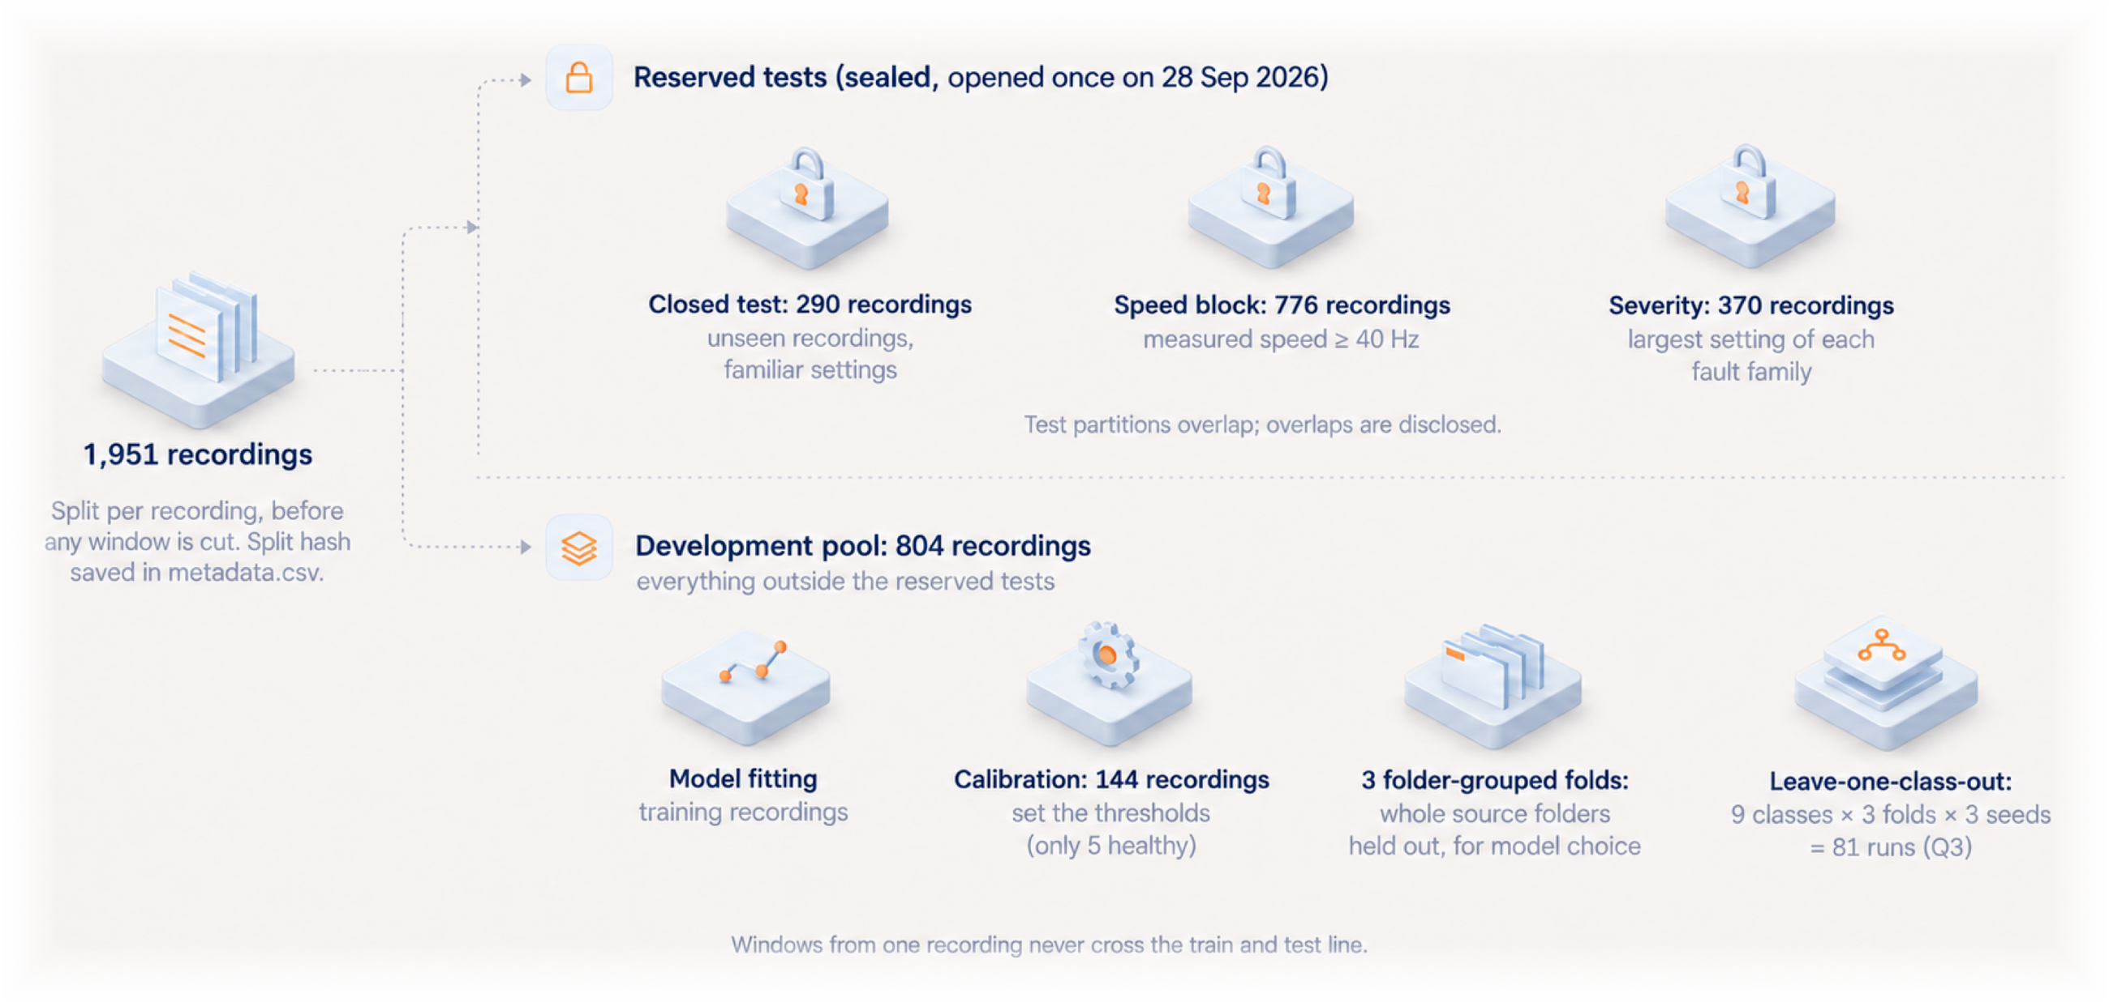
MACHINESENSE
How the data is split
09
Notes:
[25 s]
This is how the data is split. Three test sets were sealed and opened only once, on 28 September. That's a closed test of 290 recordings, an unseen-speed block of 776, and 370 recordings at the largest fault settings.
Everything else, 804 recordings, is the development pool. That's where I trained the models, set the thresholds on 144 calibration recordings, and ran 81 hidden-fault experiments.

Slide 10
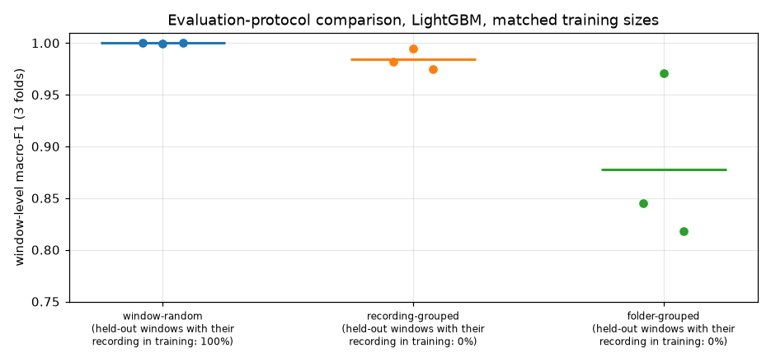
MACHINESENSE
Keeping the evaluation honest
1
Split by recording, before windowing
Windows of one recording never cross the train and test line.
2
Folder-grouped development folds
804 development recordings in 3 folds; whole source folders are held out.
1.000 → 0.984 → 0.878
3
Sealed tests, opened once
Same LightGBM, same training size. Only what is held out changes: random windows, whole recordings, whole source folders. Real output of notebook 05b, development data.
Closed split 290, speed block 776, severity 370. One final run after models, thresholds and rule were frozen.
10
Notes:
[15 s]
Why so strict? This plot shows it. The same model scores a perfect 1.0 when windows are split at random, because parts of one recording sit on both sides. Hold out whole recordings and it's 0.984. Hold out whole folders and it drops to 0.878. That gap is exactly what I didn't want to fool myself with.

Slide 11
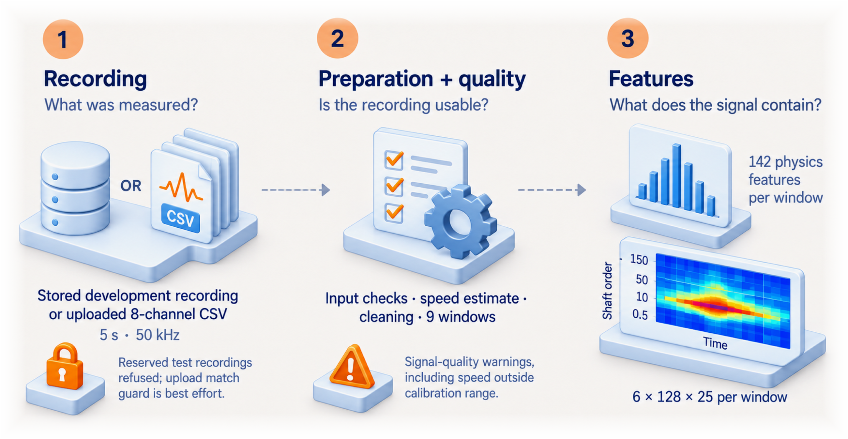
MACHINESENSE
Diagnosis, part 1: from recording to features
11
Notes:
[15 s]
Now the diagnosis itself. In the app, a recording comes either from the stored development set or from an uploaded CSV file. It goes through the same preparation, with quality checks. So you get a warning if, for example, the speed is outside what the models were calibrated on.

Slide 12
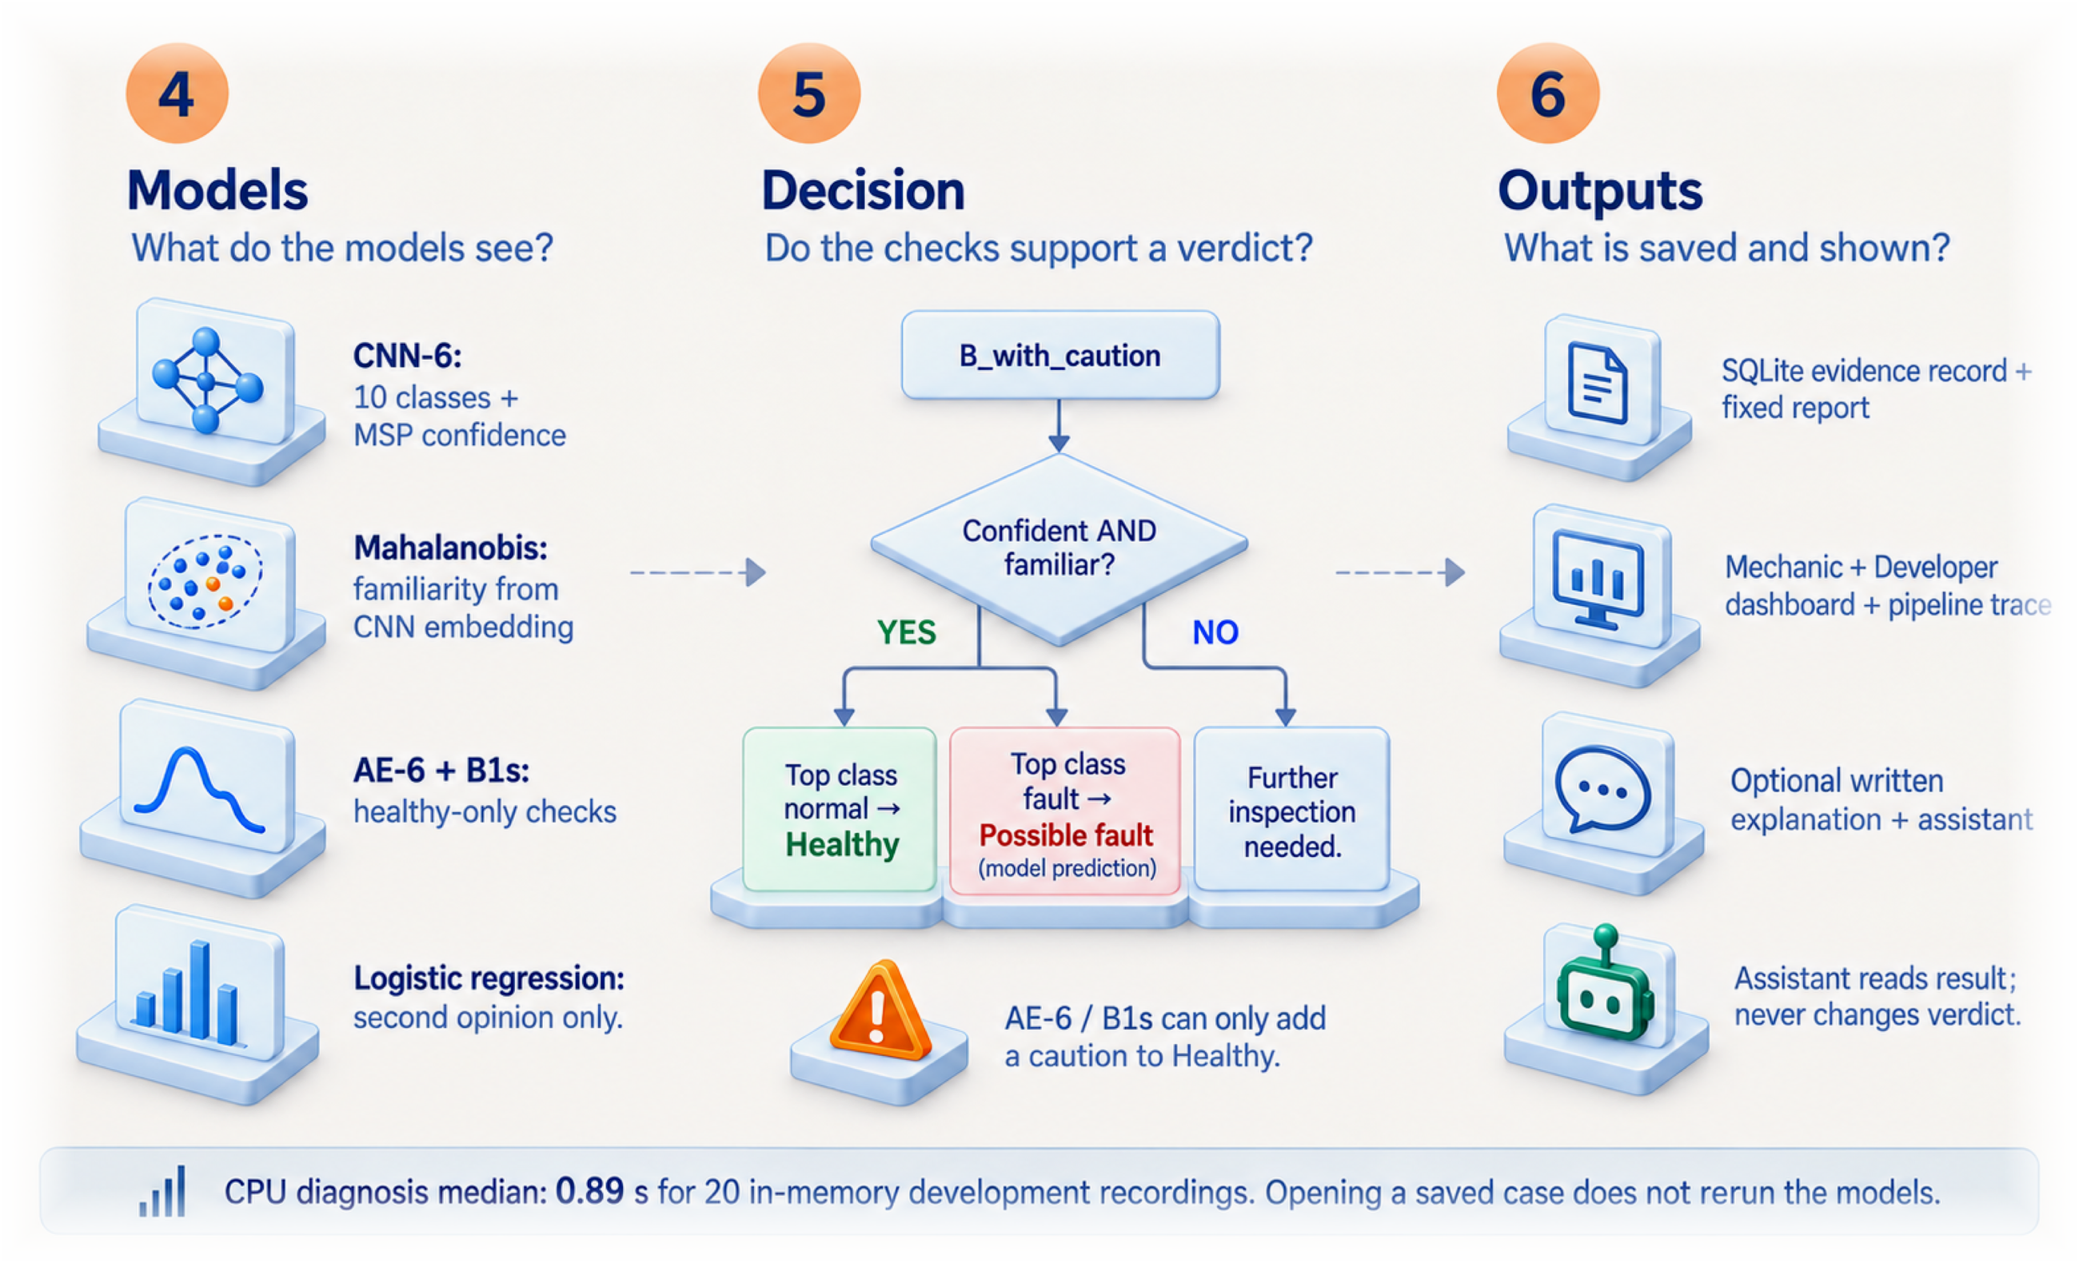
MACHINESENSE
Diagnosis, part 2: models, decision and outputs
Q1 Is it healthy?
AE-6 + B1s, trained on healthy data only. They can add a caution, never overturn a verdict.
Q2 Which known fault?
CNN-6 on the order spectrogram; logistic regression as a second opinion.
Q3 Is it unfamiliar?
MSP confidence + Mahalanobis familiarity. If either fails: further inspection.
12
Notes:
[30 s]
Then the models. Each question has its own check.
CNN-6, a small convolutional network, looks at the order spectrogram and names the known condition. Its confidence, plus a familiarity score on its internal features, decide whether that match can be trusted. If either check fails, the answer is "further inspection needed".
Two models trained only on healthy data can add a caution to a healthy result, but they can't overturn the verdict.
Everything is saved as an evidence record.

Slide 13
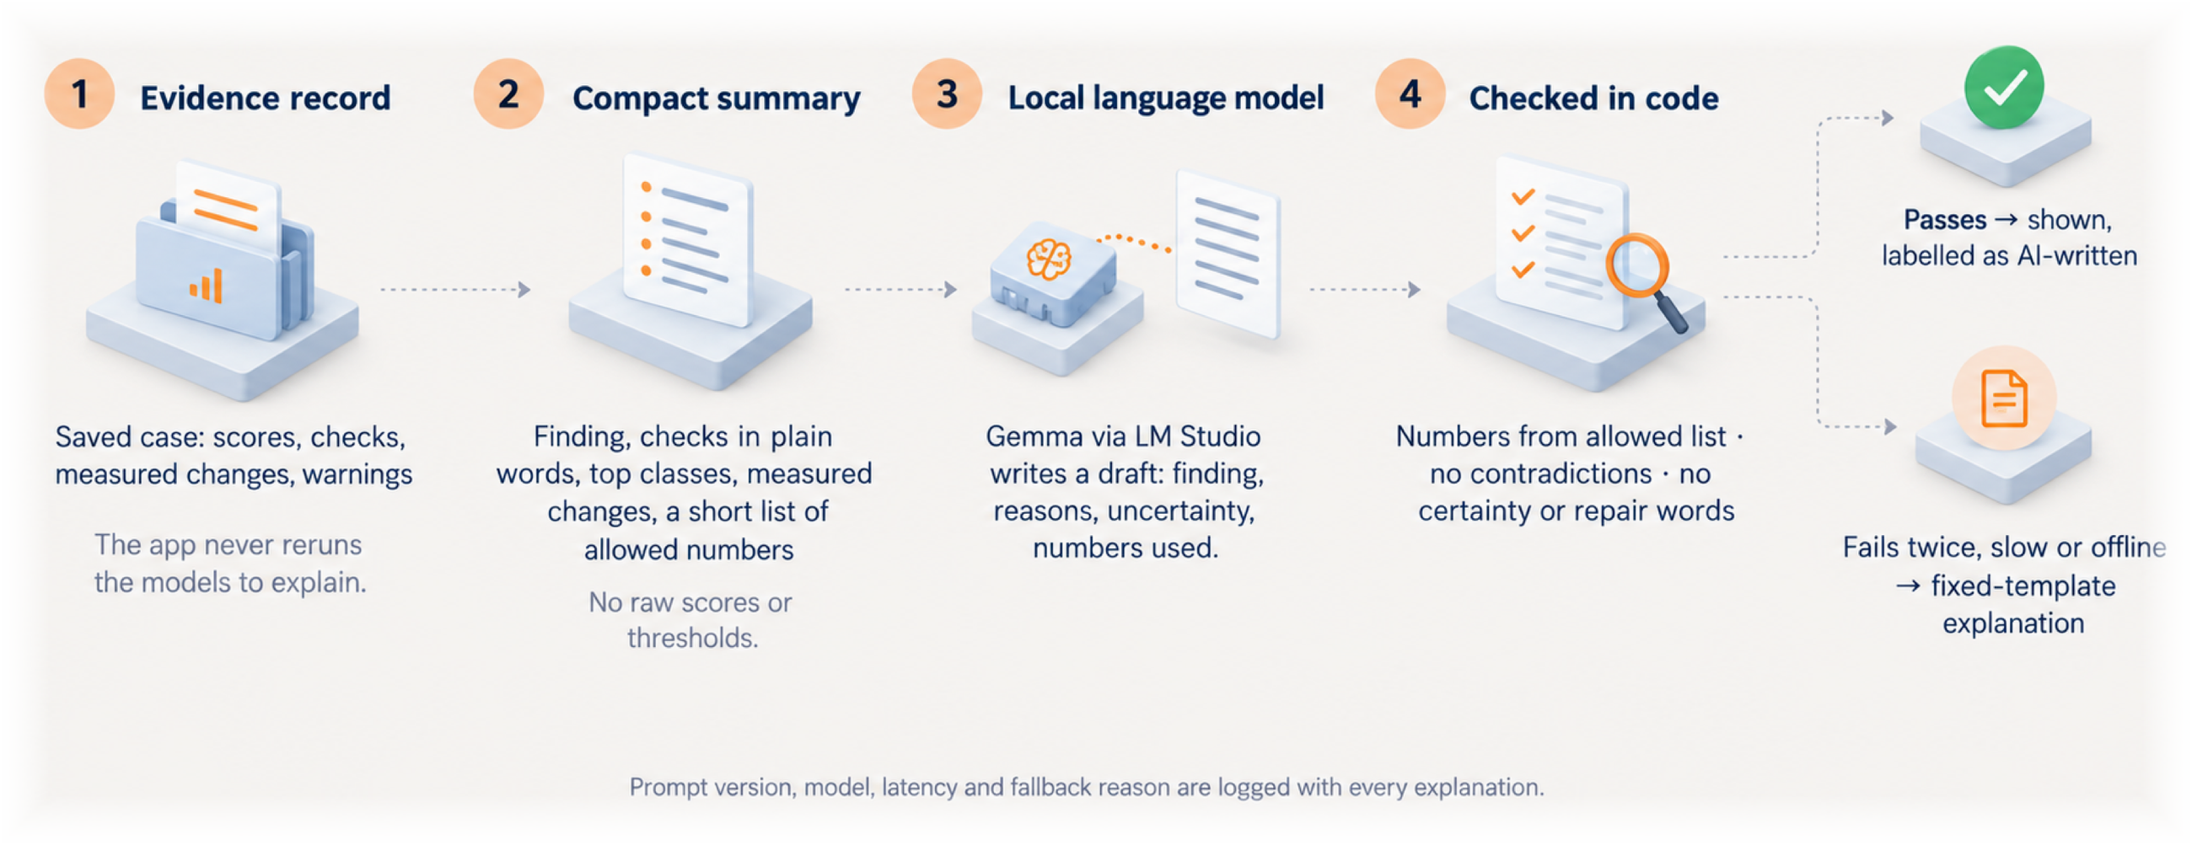
MACHINESENSE
How explanations stay honest
13
Notes:
[20 s]
The written explanation comes from a local language model, but the model never sees raw scores. Code gives it a short summary with a fixed list of allowed numbers. Then code checks the draft: every number, no contradictions, no repair advice. If the draft fails twice, or the model is offline, the app shows a fixed template instead.

Slide 14
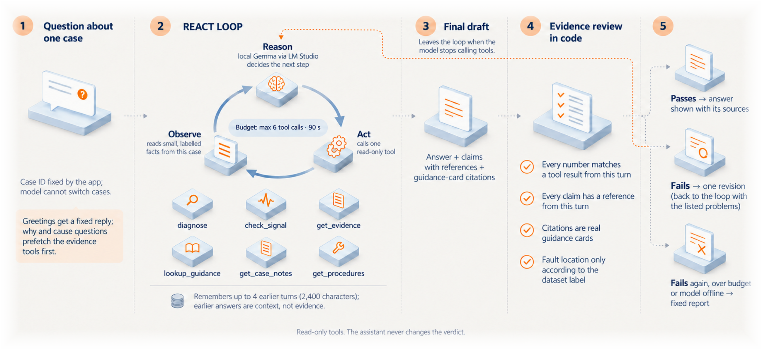
MACHINESENSE
The assistant: a ReAct agent with guardrails
14
Notes:
[25 s]
The assistant is a ReAct agent. It reasons, calls one of six read-only tools, looks at the result, and repeats, within six tool calls and ninety seconds. It's locked to one case.
Before anything is shown, code reviews the answer. Every number has to come from a tool result in that same turn. The model gets one chance to revise. If it fails again, the user sees the fixed report. And the assistant can never change the verdict.

Slide 15
MACHINESENSE
Why these models
input
0.989
healthy only
Order spectrogram
CNN-6
AE-6 + B1s
A fault stays at the same shaft order when speed changes. A plain spectrogram could not separate 0.5× from 1× at 12 Hz.
Mean development macro-F1 over 3 seeds. ResNet-18: 0.969 and about 10× slower on a CPU. CNN-7 with microphone: 0.982 and a shortcut risk.
Need no fault examples, so the 49 against 333 imbalance does not matter. Similar AUROC, but they fail differently.
≈ 0.875
frozen
≈ 4 ms
MSP + Mahalanobis
Fixed decision rule
Small on purpose
Highest deployable macro AUROC for unfamiliar faults. One shared covariance stays stable with few recordings per class.
Easy to inspect and explain, frozen before the test. A learned combiner was worse on both criteria.
CNN-6 has 0.6 M parameters and runs in about 4 ms per recording on a CPU, so it is cheap to retrain 81 times.
15
Notes:
[10 s, skip if short on time]
Quickly on the choices. I picked every model on development data, against alternatives. CNN-6 scored best, 0.989, and it's small: about 0.6 million parameters and around 4 milliseconds per recording.

Slide 16
MACHINESENSE
Tech stack: everything runs locally
Data and training
Python 3.12
PyTorch on Apple MPS
scikit-learn
LightGBM
MLflow tracking
Inference
CPU only
Hashed model bundle
885 ms median diagnosis
Backend
FastAPI
Pydantic v2
SQLite case store
Frontend
React 18
Vite
Tailwind
three.js 3D rig
Assistant
Gemma via LM Studio
No data leaves the machine
6 read-only tools
Answers checked in code
16
Notes:
[15 s]
And the stack. PyTorch for training. FastAPI and SQLite on the back end. React on the front end, with a 3D model of the rig. Gemma through LM Studio for the assistant. Nothing leaves the machine.

Slide 17
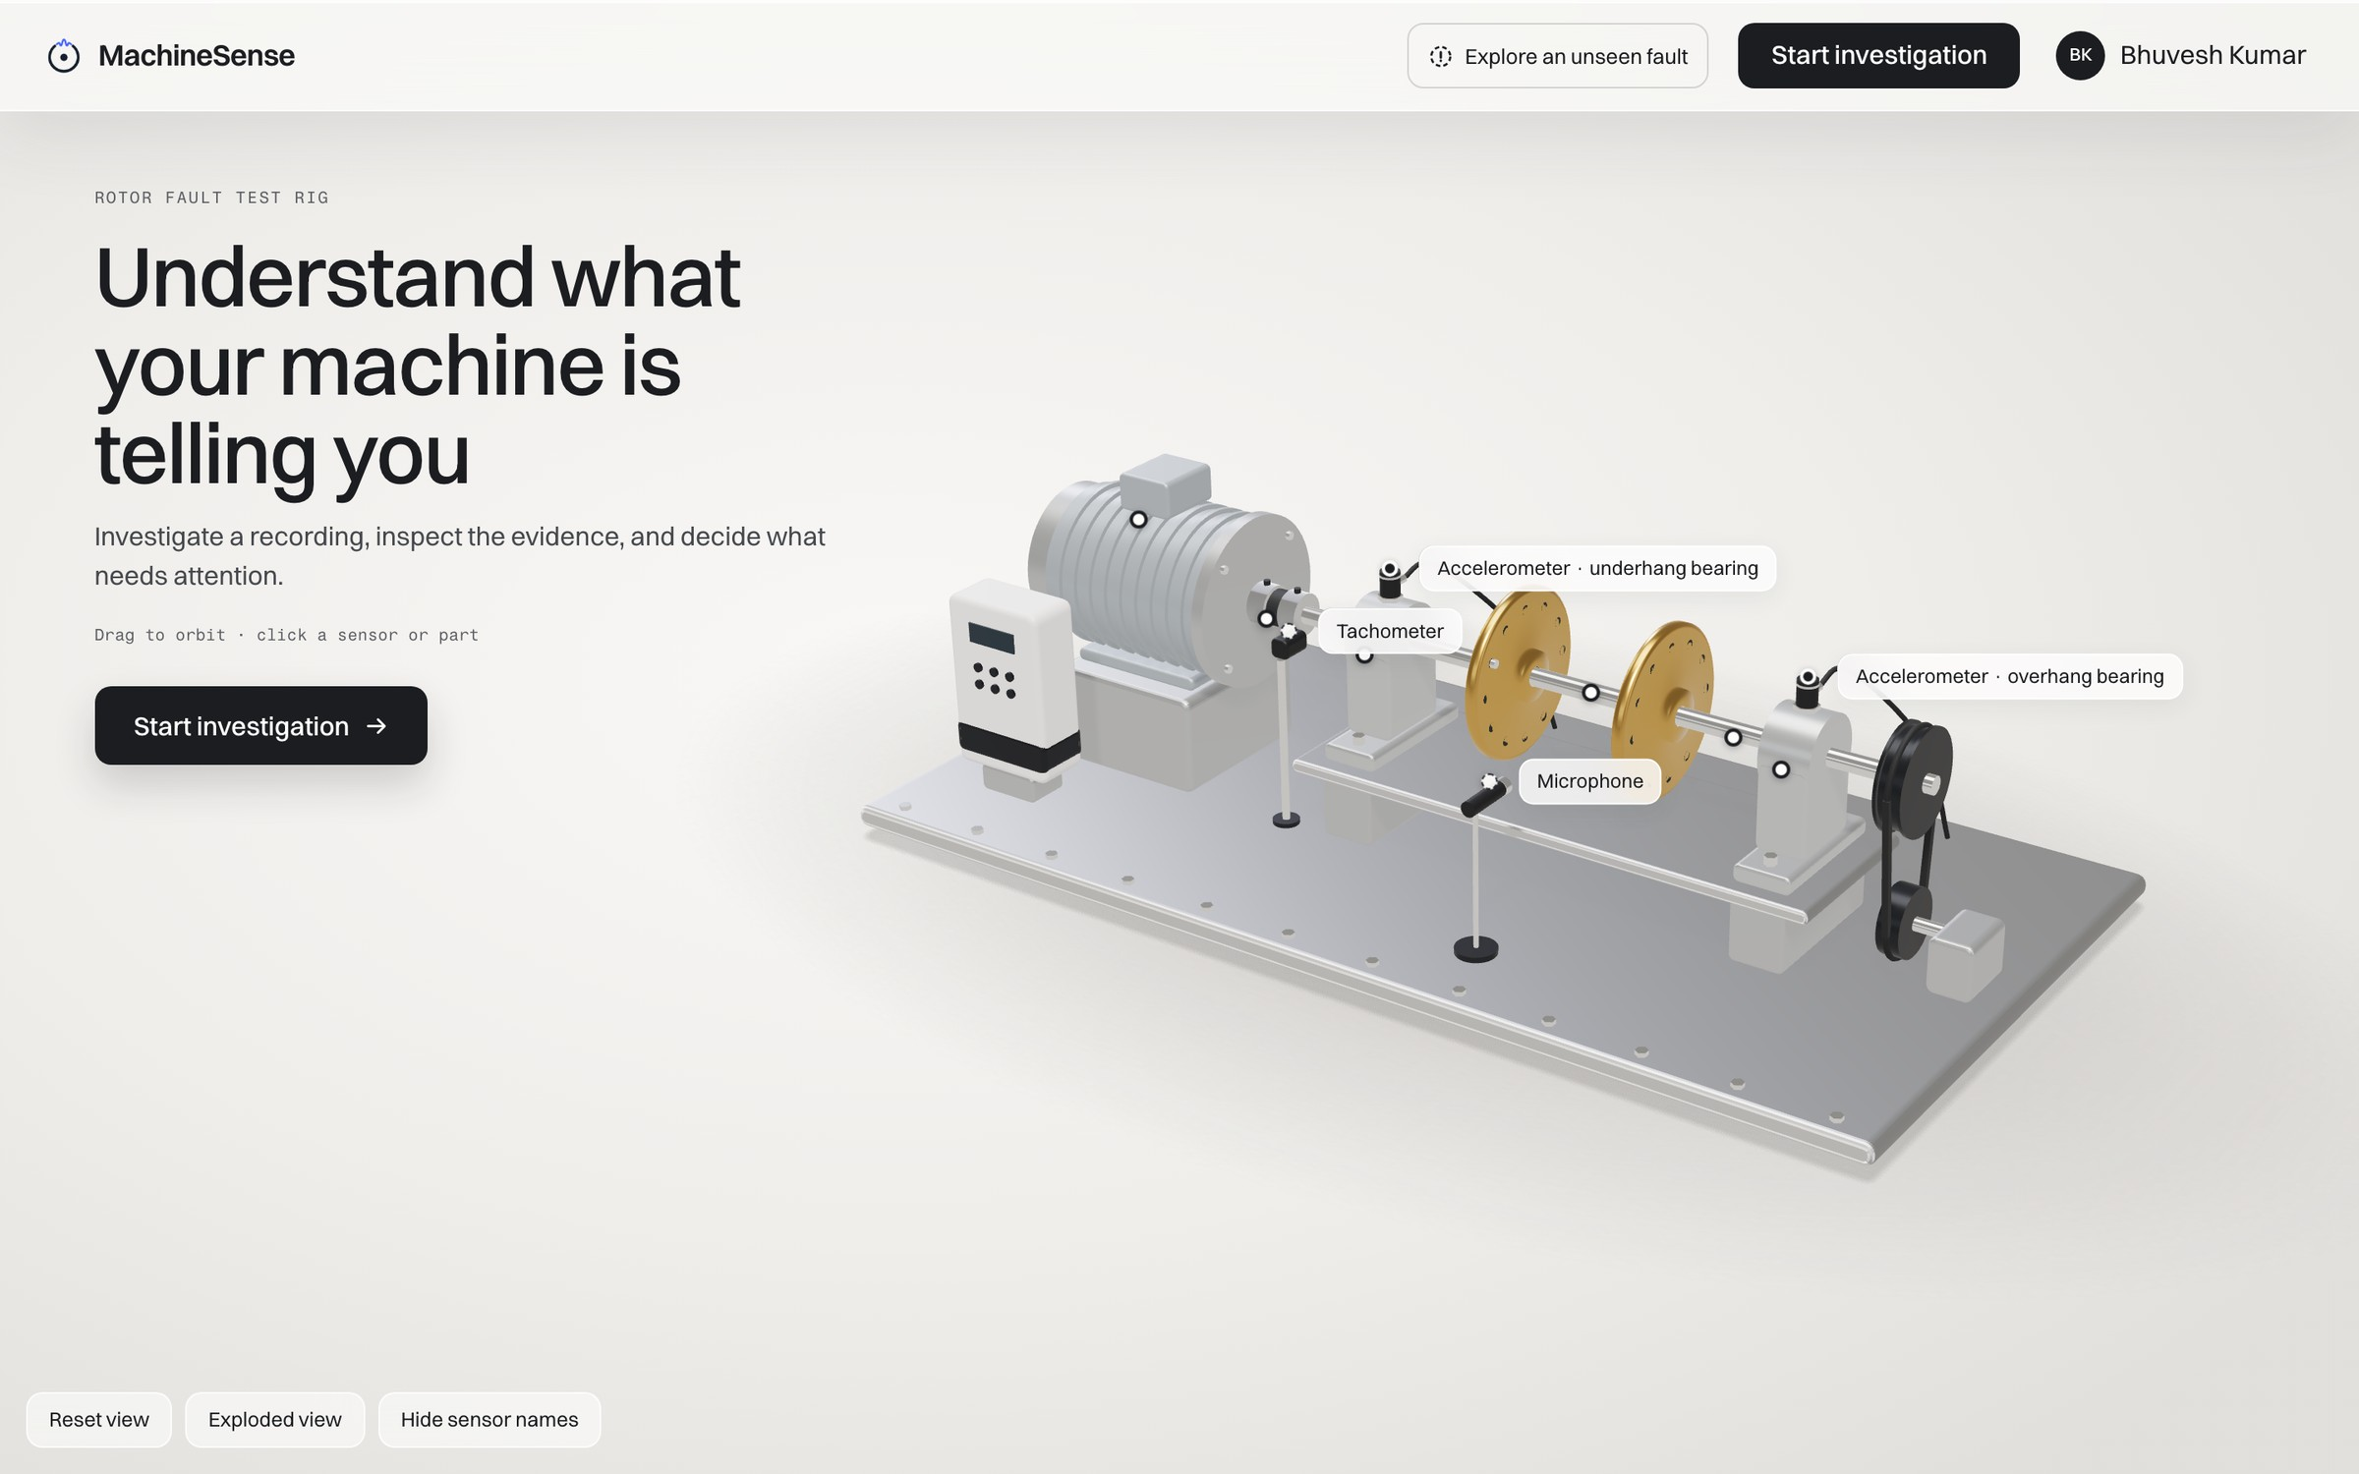
MACHINESENSE
Live demo
github.com/bhuveshsharma09/MachineSense
Bhuvesh Kumar · NUS-ISS
17
Notes:
[about 3 min, live]
Let me show you the app.
- Home page: This is the home page, with the 3D rig and its sensors.
- Healthy recording (normal__24.576): I'll start an investigation with a healthy recording. The verdict is healthy, and you can see the checks that support it.
- Imbalance (imbalance__30g__19.456): Now a known fault. It says possible imbalance, and it clearly marks this as a model prediction. The rig highlights the rotor discs. The sensors show where the vibration changed compared with a healthy machine. Below that are the suggested checks.
- Bearing fault (underhang__cage_fault__6g__35.0208): For a bearing fault, the envelope spectrum shows the bearing-defect lines.
- Uncertain case (imbalance__10g__13.9264): This one is imbalance too, but the system isn't sure. So it says further inspection needed. That's by design: it doesn't guess.
- Developer view: Switching to the Developer view, you can see every score against its threshold, and why the rule decided what it did.
- Pipeline page: This page shows each stage of the diagnosis, step by step.
- Assistant: I'll ask: "Which sensor shows the largest change?" It answers with sources you can check.
- Unseen-fault page: Last, I hide horizontal misalignment from the model. You can see a case where the hidden fault is called healthy. I show this failure on purpose, because it's real.

Slide 18
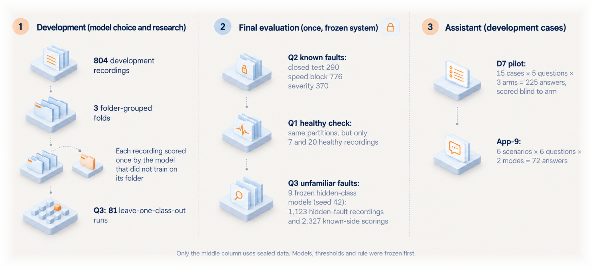
MACHINESENSE
What data each evaluation uses
18
Notes:
[15 s]
Back to the slides. Before the numbers, one thing to be clear on. Development data chose the models. Only the final evaluation touched the sealed tests, once, after everything was frozen. The assistant was evaluated on development cases.

Slide 19
MACHINESENSE
Final evaluation: sealed tests, opened once
Frozen system, one run on 28 September 2026, one test rig. Reserved recordings only.
Q1 Is it healthy?
Q2 Which known fault?
Q3 Is it unfamiliar?
0
0.916
82.4 %
faults called healthy
ten-class macro-F1, 290 recordings
of unfamiliar faults sent for inspection
283 / 283 faults detected on the closed split
5 of 7 healthy recordings sent to inspection
19 of 20 on the unseen-speed block
0.845 to 0.972 95 % interval
0.901 at unseen speeds (≥ 40 Hz)
0.747 at the largest unseen settings
925 / 1,123 hidden-fault recordings
0.879 macro AUROC (Mahalanobis)
32.9 % of known-side scorings also rejected
Healthy calibration covered only 18 to 38 Hz.
Development folds gave 0.983 to 0.994.
Rejection rose at unseen speeds and settings.
19
Notes:
[35 s]
These are the sealed-test results.
Known faults: 0.916 macro-F1 on the closed test. That's below the development range of about 0.98 to 0.99, and that's exactly why a sealed test matters.
Unfamiliar faults: 82 percent of hidden-fault recordings were sent for inspection.
Healthy check: no fault was ever called healthy. The flip side is that most healthy test recordings were also sent for inspection. That's mainly because the healthy calibration only covered 18 to 38 hertz.

Slide 20
MACHINESENSE
Unfamiliar faults: bearings caught, shaft faults harder
Bearing faults
99 to 100 % sent for inspection: no known class looks like them.
Imbalance and vertical misalignment
Often given another known shaft-fault label (114 and 44 recordings).
Horizontal misalignment
19 recordings called healthy: the most serious miss.
Why
In the CNN-6 feature space, an unseen shaft fault overlaps known shaft faults, so distance alone struggles.
20
Notes:
[25 s]
Breaking down the unfamiliar faults: unseen bearing faults are almost always caught, 99 to 100 percent. Shaft faults are harder. To the network, imbalance and misalignment look alike, so an unseen one often gets another shaft-fault label. The worst case is horizontal misalignment: 19 recordings were called healthy.

Slide 21
MACHINESENSE
Evaluating the investigation assistant
D7 pilot
App-9: conversation mode
225 answers: 15 cases × 5 questions × 3 arms, blind-scored
72 answers: 6 scenarios × 6 questions, two modes
0
unsupported repair recommendations, in any arm
69.4 %
directly responsive (single question: 38.9 %)
31 %
unnecessary refusals with the code review on (1 % without)
8.6 %
provenance errors in reviewed drafts (was 25.9 %)
15 / 15
correct sensor named with the review on
0
cross-case leaks and 0 repair advice shown
Development cases, small samples, author-scored: read these as pilot results, not proof of safety.
21
Notes:
[20 s]
I evaluated the assistant twice.
In the D7 pilot, no setup gave unsupported repair advice, even without the code review. But the review added refusals: 31 percent of answers.
In App-9, conversation mode answered the actual question 69 percent of the time, against 39 percent for single-question mode.
These are small pilots that I scored myself, so I treat them as early results.

Slide 22
MACHINESENSE
Challenges along the way
99.3 %
A shortcut in the microphone
1.000
A perfect score that was wrong
Microphone bursts in 168 files were linked to two classes: a simple classifier on them reached 99.3 % precision. The audit found them before any training.
Random window splits scored 1.000 because pieces of one recording sat on both sides. Folder-grouped folds gave 0.878.
78 %
Healthy rejections follow speed
1
improvement cleared its bar
Healthy recordings below the calibrated speed range were not called plain healthy in 78 % of runs. The gap was data coverage, not the model.
Of the research stages declared in advance, only E1 (specialist autoencoders) passed: +10.1 points unknown recall on 3 seeds. Not deployed: found after the freeze.
22
Notes:
[25 s]
A few challenges shaped the project.
The microphone had bursts linked to two classes. A simple classifier on them reached 99.3 percent precision. That's a pure shortcut, and the audit caught it before training.
The perfect random-split score was the second trap.
Healthy false alarms turned out to be about speed coverage, not the model.
And of all the research ideas I declared in advance, only one passed its bar: specialist autoencoders, with about 10 points more unfamiliar-fault recall. It came after the freeze, so it's future work.

Slide 23
MACHINESENSE
Limitations and what comes next
Limitations
What comes next
One rig with induced faults: no claim about other machines
49 healthy recordings from one folder: healthy false-alarm rates are uncertain
Folder grouping is only a proxy for recording sessions
The sealed tests are now spent: new ideas need new held-out data
The assistant pilot is small and scored by its author
Test E1 on a new held-out set
Collect healthy recordings across speeds and sessions
Evaluate the fine-tuned ResNet-18 on all nine hidden faults
Relax over-strict assistant checks; use an independent scorer
Test on a second rig before claiming transfer
23
Notes:
[20 s]
The limitations: one rig with induced faults; only 49 healthy recordings, all from one folder; folder grouping is only a stand-in for recording sessions; and the sealed tests are now used up.
Next steps: test the specialist autoencoders on new held-out data, collect healthy recordings across more speeds, and try a second rig.

Slide 24
MACHINESENSE
Say what the evidence supports, and no more
Three questions from one recording, 0.916 macro-F1 on sealed tests, 82 % of unfamiliar faults sent for inspection, and every verdict shown with its evidence and its limits.
github.com/bhuveshsharma09/MachineSense
Bhuvesh Kumar · NUS-ISS
24
Notes:
[15 s]
To wrap up: MachineSense answers three questions from one recording. It scores 0.916 on sealed tests, and it sends 82 percent of unfamiliar faults for inspection. And it shows the evidence and the limits next to every verdict. The idea throughout is simple: say what the evidence supports, and no more. Thank you.

