Slide 1
CNESSI Citation Network with Enhanced Structural and Semantic Information
Bhuvan M S – 12IT16
Computer Science and Automation
Indian Institute of Science, Bangalore
Prof. M. Narasimha Murty
Mr. Govind Sharma
Prof. Ananthanarayana. V. S

Slide 2
Introduction
Digital Libraries like Google Scholar
Ranked according citation count
Highly cited documents overshadow relevant ones
All citations are NOT equal!
Author Ranking
H-index: normalized over citation count
Citation Network – Ideal scope of analysis
Syntactic information limiting the research scope

Slide 4
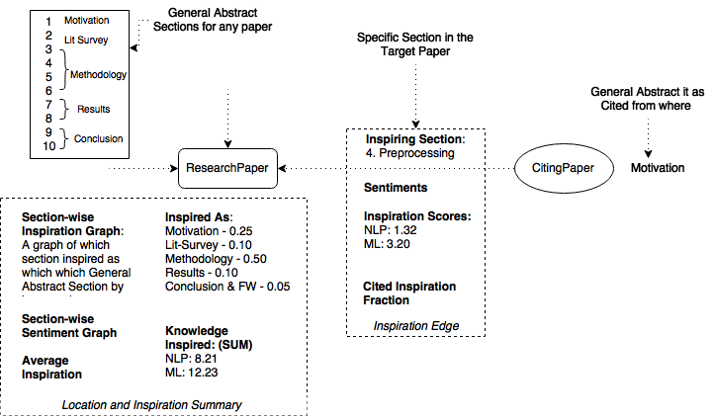

Slide 5
Literature Review
Scientometrics
Webometrics
Altmentrics
CiteSeerX, Arnetminer
Microsoft Academic research
No work on quantifying the amount of knowledge in the text – Semantic Approach!

Slide 6
Outcome of Lit Survey

Slide 7
Problem Statement

Slide 8
Hybrid Methodology
6 Phases
Structural Information addition
Semantic Information addition

Slide 10
Phase 1
Raw PDF to Python Objects with Raw Un-validated Sections

Slide 13
Phase 2
Rule Based Raw Section Validation

Slide 15
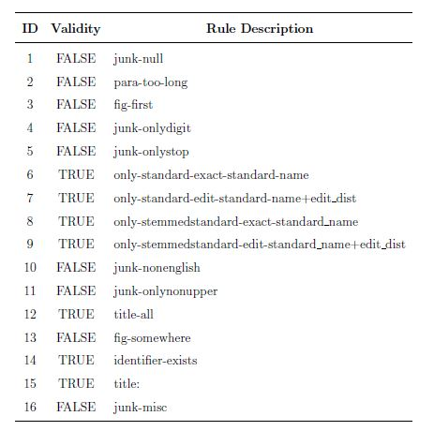
Validation Rules

Slide 16
Phase 3
Classification of Raw Validated Sections into Generic
Sections

Slide 17
Classes–Generic Section
Class Code | Generic Part
0 | ? (Unclear)
1 | Motivation
2 | Background
3 | Literature Review
4 | Methodology
5 | Results And Discussion
6 | Conclusion And Future Work
Lossless merging is done after classification

Slide 18
Feature Vector
Training Data: Tagged 100 documents
922 sections of 100 documents
Overall Available data:
7995 - documents
68804 – valid header named sections
Feature Set
Positional + Noise + POS + Bag-of-Words
Finally – 9 + 2 + 37 + 4197 = 4245 features

Slide 20
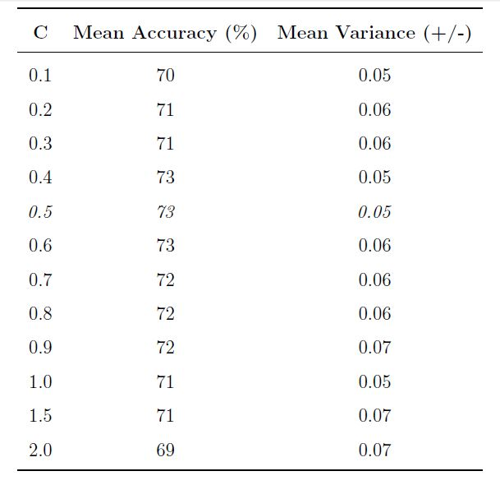
SVM Results

Slide 21
Confusion Matrix Obs.
Classified as => | 0 | 1 | 2 | 3 | 4 | 5 | 6
0 – Unclear? | 14 | 0 | 1 | 0 | 5 | 0 | 0
1 | 0 | 19 | 0 | 1 | 3 | 0 | 0
2 | 0 | 1 | 0 | 0 | 5 | 0 | 0
3 | 0 | 0 | 1 | 4 | 4 | 0 | 0
4 | 10 | 0 | 0 | 0 | 82 | 13 | 0
5 | 2 | 0 | 0 | 0 | 13 | 27 | 1
6 | 3 | 0 | 0 | 0 | 3 | 1 | 18

Slide 22
Phase 4
Knowledge Topics-Terms Mining

Slide 24
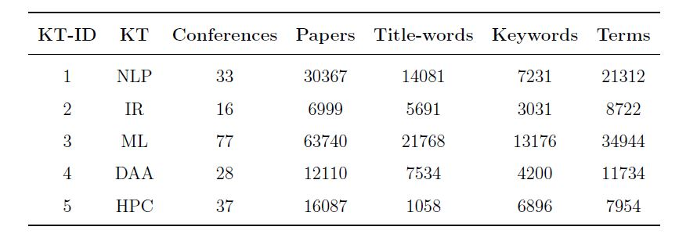
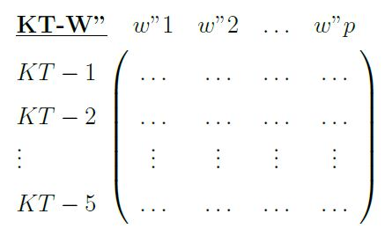
KT statistics
Row-Normalized
Word-Frequency Matrix

Slide 25
Phase 5
Section-wise Trait Analysis

Slide 26
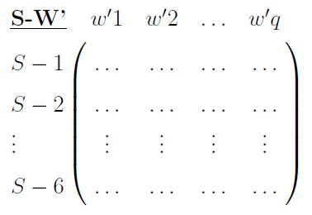
Row-Normalized Document-Frequency Matrix

Slide 27

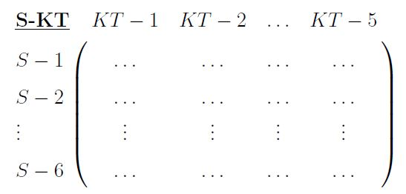
Row-Normalized Document-Frequency Matrix
W” normalized with respect to W’
Corpus level KSV matrix: General Trait KSVs of each section

Slide 28
Phase 6
LDA on all Sections and Cite Contexts of all Research
Documents

Slide 29
LDA Preprocessing

Slide 30
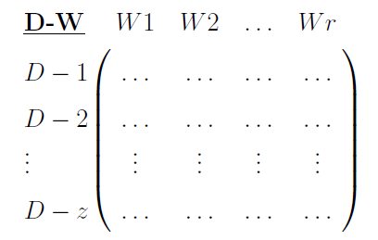
Term-Frequency Matrix

Slide 31
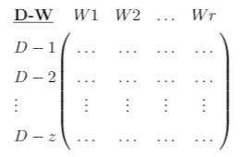
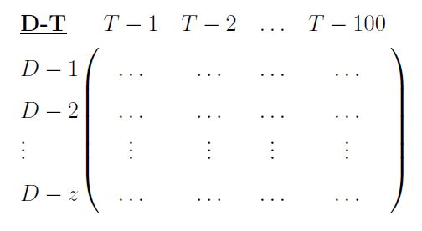
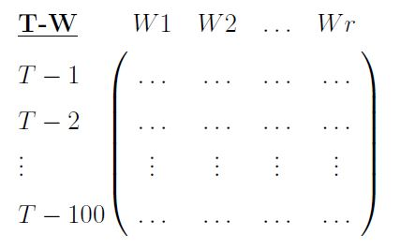
Term-Frequency Matrix
LDA Processing
*
Normalized Matrices

Slide 32

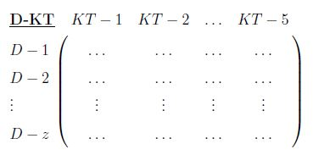
Document level KSV matrix: Node and Edge information

Slide 33
Analysis & Discussion
Structural Information
Supervised ML Technique – Evaluated
Semantic Information – Data-centric
LDA – Unsupervised Soft Clustering
Matrix factorization
Mapping with respect to KT
Does not need explicit evaluation
KSV – not normalized
Relative study only

Slide 34
Semantic Applications
Knowledge Share of the Document
Cited-to section identification
Knowledge Projection based ranking

Slide 35
Interesting Analysis
Author-to-Author Domain analysis
Knowledge Diffusion and Knowledge Evolution
Author-specific Focus Analysis and Author Impact Ranking

Slide 36
Conclusion
Raw Citation Network to Structural and Semantic Information Rich Citation Network created.
Widens the horizon of Citation Analysis significantly
Superior organization of digital libraries
Better Ranking and evaluation of paper and authors
Better search engine

Slide 37
Timeline
Total - 15 weeks
Motivation, Lit Survey and Problem Statement establishment - 2 weeks
Methodology flow and phase 1 - 2 weeks
Phase 2 – 1 week
Phase 3 – 2 week
Phase 4 – 1 week
Phase 5 – 3 weeks
Phase 6 – 3 weeks
Thesis and Presentation – 1 week

Slide 38
Thank You
Q & A

