Slide 1



Crop Rotation Recommender INTERNSHIP_17513641056863b20937d78

Slide 2

Learning Objectives
Understand and apply machine learning models for real-world agricultural use cases.
Gain hands-on experience with Flask for building interactive web applications.
Learn how to integrate trained ML models into a web-based interface.
Explore the concept of sustainable farming through crop rotation recommendations.
Improve skills in version control for collaborative project management.
Strengthen problem-solving by enhancing the project with improvised features like better UI and formatted outputs.
GOAL
Source :
www.freepik.com/

Slide 3
Tools and Technology used
Python – Core programming language for model and backend logic
Scikit-learn – For training and using the crop recommendation ML model
Flask – Web framework to build the application
HTML, CSS (Internal Styling) – For frontend user interface
Joblib & Pickle – To save and load ML models and label encoders
NumPy – For handling numerical computations
Git & GitHub – Version control and project collaboration

Slide 4
Methodology
Data Collection & Preprocessing
Used agricultural dataset with soil nutrients (N, P, K), temperature, humidity, pH, and rainfall.
Cleaned and prepared data for training.
Model Training
Trained a classification model (Scikit-learn) to predict the best crop.
Applied Label Encoding for crop names.
Model Saving
Saved the trained model (crop_model.pkl) and label encoder (label_encoder.pkl) using Joblib/Pickle.
Web Application Development
Built backend using Flask.
Created input form in HTML & CSS for user data entry.
Implemented prediction route to process input and return results.
Result Display
Top 3 crop recommendations displayed on result page with probability percentages.
Version Control
Managed project with Git & GitHub for tracking and submission.

Slide 5
Agriculture is the backbone of India’s economy, yet farmers face uncertainty in crop selection.
Choosing the wrong crop can lead to poor yield and financial losses.
Soil nutrients, pH, temperature, rainfall, and humidity greatly influence crop productivity.
Farmers often lack access to scientific data-driven tools for decision-making.
Traditional practices rely heavily on experience rather than real-time analysis.
Climate change makes it harder to rely on old cropping patterns.
Unsustainable crop choices reduce soil fertility over time.
There is a need for smart systems that guide farmers in crop rotation.
Machine Learning can identify patterns and recommend suitable crops effectively.
This project aims to build a Crop Rotation Recommender System to support sustainable farming.
Problem Statement:

Slide 6
Solution:
Developed a Crop Rotation Recommender System using Machine Learning.
System takes soil nutrients (N, P, K), temperature, humidity, pH, and rainfall as input.
Predicts the top 3 most suitable crops for given conditions.
Uses a trained classification model and label encoding for accurate predictions.
Integrated into a Flask Web Application with a user-friendly interface.
Displays clean and readable crop recommendations with probabilities.
Helps farmers adopt sustainable farming practices by suggesting rotation-friendly crops.
Reduces risk of crop failure and improves soil health over time.
Scalable design – allows adding more datasets or ML models in the future.
Easy deployment – lightweight application that can run on local systems or cloud servers.
GITHUB LINK:CROP RECOMMENDER

Slide 7
Conclusion:
The project successfully demonstrates a Machine Learning–based crop recommendation system.
Farmers can make data-driven decisions for sustainable agriculture.
The system helps in improving productivity and maintaining soil fertility through better crop rotation.
A simple and user-friendly web interface ensures accessibility for non-technical users.
The model is scalable and adaptable, allowing future integration of more datasets, parameters, and features.
Future Scope:
Adding real-time weather and soil sensor data for more accurate predictions.
Extending the system into a mobile app for farmers with multilingual support.
Incorporating fertilizer and pesticide recommendations for complete crop planning.

Slide 8
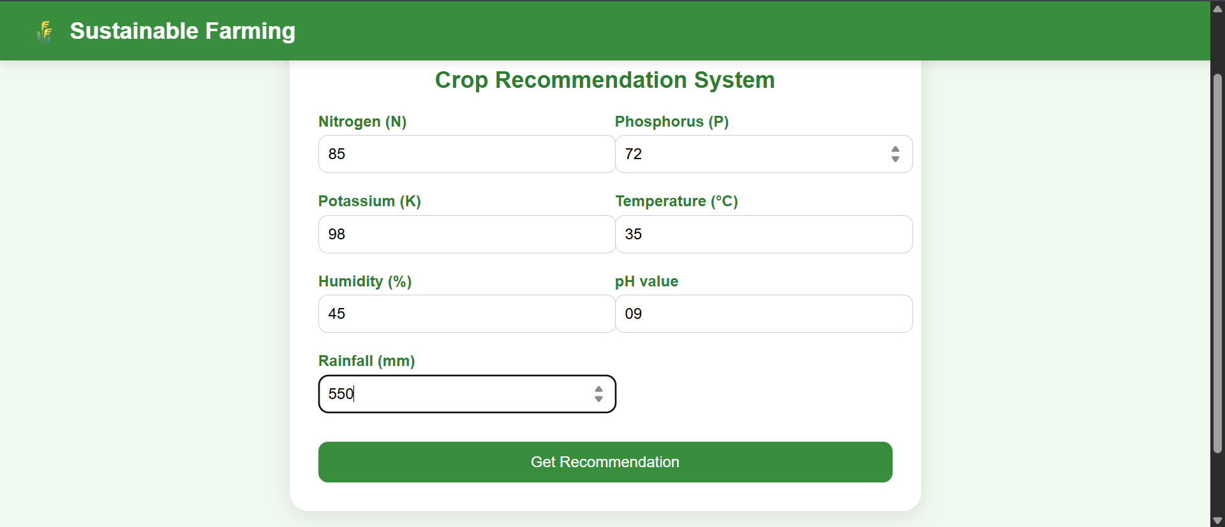
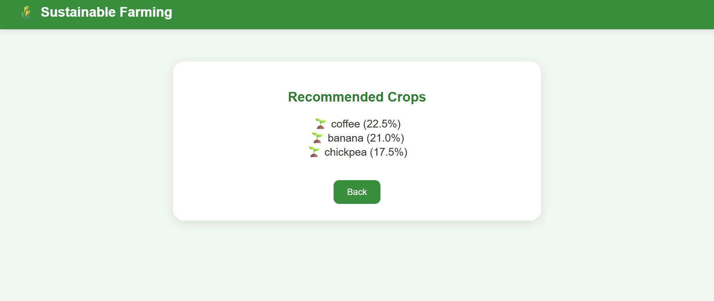
Screenshot of Output:
Input we provide:
Output we got:

