Slide 1
AI-Driven Crop Disease Prediction and Management System
PIP4004 Capstone Project
Final Review
Batch Number: CSG-G11
Under the Supervision of,
Prof. Himanshu Sekhar Rout
Assistant Professor
Presidency School of Computer Science and Engineering
Presidency University
NAME | ROLL NUMBER
1. BHUVANESHWAR C | 20211CSG0002
2. PRAVEEN P | 20211CSG0016
3. RASHMI V | 20211CSG0058
4. VISHNU VARDHANA S | 20211CSG0062
Name of the Program: Computer Science and Technology(CSG)
Name of the HoD: Dr. Saira Banu Athem
Name of the Program Project Coordinator: Dr. Manjula H M
Name of the School Project Coordinators: Dr. Sampath A K

Slide 2
Introduction
Crop diseases significantly impact agricultural productivity, leading to financial losses for farmers. Early detection and effective management are essential to prevent widespread damage. Traditional disease identification methods rely on manual inspection, which can be time-consuming and error-prone.
This project, AI-Driven Crop Disease Prediction and Management System, uses machine learning and deep learning to analyze crop images and environmental data, providing automated disease detection and treatment recommendations. The system is accessible via a mobile and web application, ensuring real-time insights and support for farmers.
Problem Statement: Crop diseases significantly impact agricultural productivity, leading to financial losses.

Slide 3
Literature Survey
Existing Approaches:
Manual inspection (time-consuming, error-prone).
Rule-based image processing (limited generalization).
Machine learning & deep learning (high accuracy, but challenges exist).
Gaps Identified:
Lack of large, diverse datasets for training AI models.
Generalization issues across different crops and environments.
Limited integration of environmental/climatic data.
Computational resource constraints for mobile/edge deployment.

Slide 4
Research Gaps in Existing Methods
Data Limitations: Lack of diverse, labeled datasets.
Model Generalization: AI models trained on specific crops fail in different regions.
High Computational Cost: Deep learning models require high-performance hardware.
Environmental Factors Ignored: Most models do not consider temperature, humidity, soil health.
User Adoption Barriers: Digital illiteracy among farmers, lack of local language support.
Connectivity Issues: Many solutions require internet access, limiting rural usage.

Slide 5
Proposed Methodology
System Overview
Image Acquisition: Farmers upload crop images via web app.
Preprocessing: Image enhancement, noise reduction, normalization.
AI-Based Disease Detection:
CNN models (ResNet, MobileNet) classify diseases from images.
Random Forest models integrate environmental data for prediction.
Treatment Recommendations: Suggests chemical, biological, or preventive measures.
User Interface: Simple, accessible mobile & web application.

Slide 6
System Architecture
Image Acquisition
Preprocessing Module
AI-Based Disease Detection
Environmental Data Integration
Treatment Recommendation Engine
User Interface

Slide 7
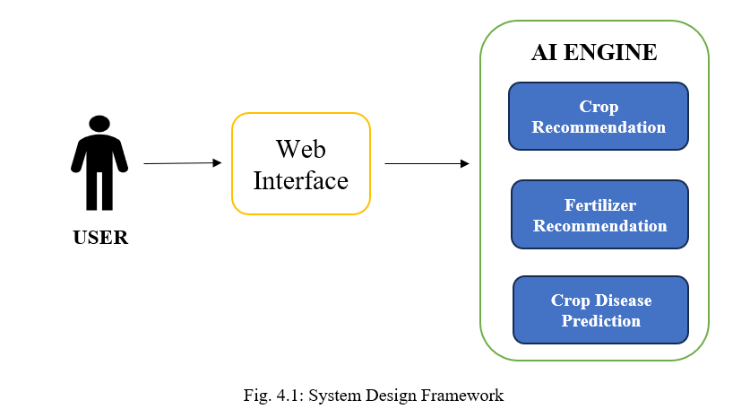

Slide 8
Data Collection & Preprocessing
1. Data Collection
Crop Images: Farmers upload images via mobile/web app; additional data from public datasets (e.g., PlantVillage).
Environmental Data: Weather APIs provide temperature, humidity, and rainfall; IoT sensors (optional) collect soil and climate data.
Expert Labeling: Agronomists and farmers help annotate images for AI training.
2. Data Preprocessing
Image Processing: Resize, normalize, denoise, and augment images for better AI accuracy.
Environmental Data Cleaning: Fill missing values, normalize data, and aggregate time-series weather data.
Label Encoding: Convert disease names into numerical categories for machine learning classification.

Slide 9
Hardware & Software Components
1. Hardware Components
Mobile Devices & Cameras: Farmers use smartphones to capture and upload crop images.
Cloud Servers & GPUs: AWS, Google Cloud, or on-premise GPUs for training deep learning models.
IoT Sensors (Optional): Collect temperature, humidity, and soil moisture data.
2. Software Components
AI/ML Frameworks: TensorFlow, PyTorch for training the disease prediction model.
Web & Mobile Development: React (Web), Flutter/React Native (Mobile).
Database & Cloud: Firebase, MySQL, PostgreSQL for storing user and disease data.
APIs & DevOps: OpenWeather API for weather data, Docker & Kubernetes for scalable deployment.

Slide 10
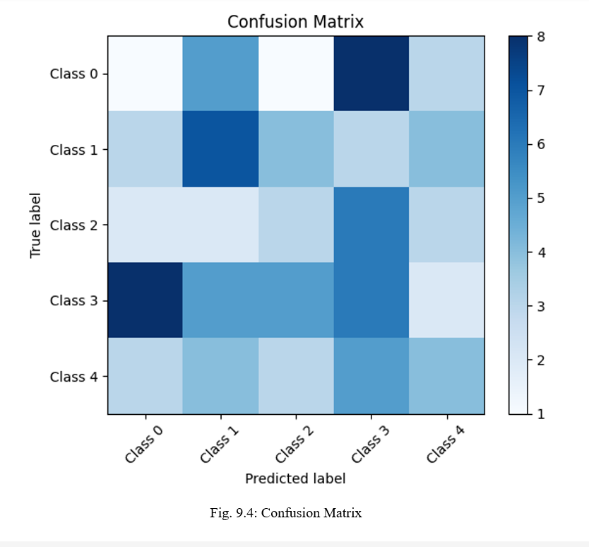
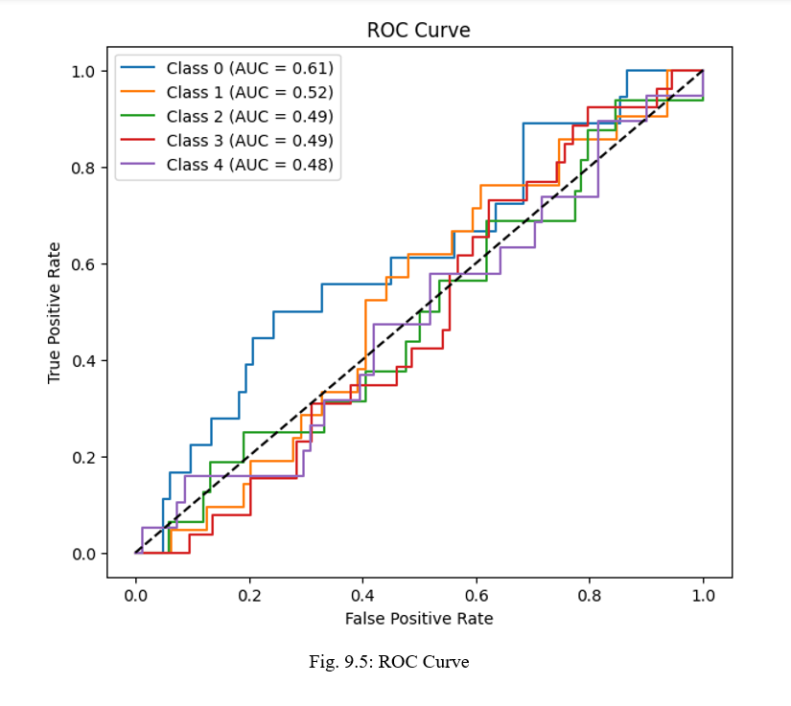
RESULTS AND DISCUSSION

Slide 11
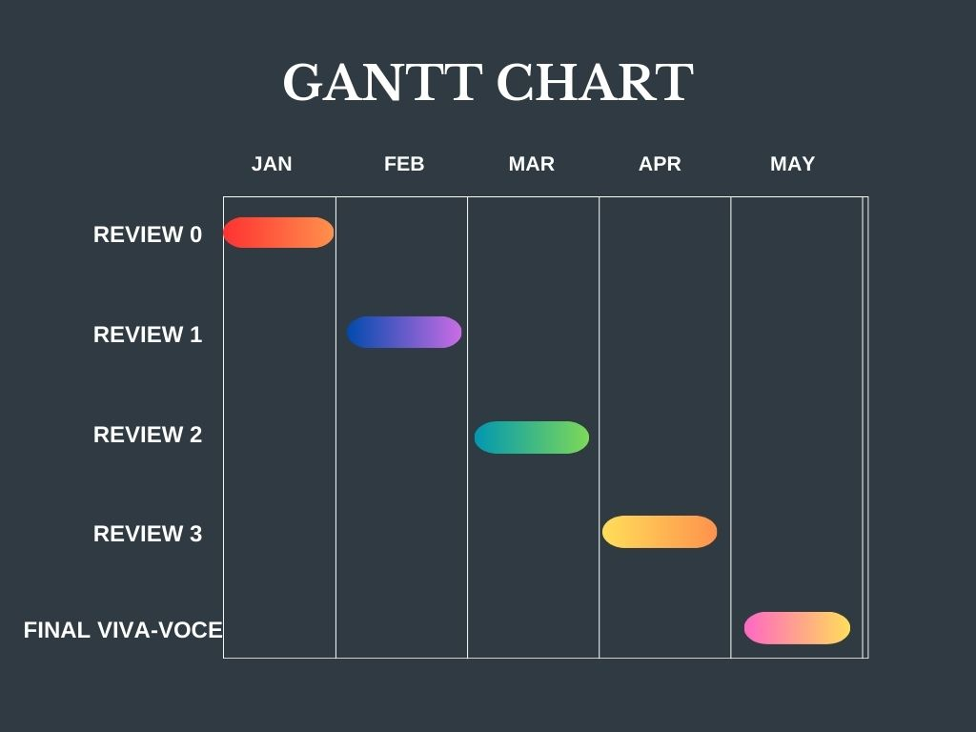
TIMELINE FOR EXECUTION OF PROJECT

Slide 12
Conclusion
The AI-Driven Crop Disease Prediction and Management System leverages machine learning and cloud-based technologies to provide farmers with an efficient, real-time solution for detecting and managing crop diseases. By integrating image analysis, environmental data, and AI-powered recommendations, the system enhances early disease detection, reducing crop losses and improving agricultural productivity.
The combination of mobile and web applications, deep learning models, and cloud-based deployment ensures accessibility, scalability, and accuracy. Additionally, continuous user feedback helps improve model performance over time.

Slide 13
References (IEEE Paper format)
Mohanty, S. P., Hughes, D. P., & Salathé, M. (2016). Using deep learning for image-based plant disease detection. Frontiers in Plant Science, 7, 1419. [DOI: 10.3389/fpls.2016.01419]
Zhang, S., Huang, W., Zhang, C., & Li, P. (2020). Plant disease recognition based on deep learning and mobile application. Computers and Electronics in Agriculture, 169, 105223. [DOI: 10.1016/j.compag.2020.105223]
Picon, A., et al. (2019). AI-powered mobile application for plant disease detection using convolutional neural networks. International Journal of Agricultural Technology, 15(2), 120-134.
Li, Y., Chen, D., Wang, H., & Zhang, H. (2021). A hybrid deep learning model integrating climatic data for plant disease prediction. Agricultural Systems, 192, 103176. [DOI: 10.1016/j.agsy.2021.103176]
Ferentinos, K. P. (2018). Deep learning models for plant disease detection and diagnosis. Computers and Electronics in Agriculture, 145, 311-318. [DOI: 10.1016/j.compag.2018.01.009]

Slide 14


