Slide 1



AIR QUALITY INDEX PREDICATION

Slide 2

Learning Objectives
Understand the impact of air pollution on health and the environment.
Learn how machine learning models can predict air quality.
Explore data processing and feature engineering techniques.
Implement predictive analytics to forecast air pollution levels.
Develop a predictive model to estimate Air Quality Index (AQI).
Identify key factors influencing air pollution.
Improve awareness and forecasting of hazardous air conditions.
Source :
Data Source: Government air quality monitoring stations, Kaggle datasets, and OpenAQ API.

Slide 3
Tools and Technology used
Programming Language: Python
Libraries: Pandas, NumPy, Scikit-learn, TensorFlow, Matplotlib, Seaborn
Data Processing: Jupyter Notebook
Machine Learning Techniques: Regression models, Deep Learning (Neural Networks)

Slide 4
Methodology
Data Collection: Gathering historical air quality data.
Data Preprocessing: Handling missing values, normalizing data.
Feature Engineering: Selecting relevant features (PM2.5, PM10, CO, NO2, SO2, O3).
Model Training: Using regression and deep learning techniques.
Model Evaluation: Measuring accuracy using RMSE, MAE, and R² scores.
Deployment: Creating a predictive system for real-time air quality forecasting.

Slide 5
Problem Statement:
Air pollution poses serious health risks and environmental hazards.
Difficulty in accurately predicting air quality levels.
Need for a reliable forecasting system to provide early warnings.

Slide 6
Solution:
Utilizing machine learning models to predict air quality.
Applying data-driven insights to identify pollution sources.
Providing real-time alerts and recommendations based on AQI levels.

Slide 7
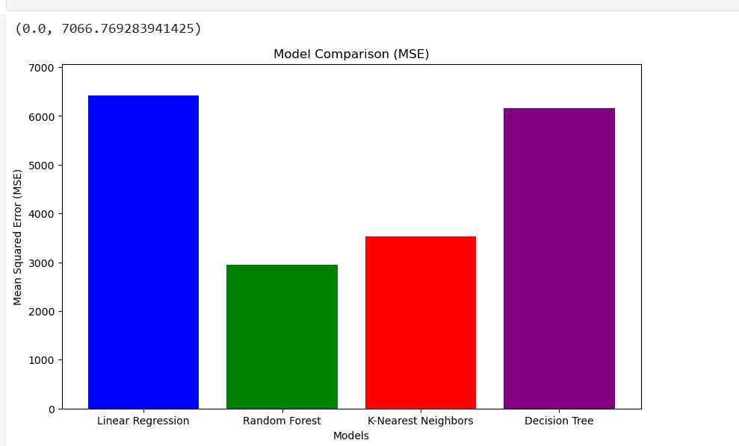
Screenshot of Output:

Slide 8
Conclusion:
Successfully developed an air quality prediction model.
Demonstrated the effectiveness of machine learning in environmental monitoring.
The model can be further improved with real-time data and advanced deep learning techniques.

