Slide 1
EXPLORATORY DATA ANALYSIS
Customer Policy Analysis for Premium Discount Strategy

Slide 2
🧰 Step 1: Importing Libraries
We start by bringing in tools that help us work with data and make charts:
Pandas → For reading and organizing data
NumPy → For handling numbers and calculations
Matplotlib & Seaborn → For creating visuals and charts
OS & Warnings → For managing files and keeping the output clean

Slide 3
📂 Step 2: Loading Data
We have two datasets:
Customer Details → Information like age, gender, vehicle age, etc.
Policy Details → Information like annual premium, sales channel, and whether they responded to the policy offer.
These two are read into the program and stored in memory.

Slide 4
🧹 Step 3: Data Cleaning
Before analysis, we need to make sure our data is accurate and tidy.
The script does several cleaning steps:
Handle Missing Values (handle_nulls)
If something is missing, it fills it in smartly:
Numbers → replaced with the average value
Text → replaced with the most common value
Handle Outliers (handle_outliers)
Sometimes numbers are way too high or too low (like an error).
Those “outliers” are replaced with average values to keep things realistic.
Clean Text (clean_strings)
Makes all text lowercase and removes extra spaces, so values like “ Male ” and “male” are treated the same.
Remove Duplicates (remove_duplicates)
Deletes any repeated records to ensure each customer is counted once.

Slide 5
🔗 Step 4: Merging the Two Datasets
We combine the customer and policy data into a single master table using the unique customer_id.
This helps us see all details for each customer in one place.

Slide 6
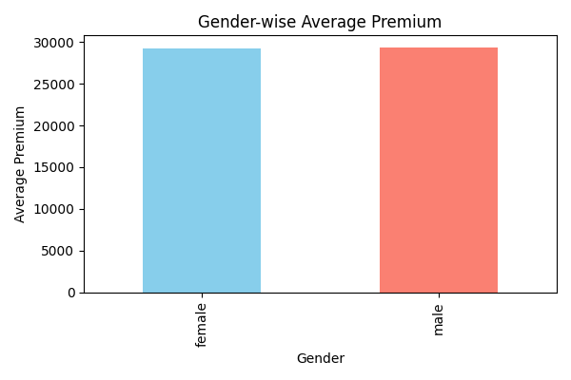
💡 Step 5: Generating Insights
Here we create simple charts to visualize trends:
Gender-wise Average Premium
→ Compares how much premium males vs. females pay on average.
.

Slide 7
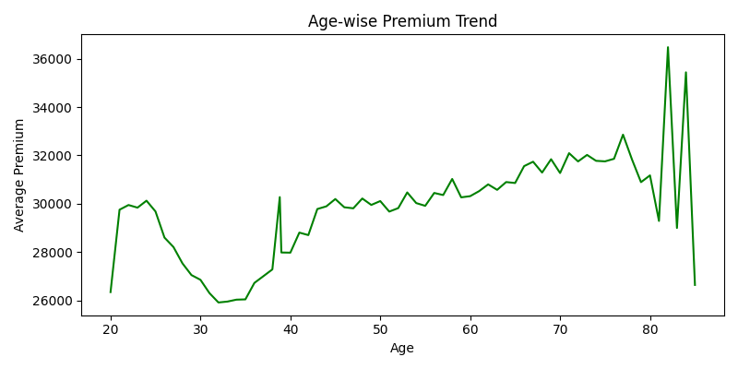
Age-wise Premium Trend
→ Shows how premium changes as people get older.

Slide 8
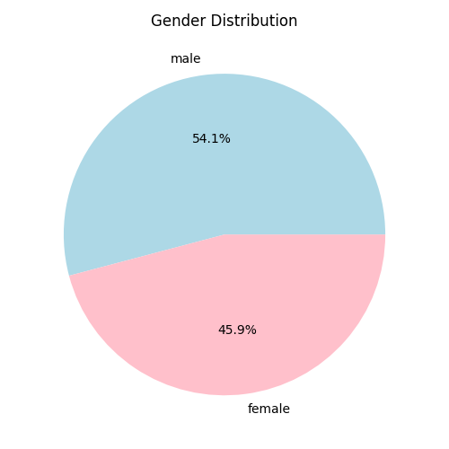
Gender Distribution Pie Chart
→ Displays what percentage of customers are male or female.

Slide 9
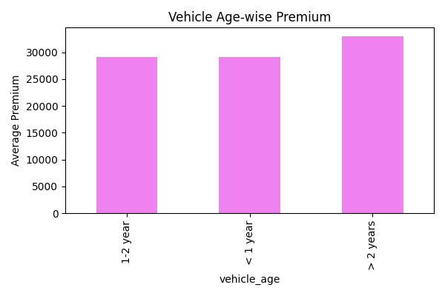
Vehicle Age vs. Premium
→ Shows how the vehicle’s age affects the premium cost.

Slide 10
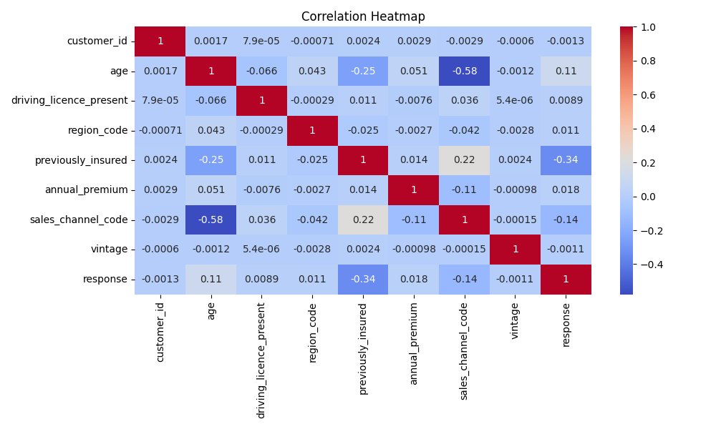
A heatmap is a visual chart that uses colors to represent the magnitude or intensity of data values.

Slide 11
What do the colors mean?Dark red: Strong positive relationship Dark blue: Strong negative relationship Light colors: Weak or no relationship
What does the data show here?
Let’s look at some interesting parts of your heatmap:
Age and Sales Channel Code (-0.58):There’s a fairly strong negative relationship, meaning certain sales channels are used more by younger or older age groups (as one increases, the other tends to decrease).
2. Previously Insured and Response (-0.34):People who were already insured are less likely to respond to a new insurance offer — makes sense, since they already have coverage.
3. Previously Insured and Annual Premium (0.22):Slight positive relationship — those who were previously insured might have slightly higher premium values.
4. Most other values (close to 0):These show little or no correlation, meaning those features don’t affect each other much.

Slide 12
🔍 Step 6: Correlation Analysis
This part checks how strongly two factors are related — for example, how much age affects the annual premium.
It also produces a heatmap (a colorful chart) that shows relationships between all numeric factors.
Positive correlation → as one increases, the other increases
Negative correlation → as one increases, the other decreases
No significant relationship → they’re mostly independent

Slide 13
💾 Step 7: Save and Run

