Slide 1
Tinder2 – Tinder for the 22nd Century
Bhuvan Venkatesh
Notes:
If tinder was so good, why is there no tinder2
I designed a dating app for the next century
This dating app has zero-knowledge proofs of user traits on the blockchain

Slide 2

Audience: (future) Millennials
Notes:
Reason for future millennials is that apps are just going to get more and more geared toward natural human tendencies, fast reliable communication in a world full of choices
We need to appeal to people who are more willing to try online interfaces.
Millennials are more willing to send good things out than bad things

Slide 3
Conventual Dating Apps have you self report. We know this is bad [2].
Notes:
People lie online [1]
Dating apps like Tinder have you pick out descriptions of yourself.
Eharmony and more serious dating apps get around this by forcing users to do surveys but even then the signal is self reported. If you truly believe you are X then the survey won’t show this.
Surveys are hard to design and get signal out every person.
Algorithms are cool but humans have been naturally verifying claims for millions of years before algorithmic verification

Slide 4
Instead, Have people pick traits and make that your profile.
Notes:
There are cons to this are your friends could be really bad or joking and put lackluster qualities
The pros are that your friends pick your traits which tend to be accurate if they have your best interests at hand
Their reputability also goes up
We’ll also limit to single words so we aren’t subject to more bias (very nice, or kinda nice) [1]

Slide 5
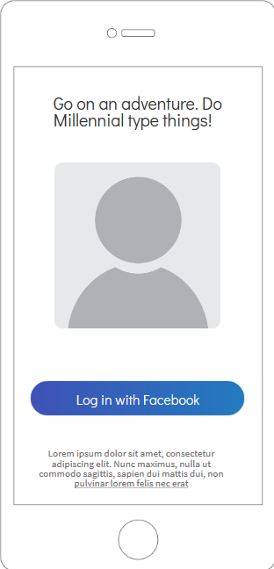
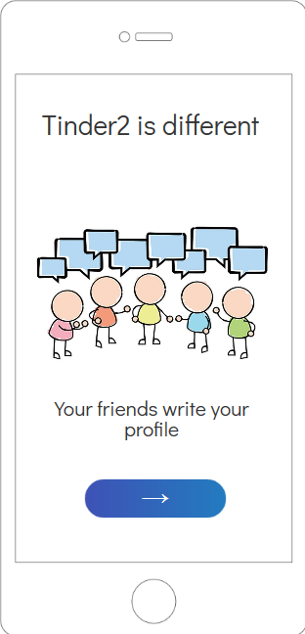
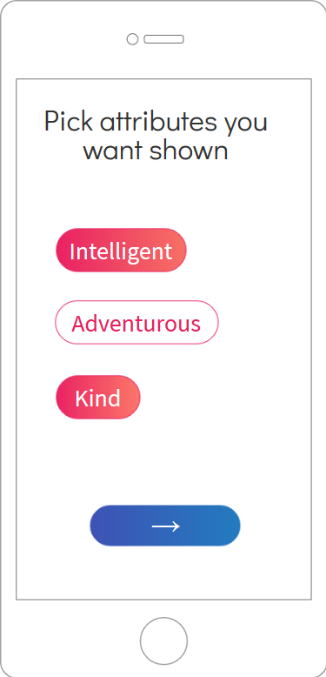
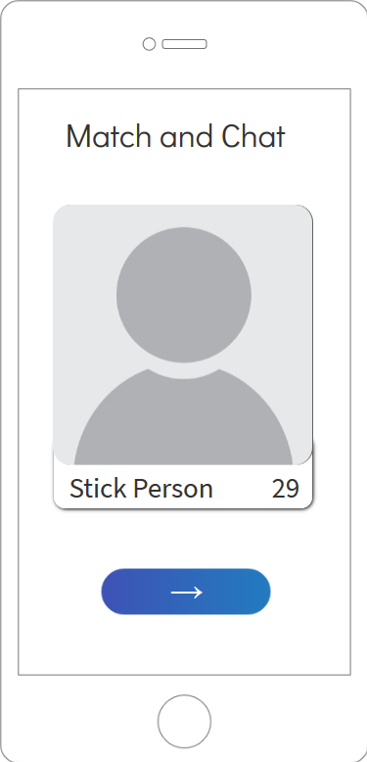
Notes:
Enter Tinder2, a web application where your friends write your profile quite literally
The motivation for tinder2 is that we think that a generation of people who grew up with quick dating apps will still be hooked on them as they grow older
The UI and design is inspired mostly by Tinder to have a friendly approach to matching
The new user flow is shown above.
Same login
Showing how tinder2 shows profile
Selecting traits
Swiping just like tinder

Slide 6
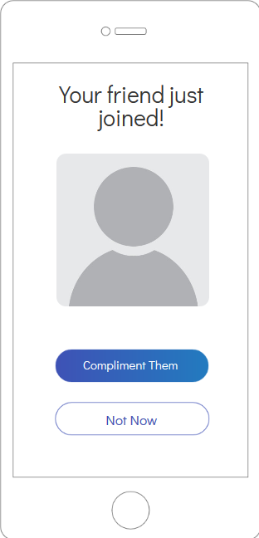
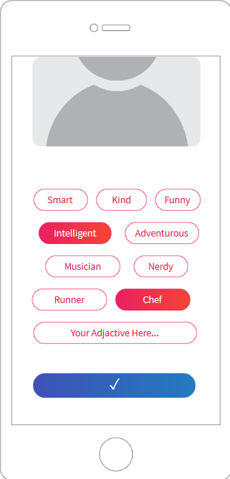
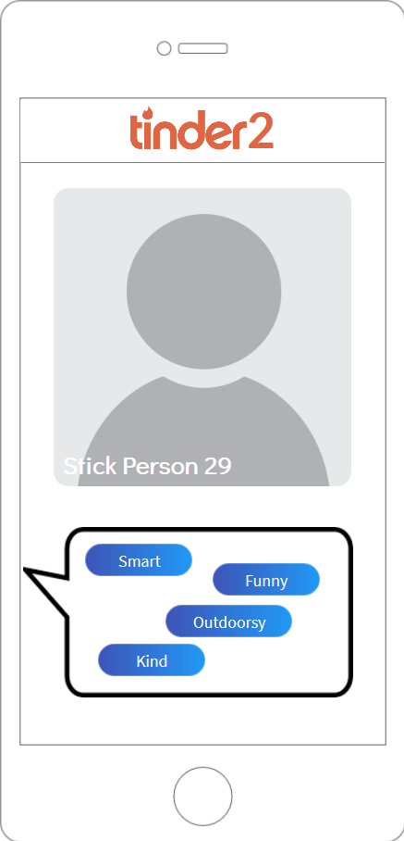
Notes:
Why do we choose these signals? First we want to differentiate it from traditional signals of what they describe
New user notification
You get a notification to describe somebody
You choose the signals and add some more signals
They appear in a bubble when you swipe
We make it appear as a bubble just so we know this is gossip
All other UI elements replaced with a minimalist approach

Slide 7
Signals, Signals, Signals – Collusion is Hard
Notes:
The main benefit of the application is that collusion is hard
The cost to the sender is that they’ll have to coordinate amongst their 100 friends what traits they’d like to select
The benefit to the sender is that they can still pick out what traits they want shown
The signal to the receiver is high because collusion is hard. All the signals of quality are verified by at least a few different people
We can even choose a gold star trait that most people said that this person is X or Y
The problem is in smaller communities, collusion can grow to become a social norm [3]. This is the Twitter or Instagram follow-back model

Slide 8
With friends like these who needs enemies?
Notes:
Cons: We need a lot of moderation on tags to make sure that they remain positive and personality describing.
Reliability is incremental to the task at hand. Reason being is if we don’t have reliability, the tags become meaningless thought bubble people can just throw away. Collusion is a natural way of doing this
Another interesting algorithmic perspective is we can pick people who are seen as nice or outdoorsy and weight their opinion higher. This is a chain of trust model that we use in determining misinformation

Slide 9
Citations
[1] Hancock, J. T., Toma, C., & Ellison, N. (2007). The truth about lying in online dating profiles. Proceedings of the SIGCHI Conference on Human Factors in Computing Systems - CHI 07. doi:10.1145/1240624.1240697
[2] Nicole Ellison, Rebecca Heino, Jennifer Gibbs; Managing Impressions Online: Self-Presentation Processes in the Online Dating Environment, Journal of Computer-Mediated Communication, Volume 11, Issue 2, 1 January 2006, Pages 415–441, https://doi.org/10.1111/j.1083-6101.2006.00020.x
[3] Santos, F. P., Santos, F. C., & Pacheco, J. M. (2016). Social Norms of Cooperation in Small-Scale Societies. PLOS Computational Biology, 12(1). doi:10.1371/journal.pcbi.1004709

