Slide 1


Confluence Buildathon
IEEE CS . PES University
Date
Time
Sunday, October 25th
8:00 AM – 6:00 PM
Venue
Team Size
13th Floor, BE Block, PES University
3–4 members
Notes:
Raid Replay, Lossless track.

Slide 2
Team Members & Track
Who We Are
Meet the Team
Team Name
Byte Tackle
Project
Raid Replay
Track
Lossless – Bridging systems and formats
P MANAS SIDDHARDHA
PES1UG24AM186
Rohith Karning
PES1UG24AM229
S Bhuvanashree
PES1UG24AM235
Pabbisetty Harshitha Sai
PES1UG24AM182
Notes:
Introduce the team. Fill in team name, names and SRNs before submitting.

Slide 3
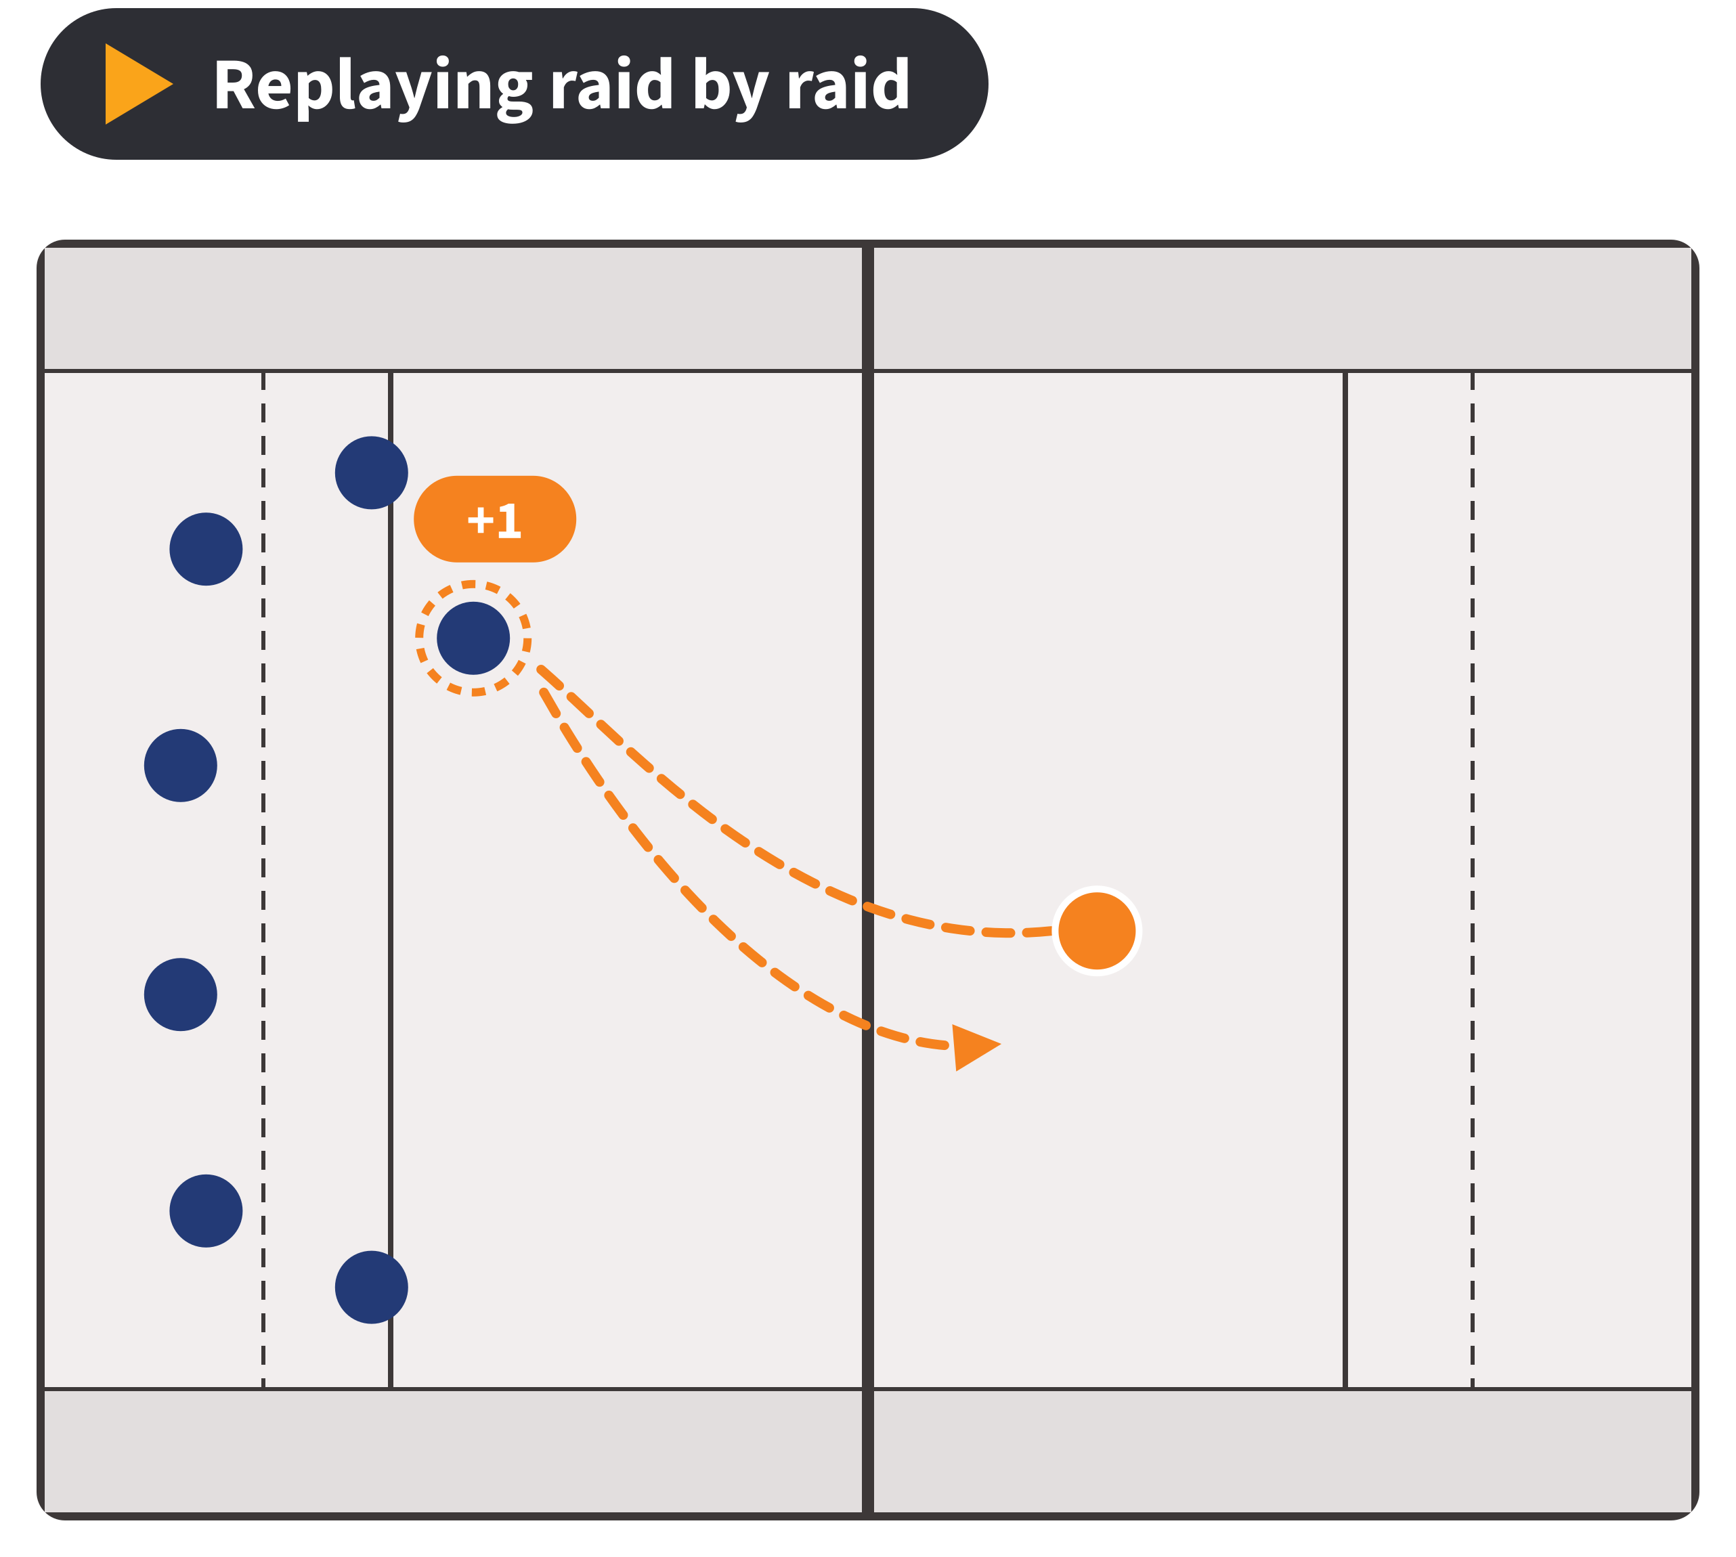
One Line Pitch
Raid Replay gives kabaddi the open data standard it's missing: a lossless, two-way bridge between Pro Kabaddi raid‑by‑raid data and IPTC Sport Schema.
230 million people watch Pro Kabaddi, yet no open sports-data standard can describe a single raid.
Notes:
Say the pitch slowly, then the stat.
230 million viewers figure: KabaddiPy paper (CMSAC 2024), citing Pro Kabaddi League viewership.

Slide 4


The Existing Software
1
The Software
The Gap We Found
Sport Schema has plugins for 10 sports, but none for kabaddi. Raids, super tackles, do‑or‑die raids and all‑outs have no standard home, so every dataset uses a one‑off format.
Standard: IPTC Sport Schema — sportschema.org
Data: kabaddiPy — github.com/kabaddiPy
2
What It Does
Sport Schema is IPTC's open standard for sharing sports results, stats and play-by-play. kabaddiPy collects raid-by-raid data from 10 seasons of Pro Kabaddi.
Kabaddi is our first step: the same plugin pattern works for any sport the standards leave out.
Notes:
IPTC is the body behind news-industry formats like NewsML and SportsML. Sport Schema is its newest standard (v1.1).
IPTC's own page says plugins cover 10 sports such as soccer, motor racing, tennis, rugby and esports.
Say 'no open, published standard covers kabaddi', not 'nothing exists anywhere'. We can't prove a negative.

Slide 5
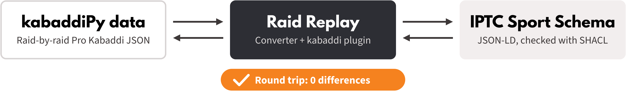
Our Idea
What We're Building
The Improvement
How It Fits the Track
A proposed kabaddi plugin for IPTC Sport Schema, plus a converter that turns Pro Kabaddi raid data into Sport Schema and back.
Every raid, tackle, bonus, all-out, card and review becomes standard data that any news site, fantasy app or analyst can read.
A lossless bridge between two named systems, kabaddiPy data and IPTC Sport Schema, round-tripped on 5 matches with 0 differences.
Notes:
Call it a 'proposed' plugin: IPTC hasn't approved it. If we post it to IPTC's public sports mailing list before the event, mention any reply.
Kabaddi terms live in our own namespace on top of Sport Schema's core classes.

Slide 6
Our Approach
Tools & Technologies
What We'll Definitely Finish
Python + rdflib: Sport Schema graphs as JSON-LD
pySHACL: IPTC's shapes plus our kabaddi shapes
kabaddiPy-data: raid-by-raid data, seasons 1–10
DeepDiff: the round-trip check, 0 differences
HTML, SVG + JavaScript: the animated replay mat
Kabaddi vocabulary + validation shapes: raids, tackles, bonus, super tackles, do-or-die, all-outs, cards, reviews
Two-way converter: to Sport Schema and back
Round-trip proof: 5 test matches, 0 differences
Then: raid-by-raid replay of the Season 10 semi-final
Notes:
Round-trip traps we've already planned for: RDF graphs have no built-in order and no null.
Every raid gets a sequence number, missing values have one agreed encoding, and the diff compares JSON with sorted keys and consistent number types.
Validation = IPTC's official SHACL shapes for the core schema + our own shapes for kabaddi terms.

Slide 7



How We'll Show It Works
Risk & Backup Plan
Before vs. After
Who Benefits
5 matches go to Sport Schema and back with 0 differences, and every file passes validation.
Sports news sites, fantasy apps, kabaddi analysts and coaches, and other kabaddi leagues.
kabaddiPy-data has no licence file. We'll ask its authors and keep a synthetic match ready.
Live demo: the Season 10 semi-final replays raid by raid on an animated mat, driven only by our converted file. Same scoreboard from both formats, diff = 0.
Notes:
Test matches: a normal match, a tie, the Season 10 semi-final, one full of super tackles, do-or-die raids and all-outs, and one with cards, reviews and substitutions. Add one with missing fields if time allows.
Be upfront that the mat animation is symbolic: raid data has no player positions, so it shows the raider crossing and who goes out.
Backup: if the kabaddiPy authors don't reply, real matches are demo-only and the synthetic match is our shareable sample.

