Slide 1


Confluence Buildathon
IEEE CS . PES University
Date
Time
Sunday, October 25th
8:00 AM – 6:00 PM
Venue
Team Size
13th Floor, BE Block, PES University
3–4 members
Notes:
Raid Replay, Lossless track.

Slide 2
Team Members & Track
Who We Are
Meet the Team
Team Name
Byte Tackle
Project
Raid Replay
Track
Lossless – Bridging systems and formats
P MANAS SIDDHARDHA
PES1UG24AM186
Rohith Karning
PES1UG24AM229
S Bhuvanashree
PES1UG24AM235
Pabbisetty Harshitha Sai
PES1UG24AM182
Notes:
Introduce the team. Fill in team name, names and SRNs before submitting.

Slide 3
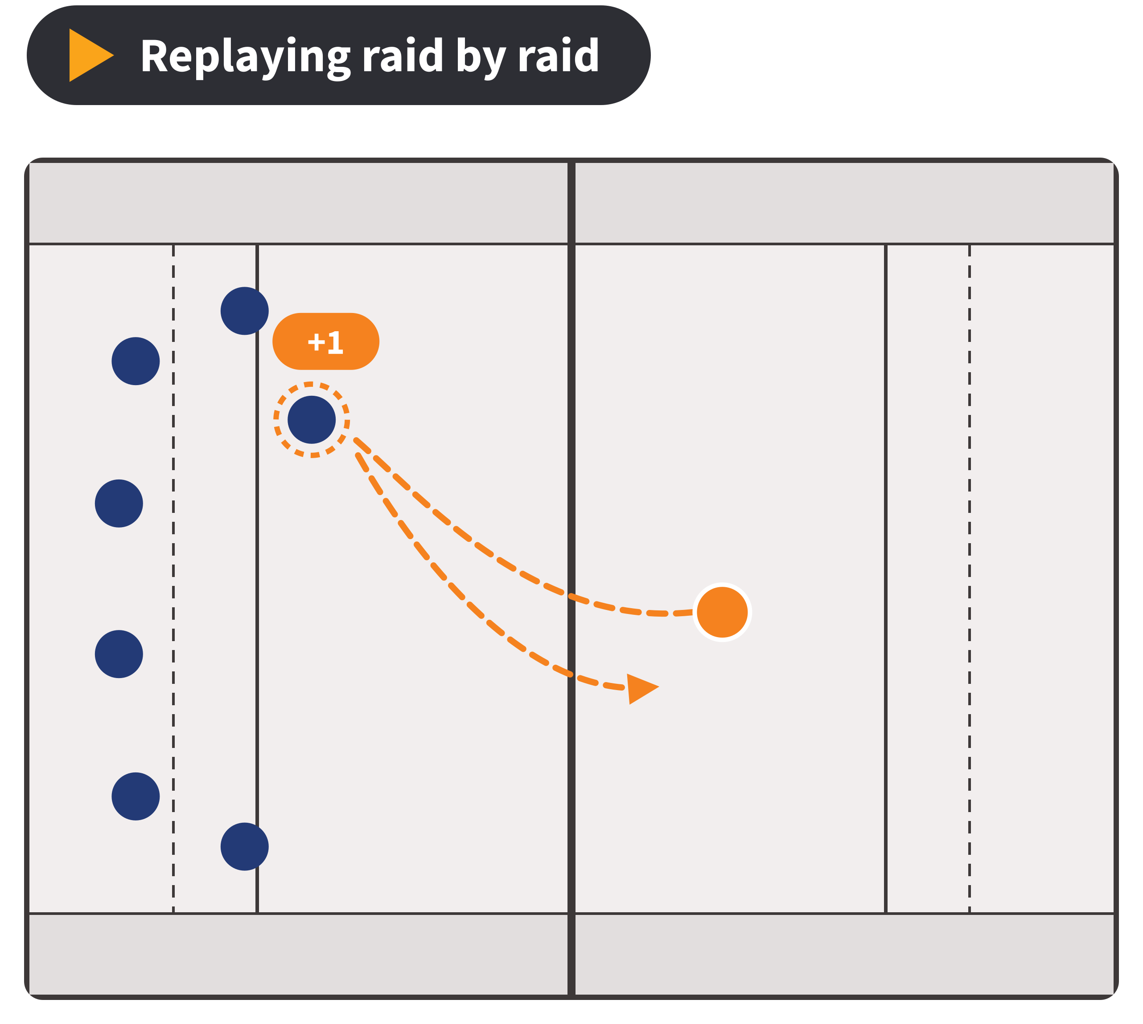
One Line Pitch
Raid Replay gives kabaddi the open data standard it's missing: a lossless, two-way bridge between Pro Kabaddi raid‑by‑raid data and IPTC Sport Schema.
230 million people watch Pro Kabaddi, yet no open sports-data standard can describe a single raid.
Notes:
Say the pitch slowly, then the stat.
230 million viewers figure: KabaddiPy paper (CMSAC 2024), citing Pro Kabaddi League viewership.

Slide 4


The Existing Software
1
The Software
The Gap We Found
Sport Schema has plugins for 10 sports, but none for kabaddi. Raids, super tackles, do‑or‑die raids and all‑outs have no standard home, so every dataset uses a one‑off format.
Standard: IPTC Sport Schema — sportschema.org
Data: kabaddiPy — github.com/kabaddiPy
2
What It Does
Sport Schema is IPTC's open standard for sharing sports results, stats and play-by-play. kabaddiPy collects raid-by-raid data from 10 seasons of Pro Kabaddi.
Kabaddi is our first step: the same plugin pattern works for any sport the standards leave out.
Notes:
IPTC is the body behind news-industry formats like NewsML and SportsML. Sport Schema is its newest standard (v1.1).
IPTC's own page says plugins cover 10 sports such as soccer, motor racing, tennis, rugby and esports.
Say 'no open, published standard covers kabaddi', not 'nothing exists anywhere'. We can't prove a negative.

Slide 5
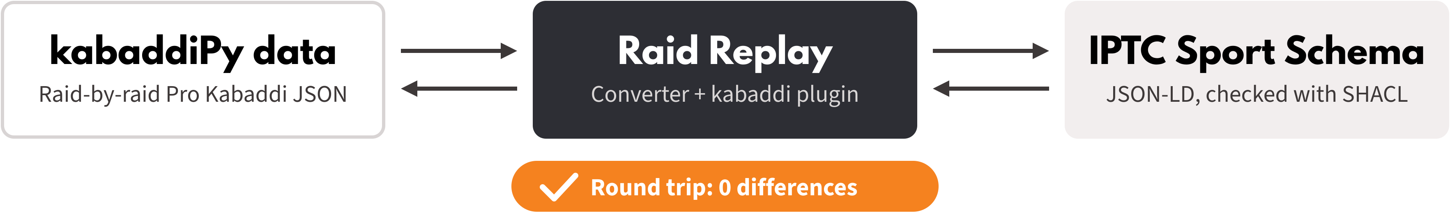
Our Idea
What We're Building
The Improvement
How It Fits the Track
A proposed kabaddi plugin for IPTC Sport Schema, plus a converter that turns Pro Kabaddi raid data into Sport Schema and back.
Every raid, tackle, bonus, all-out, card and review becomes standard data that any news site, fantasy app or analyst can read.
A lossless bridge between two named systems, kabaddiPy data and IPTC Sport Schema, round-tripped on 5 matches with 0 differences.
Notes:
Call it a 'proposed' plugin: IPTC hasn't approved it. If we post it to IPTC's public sports mailing list before the event, mention any reply.
Kabaddi terms live in our own namespace on top of Sport Schema's core classes.

Slide 6
Our Approach
Tools & Technologies
What We'll Definitely Finish
Python + rdflib: Sport Schema graphs as JSON-LD
pySHACL: IPTC's shapes plus our kabaddi shapes
kabaddiPy-data: raid-by-raid data, seasons 1–10
DeepDiff: the round-trip check, 0 differences
HTML, SVG + JavaScript: the animated replay mat
Kabaddi vocabulary + validation shapes: raids, tackles, bonus, super tackles, do-or-die, all-outs, cards, reviews
Two-way converter: to Sport Schema and back
Round-trip proof: 5 test matches, 0 differences
Then: raid-by-raid replay of the Season 10 semi-final
Notes:
Round-trip traps we've already planned for: RDF graphs have no built-in order and no null.
Every raid gets a sequence number, missing values have one agreed encoding, and the diff compares JSON with sorted keys and consistent number types.
Validation = IPTC's official SHACL shapes for the core schema + our own shapes for kabaddi terms.

Slide 7



How We'll Show It Works
Risk & Backup Plan
Before vs. After
Who Benefits
5 matches go to Sport Schema and back with 0 differences, and every file passes validation.
Sports news sites, fantasy apps, kabaddi analysts and coaches, and other kabaddi leagues.
kabaddiPy-data has no licence file. We'll ask its authors and keep a synthetic match ready.
Live demo: the Season 10 semi-final replays raid by raid on an animated mat, driven only by our converted file. Same scoreboard from both formats, diff = 0.
Notes:
Test matches: a normal match, a tie, the Season 10 semi-final, one full of super tackles, do-or-die raids and all-outs, and one with cards, reviews and substitutions. Add one with missing fields if time allows.
Be upfront that the mat animation is symbolic: raid data has no player positions, so it shows the raider crossing and who goes out.
Backup: if the kabaddiPy authors don't reply, real matches are demo-only and the synthetic match is our shareable sample.

Slide 8
What We Delivered
✓
Kabaddi plugin for Sport Schema
6 classes, ~40 properties, SHACL shapes with 5 rules of the game
PROMISED IN THE PROPOSAL → BUILT
1,060
real Pro Kabaddi matches converted to Sport Schema and back
0 differences
103,176 play-by-play events · 4.29 million RDF triples · Turtle and JSON-LD
✓
Two-way converter
native kabaddi JSON ⇄ Sport Schema Turtle and JSON-LD
✓
Round-trip proof
5 test matches (normal, tie, final, dense, discipline): 0 differences
✓
Real kabaddiPy data
the official PKL feed, seasons 1–10: every match there and back
✓
Season 10 knockout replay
both semi-finals and the final, driven by the JSON-LD alone
✓
Validation
every file passes IPTC's own shapes plus our plugin
Notes:
Everything on the proposal's 'What we'll definitely finish' list is done, plus the stretch goal: real data. The left column is the plan from slide 6; the right card is the headline: all 1,060 matches in kabaddiPy-data, seasons 1 to 10, go to Sport Schema and back with zero differences.

Slide 9
Proof It's Lossless
0
differences after the round trip
10 simulated files + all 1,060 real matches, in Turtle and in JSON-LD (DeepDiff)
90 / 90
tests pass
round trip, validation, negative tests, simulator rules, real feed
12 / 12
deliberate corruptions caught
2 → "2", false → 0, swapped raids, a purple card, a 45-second raid …
0
violations with our plugin
without it, IPTC's own shapes reject every file: 1,751–3,626 violations each
Not a fake pass: the diff checks types (2 ≠ "2", false ≠ 0, null ≠ missing), and the validator is strict enough to reject every file when our plugin is removed. The live page re-checks 3,649 fields in the browser.
Notes:
Four numbers. Zero differences across 2,130 files. 90 of 90 tests. 12 of 12 deliberate corruptions caught, five by the diff and seven by the validator. And the checker isn't a rubber stamp: remove our plugin and IPTC's own closed shapes reject every single file.

Slide 10
Real Pro Kabaddi Data
The official PKL feed is messier than our simulator. Three rules make it lossless:
103,176
play-by-play events
1
Null ≠ missing
About 150 deliberate nulls per match. An explicit null becomes kab:nullField "defender_id" and comes back as null.
4.29 M
RDF triples
2
Order is data
event_no runs backwards in 354 of 1,060 matches, so events keep the feed's own order (sport:sequenceNumber, rdf:List).
3 / 3
Season 10 knockouts pass SHACL
3
Typed references
Team ids are "7" in the team list but 7 in events. Each comes back exactly as it was — unknown keys are an error.
Notes:
This is the part that answers 'you designed both formats'. kabaddiPy-data is the official match-centre feed, a format we did not design. It forced two new rules: null is not missing, and references are typed. Licence: the dataset has no licence file, so as our proposal planned, real matches are demo-only and not in our repo.

Slide 11
What Our Validator Found
In the official PKL feed
Reported as warnings — converted as-is, never silently fixed
1. raid_points includes technical / all-out points 742 times and leaves them out 1,276 times
2. A substitution's player_id means “coming on” in seasons 2–5, “going off” in seasons 1 and 6–10
3. The running score resets at half-time (20–11 + 17–10 = 37–21)
4. –1 touch points; “Timeout” and “TimeOut” as two event types
In IPTC Sport Schema 1.1 itself
Patched in memory; the official files stay untouched
1. 15 of 17 vocabulary files miss a full stop, so strict parsers can't read them
2. 6 shapes only Apache Jena tolerates; 4 shapes referenced but never defined
3. skos:HasTopConcept typo, 228 times
4. Scores and sequence numbers typed as strings — the 2 vs “2” trap
Notes:
A standard is only useful if it catches real problems. On the left, what our rules flagged in the official feed: the same field means two different things. On the right, six bugs in IPTC's own release that stop strict tools from reading it. We report them; we don't hide them.

Slide 12
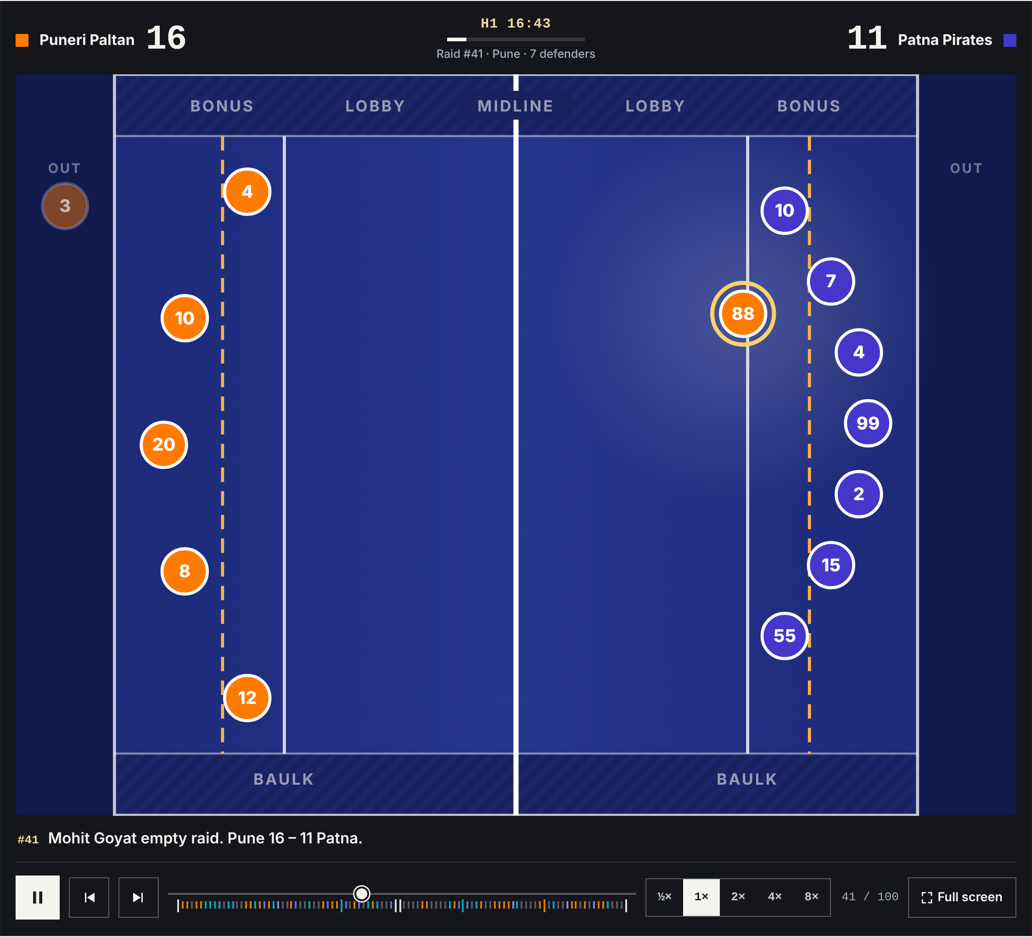
Live Demo
1
Replay a real knockout
Season 10 Semi-final 1, event by event, driven only by the Sport Schema JSON-LD
2
Two scoreboards, one result
From the original feed and from Sport Schema: both end on the official 37–21
3
diff = 0, in the browser
The page rebuilds the feed from JSON-LD and compares 3,649 fields
4
Query it
python -m kabaddipy query — every do-or-die raid and super raid of the final
Notes:
Open site/real.html, press F for full screen. Point at the two scoreboards and the diff badge. Then switch to the terminal: python -m kabaddipy validate (passes, with the feed's warnings) and python -m kabaddipy validate --no-plugin (IPTC rejects it). Be upfront: positions are illustrative; the feed records who raided and who was touched, not where anyone stood, so revivals follow the rules.

