Slide 1
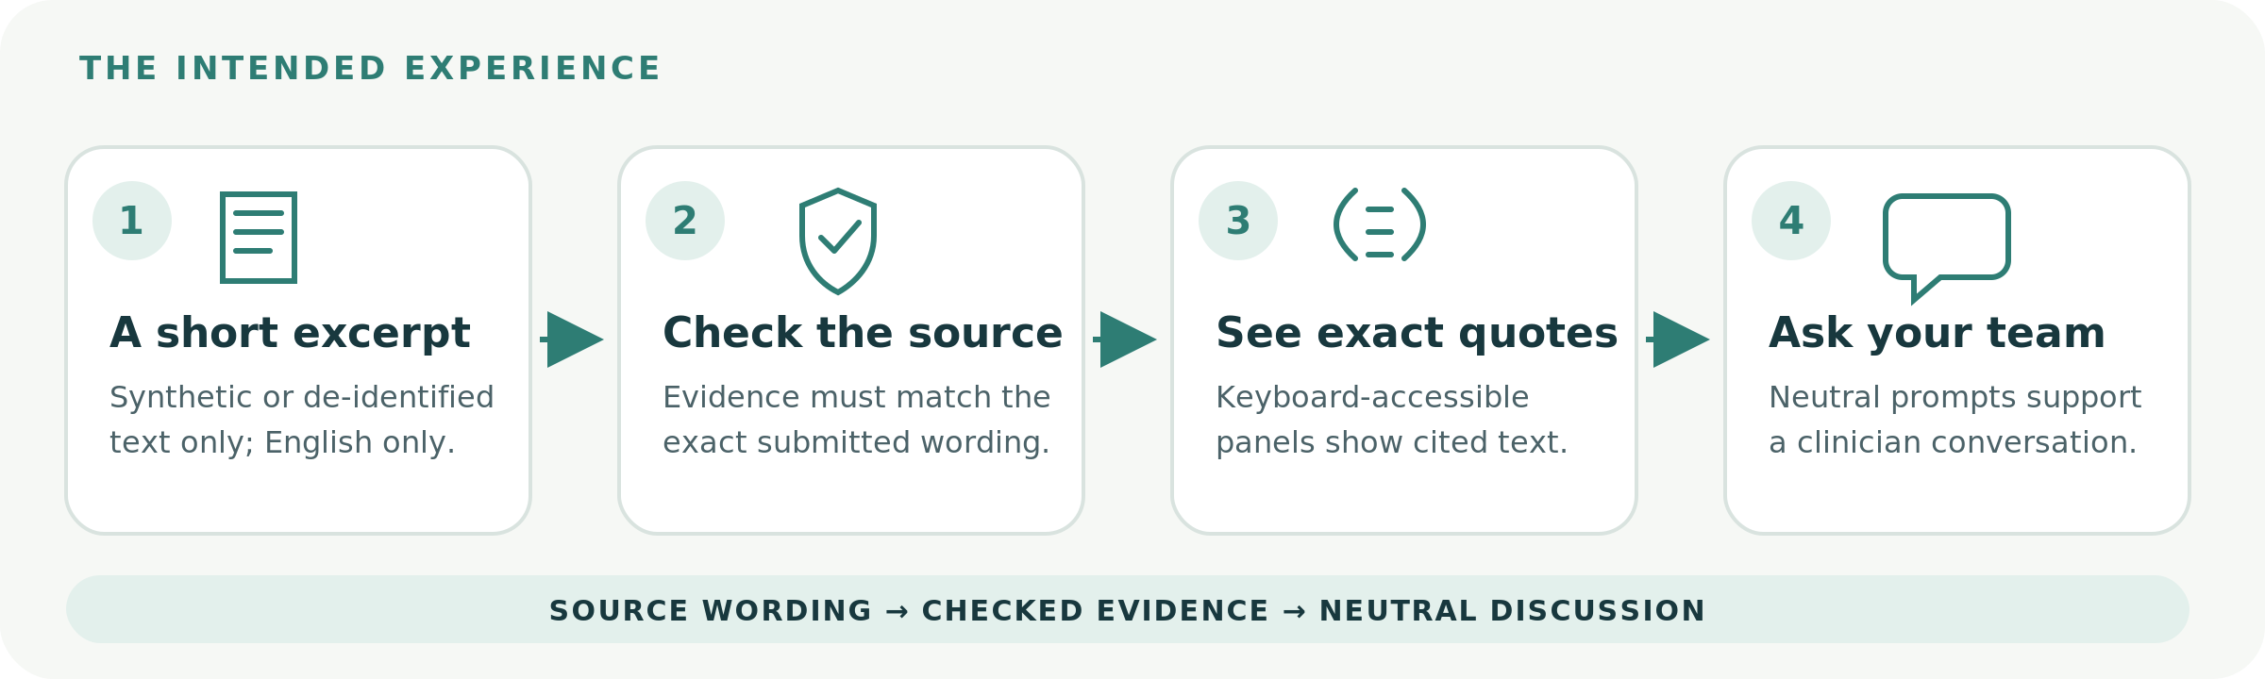
PROJECT OVERVIEW / 27 OCTOBER 2026
Lumen
A source-linked companion for pathology-report wording and care-team conversations
SYNTHETIC ONLY • ENGLISH ONLY • MODEL OFF
A software prototype, not a clinical product. No live model output, clinician review, or patient outcome evaluation has been completed.
SYNTHETIC-ONLY | MODEL DISABLED | NOT FOR CLINICAL DECISIONS
01

Slide 2
01 / PATIENT EXPERIENCE
Keep the source in view
Designed to turn report wording into a better-supported conversation - not a care decision.
Exact source quotes • missing facts stay ‘not stated’ • neutral care-team questions
English text only • no uploads/OCR • no diagnosis or treatment advice
SYNTHETIC-ONLY | MODEL DISABLED | NOT FOR CLINICAL DECISIONS
02

Slide 3
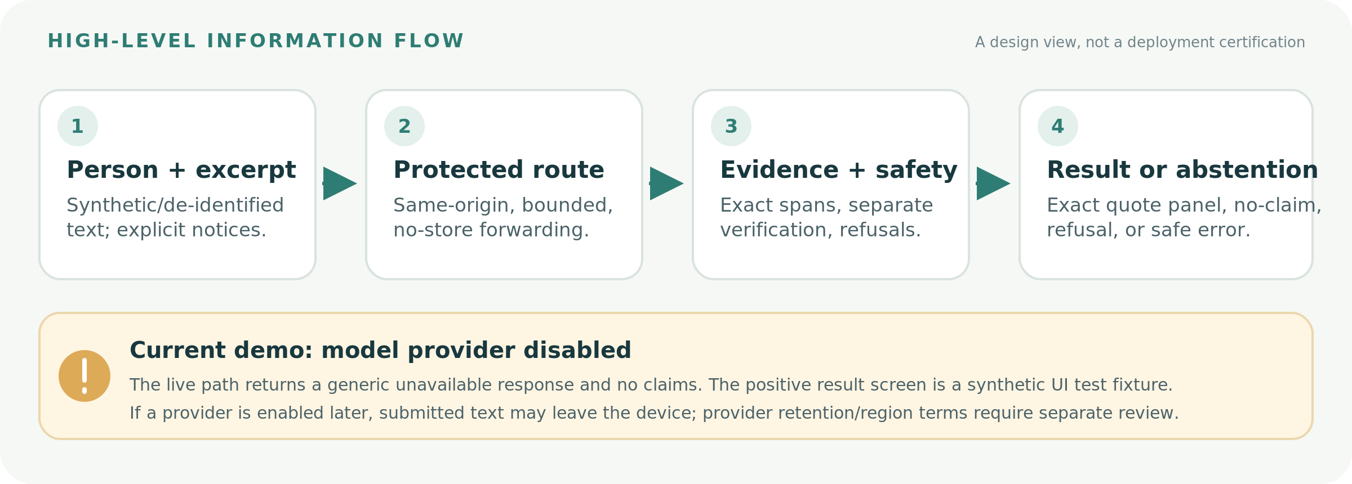
02 / TRUST AND DATA FLOW
A bounded path with explicit limits
High-level flow: browser to same-origin service route to evidence/safety checks and a result or abstention.
The current provider-disabled path returns no claims. If a provider is enabled later, text may be processed externally; terms and retention need review.
SYNTHETIC-ONLY | MODEL DISABLED | NOT FOR CLINICAL DECISIONS
03

Slide 4
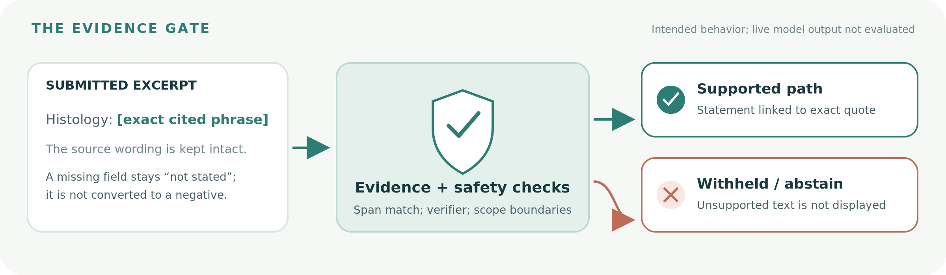
03 / EVIDENCE GATE
Unsupported wording should not pass through
The intended result path links each displayed statement to source text; live model behavior has not been evaluated.
A matching quote is necessary, not proof of semantic or clinical correctness. The provider remains disabled in this demo.
SYNTHETIC-ONLY | MODEL DISABLED | NOT FOR CLINICAL DECISIONS
04

Slide 5
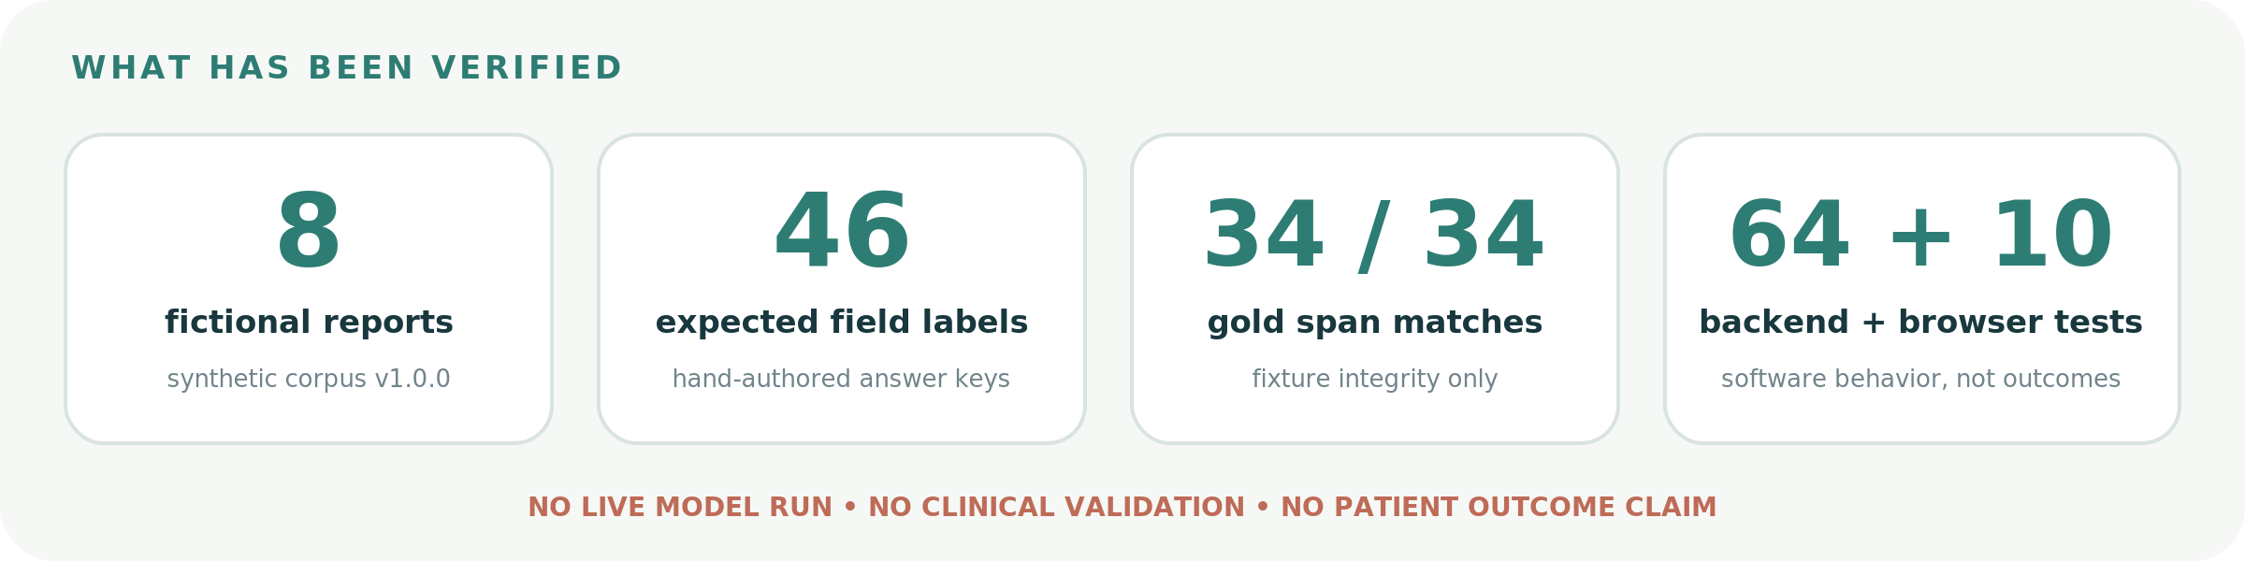
04 / WHAT WE VERIFIED
Software checks are not clinical proof
Counts below are reproducible software/fixture evidence only; they do not measure model quality or patient impact.
Measured: 64 backend tests, 10 browser flows, 0 axe violations in tested states, 34/34 exact gold fixture spans.
Not measured: model accuracy, unsupported-claim rate, clinical correctness, latency, or outcomes.
SYNTHETIC-ONLY | MODEL DISABLED | NOT FOR CLINICAL DECISIONS
05

Slide 6
05 / POTENTIAL IMPACT AND FEASIBILITY
A useful hypothesis - not a proven outcome
Lumen aims to make report wording easier to discuss; user benefit, adoption and clinical impact have not been measured.
POTENTIAL CONTRIBUTION
FEASIBILITY TODAY
Keep exact report wording visible, preserve missing information as ‘not stated’, and offer neutral questions for a care-team conversation. This is a design hypothesis; no patient benefit has been demonstrated.
A synthetic software prototype is tested locally. The provider is off; the positive result is a test fixture. Patient-facing use needs clinical review, human evaluation, privacy/operations and manual accessibility work.
REQUIRED BEFORE ANY PATIENT-FACING CONSIDERATION
01
Clinical co-design
02
Human evaluation
03
Privacy + operations
04
Accessibility review
No clinical validation or patient benefit is claimed. Current status: Gate 2 not passed; model disabled.
SYNTHETIC-ONLY | MODEL DISABLED | NOT FOR CLINICAL DECISIONS
06

Slide 7
LUMEN / DISCUSSION
Questions?
What we know: software behavior on synthetic fixtures.
What we do not know: model quality, clinical correctness, or patient impact.
Lumen is not for clinical decisions or patient use.
SYNTHETIC-ONLY | MODEL DISABLED | NOT FOR CLINICAL DECISIONS
07

