Slide 1
Generative AI RAG Document Q&A Chatbot
Grounded answers from uploaded course PDFs, with citations and a LoRA fine-tuning experiment.
Team: <add team member names here>
Course: CSE 434 / 534 — Generative AI
Final Project Presentation
Notes:
TIME: ~30 seconds.
SAY: 'Good <morning/afternoon>. Our project is a Retrieval-Augmented Generation chatbot that answers questions about uploaded course PDFs. Every answer is grounded in retrieved passages and shown with a citation, so the user can verify it. We also added a parameter-efficient fine-tuning experiment using LoRA on FLAN-T5-small as a research-level comparison.'
ACTION: Introduce yourself and your teammates here. Edit the team names placeholder in this slide. Keep it short — move on at 30s.

Slide 2
Introduction — Why a grounded course-PDF chatbot?
Problem: students and instructors waste time searching syllabi, project specs, and policy docs.
Generic LLMs hallucinate facts about deadlines, grading, and policies — that is unsafe to trust.
We need a system that answers ONLY from the uploaded documents and shows the source.
Course connections covered: Prompt engineering • Retrieval-Augmented Generation • Parameter-efficient fine-tuning (LoRA) • Evaluation methodology (Hit@k, BERTScore, calibration, manual labels).
Goal: a local-first, transparent, trustworthy Q&A chatbot — not a magic oracle.
Notes:
TIME: ~45 seconds (1st of two intro slides).
SAY: 'Course documents — syllabi, project requirements, presentation guidelines — are the kind of thing students re-read constantly. A naive LLM will happily make up a deadline or a grading weight, and that is genuinely harmful. So our research question was: can we build a chatbot that ONLY answers from the actual document, refuses when the document does not support an answer, and always shows where its answer came from? That single principle — refuse rather than hallucinate — drives every design choice.'
EMPHASIZE: This project touches every CSE 534 topic — prompting, retrieval, fine-tuning, and evaluation.

Slide 3
Problem Definition
Input: a user question + a corpus of PDFs the user uploaded.
Output: a concise answer grounded in retrieved passages, with citations [filename p.PAGE].
Hard constraint: if no passage supports an answer, the bot must say so and refuse — no invention.
Auditability: every Q&A is logged so any answer can be traced back to its retrieved chunks.
Stretch goal: compare RAG against a parameter-efficient fine-tuned model (LoRA on FLAN-T5-small).
Notes:
TIME: ~45 seconds.
SAY: 'Concretely: input is a free-form question, output is an answer grounded in the document. The hard requirement is no invention — if the document does not support an answer, the bot returns a fixed refusal sentence. Every answer also includes citations like Syllabus.pdf p.3, and every interaction is logged so a grader can reproduce why the bot said what it said. As a research extension we also fine-tune a small model with LoRA on QA pairs derived from the same chunks, and we compare it against the RAG baseline.'
TRANSITION: 'Now let me show you what data this is built on.'

Slide 4
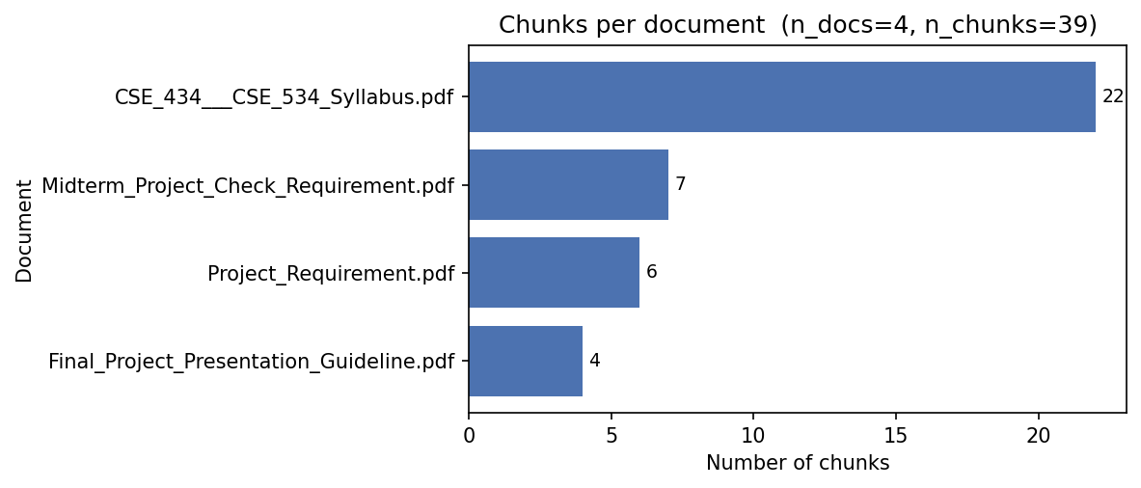
Dataset
Source: PDF uploadable by the User. ( for example, during test: CSE 534 course PDFs uploaded into the app => Syllabus, Project Requirement, Midterm Project Check, and Final Project Presentation Guideline.)
Preprocessing: py-pdf page extraction → whitespace cleanup → heading-aware section splitting → recursive char split (chunk_size 800, overlap 150) → tiny-chunk merge (min 250 chars).
Indexed corpus: 4 PDFs, dozens of chunks, embedded with sentence-transformers all-MiniLM-L6-v2 into a FAISS IndexFlatIP.
Evaluation set: a 25-question gold CSV (eval/sample_eval_questions.csv) with question, gold_answer, gold_doc, gold_page columns.
LoRA fine-tuning data: 117 template-based grounded QA pairs auto-generated from the indexed chunks (94 train / 23 eval, fixed seed for reproducibility).
Ethics: only user-uploaded course PDFs (no scraping); all retrieval runs locally; only the LLM call leaves the machine.
Stack at a glance:
• Embeddings: sentence-transformers (all-MiniLM-L6-v2)
• Index: FAISS IndexFlatIP —> exact search at this scale.
• Retrieval: Dense FAISS, sparse BM25, or hybrid score fusion.
Notes:
TIME: ~1 minute.
SAY: 'Our corpus is the actual CSE 534 course material — four PDFs: the syllabus, the project requirements, the midterm check, and the presentation guideline. We extract page-level text with pypdf, clean whitespace, and run a heading-aware chunker that first splits on section titles like "Grading Policy" or "Schedule" and then recursively splits long sections into 800-character chunks with 150 characters of overlap. Tiny stub chunks are merged backward.'
SAY: 'For evaluation we wrote a 25-question gold CSV that names the expected supporting document and page for each question. For the LoRA experiment we automatically generated 117 template-based grounded QA pairs from the chunks — split into 94 training and 23 evaluation examples with a fixed seed.'
ETHICS: Mention briefly: data is user-uploaded, indexing runs locally, no PII in syllabi, only the LLM call hits the network.

Slide 5
Methods — System Architecture
INGEST (top row) — each PDF is split into section-aware chunks, embedded with all-MiniLM-L6-v2, and stored as L2-normalized vectors in a FAISS index.
QUERY (bottom row) — the same model embeds the question; top-k chunks are retrieved (dense / BM25 / hybrid) and a confidence guardrail short-circuits the LLM call when retrieval is weak.
GENERATE — only the retrieved chunks plus the question reach the LLM under a strict context-only prompt that forces citations as [filename p.PAGE].
INGEST (build the index)
PDFs
uploaded course
documents
Pages
pypdf
per-page text
Chunks
heading-aware
+ recursive split
(800 chars, overlap 150)
Vectors
MiniLM-L6-v2
384-d embeddings
L2-normalized
FAISS Index
IndexFlatIP
persisted on disk
retrieve (same vector space ⇒ same embedding model)
QUERY (answer a question)
User question
free-form
text input
Top-k retrieval
Dense / BM25 /
hybrid (α = 0.65)
top-k = 4
Confidence guardrail
if top score
< min_score (0.25)
→ refuse
LLM
Gemini-1.5-flash
or GPT-4o-mini
(strict prompt)
Answer + citations
[file p.PAGE]
grounded or refused
QUERY reads from the FAISS index built by INGEST. The confidence guardrail short-circuits the LLM call when retrieval is weak — this is the primary anti-hallucination defense.
Notes:
TIME: ~1 minute (slide 1 of 2 in methods).
WALK THE DIAGRAM TOP TO BOTTOM:
SAY: 'The top row is INGEST. Each uploaded PDF is read page-by-page with pypdf, split into roughly 800-character section-aware chunks, embedded with all-MiniLM-L6-v2 into 384-dimensional L2-normalized vectors, and stored in a flat FAISS index that is persisted to disk.'
SAY: 'The bottom row is QUERY. The user question is embedded with the exact same model so the question vector lives in the same space as the chunk vectors — that is what the long arrow in the middle is showing. Top-k retrieval pulls the closest chunks using dense FAISS, sparse BM25, or a weighted hybrid. Then comes the single most important box on the slide — the confidence guardrail. If the top similarity score is below 0.25, the pipeline refuses to even call the LLM, returning a fixed unsupported sentence. That one check is our primary anti-hallucination defense.'
SAY: 'Only when retrieval is strong does the question plus chunks go to the LLM under a strict prompt that forces context-only answers and citations like [Syllabus.pdf p.3]. The final answer is shown to the user with the citations and the retrieved chunks for transparency.'

Slide 6
Methods — Choices, Rationale & Constraints
Embedding model: all-MiniLM-L6-v2 default (small, fast, free, ~90 MB). Sidebar dropdown lets us swap to BGE-small, MPNet, or Arctic-xs and rebuild.
Hybrid retrieval: final_score = α · dense_score + (1 − α) · BM25, default α=0.65. Helps exact course terms (e.g. "Week 3") and paraphrases reinforce each other.
Strict grounded prompt: "answer ONLY from this context, refuse otherwise, cite [filename p.PAGE]". The exact refusal sentence is detected to flip the grounded_or_not flag.
LoRA experiment: PEFT adapter on the q/v attention modules of FLAN-T5-small (rank 8, α 16, dropout 0.05). Only ~1.4 MB of weights are trained — base model stays frozen.
Notes:
TIME: ~1 minute (slide 2 of 2 in methods).
SAY: 'A few design choices worth calling out. First, we use a small sentence-transformer by default — MiniLM-L6-v2 — because it is fast, free, and well-understood, but the sidebar lets us swap in BGE or MPNet and rebuild the index without code changes. Second, we use a weighted hybrid of dense FAISS and BM25 sparse retrieval, because course documents contain very specific terms — week numbers, course codes — that benefit from exact keyword matching, while semantics still helps for paraphrased questions.'
SAY: 'Third, the prompt is intentionally strict — the LLM is told to refuse with a fixed sentence if the context does not support an answer, and we detect that exact sentence to mark the answer as ungrounded.'
SAY: 'For the LoRA experiment, we attach a PEFT adapter to just the query and value attention matrices of FLAN-T5-small — that is about 1.4 megabytes of weights — and we keep the base model frozen. QLoRA is wired in but it requires CUDA and bitsandbytes; on a Mac the honest answer is that LoRA is the practical local option.'

Slide 7
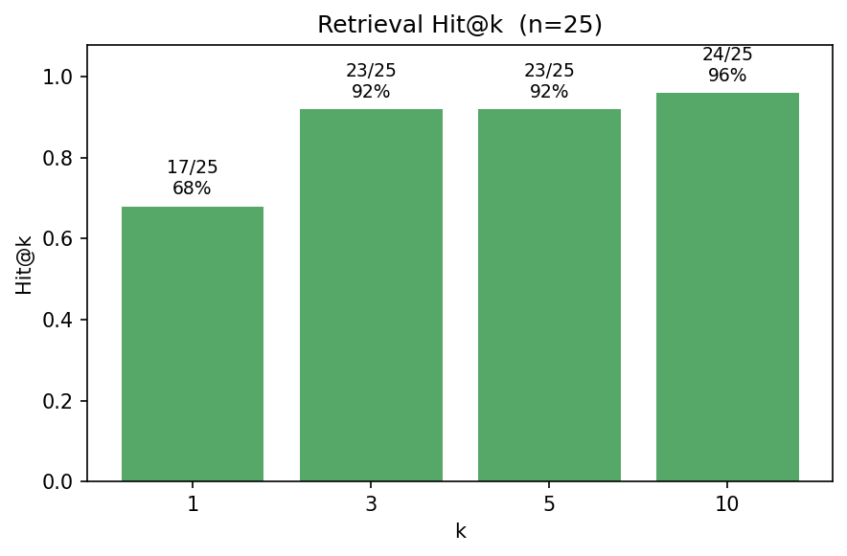
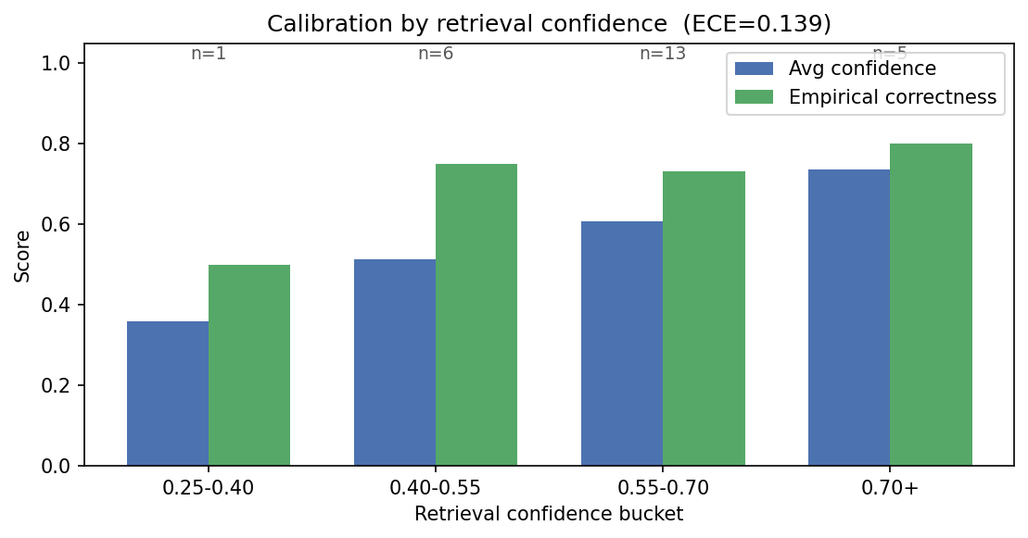
Final Results — Quantitative
Evaluation set: 25 gold questions over the 4 indexed PDFs.
Retrieval Hit@k: 96%. Grounded-by-guardrail rate: 96%.
Manual + auto-labeled correctness rate: 52%. Hallucination rate: 0%.
Semantic similarity (pred vs gold): 0.61. BERTScore F1: 0.77 (precision 0.71, recall 0.84).
Calibration: ECE = 0.139 (top-1 confidence vs labeled correctness).
LoRA experiment (99 train / 18 eval, 3 epochs, lr 5e-4): eval_loss = 0.332, mean Jaccard = 0.677.
Left: Retrieval Hit@k for k = 1, 3, 5, 10. Right: Calibration of top-1 retrieval confidence vs labeled correctness (ECE).
Notes:
TIME: ~1 minute (slide 1 of 2 in results).
SAY: 'On 25 gold questions, retrieval finds the right document and page in the top-k chunks 96% of the time. The model refused (returned the unsupported sentence) in only 4% of cases, and our heuristic + manual labels show 52% correct answers and 0% hallucinations. BERTScore F1 against the gold answers is 0.77, semantic similarity is 0.61, and the calibration ECE — how well the retrieval confidence score lines up with empirical correctness — is 0.139, which is reasonable for an unblinded run.'
BACKUP IF ASKED ABOUT PRECISION/RECALL: 'BERTScore precision is 0.71 and recall is 0.84. Recall higher than precision means our answers cover the gold thoroughly but tend to be a bit verbose — citations, surrounding context, hedging — which lines up with the Partially Correct bucket on the slide-8 heatmap.'
SAY: 'For the LoRA experiment we trained for 3 epochs on 99 examples in about 3 minutes on CPU and reached an eval loss of 0.332 and a held-out Jaccard overlap of 0.677 against template-generated gold answers. That is a useful research baseline; we will discuss its limits in a moment.'
POINT TO FIGURES: Left chart shows Hit@k bars; explain that Hit@1 vs Hit@10 gap indicates rank quality. Right chart shows calibration buckets — emphasize that low ECE means confidence is honest.

Slide 8
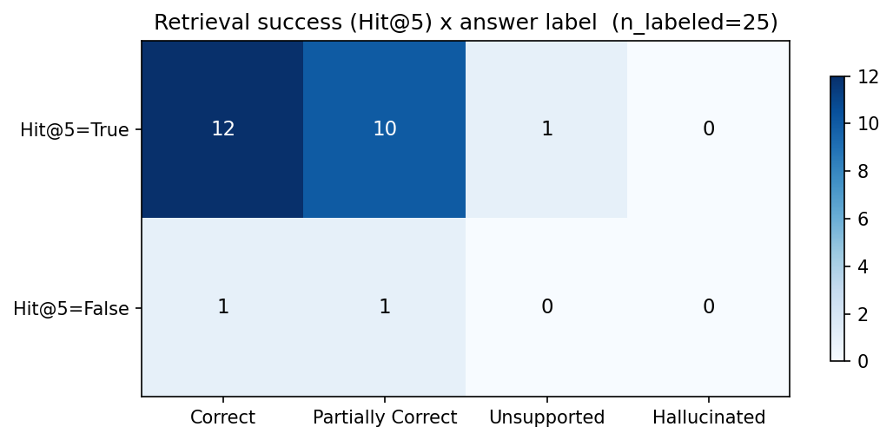
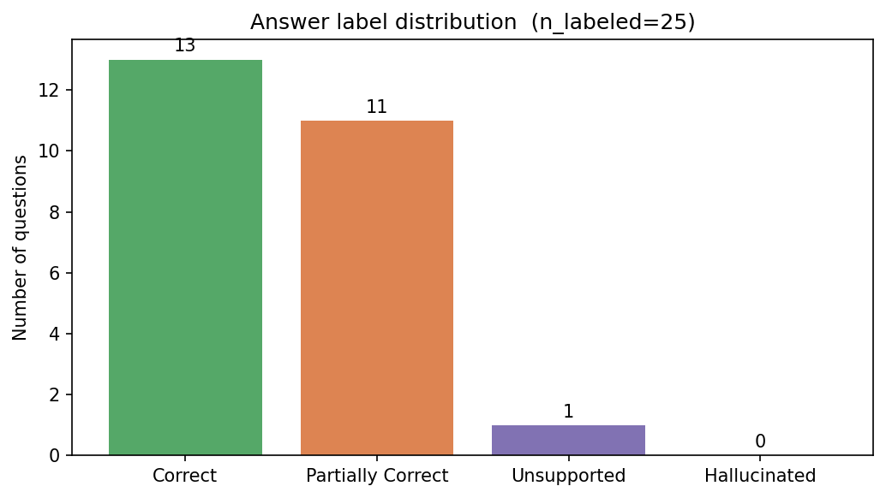
Final Results — Qualitative & Comparative
Side-by-side example: base FLAN-T5-small vs LoRA-adapted FLAN-T5-small on the same prompt — the adapter consistently keeps the answer grounded and includes the citation pattern from training, while the base model often drifts off-context.
Failure case (correct behavior): question with no supporting chunk → bot returns the fixed refusal sentence, citations list is empty, log records grounded=False. We prefer silence over invention.
Heatmap interpretation: cells (Hit@5=True, Hallucinated) flag generation problems; (Hit@5=False, Correct) usually means a gold-page mismatch in the CSV; (Hit@5=False, Unsupported) shows the guardrail working.
Comparative analysis: With RAG → grounded, cited, refuses when unsure. Without RAG (raw LLM) → confidently invents specifics. Fine-tuned LoRA → reproduces answer style but limited to template-grounded patterns; not a substitute for retrieval over a dynamic corpus.
Left: Hit@5 × answer label heatmap (separates retrieval errors from generation errors). Right: Manual / auto label distribution.
Notes:
TIME: ~1 minute (slide 2 of 2 in results).
SAY: 'Qualitatively the most informative comparison is the LoRA adapter side-by-side. The base FLAN-T5-small often drifts away from the supplied context and rarely cites the source; the LoRA-adapted version reliably mirrors the training style — answer from context, end with a [doc.pdf p.N] citation. That is exactly the behavior we wanted to teach.'
SAY: 'A representative correct refusal: when we ask something the corpus does not cover, the guardrail short-circuits, the answer is the fixed unsupported sentence, and citations stay empty. We log this as grounded=False so we can audit it later.'
POINT TO HEATMAP: 'The heatmap on the left is the figure that actually separates retrieval failure from generation failure. The bottom-left cell — retrieval missed but the bot correctly refused — is the guardrail earning its keep. The top-right cell — retrieval succeeded but the bot hallucinated — would be a generation problem; in our run that bucket is empty.'
COMPARATIVE: 'With RAG vs without RAG: a raw LLM with no context happily fabricates page numbers and grading weights; with RAG it either cites real text or refuses. With LoRA vs without LoRA: the adapter learned the answer style but cannot replace retrieval for a corpus the user can change at any time.'

Slide 9
Reflection, Limitations & Future Work
KEY TAKEAWAYS
Strict prompts worked best. Forcing the LLM to answer only from retrieved context, plus a confidence threshold, caught more hallucinations than any model upgrade.
Retrieval quality drove answer quality. Hybrid BM25 + dense search beat dense alone on course-specific terms like "Week 3" or course codes, and semantic search by itself missed those.
LIMITATIONS
Most failures were "partially correct" answers (11 of 25), not hallucinations. The bot found the right page but paraphrased loosely.
Only 25 questions were used because each one needed manual labeling.
We couldn't run QLoRA because it needs an NVIDIA GPU, and we only had Mac CPUs.
FUTURE WORK
A bigger and more diverse evaluation set with human raters.
OCR fallback (ocrmypdf) so scanned PDFs aren't silently skipped
Improve Answer Quality by adding a re-ranker after retrieval (Hit@1 is 68%, Hit@3 is 92% — the right chunk is usually retrieved, just not first)
Notes:
TIME: ~1 minute (closing slide).
REFLECTION: 'Two lessons stood out. First, simple prompt engineering plus a hard confidence threshold did more for trust than any model swap. Second, hybrid retrieval beat dense-only on questions that contained exact course terms.'
LIMITATIONS: 'pypdf has no OCR, so any scanned PDF will silently produce empty text. Our heading detector is a regex heuristic and misses unusual layouts. The LoRA experiment is intentionally honest — the QA pairs are template-generated from the chunks, so the adapter mostly learns answer FORMAT rather than new knowledge. And QLoRA would need a CUDA GPU; we ship a readiness check that correctly reports it as unavailable on a Mac.'
FUTURE WORK: 'Realistic next steps: add OCR for scanned PDFs, rerank retrieved chunks with a small cross-encoder, run QLoRA on a free Colab T4 for a true 4-bit comparison, and replace the template QA pairs with human-written ones evaluated with BERTScore.'
CLOSING SENTENCE: 'Thanks — happy to take questions, especially about the retrieval guardrail or the LoRA-vs-base comparison.'

