Slide 1
Authentic Learning with Audio, Video and Cell Phones
Ben Wilkoff
10.21.2010

Slide 2

This is not a presentation.
This is a discussion.

Slide 3
Our group code is ihodk6
Post questions, ideas, responses and resources.

Slide 4
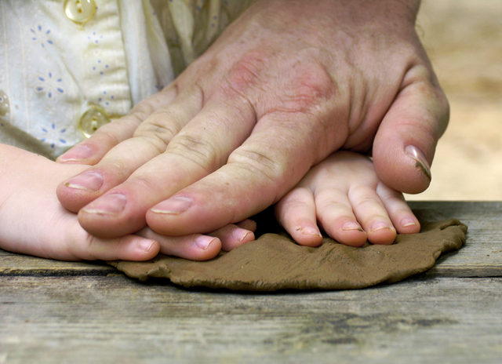
What is Authentic Learning?

Slide 5

For a Real Purpose.

Slide 6

With a real audience.

Slide 7
What can we do with Cell Phones that we can’t do any other way?

Slide 8
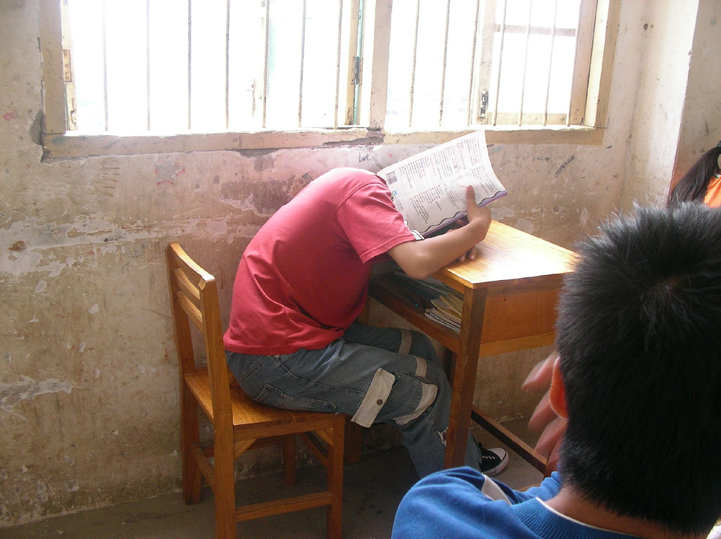
Free Interactive Response System

Slide 9

On the fly reflection
Notes:
How will your students reflect on the way out the door?

Slide 10
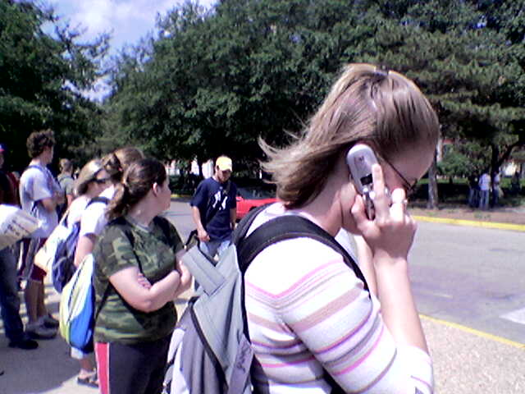
Make contact(s) and manage conversations

Slide 11
What can we do with Audio that we can’t do any other way?

Slide 12

Just-in-time reflection and Sharing.
Vocaroo

Slide 13

Producing Polished Works
Myna
Notes:
Is podcasting a viable way for students to show their knowledge in your classroom?

Slide 14

Providing Context for all work.
Voicethread

Slide 15
What can we do with Video that we can’t do any other way?

Slide 16
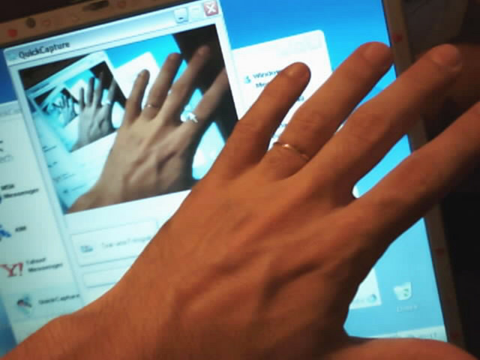
Demonstrate and Capture Learning
ScreenJelly, Screenr, Jing

Slide 17
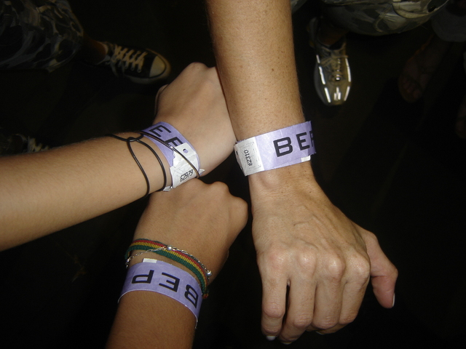
Make everyone a teacher.
Notes:
How do you search for other teachers?
site:screenr.com science

Slide 18

Be Human.

Slide 19
We need Authentic Learning in our Classrooms.
Audio, Video and Cell Phones get us there.

Slide 20
Ben Wilkoff
@bhwilkoff
303.720.6269 http://learningischange.com

